Slide 1
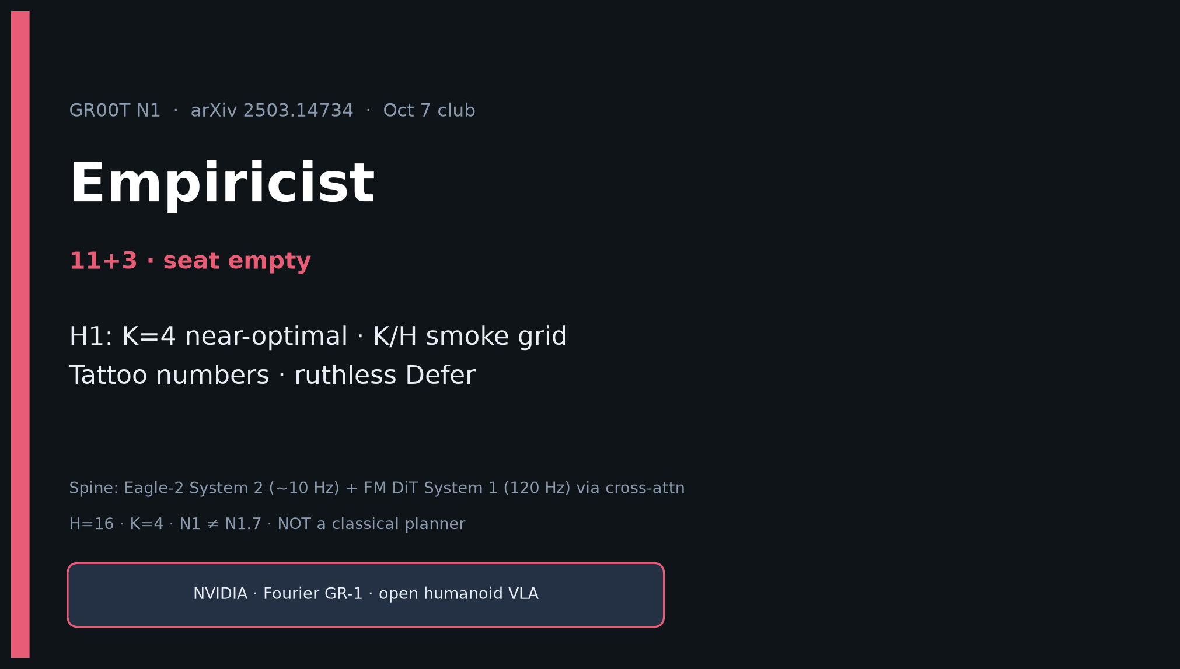
Empiricist · 11+3 · 1/14
Notes:
EMPIRICIST — 11+3. Feasible GPU-honest track.
H1: K=4 near-optimal. K/H smoke grid. Tattoo ~45% vs DP 33.4%/BC-T 26.4%; real 76.8% vs DP 46.4%.
Ruthless Defer full pretrain. Env outlines in /workspace/groot-n1-quiet/env_outline/.

Slide 2
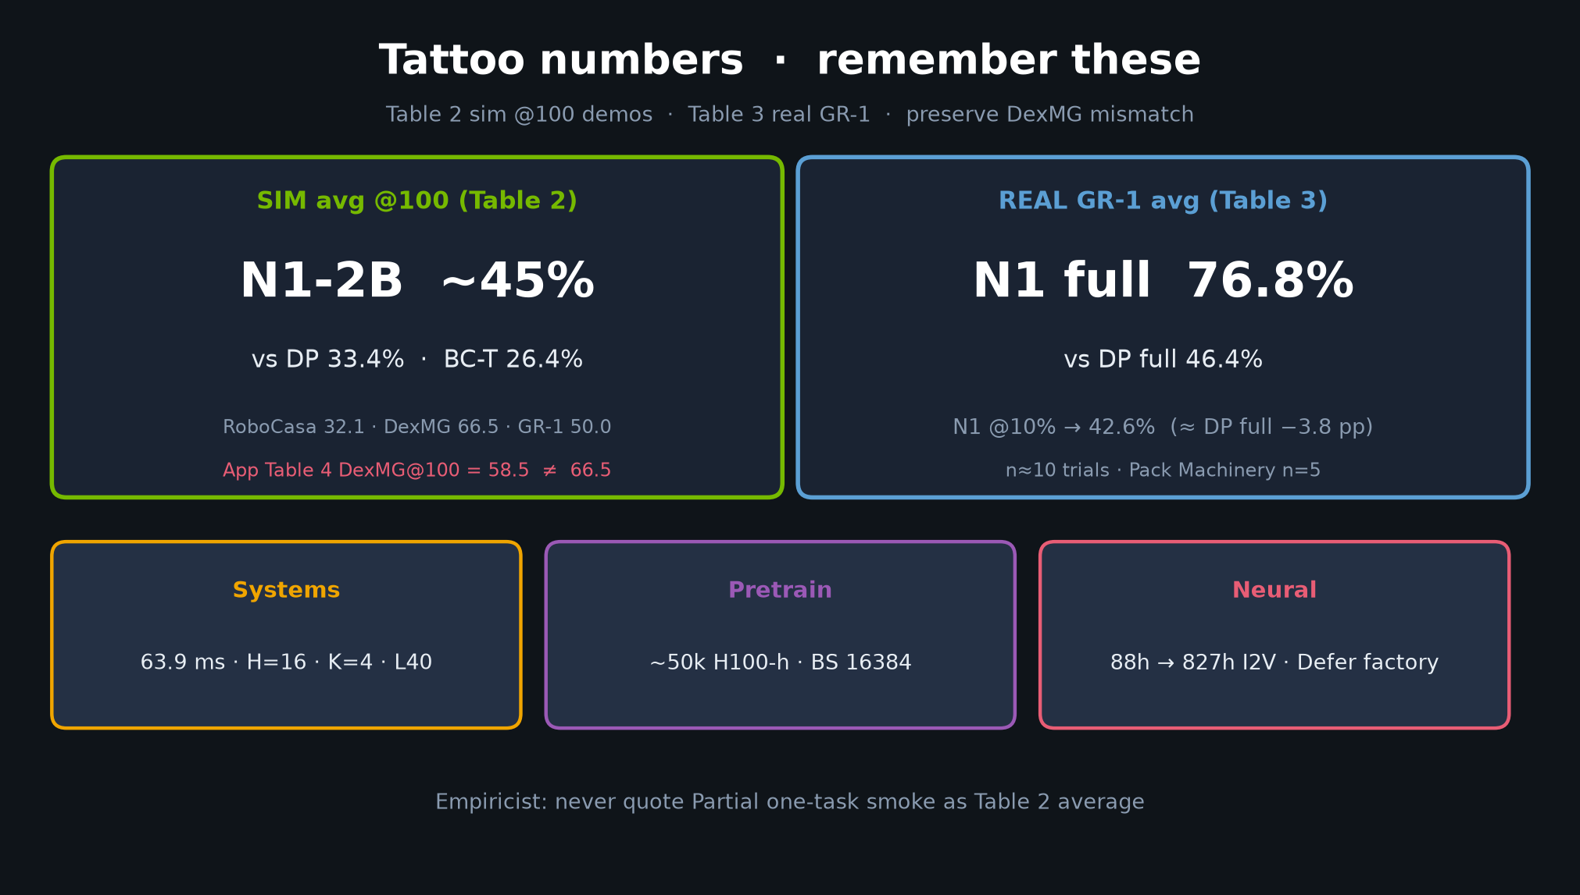
Empiricist · 11+3 · 2/14
Notes:
TATTOO NUMBERS first so the room shares anchors.
Sim avg ~45% vs DP 33.4% / BC-T 26.4%. Real 76.8% vs DP 46.4%.
DexMG Table 2/4 mismatch: preserve both. Never quote Partial as Table 2.

Slide 3
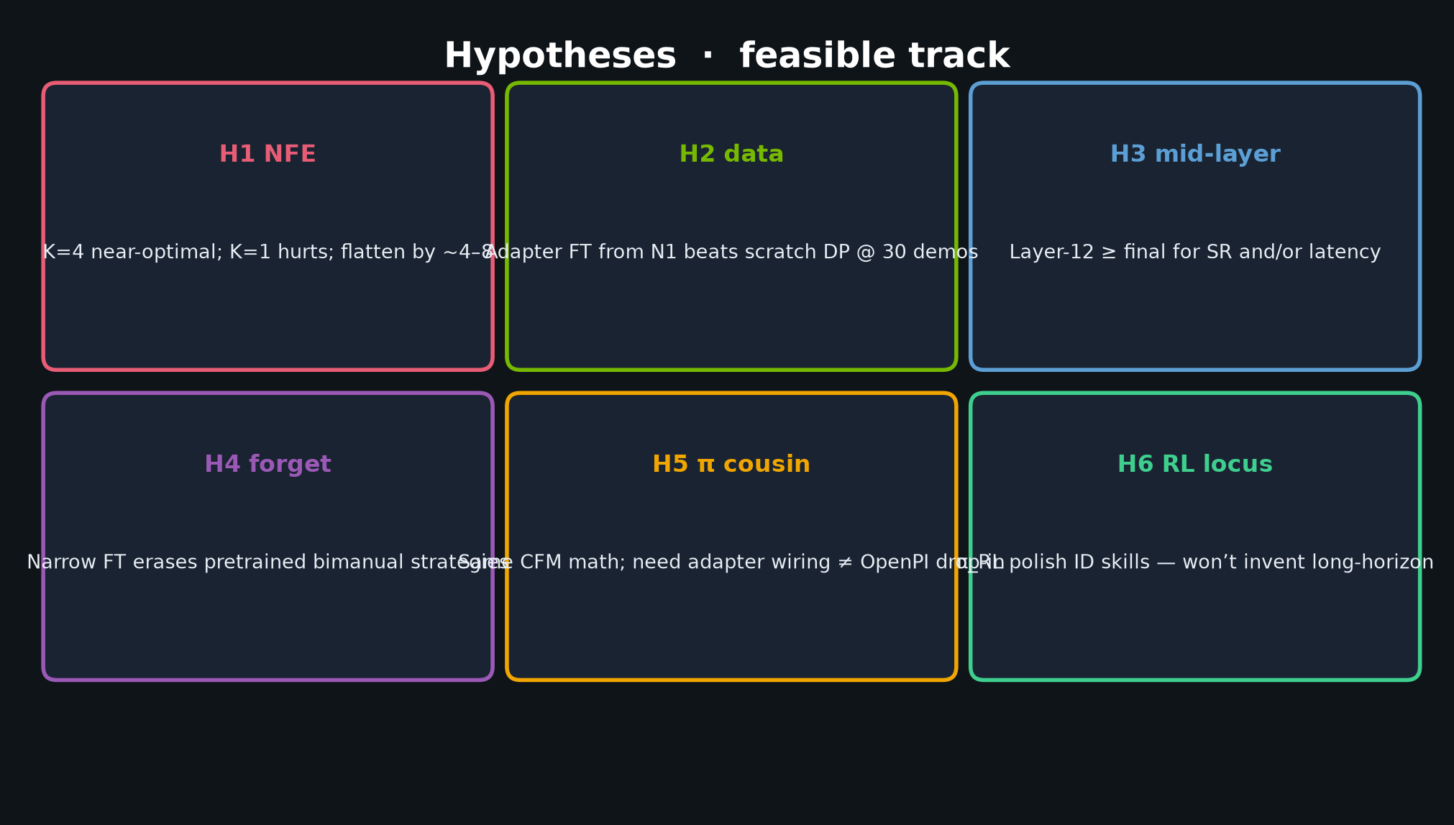
Empiricist · 11+3 · 3/14
Notes:
HYPOTHESES H1–H6. Lead with H1 NFE.
Falsifiers: K=1 matches K=4; N1 init never beats scratch DP @30; mid-layer strictly worse.

Slide 4
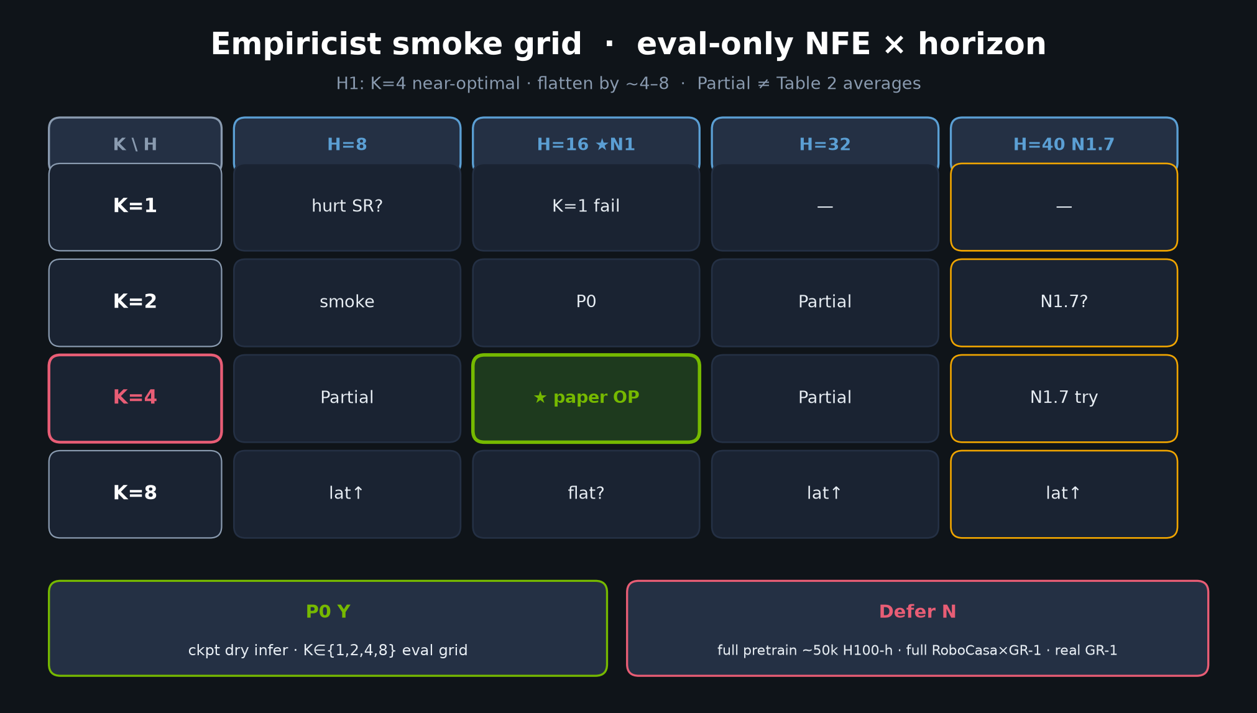
Empiricist · 11+3 · 4/14
Notes:
K/H SMOKE GRID — P0 centerpiece.
K∈{1,2,4,8} × H∈{8,16,32,40}. Paper OP = K=4,H=16.
N1.7 may allow H≤40 — label separately. Log ms/chunk + VRAM.

Slide 5
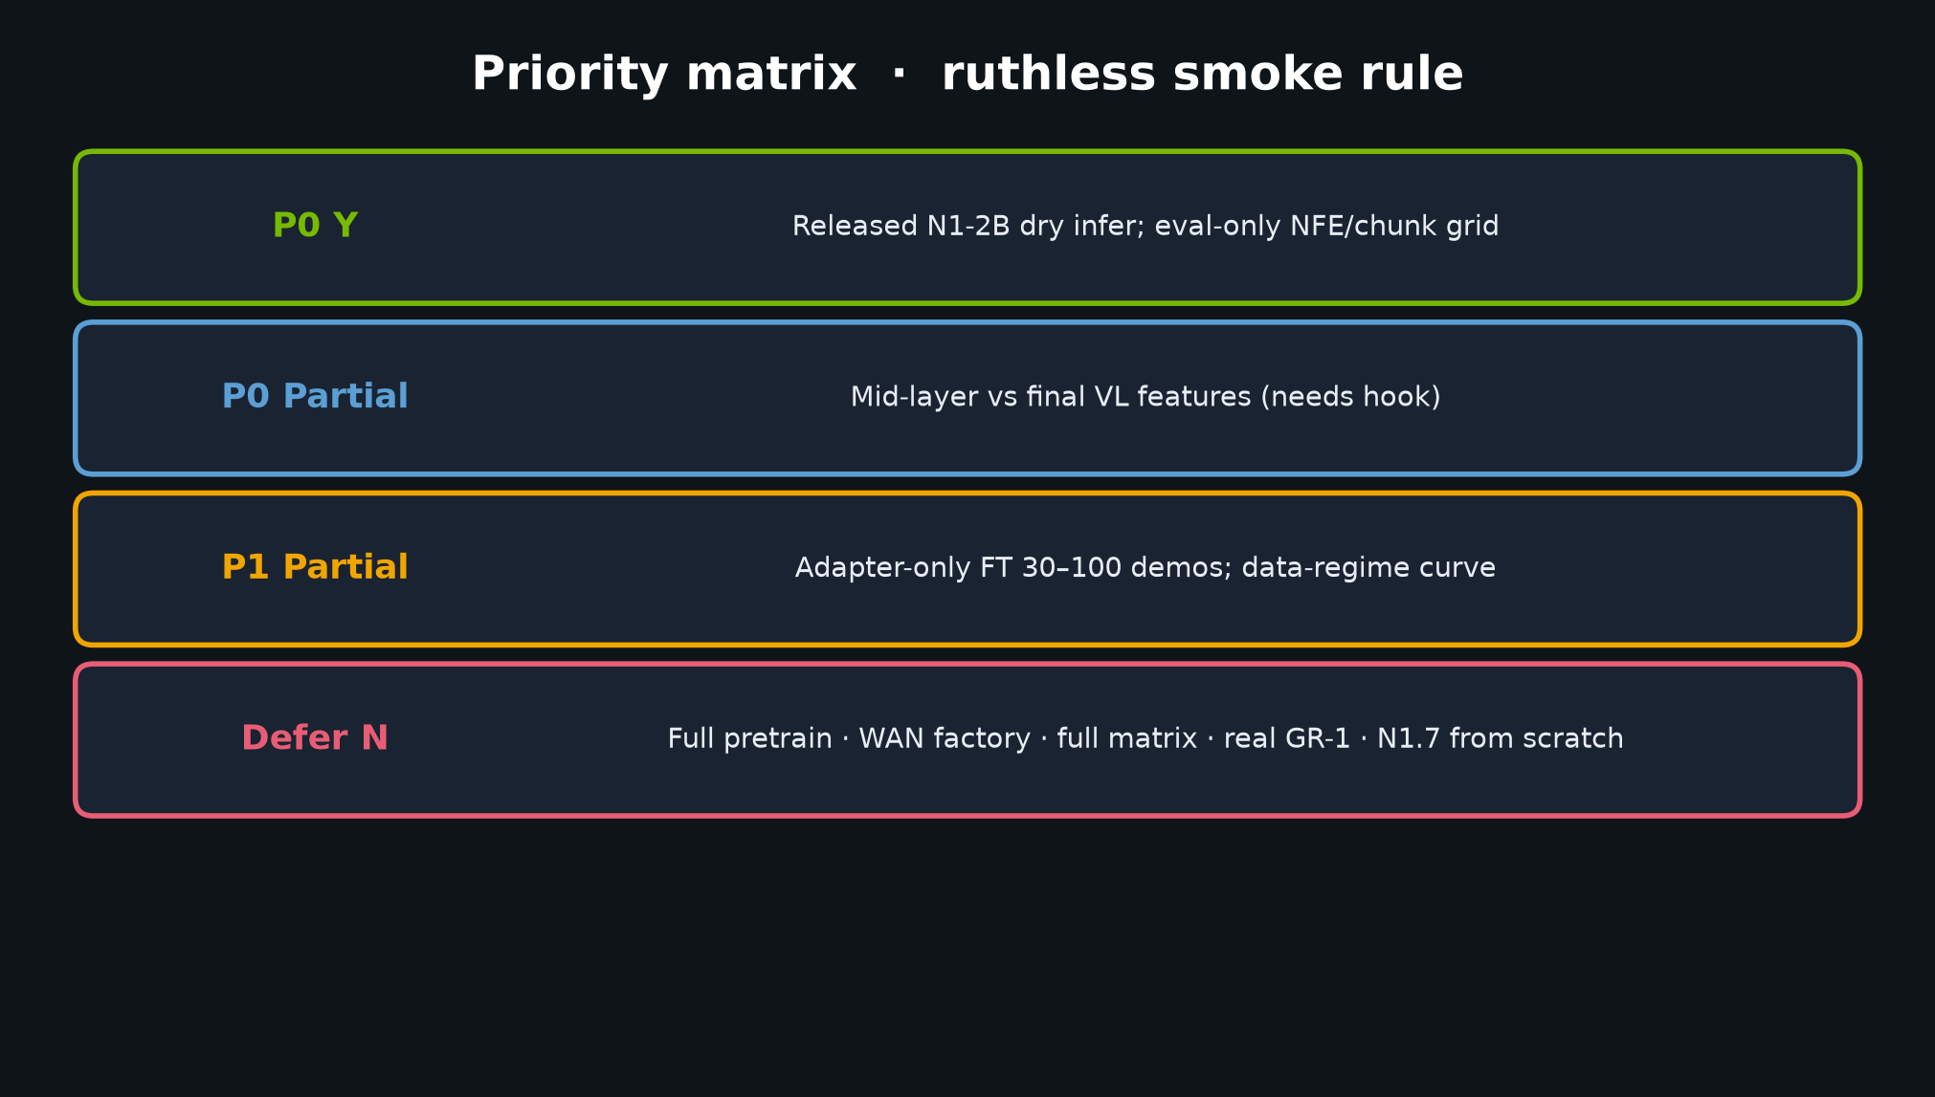
Empiricist · 11+3 · 5/14
Notes:
PRIORITY MATRIX — P0 Y dry infer + NFE grid; P0 Partial mid-layer; P1 Partial adapter FT; Defer N full pretrain/WAN/real/N1.7-from-scratch.
Ruthless smoke rule.

Slide 6
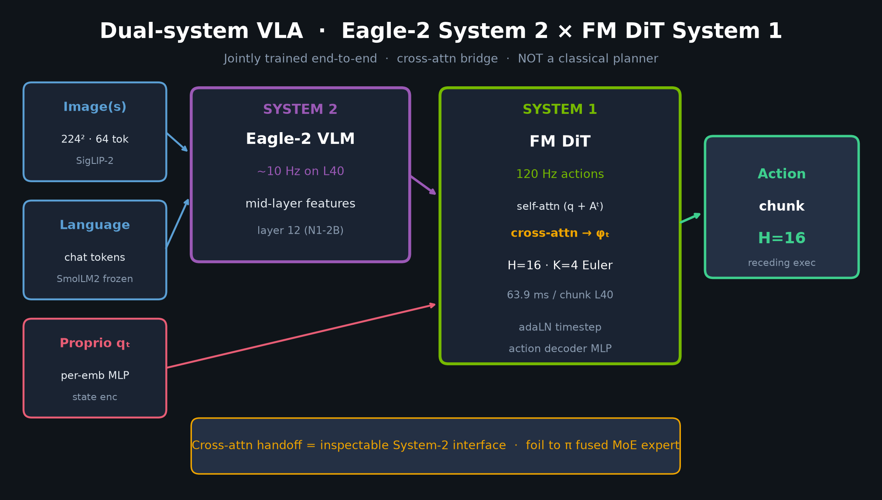
Empiricist · 11+3 · 6/14
Notes:
DUAL-SYSTEM implement-facing — mid-layer 12, per-emb MLPs, K=4, 63.9 ms.
Cache VL tokens across denoise when possible.

Slide 7
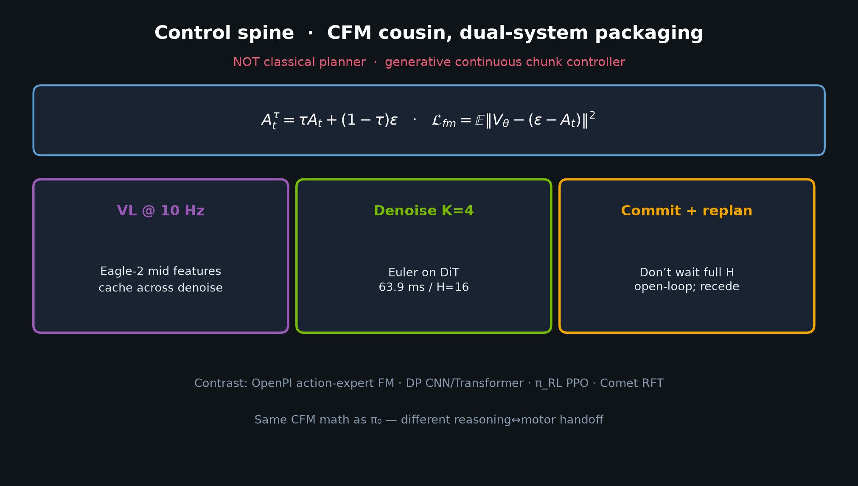
Empiricist · 11+3 · 7/14
Notes:
CONTROL SPINE / CFM — same math as π₀; need adapter wiring.
Receding horizon; don’t cargo-cult 120 Hz without measuring commit latency.

Slide 8
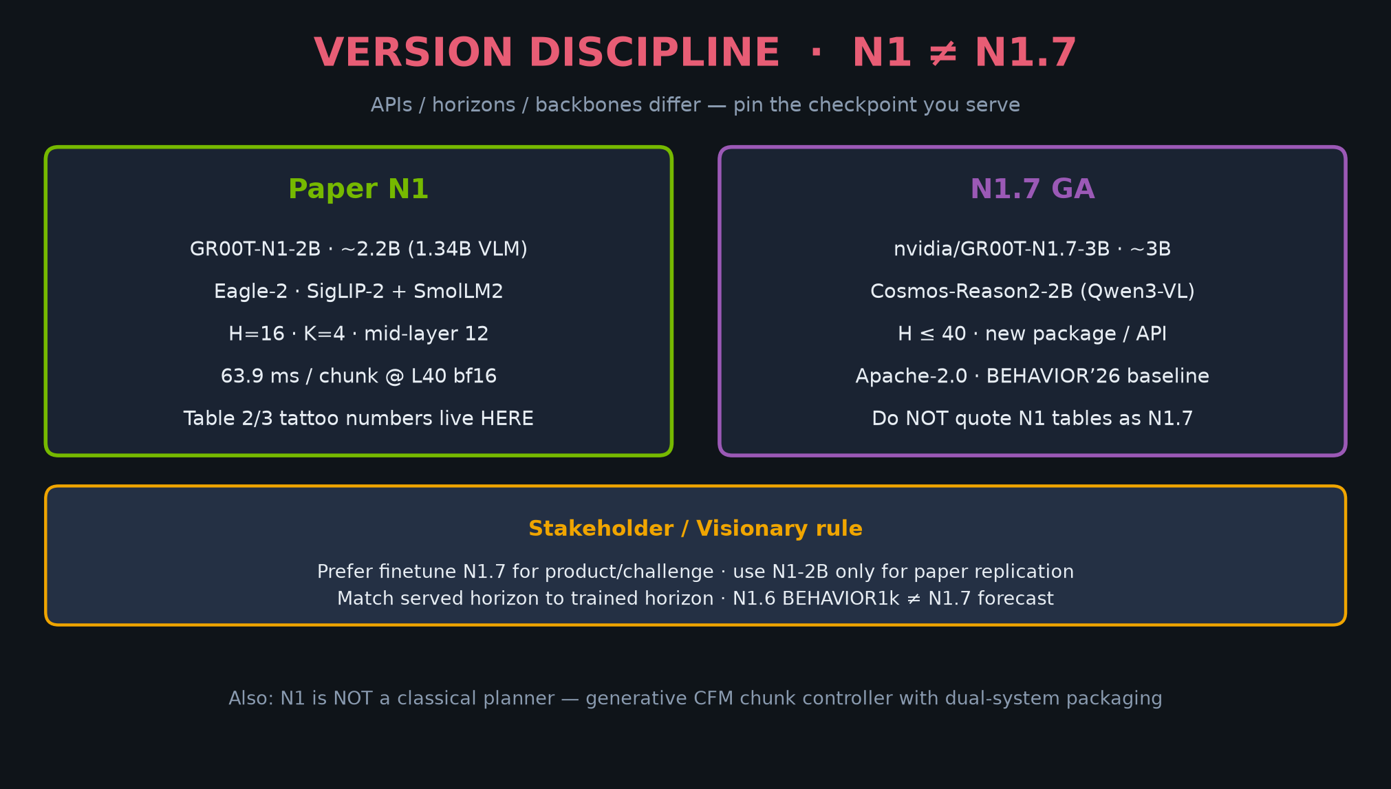
Empiricist · 11+3 · 8/14
Notes:
VERSION DISCIPLINE — do not equate N1 smokes with N1.7 BEHAVIOR baseline numbers.
Prefer released N1.7 for challenge track; N1-2B for paper replication.

Slide 9
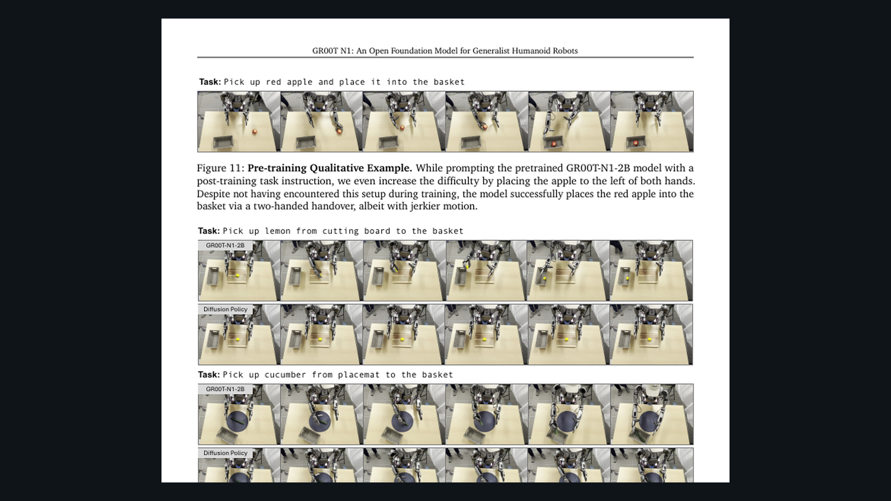
Empiricist · 11+3 · 9/14
Notes:
PAPER FIG 9 neural ablation — only claim if true I2V+IDM; else mark proxy.

Slide 10
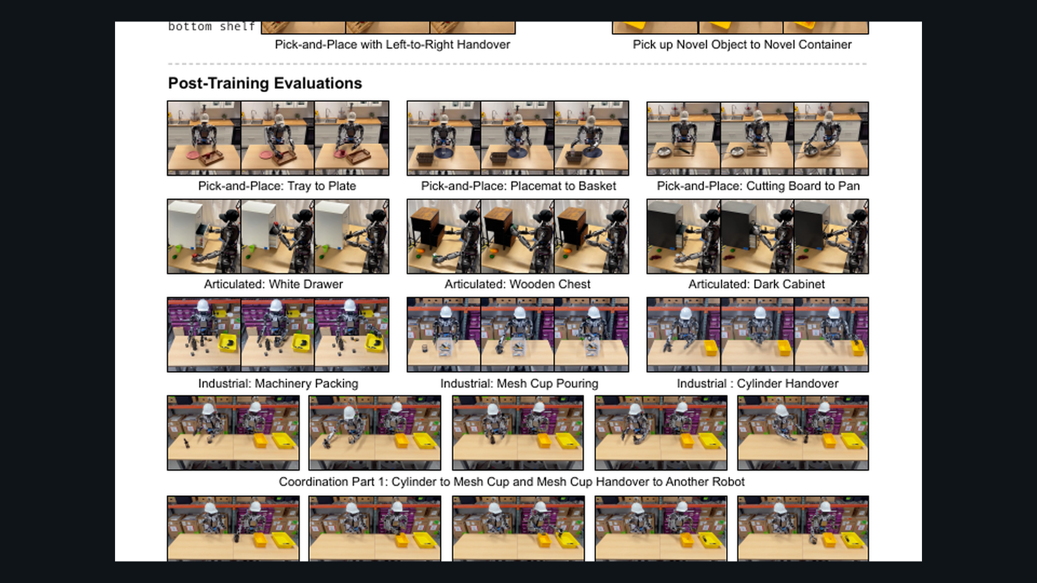
Empiricist · 11+3 · 10/14
Notes:
PAPER tables crop — what full reproduction would look like; we are not claiming it from Partial.

Slide 11
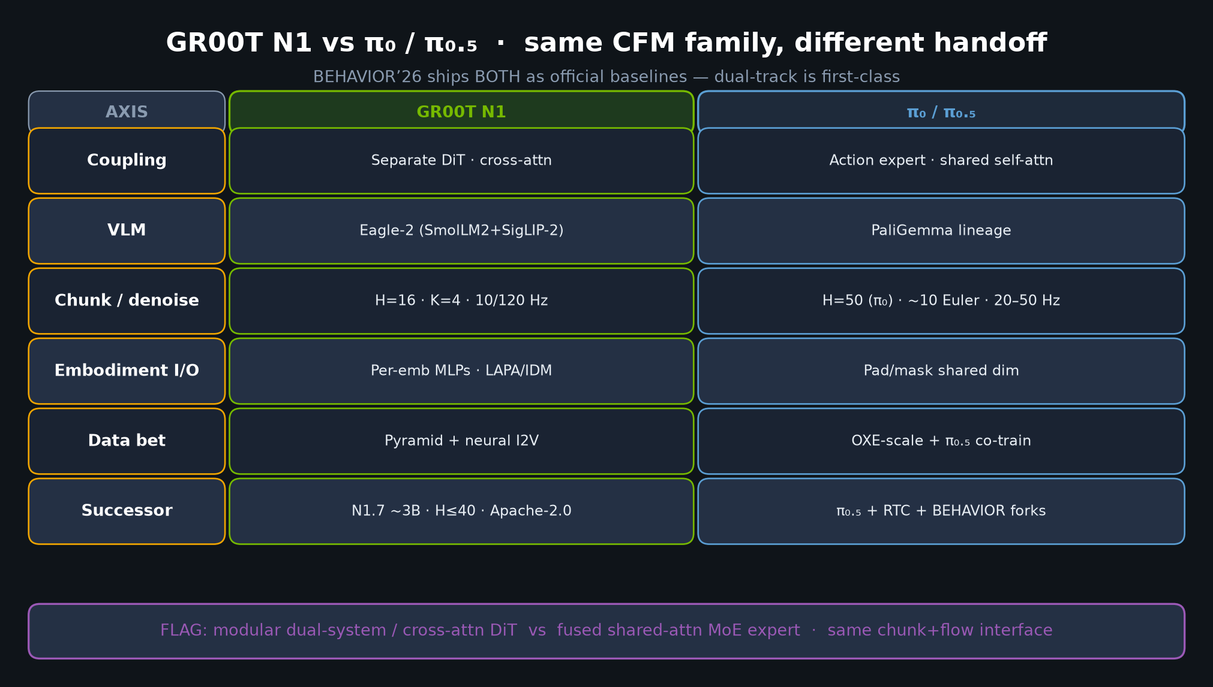
Empiricist · 11+3 · 11/14
Notes:
N1 vs π — Empiricist should not expect OpenPI scripts to drop-in without adapter wiring.

Slide 12
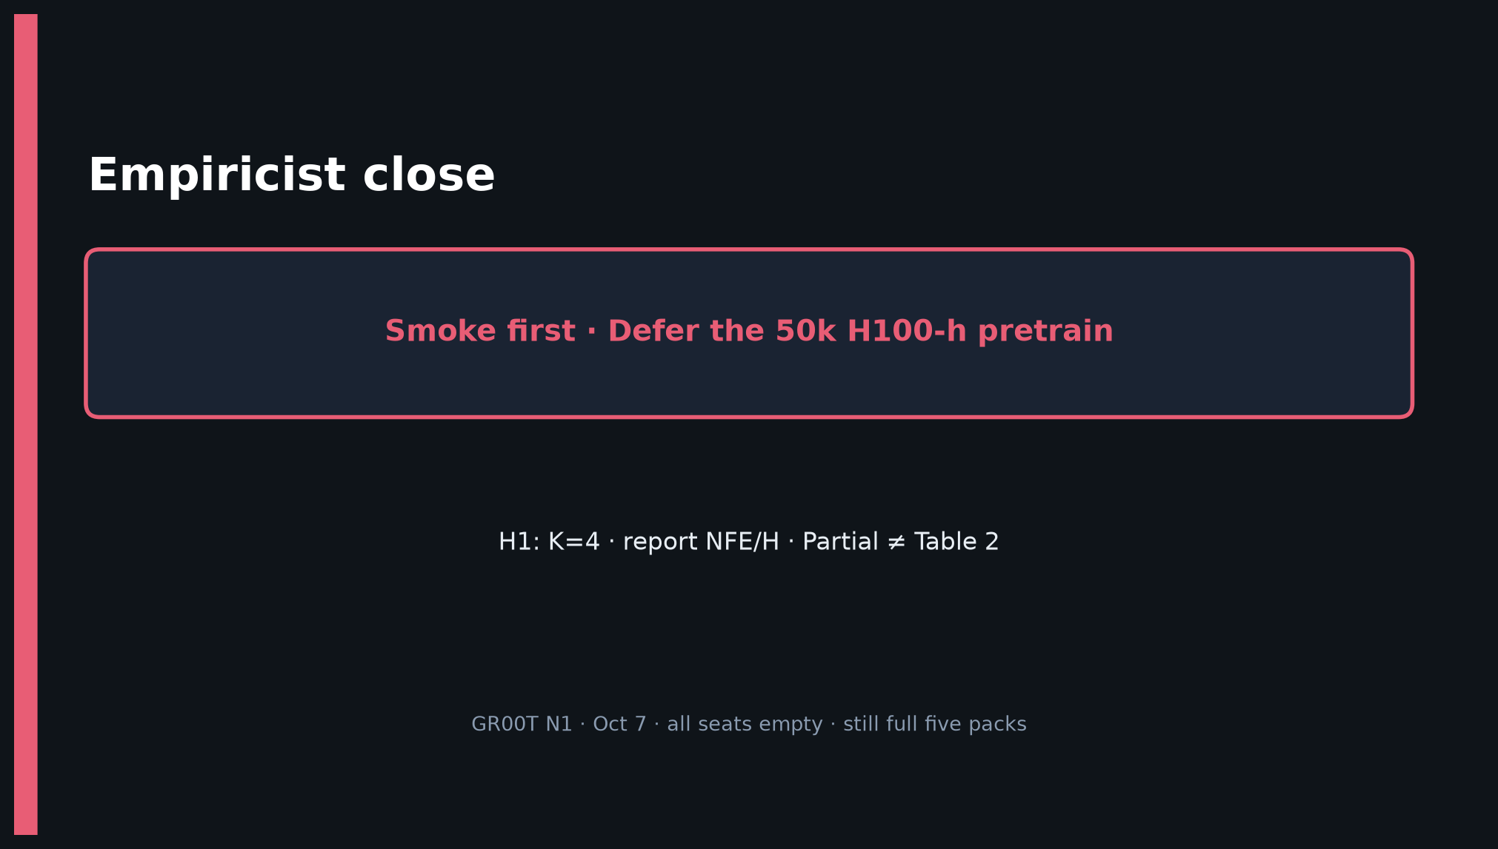
Empiricist · 11+3 · 12/14
Notes:
CLOSE — Smoke first; Defer 50k H100-h; H1 K=4; report NFE/H; Partial ≠ Table 2.

Slide 13
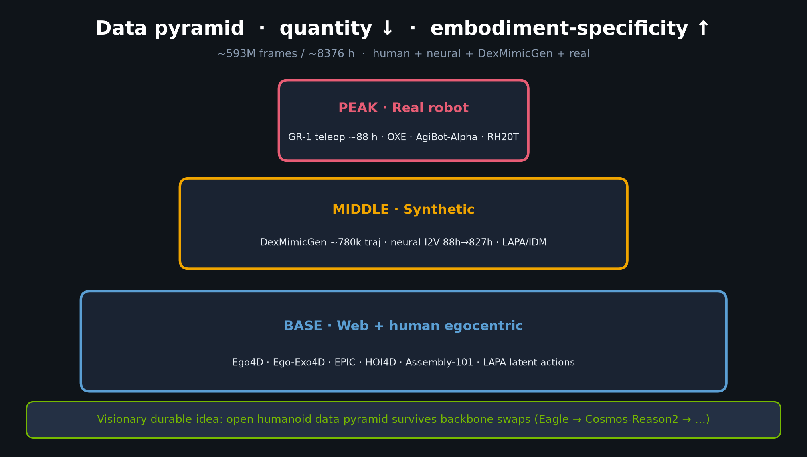
Empiricist · 11+3 · 13/14
Notes:
BACKUP — data pyramid if asked what full pretrain mixture looked like (Defer to re-run).

Slide 14
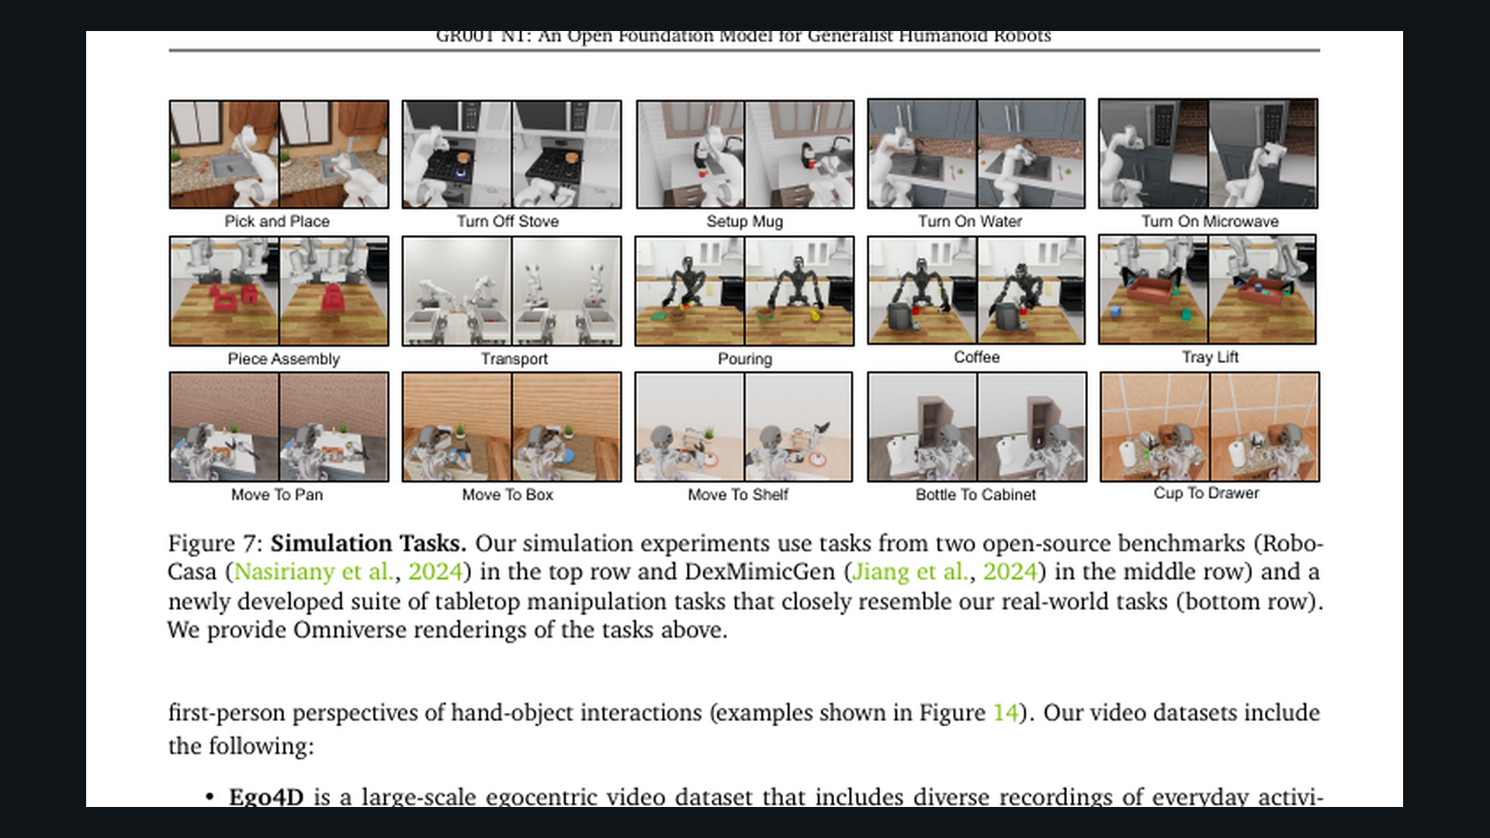
Empiricist · 11+3 · 14/14
Notes:
SPARE — sim task gallery Fig.7 for task selection discussion.

