Slide 1
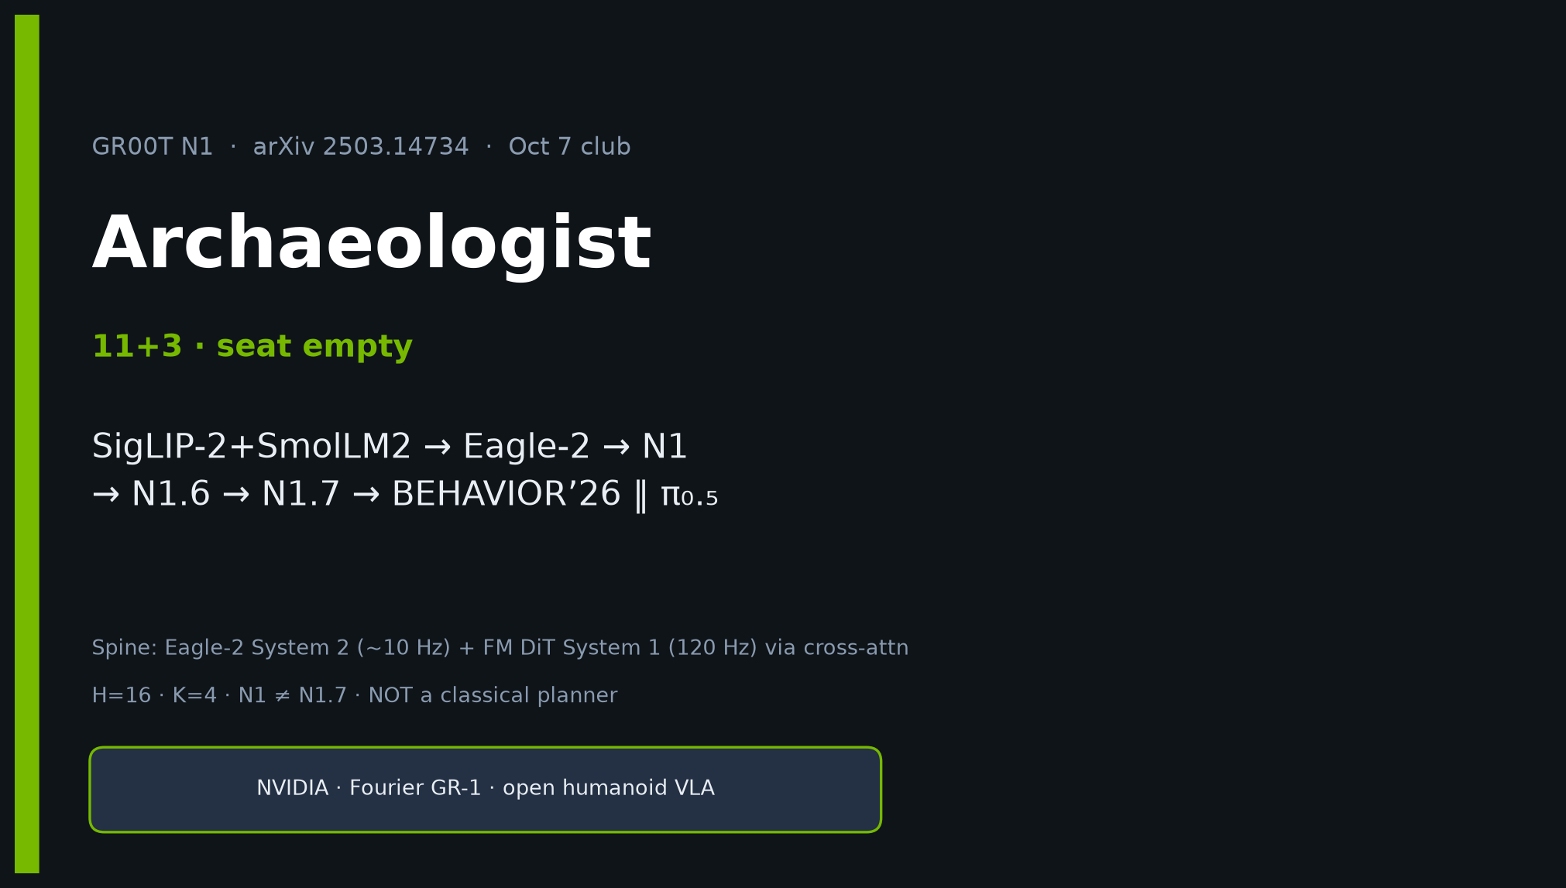
Archaeologist · 11+3 · 1/14
Notes:
ARCHAEOLOGIST — 11+3. Seat empty; still own intellectual history.
Genealogy MUST: SigLIP-2+SmolLM2 → Eagle-2 → N1 → N1.6 → N1.7 → BEHAVIOR’26 ‖ π₀.₅.
CLEAR vs TENTATIVE labels. Contrast π₀ (cite+contrast). NOT classical planner.

Slide 2
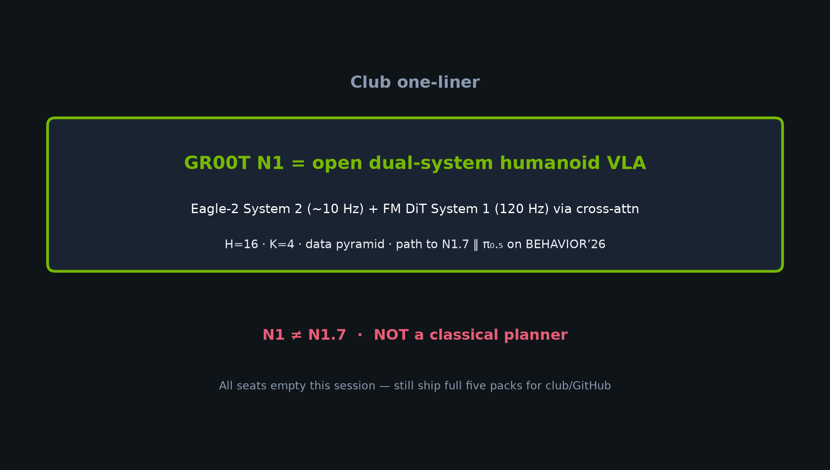
Archaeologist · 11+3 · 2/14
Notes:
CLUB ONE-LINER / SPINE early.
Dual-system cross-attn FM; N1≠N1.7; path to BEHAVIOR’26 dual baseline.

Slide 3
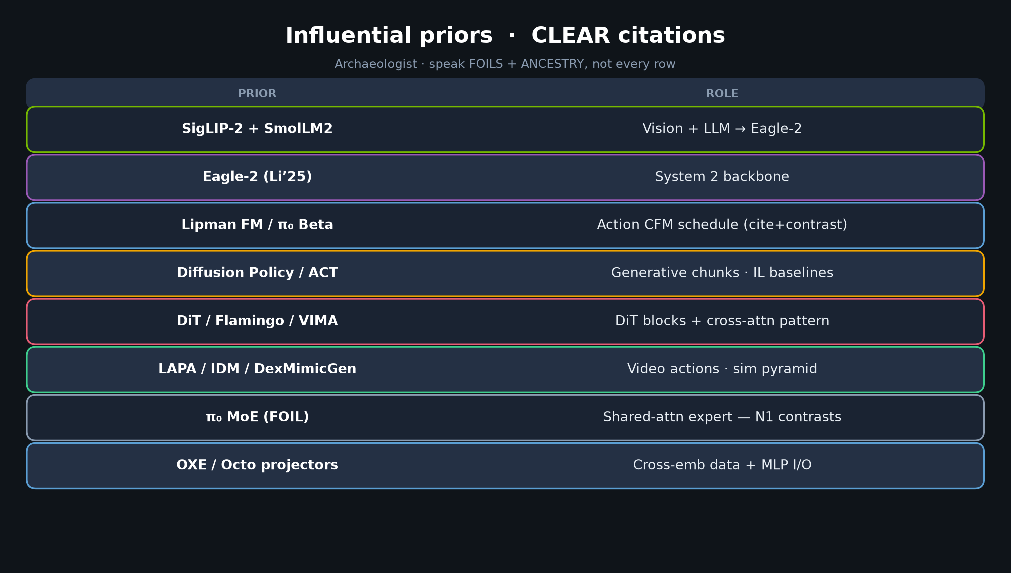
Archaeologist · 11+3 · 3/14
Notes:
PRIOR TABLE CLEAR — densest citation slide. Speak FOILS + ANCESTRY.
SigLIP-2/SmolLM2/Eagle-2 · Lipman FM · π₀ cite+contrast · DP/ACT · DiT/Flamingo/VIMA · LAPA/IDM/DexMG · OXE/Octo.
π₀ MoE is the FOIL N1 explicitly contrasts.

Slide 4
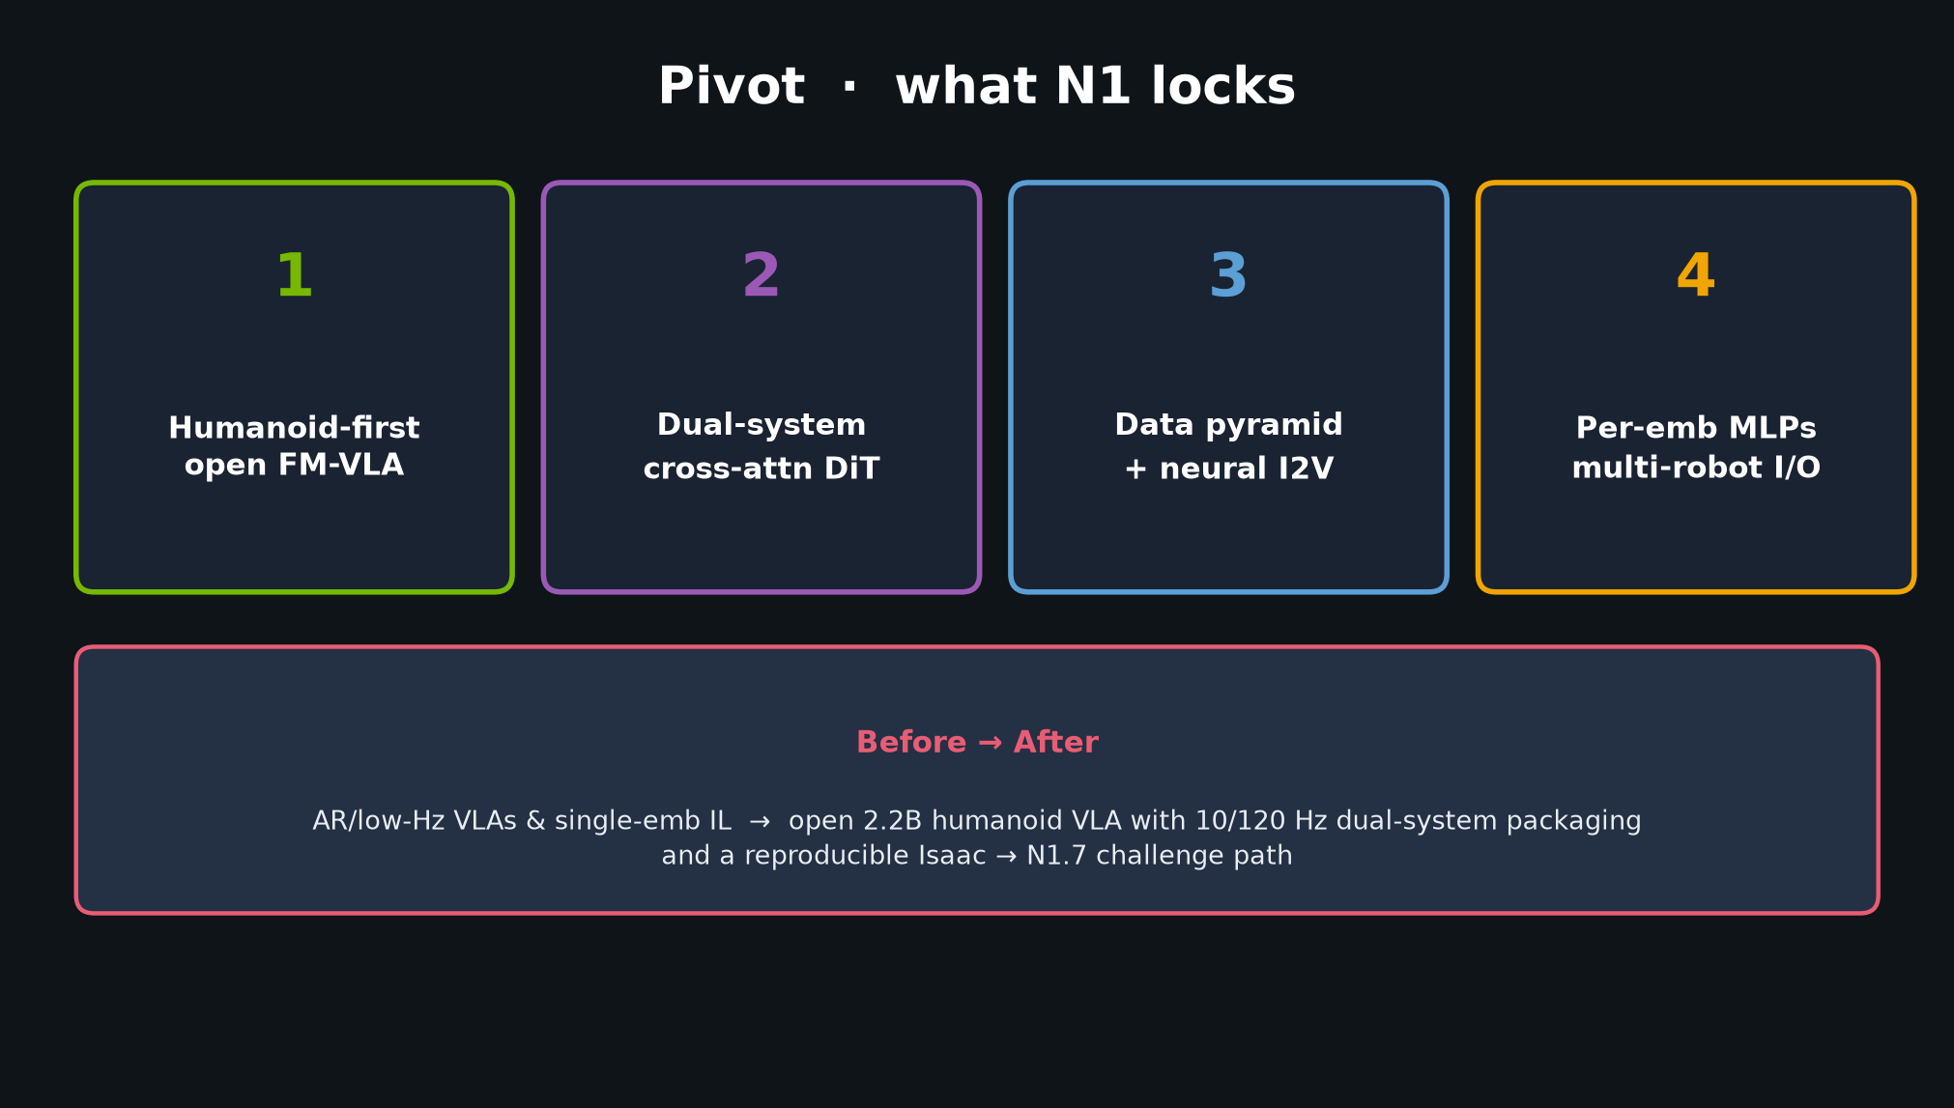
Archaeologist · 11+3 · 4/14
Notes:
PIVOT — humanoid-first open FM-VLA; dual-system cross-attn DiT; data pyramid; per-emb MLPs.
Before/after for the room.

Slide 5
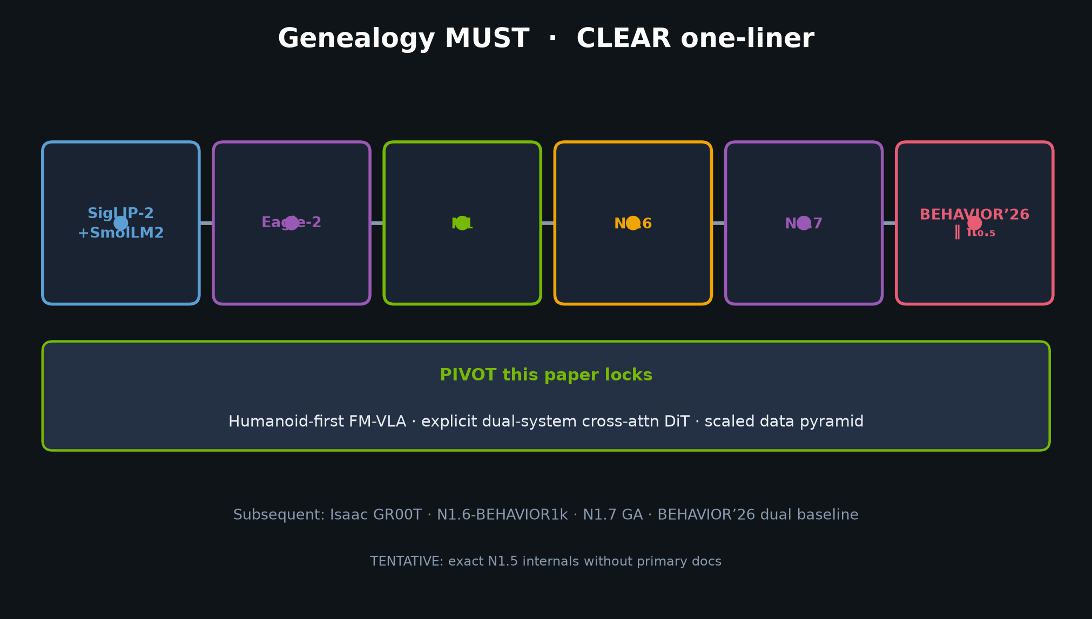
Archaeologist · 11+3 · 5/14
Notes:
GENEALOGY MUST — THE payoff slide.
SigLIP-2+SmolLM2 → Eagle-2 → N1 → N1.6 → N1.7 → BEHAVIOR’26 ‖ π₀.₅.
Spend 90–120s. TENTATIVE: N1.5 internals without primary docs.

Slide 6
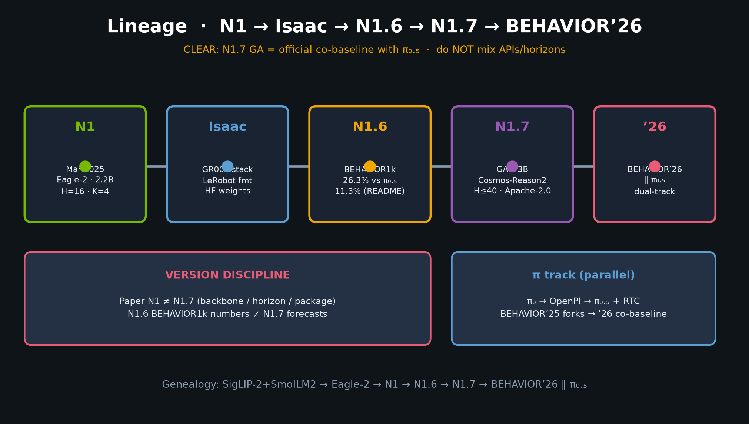
Archaeologist · 11+3 · 6/14
Notes:
TIMELINE DETAIL — N1→Isaac→N1.6→N1.7→’26 with parallel π track.
Version discipline callout on same visual.

Slide 7
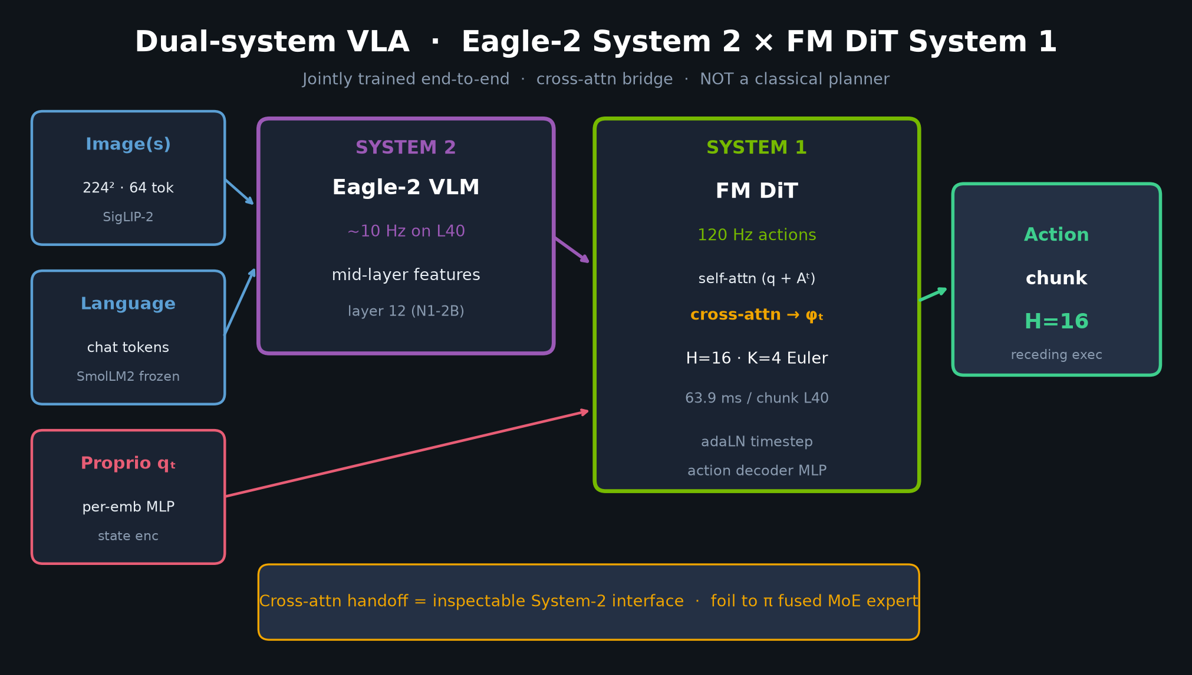
Archaeologist · 11+3 · 7/14
Notes:
ARCHITECTURE redraw — dual-system + cross-attn. Contrast MoE.
Middle-layer 12; H=16; K=4.

Slide 8
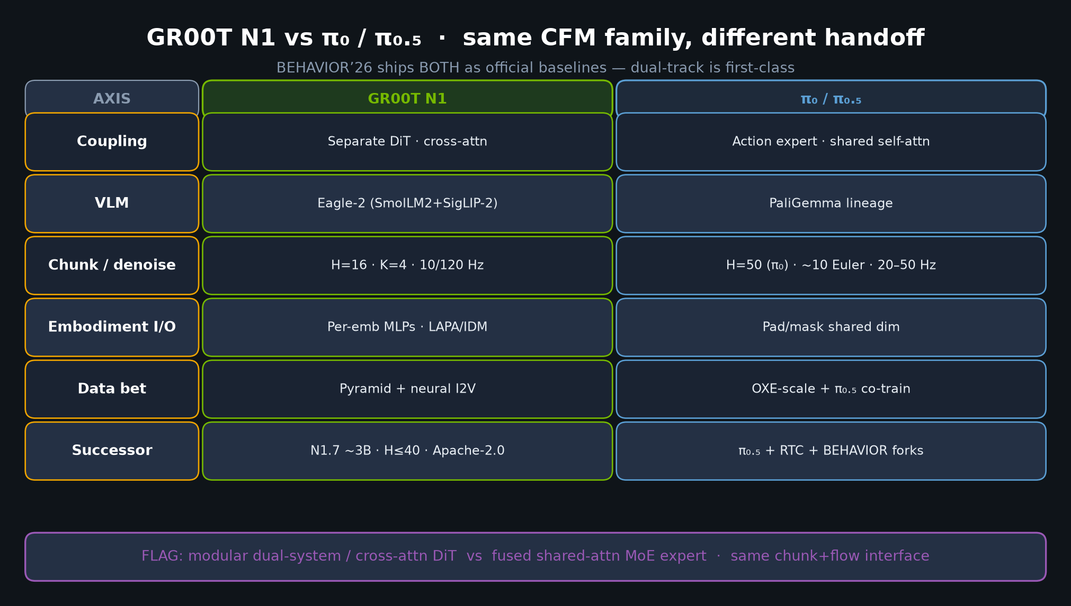
Archaeologist · 11+3 · 8/14
Notes:
N1 vs π₀ TABLE — coupling foil is the session FLAG.

Slide 9
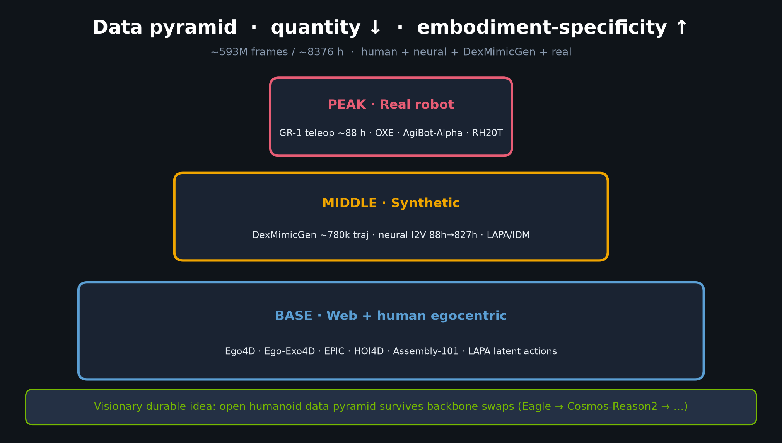
Archaeologist · 11+3 · 9/14
Notes:
DATA PYRAMID as methodological contribution, not just “more data.”

Slide 10
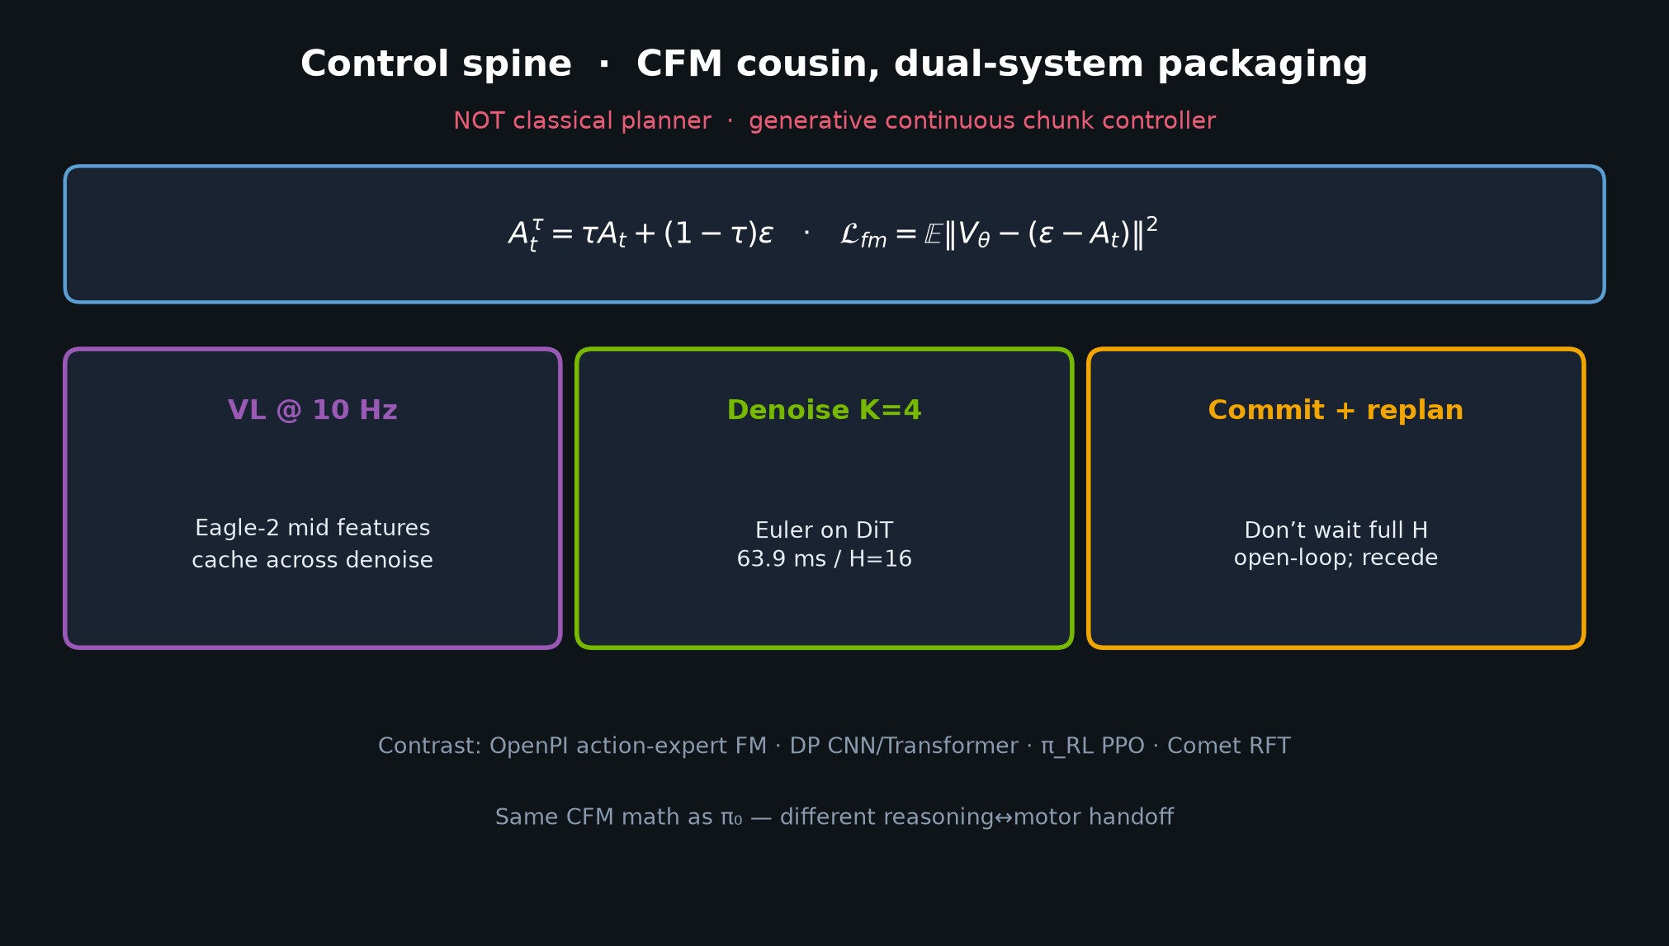
Archaeologist · 11+3 · 10/14
Notes:
CONTROL SPINE — CFM kinship with π; chunk habit from DP/ACT; not planner.

Slide 11
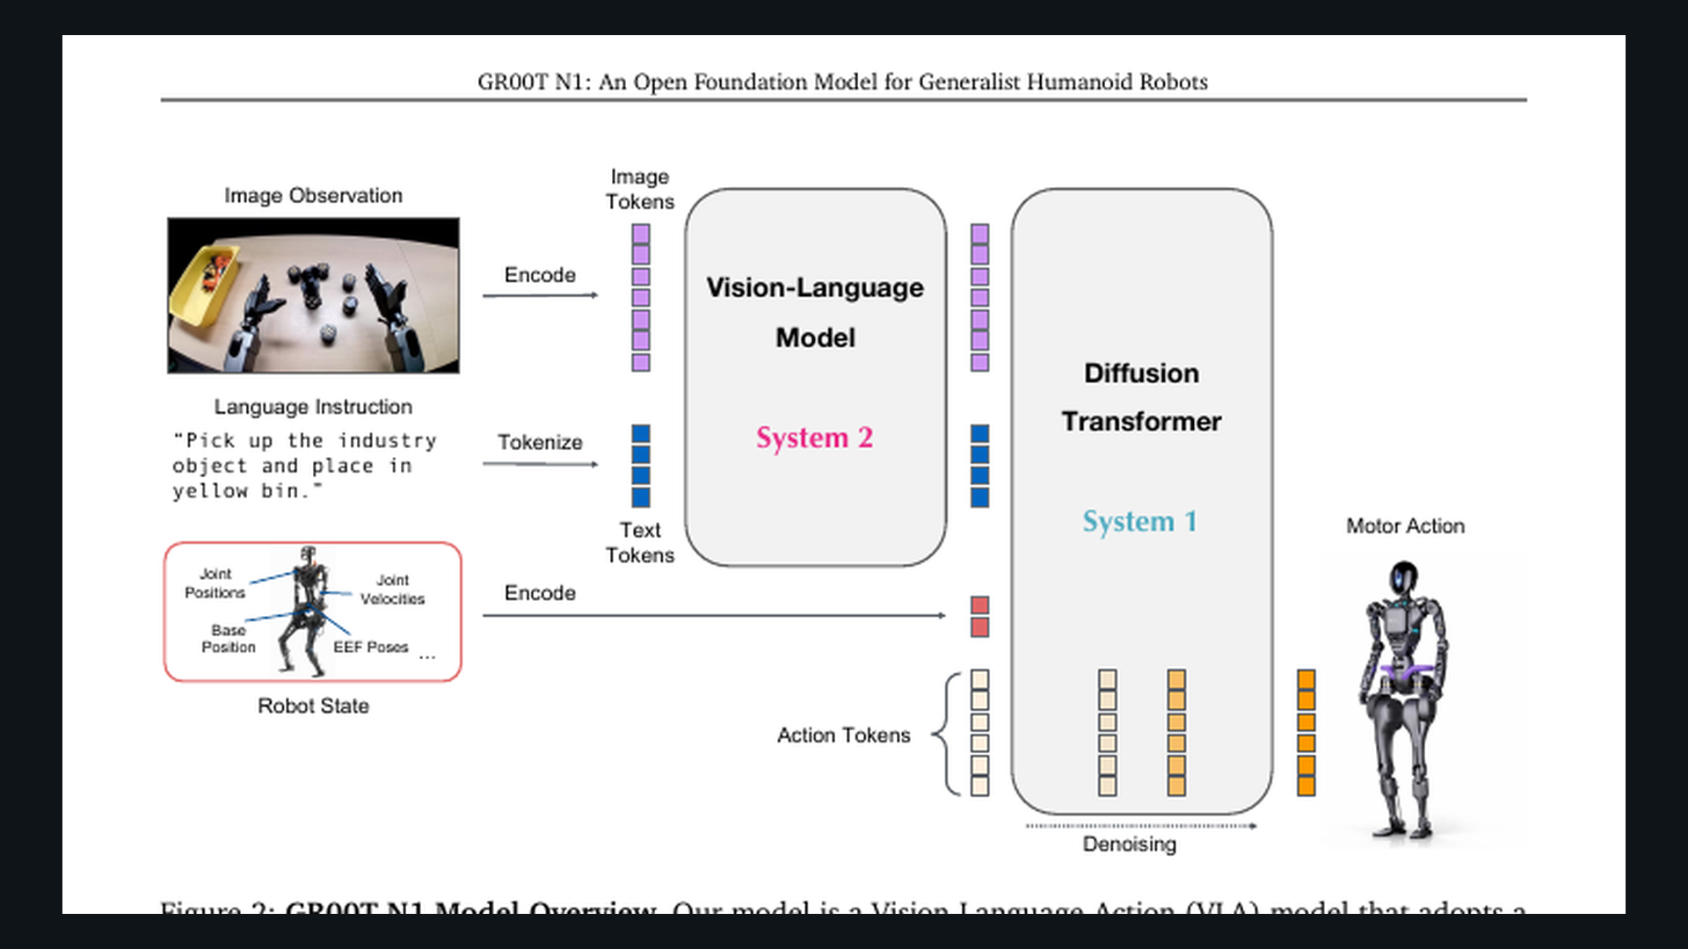
Archaeologist · 11+3 · 11/14
Notes:
PAPER FIG 2 — bibliographic visual of dual-system overview.
Point at Eagle-2 System 2 → DiT System 1 → motor actions.
30–45s; supports the pivot packaging claim.

Slide 12
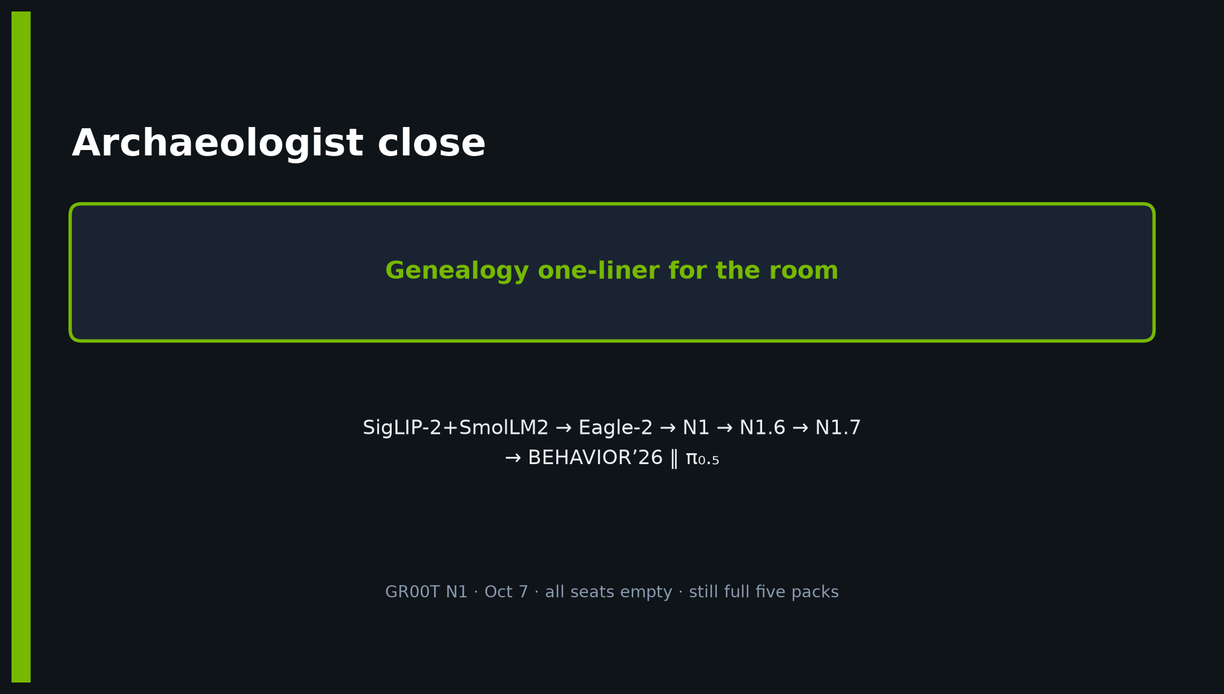
Archaeologist · 11+3 · 12/14
Notes:
CLOSE — restate genealogy one-liner + pivot + CLEAR/TENTATIVE hygiene.

Slide 13
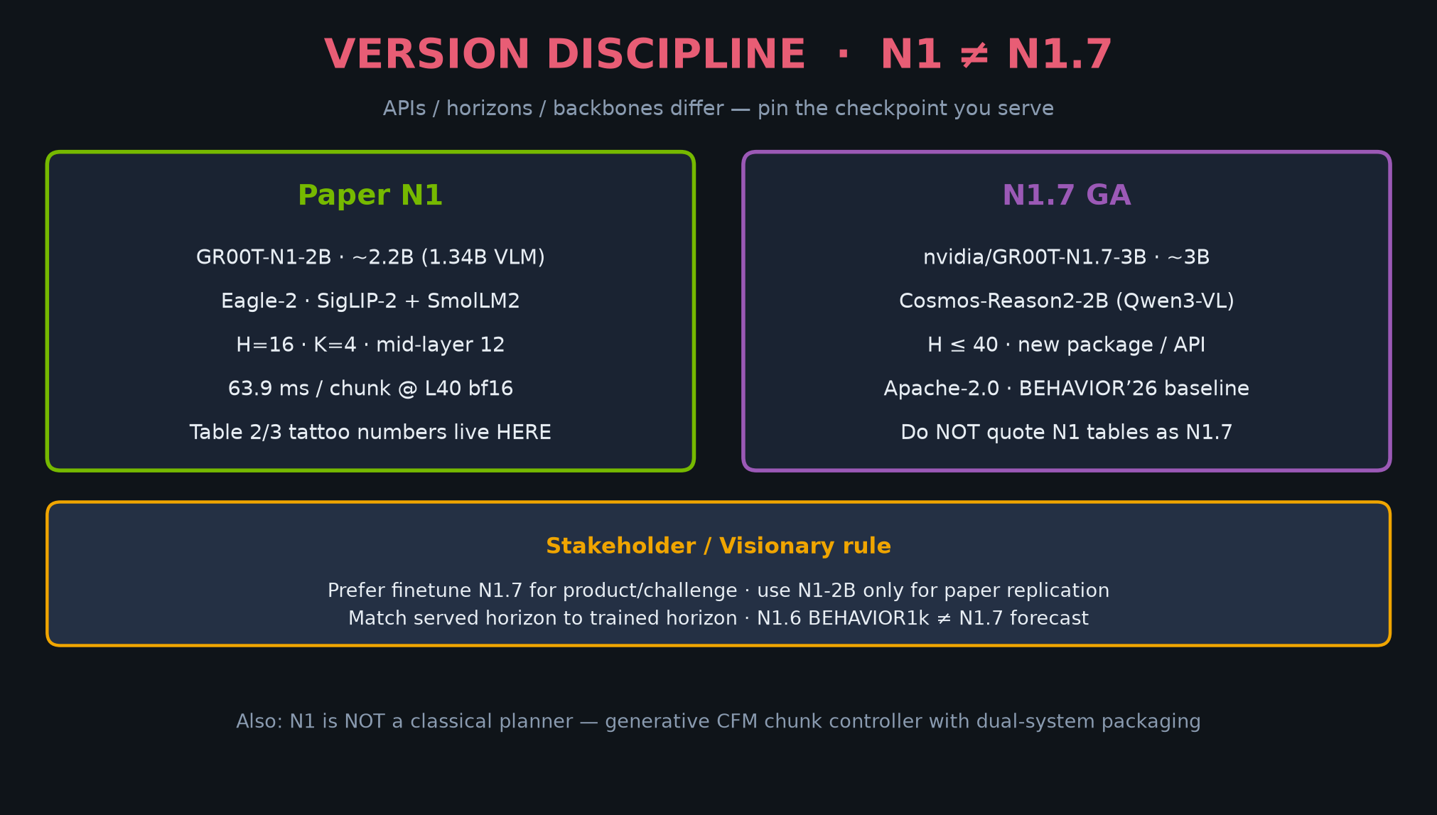
Archaeologist · 11+3 · 13/14
Notes:
BACKUP — version discipline card if asked N1 vs N1.7 vs N1.6 numbers.
CLEAR: do not conflate paper tables with challenge baseline forecasts.

Slide 14
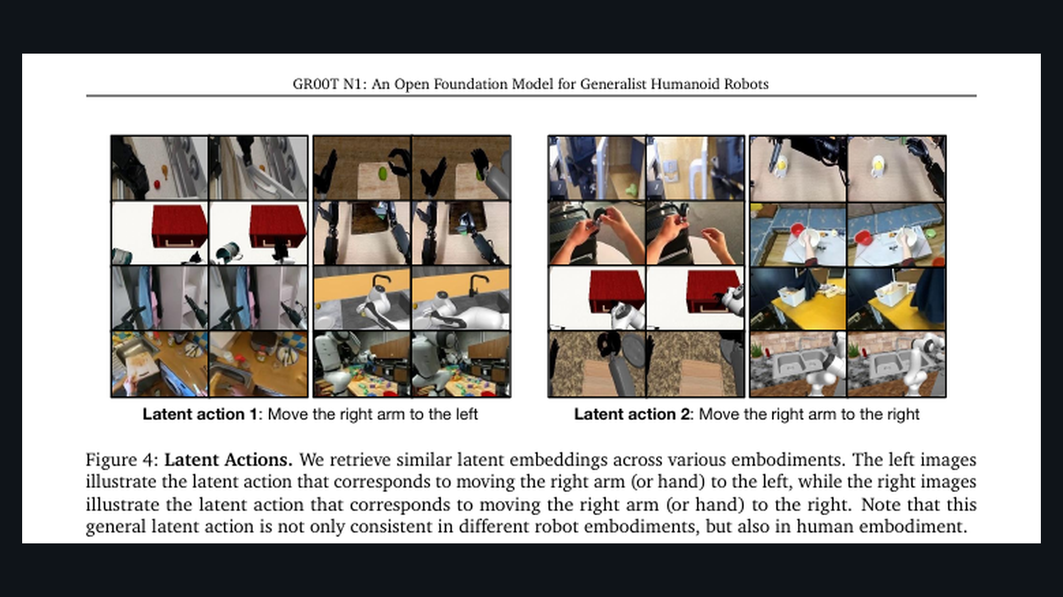
Archaeologist · 11+3 · 14/14
Notes:
SPARE — paper cover / latent actions Fig.4 if asked about LAPA cross-emb.

