Slide 1
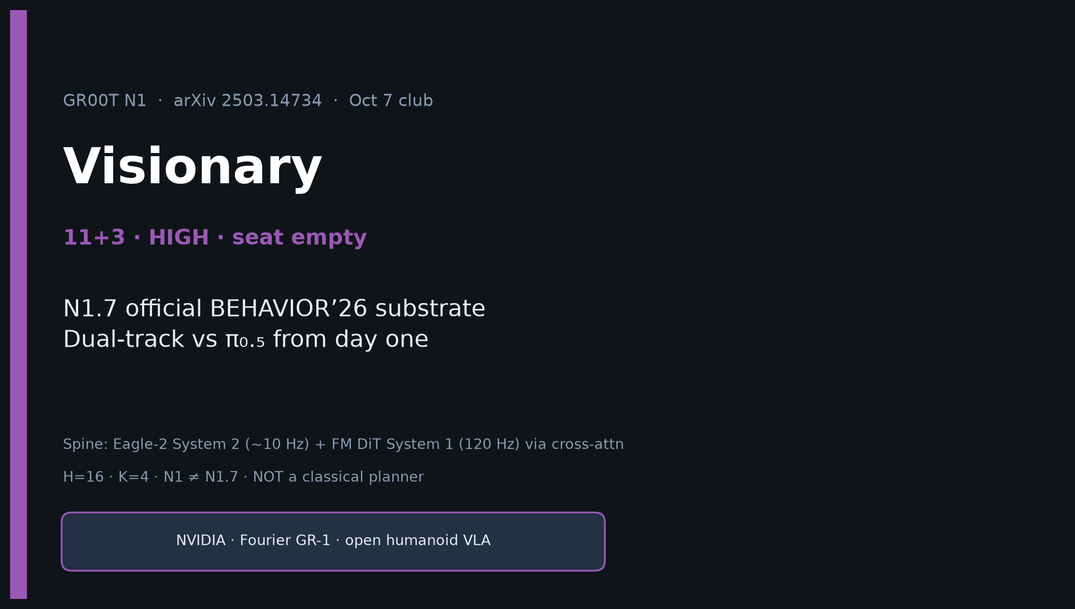
Visionary · 11+3 · 1/14
Notes:
VISIONARY OPENING — HIGH PRIORITY for BEHAVIOR’26. Timing 11+3. DENSEST DECK. Built first.
All seats empty this session — still deliver full strategy notes.
ONE SENTENCE for the room:
GR00T N1 established the open dual-system humanoid VLA; for 2026 BEHAVIOR, treat N1.7 as the NVIDIA-side official start parallel to π₀.₅.
MUST HIT all 6 pack bullets (agenda next). Skip Discord/Drive.
Spine reminder: Eagle-2 System 2 (~10 Hz) + FM DiT System 1 (120 Hz) via cross-attn. H=16, K=4. N1 ≠ N1.7. NOT a classical planner.

Slide 2
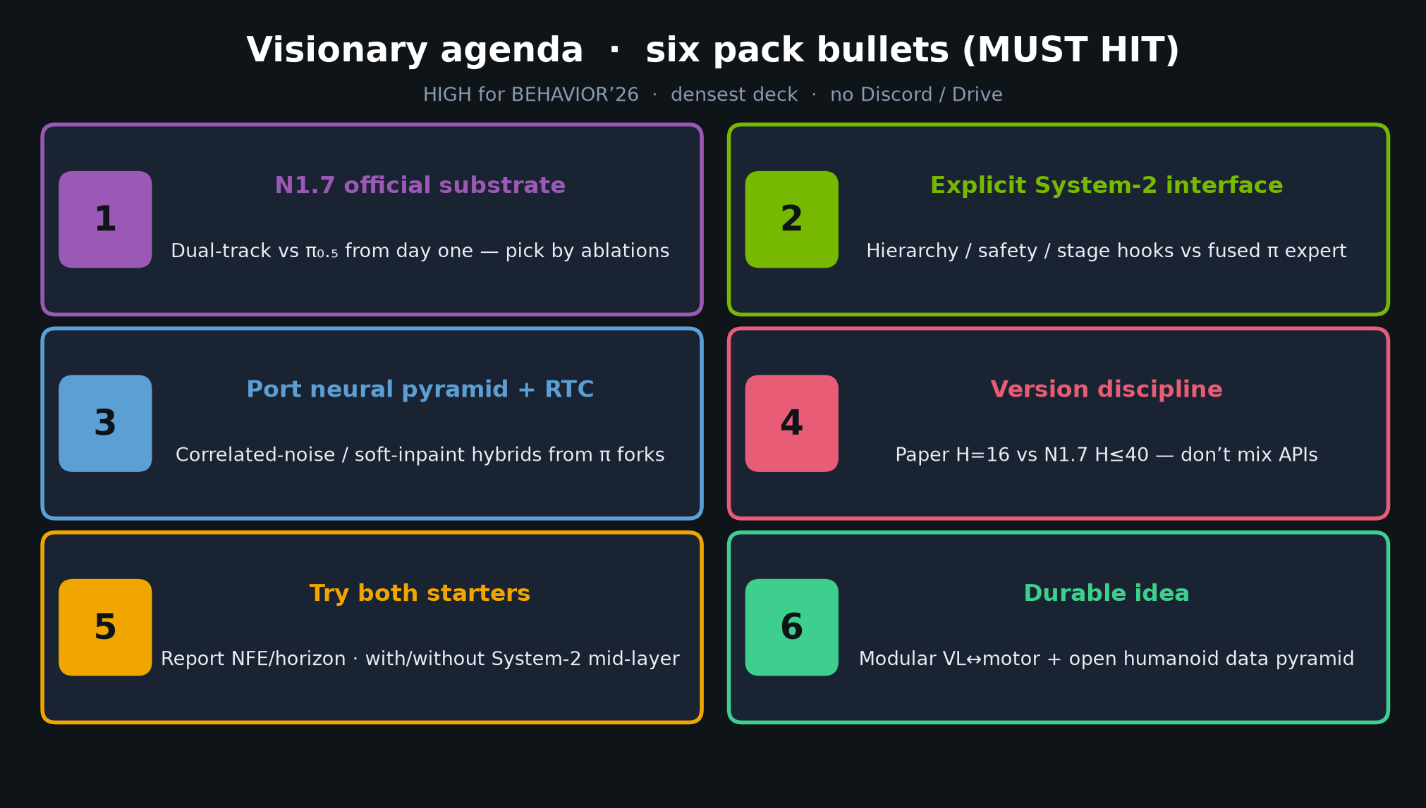
Visionary · 11+3 · 2/14
Notes:
SIX PACK BULLETS — densest agenda. Hit EVERY item verbally.
1. N1.7 is official substrate — dual-track vs π₀.₅ from day one
2. Explicit System-2 interface → hierarchy/safety hooks vs fused π expert
3. Port neural pyramid ideas + RTC/correlated-noise hybrids from π forks
4. Version discipline: paper H=16 vs N1.7 H≤40 — don’t mix APIs
5. Try both starters; report NFE/horizon; with/without System-2 mid-layer
6. Durable idea: modular VL↔motor + open humanoid data pyramid — not a bigger PaliGemma clone
Spend ~90s walking the six; details follow.

Slide 3
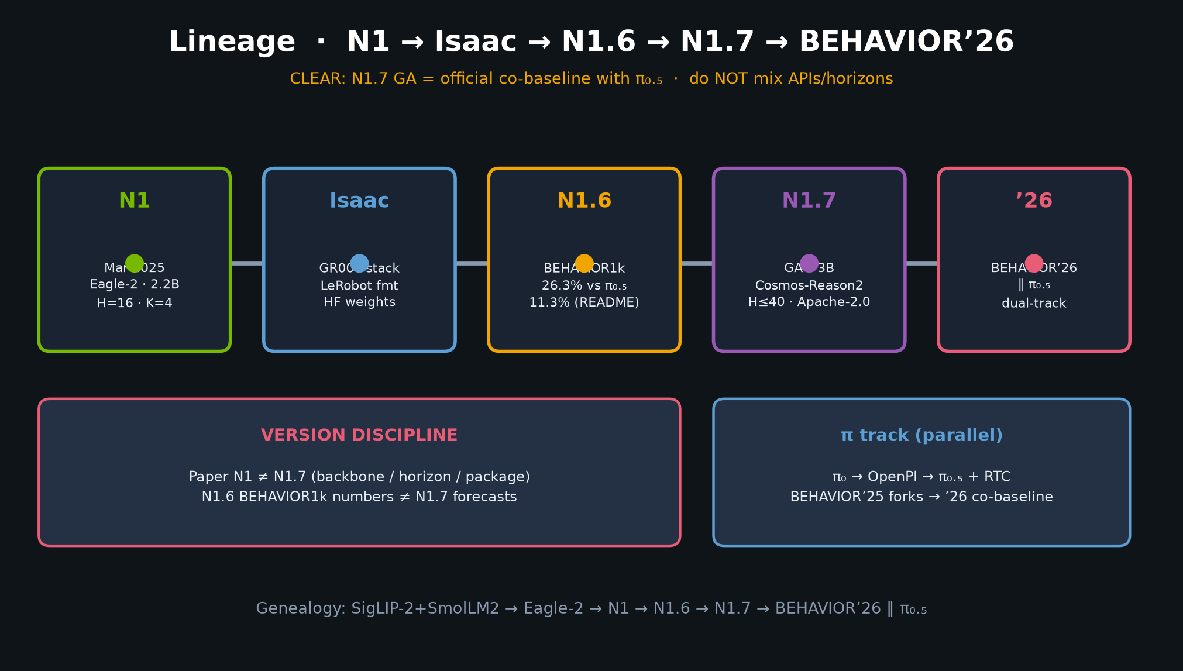
Visionary · 11+3 · 3/14
Notes:
BULLET 1 — N1.7 OFFICIAL SUBSTRATE.
Organizers ship finetune+serve+eval for GR00T N1.7-3B on R1 Pro parallel to π₀.₅.
Visionary default: dual-track every serious entry; pick by held-out scene ablations, not brand loyalty.
Challenge recipe freezes vision+LLM, tunes projector+action head. Accept Cosmos-Reason2 HF gate.
Do NOT treat N1 paper numbers as N1.7 challenge forecasts.

Slide 4
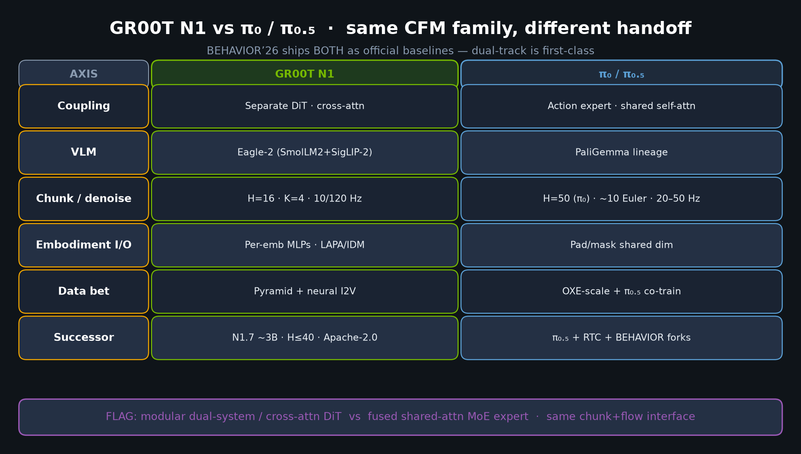
Visionary · 11+3 · 4/14
Notes:
N1 vs π₀/π₀.₅ CONTRAST TABLE — required densest comparison.
Coupling: Separate DiT cross-attn vs action-expert shared self-attn.
VLM: Eagle-2 vs PaliGemma. Chunk: H=16/K=4 vs H=50/~10 Euler.
I/O: per-emb MLPs vs pad/mask. Successor: N1.7 vs π₀.₅+RTC.
FLAG: same CFM chunk family; different reasoning↔motor handoff and data-pyramid bets.
BEHAVIOR’26 ships BOTH — dual-track ablations are first-class.

Slide 5
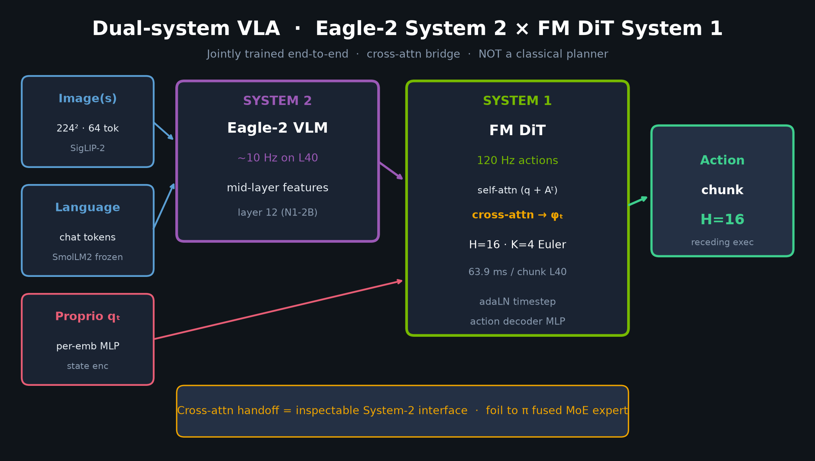
Visionary · 11+3 · 5/14
Notes:
BULLET 2 — EXPLICIT SYSTEM-2 INTERFACE.
GR00T’s mid-layer cross-attn handoff is a natural place for stage memory, safety filters, or tool-use gating.
π₀.₅’s fused expert is denser/faster to train but harder to instrument.
BEHAVIOR’26’s 100 full-length tasks will punish flat short-horizon policies — expect winners to add hierarchy / progress estimators on top of whichever FM head wins the motor layer.
Point at: System 2 (~10 Hz) → cross-attn → System 1 (120 Hz). NOT classical planner.

Slide 6
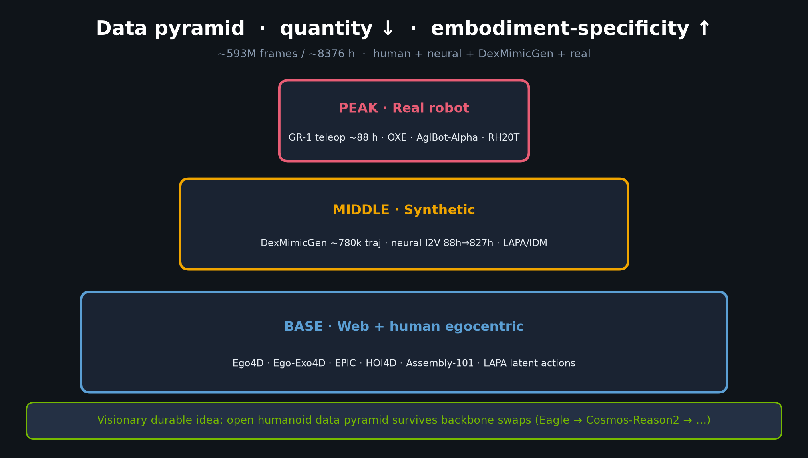
Visionary · 11+3 · 6/14
Notes:
BULLET 3 — PORT NEURAL PYRAMID + RTC HYBRIDS.
N1’s edge narrative is heterogeneous pretrain (human + neural + sim + real). For BEHAVIOR, demo scale + synthetic augmentation matter as much as DiT vs MoE.
π-side 2025 answers: correlated FM noise, multi-sample FM, soft inpainting (RTC / RLC).
High-EV hybrid: GR00T DiT + π-style async chunk execution (RTC).
Point at pyramid apex = real; base = web/human via LAPA.

Slide 7
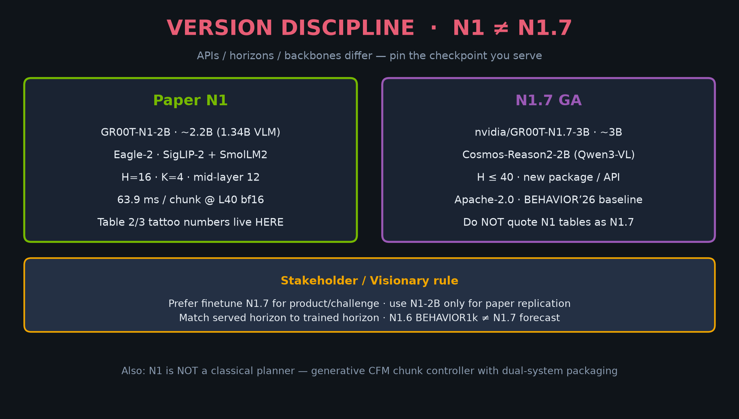
Visionary · 11+3 · 7/14
Notes:
BULLET 4 — VERSION DISCIPLINE CARD.
Paper N1: H=16, Eagle-2, 2.2B. N1.7: H≤40, Cosmos-Reason2, ~3B, new package.
Challenge codepaths must match served horizon to trained horizon.
Do not evaluate N1.6 BEHAVIOR1k numbers as N1.7 forecasts.
Stakeholder alignment: prefer nvidia/GR00T-N1.7-3B for product/challenge; N1-2B for paper replication only.

Slide 8
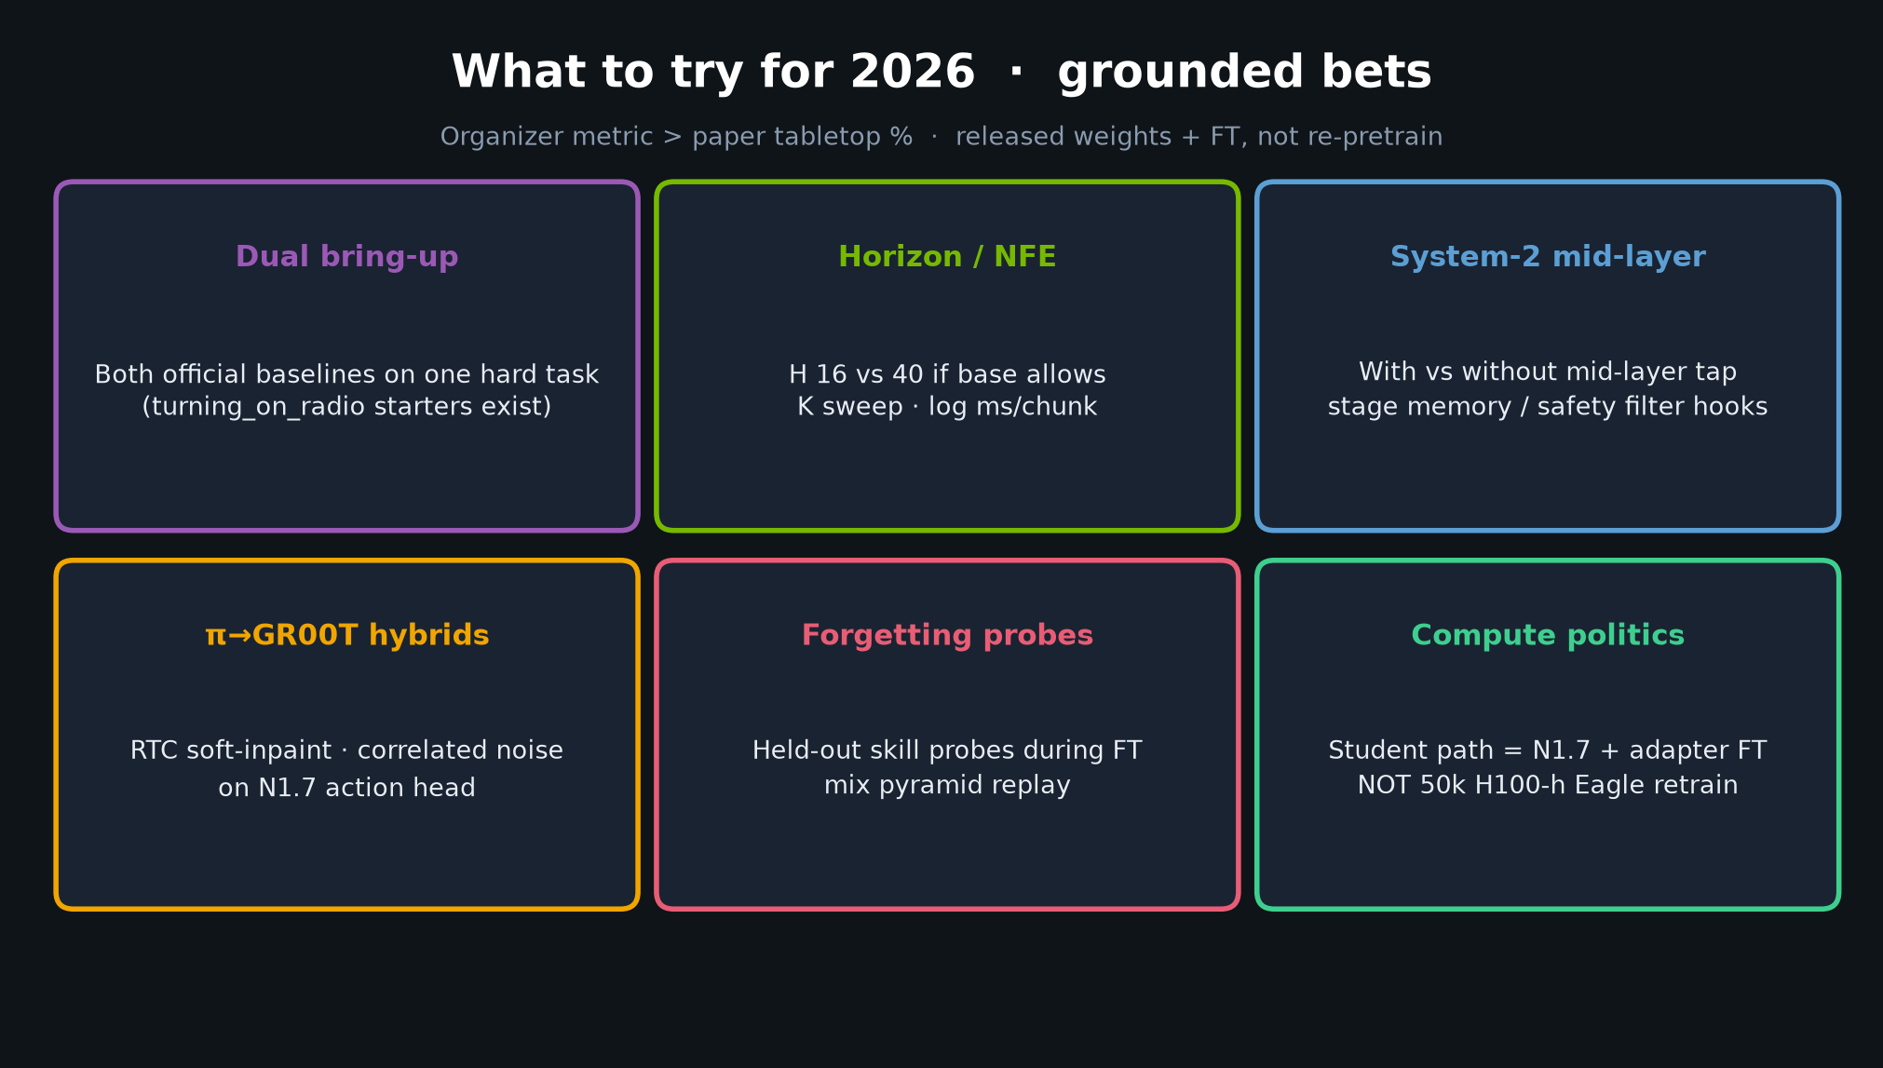
Visionary · 11+3 · 8/14
Notes:
BULLETS 5–6 + BETS — what to try; durable idea.
Try both official starters on hard BEHAVIOR tasks.
Report NFE/horizon; with/without System-2 mid-layer.
Port 2025 π-winner noise/execution tricks onto N1.7 action head.
Watch catastrophic forgetting — mix pyramid replay.
Prefer organizer metric (BDDL partial credit) over paper tabletop %.
DURABLE IDEA: modular VL↔motor coupling + open humanoid data pyramid — backbone will keep swapping; productize the interface.

Slide 9
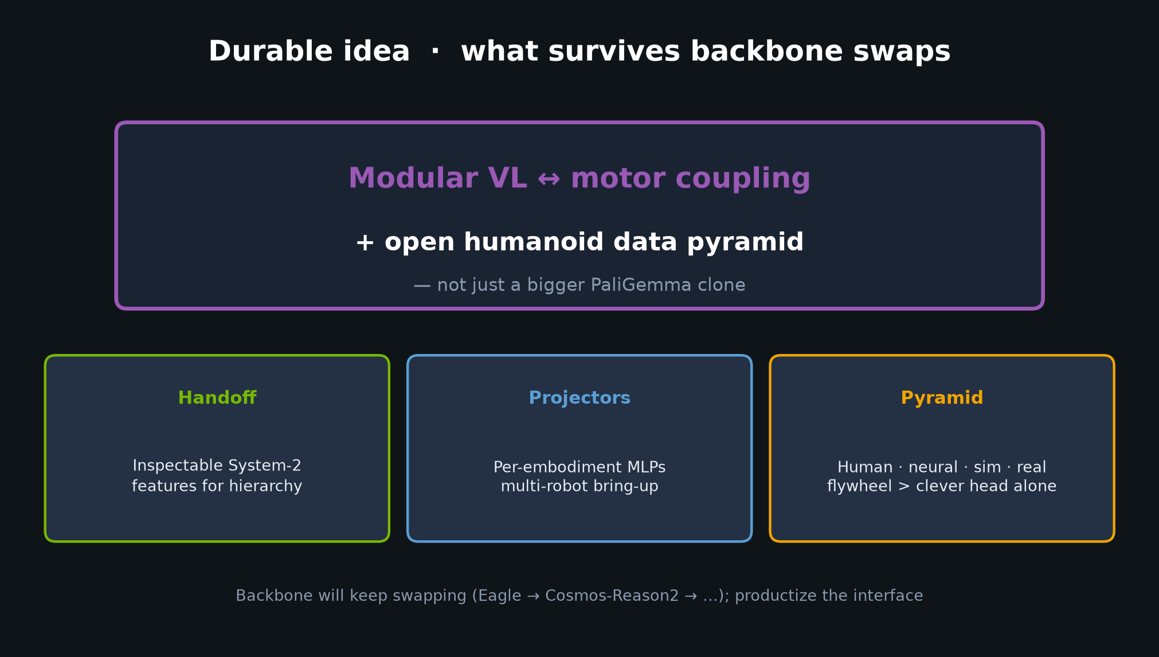
Visionary · 11+3 · 9/14
Notes:
DURABLE IDEA slide — close the six.
Modular VL↔motor + open humanoid data pyramid.
Not just a bigger PaliGemma clone.
Handoff inspectability · embodiment projectors · pyramid flywheel.
One-slide message from DELIVERABLE §9:
Win by post-train data, long-horizon structure, and eval-time control — optionally π_RL-style sim refinement — not by replaying N1’s 50k-GPU-hour pretrain.

Slide 10
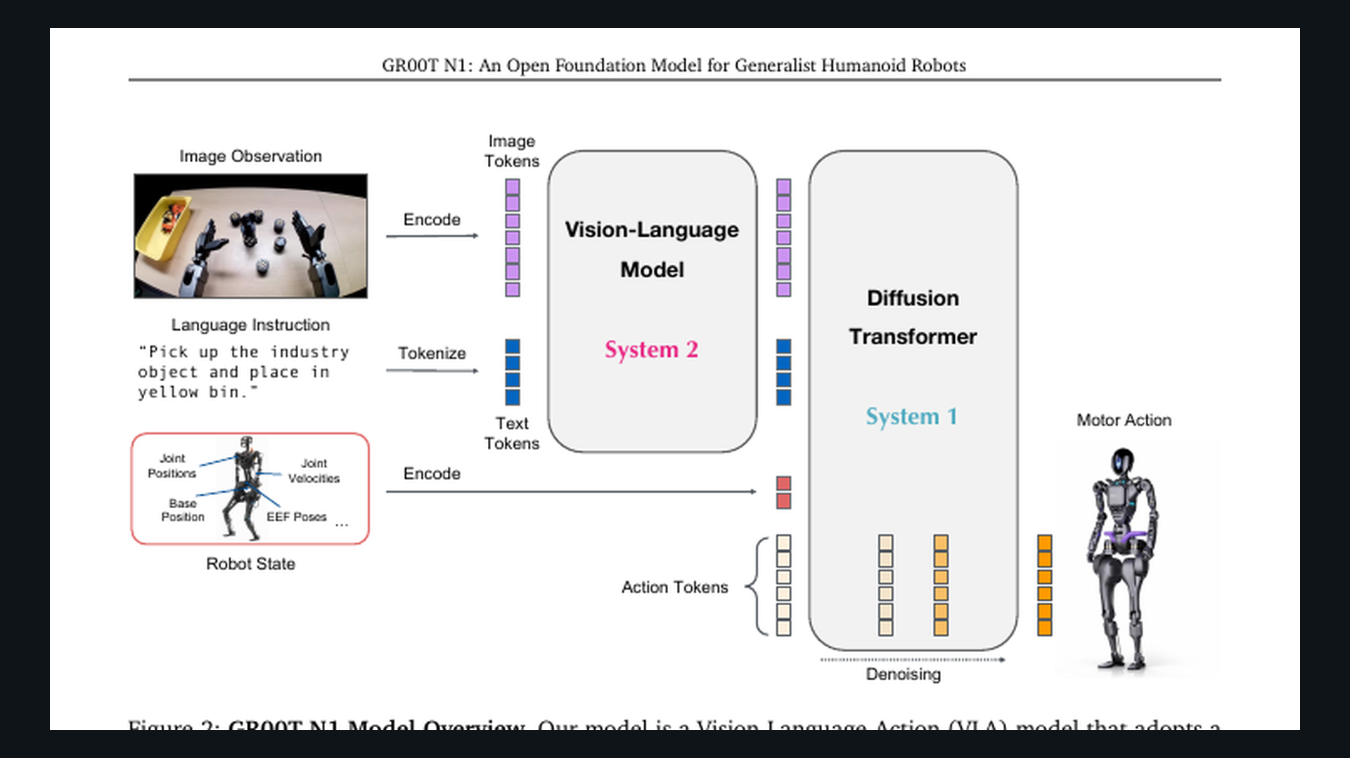
Visionary · 11+3 · 10/14
Notes:
PAPER FIG 2 — dual-system overview crop. Bibliographic visual 30–45s.
Point at VLM System 2 → DiT System 1 → motor actions. Joint training story.

Slide 11
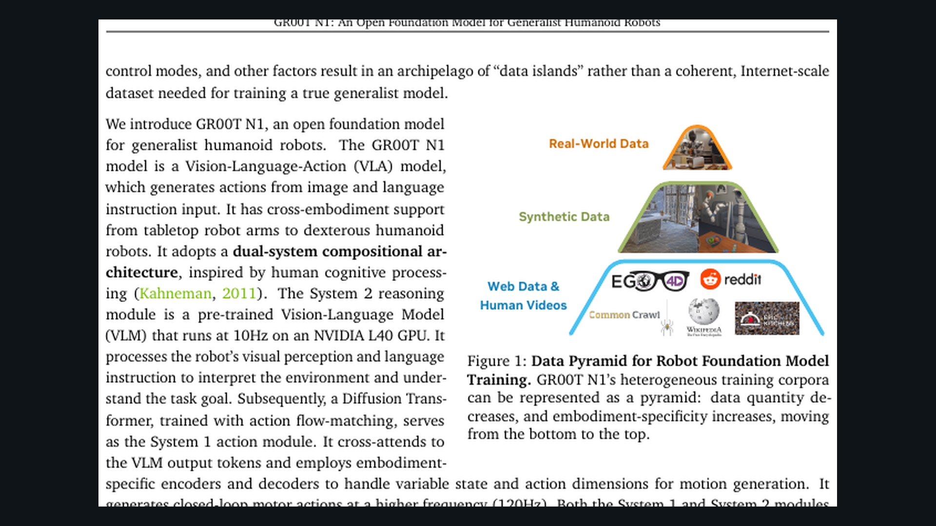
Visionary · 11+3 · 11/14
Notes:
PAPER FIG 1 — data pyramid crop. Supports durable idea + bullet 3.
Quantity decreases / embodiment-specificity increases toward real peak.

Slide 12
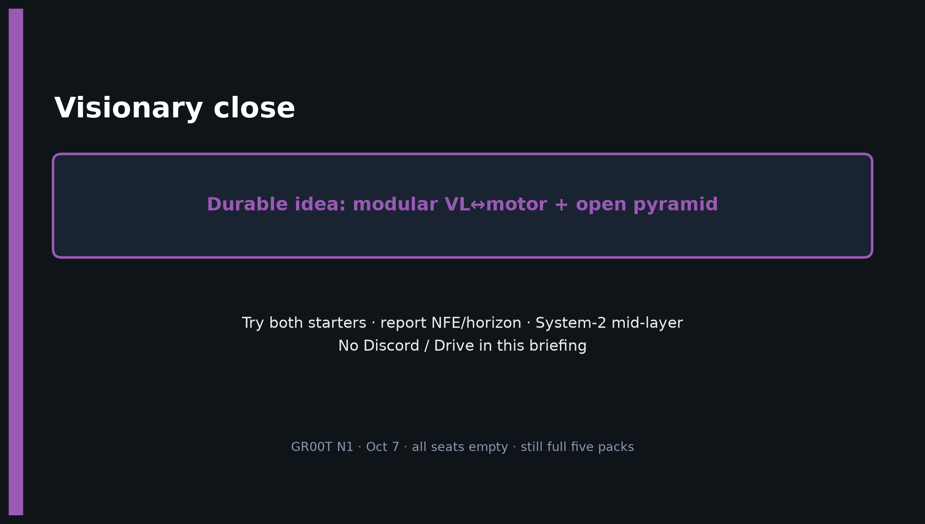
Visionary · 11+3 · 12/14
Notes:
CLOSE — restate durable idea + dual-track + version pin.
Q&A prompts:
• “Which baseline?” → Both; ablate on 2026 split.
• “Is N1 a planner?” → No; generative CFM chunk controller with dual-system packaging.
• “Can we quote Table 2 for N1.7?” → No; version discipline.
No Discord/Drive asks in this briefing.

Slide 13
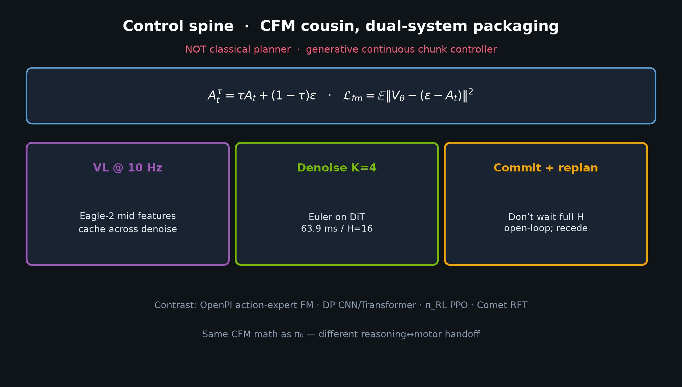
Visionary · 11+3 · 13/14
Notes:
BACKUP — control spine / CFM equation if asked about math kinship with π₀.
Same CFM; different handoff. Receding execution.

Slide 14
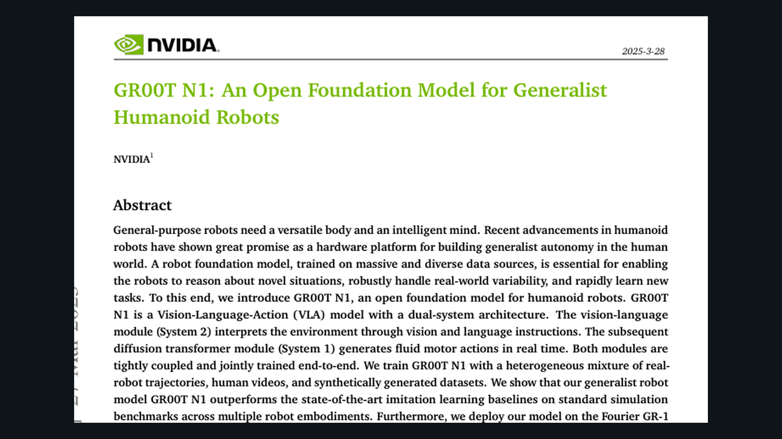
Visionary · 11+3 · 14/14
Notes:
SPARE — paper cover for bibliography / GitHub pack branding.
arXiv 2503.14734 · NVIDIA · Fourier GR-1.

