Slide 1
PIPELINE CPU PROJECT · FINAL DEMO
A 5-stage RISC-V RV32I processor in Verilog
46 encodings, full forwarding, a load-use interlock, branch prediction, and machine-mode interrupts. Verified byte-for-byte against a golden reference model we wrote ourselves, and synthesized for an Artix-7 at 74 MHz.
IF
ID
EX
MEM
WB
bypass network
interlock / stall
flush / killed
free
DESIGN
杨辉宗 1820232064 · microarchitecture, hazard scheme, design document
CODING
吴宏庆 1820232044 · 19 RTL modules, assembler, reference model
TESTING
王伟成 1820232061 · testbenches, trace diffing, performance measurement

Slide 2
THE MACHINE
One 5-stage pipeline, 46 encodings, two bonuses
IF
ID
EX
MEM
WB
46
2
STAGE RESPONSIBILITIES
encodings
bonus features
IF
Fetch from IMEM; BHT lookup indexed by the fetch PC
37 core + 9 system
BHT + interrupts
ID
Decode, immediate generation, register read; jal resolved here (1 bubble)
EX
ALU, branch compare + target, forwarding muxes; branches + jalr resolve here (2 bubbles)
INSTRUCTION SET
R-TYPE
add sub sll slt sltu xor srl sra or and
MEM
Data memory load/store; the BRAM word is registered on the MEM edge
I-ARITH
addi slti sltiu xori ori andi slli srli srai
LOADS/STORES
lb lh lw lbu lhu · sb sh sw
WB
Byte-lane select + extension, then register write-back
BRANCHES
beq bne blt bge bltu bgeu
U + JUMPS
lui auipc jal jalr
SYSTEM
ecall ebreak csr* mret
The shallowest design that still exposes all three hazard classes — which is the point of the exercise.

Slide 3
HAZARDS
Three mechanisms, one rule each
FORWARD
STALL
FLUSH
EX/MEM and MEM/WB results route straight back to the ALU inputs — no stall for a data hazard.
A load feeding the very next instruction is the one case forwarding cannot save.
A taken branch or trap squashes the younger instructions already in the pipe.
EX/MEM wins over MEM/WB · x0 never forwarded · store data forwarded too
load-use interlock · freeze PC + IF/ID · one bubble into ID/EX
jal = 1 bubble · branch / jalr / trap / mret = 2 bubbles · killed insns never retire
Everything above CPI 1.0 is control-flow bubbles and load-use stalls. There is no other source of delay.

Slide 4
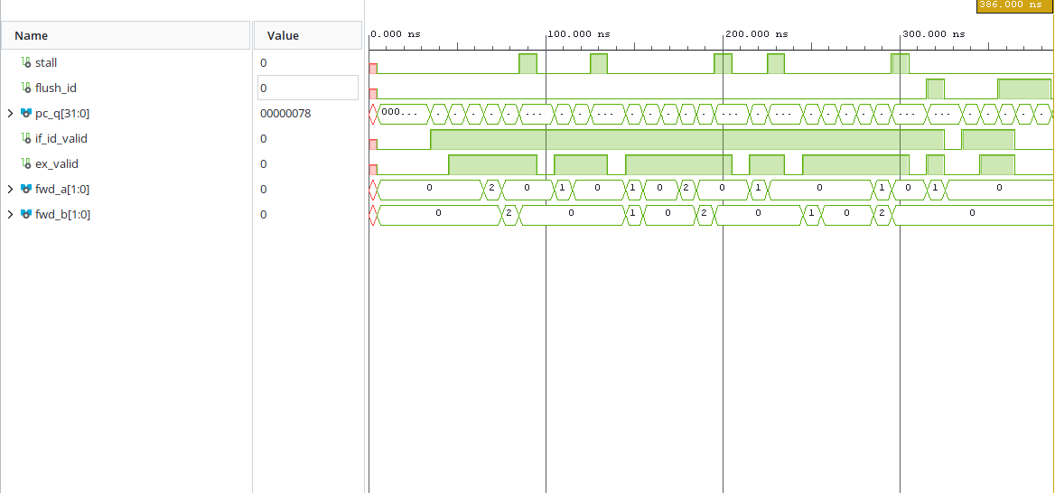
DEMO
The machine in simulation
WHAT TO POINT AT
STALL
stall high for exactly one cycle; PC and IF/ID hold their value
FORWARD
fwd_a switches to the MEM/WB path the cycle after the stall
FLUSH
both flush signals assert; the trace valid never fires for a killed insn
pc_q · stall · flush_id · fwd_a — the three hazards, live
Function is shown in simulation, not asserted — every test states its own PASS or FAIL verdict.

Slide 5
VERIFICATION
Green against an independent model, not our own expectations
RESULTS — ALL FOUR FORWARDING × BHT CONFIGURATIONS
WHY A TRACE DIFF
Per-instruction
one program per encoding, golden state
46 / 46
A final-state check tells you the answer is wrong. A commit-trace diff tells you which instruction went wrong — the difference between an afternoon of debugging and a week.
Hazard
forwarding, load-use, flush, CSR
9 / 9
Program-level
fib, bsort, bloop, bpred, irq — trace diff vs ISS
5 / 5
TESTS ARE TRUSTED, NOT JUST PASSING
Unit testbenches
imm_gen, ALU, regfile, control, BHT…
11 / 11
Every expected value is generated by the reference model, and we injected deliberate bugs to confirm each testbench fails when it should.
Toolchain self-check
assembler vs reference model
4,323
Correctness rests on EX-stage resolution + flush — the predictor only changes when instructions are fetched, never what they compute.

Slide 6
PERFORMANCE
Every figure carries its own baseline
FORWARDING ON VS OFF — SAME PROGRAMS
95.5%
−14.5%
Program
CPI fwd on
CPI fwd off
Speedup
fib
1.368
2.263
1.65×
BHT accuracy
cycles saved
bsort
1.376
1.904
1.38×
branch-heavy demo
same program
bloop
1.396
1.707
1.22×
THE HONEST PART
average
1.387
1.837
1.32×
A 2-bit table helps loop-dominated code (fib 93.4%), and hurts on alternating branches (49.9%, +10%). We report the case where it loses.
A feature is switched off and the same programs re-run — the 'show performance' requirement, not a number with no baseline.
The BHT is a cheap heuristic, not a guarantee — and saying so is more useful than hiding the case where it loses.

Slide 7
BONUS FEATURES
Two shipped, one deliberately cut
INTERRUPTS — CSRS + MRET
THE TRAP ASYMMETRY
CSRS
mstatus (MIE/MPIE) · mie · mtvec · mepc · mcause
ecall leaves mepc at the ecall itself — the handler adds 4 before mret. An interrupt leaves mepc at an instruction that never ran, so the handler must not. Get this wrong and the handler loops forever.
INSNS
csrrw csrrs csrrc + immediate forms · mret
DEMO
testbench-driven irq → timer-like ISR saves regs, toggles a counter, returns via mret
I-CACHE — DESIGNED, NOT BUILT
Direct-mapped 128 × 16 B (2 KB) — but the whole suite fits in 2 KB, so the hit rate would read ~99% on every program. A figure that reads 99% proves nothing.
RESULT
21 assertions PASS · 633/633 trace lines match the ISS · irq held while MIE=0
Both bonuses are switchable off — a feature that cannot be disabled cannot be measured.

Slide 8
SYNTHESIS
74 MHz on an Artix-7, with the path that limits it
74 MHz
1,461
819
2
setup met
LUTs
flip-flops
BRAMs
13.5 ns · WNS +0.052
post-route
post-route
IMEM + DMEM
CRITICAL PATH — THE LOAD-TO-BRANCH CHAIN
DMEM block-RAM clock-to-output (2.454 ns, the largest single term) → byte-lane select + sign extension in WB → the MEM/WB→EX forwarding mux → branch comparator → redirect into the PC clock-enable.
A 16-instruction minimum; we shipped 46, verified byte-for-byte, synthesized at 74 MHz — with both bonuses green. Thank you.

