Slide 1
OTTO Overview
Open Trust Taxonomy for Federation Operators
Kantara OTTO Working Group
Michael Schwartz, co-chair
Janusz Ulanowski, co-chair

Slide 2
Design Goals
Facilitate publication of federation data for multiple technologies
SAML
OAuth
PKI
UMA
Other services
Define interoperable API’s that empower fine-grain discovery
Participants (request metadata from one or more participants)
Roles (search for specific entities, types of entities, or categories of entities)
Schema: user attributes, authentication mechanisms
Security policies and procedures: i.e. trust marks, software statements
Create an architecture for inter-federation that avoids duplication of data

Slide 3
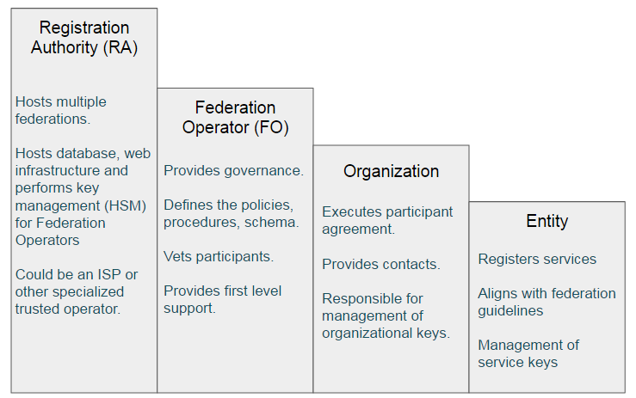

Slide 4
JSON-LD data model
Linked data model convenient for describing federation inter-relationships.
Uses standard schema described in https://schema.org where possible; extend common schema at Kantara; provides for further extension by RA’s or FO’s.
Can be converted to RDF and processed by standard tools.
Developer friends—looks like JSON, and linked data features can be ignored by those who don’t care.
Consistent with new design being developed by W3C verifiable claims task group.
See https://www.w3.org/TR/json-ld/#basic-concepts

Slide 5
API’s
Endpoints
Federation
Federation entity
Organization
Discovery / Configuration

Slide 6
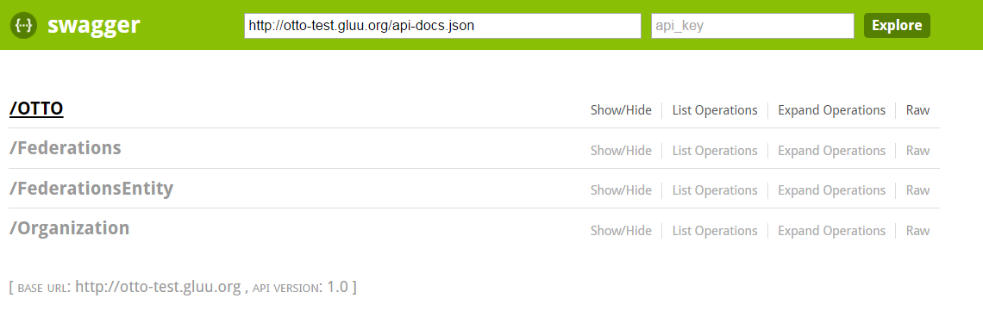
Test Implementation
Server was written to demonstrate feasibility
MongoDB was used as the backend—loose schema
Performance was tested with 10,000 entries
Query and filter features seem to scale
MIT license

Slide 7
OpenID Connect federation draft?
Complimentary
OIDC spec doesn’t say:
How organizations register
How federation metadata is distributed
How key metadata is updated (i.e. revocation)
OIDC spec puts a big burden of key management on the organizations
OTTO federations provide perhaps a centralized solution
http://openid.net/specs/openid-connect-federation-1_0.html

Slide 8
Next steps
Need to finalize JSON-LD schema
Organizations
SAML, OpenID, UMA Entities
Software statements
Trustmarks
User schema (i.e. eduperson)
Authentication: ACR / AMR
Need to convert technical spec to English with good examples
Need writers!
Kantara / Rutgers / DHS ERASMUS pilot will use OTTO—real world test.

Slide 9
Links
Join the WG: http://www.gluu.co/join-otto
Github Project: https://github.com/KantaraInitiative/wg-otto
Test code: https://github.com/GluuFederation/otto-node
Swagger UI for test code: http://otto-test.gluu.org/swagger/
OTTO test data generator: http://otto-test.gluu.org:8080/

