Slide 1
OTTO Overview
Open Trust Taxonomy for Federation Operators
Kantara OTTO Working Group
Michael Schwartz, co-chair
Janusz Ulanowski, co-chair

Slide 2
Design Goals
Facilitate publication of federation data for multiple technologies
SAML
OAuth,
PKI
Other services
Define interoperable API’s that empower fine-grain discovery
Participants (request metadata from one or more participants)
Roles (search for specific entities, types of entities, or categories of entities)
Schema: user attributes, acr, amr
Security Policies and procedures: i.e. trust marks, software statements
Create an architecture for inter-federation that avoids duplication of data

Slide 3
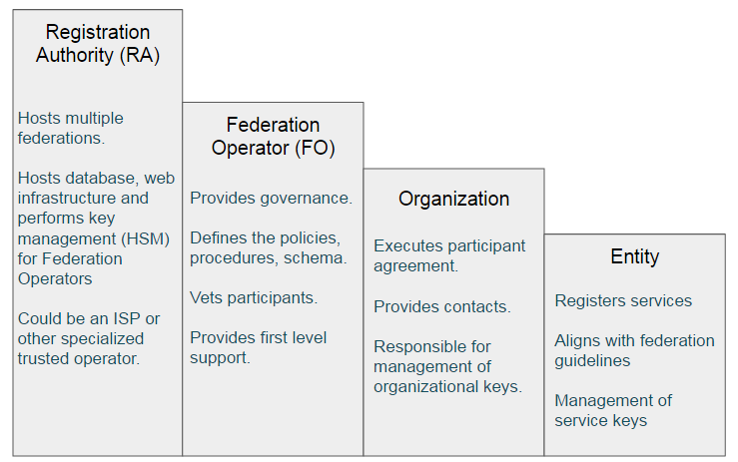

Slide 4
JSON-LD data model
Linked data model convenient for describing federation inter-relationships.
Uses standard schema described in https://schema.org where possible; extend common schema at Kantara; provides for further extension by RA’s or FO’s.
Can be converted to RDF and processed by standard tools.
Developer friends—looks like JSON, and linked data features can be ignored by those who don’t care.
Consistent with new design being developed by W3C verifiable claims task group.
See https://www.w3.org/TR/json-ld/#basic-concepts

Slide 5
Federation endpoint

Slide 6
Federation entity endpoint

Slide 7
Organization Endpoint

Slide 8
Discovery Endpoints

Slide 9
Parameter: depth
Specify which objects you want to return
GET /federations/1234?depth=federations.organization
Only return organization entities

Slide 10
Paramater: filter
Using JSPath query syntax: https://github.com/dfilatov/jspath
GET /federations?filter=.entities{.name=“MyWebsite”}
Only return entity with this name…

Slide 11
Parameter: sign
Sign either a complete or partial result set
GET /federations/1234/sign=true&alg=RS512
Return signed JWT …

Slide 12
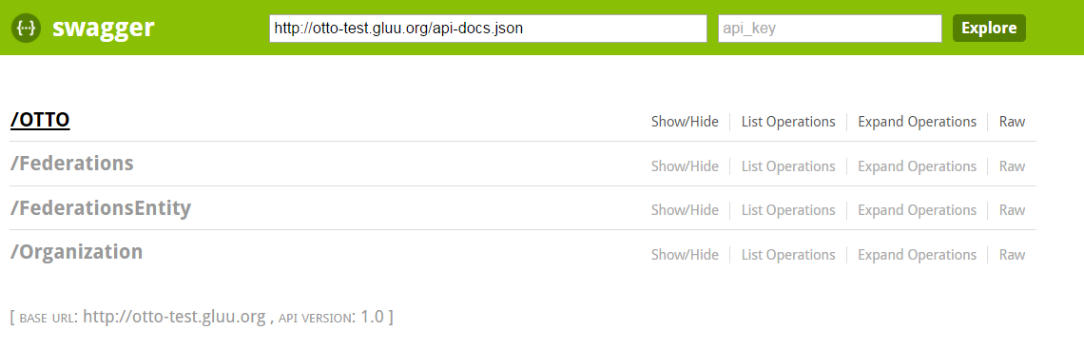
Test Implementation
Server was written to demonstrate feasibility
MongoDB was used as the backend—loose schema
Performance was tested with 10,000 entries
Query and filter features seem to scale
MIT license

Slide 13
Next steps
Need to finalize schema – both keys and values
Organizations
SAML, OpenID, UMA Entities
Software statements
Trustmarks
User schema (eduperson)
ACR / AMRs
Need to convert technical spec to English with good examples
Need writers!
Need to pilot

Slide 14
What about OpenID Connect federation draft?
Complimentary
OTTO would facilitate the creation of federations such as the kind imagined by the OIDC federation spec.
OIDC spec doesn’t say where|how the federation publishes its keys
It also doesn’t address issues beyond OpenID Connect
It has no automated discovery capabilities – for example how would the federation publish information about supported schema or trustmarks?

Slide 15
Links
Join the WG: http://www.gluu.co/join-otto
Github Project: https://github.com/KantaraInitiative/wg-otto
Test code: https://github.com/GluuFederation/otto-node
Swagger UI for test code: http://otto-test.gluu.org/swagger/
OTTO test data generator: http://otto-test.gluu.org:8080/

