Slide 1



SINGLESTOP APPLICATION
1

Slide 2
SINGLESTOP APPLICATION
Performs CRUD operations in the front end
The data at the backend can be viewed and edited by a single click on
Linter to analyze source code to flag potential error, its report is shown at the front end.
Enables automated SQL queries to execute aggregate functions/ analytical functions
2

Slide 3


Functionalities
Offers the simplest structure to organize data and it is easy for the users to understand and navigate.
Instead of a single table, the information is de-normalized into smaller tables with the entities related to each other.
It is easy to retrieve data by using multiple joins on tables.
The tables are assembled with each field itself clearly defined.
3

Slide 4
DATA MODEL
A data model provides a clear picture of the base data which is used to create the physical database
Data is organized into facts and dimensions
The data model includes all the details organized into convenient and efficient forms
Star schema model is used to provide a subject oriented design as data is stored according to its logical relationships.
4

Slide 5
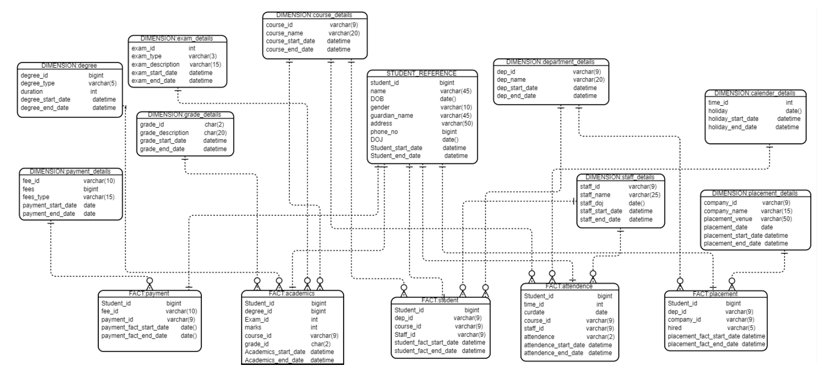
STUDENT DATA MODEL
5

Slide 6
1. To retrieve details of the student who paid for arrears select d.student_id,… from fact_academics f join details_main d on d.student_id=f.student_id join fact_payment fp on d.student_id = fp.student_id join dimension_course_details c on f.course_id = c.course_id join dimension_exam_details e on e.exam_id = f.exam_id where f.grade_id=(select grade_id from dimension_grade_details where grade_description = 'FAIL') and f.exam_id not in (select exam_id from dimension_exam_details where exam_type = 'L' or exam_type ='LI' ) and FEE_ID = (SELECT fee_id from dimension_payment_details where fees_type='ARREAR FEE’);
ANALYTICAL QUERIES
6

Slide 7
ANALYTICAL QUERIES
2. Student who has got elective from another department select… from fact_student f join details_main… join fact_academics…
join dimension_course_details c1… join dimension_department_details d1… where substr(f.dep_id,1,2) <> substr(f.course_id,1,2) and f1.degree_id <> (select degree_id from dimension_degree_details where degree_type='MBA’);
3. Staff details who teaches in multiple departments
Select… from fact_student f
join details_main… join fact_academics…
join dimension_course_details…
join dimension_department_details d1…
join dimension_staff_details s…
join dimension_department_details d2 on substr(f.staff_id,1,2) = substr(d2.dep_id,1,2)
where substr(f.dep_id,1,2) <> substr(f.course_id,1,2)
and f1.degree_id <> (select degree_id from dimension_degree_details where degree_type='MBA')
group by s.staff_id;
7

Slide 8





CONTROL FLOW DIAGRAM
USER
ANGULAR
API
MySql
PYTHON
8

Slide 9
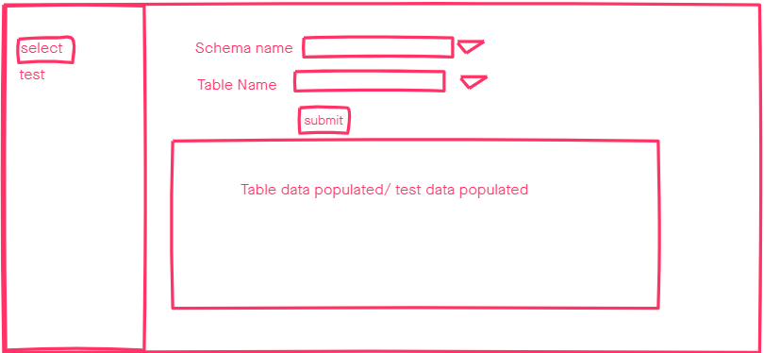
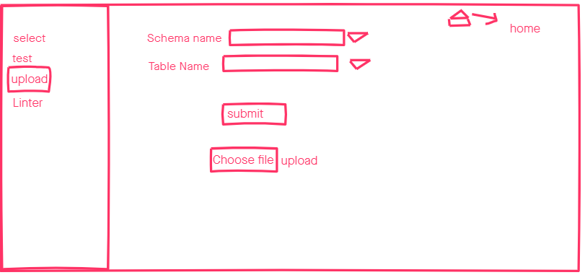
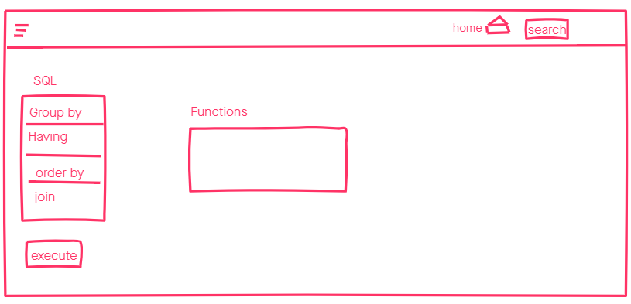
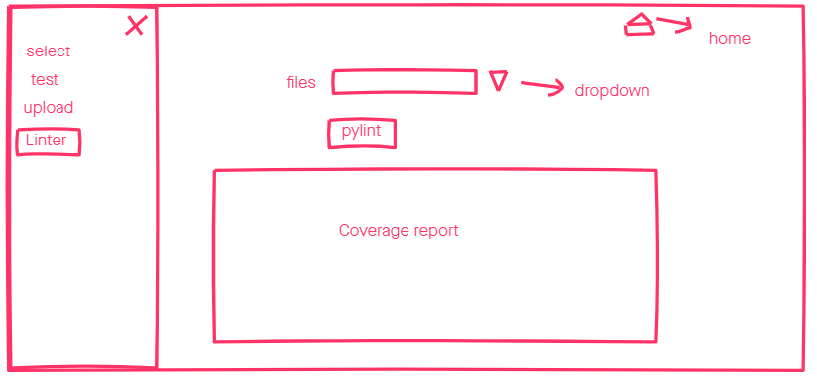
WIRE FRAME
(a)
(b)
(d)
(c)
9

Slide 10
Enhancements
The number of tests executed for a table will not be the total tests performed
Including additional functionalities
Making it possible to perform multiple joins together.
Additional validations can be included if required.
ENHANCEMENTS
10

