Slide 1
DES423 · PREDICTIVE MODELING PITCH
SessionSignal
Can browsing behavior tell us which shopping sessions will end in a purchase?
UCI Online Shoppers Purchasing Intention · 12,330 sessions · live demonstration · 7-member team

Slide 2
PROBLEM IMPORTANCE
Lost sessions are a large, persistent cost
$6.42T
70.22%
84.5%
global retail ecommerce sales in 2025 — 20.5% of all retail
average documented cart abandonment, 50 studies 2006–2025
of sessions in our dataset ended without a purchase
Abandonment has sat near 70% for two decades, so this is a structural gap, not a temporary dip. At a $6.42 trillion market scale, even small conversion gains are commercially significant.
No store can hand-review every lost session. Analyst attention is the scarce resource — and that is what we target.
Sources: eMarketer 2025 forecast; Baymard Institute (unweighted average of 50 studies, range 55%–84%); UCI dataset 468. Cart abandonment and session non-purchase are related but different measures.

Slide 3
PROBLEM STATEMENT
Which lost sessions deserve attention first?
User: an ecommerce conversion analyst.
Situation: thousands of sessions end without a purchase; only a handful can ever be investigated.
Question: which ones should the team examine first?
How we measure success
Concentrate real buyers into the top-scored slice. Our primary metric is average precision, because only 15.5% of sessions convert — plain accuracy would reward always predicting “no purchase”.
Objective: rank completed sessions by purchase probability, using browsing behavior alone.
Explicitly out of scope
Why a shopper left · guaranteed revenue recovery · real-time intervention mid-session.

Slide 4
DATASET AND TARGET
One row = one shopping session
12,330
17
15.5%
historical sessions
input features in the original data
ended in a purchase
Predict: Revenue = purchase or no purchase.
Inputs: page counts and time on page, analytics rates, visitor type, month, device and traffic categories.
Source: UCI Machine Learning Repository, dataset 468 — Online Shoppers Purchasing Intention.

Slide 5
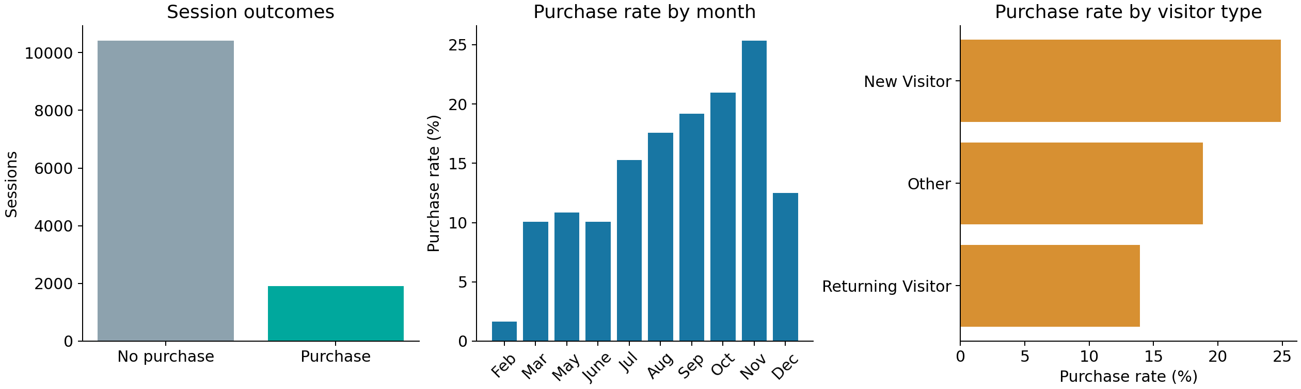
EXPLORATORY ANALYSIS
Purchases vary by month and visitor type
New visitors purchased in 24.9% of sessions versus 13.9% for returning visitors. November reached 25.4%; February was 1.6%.
Calculated from the supplied UCI CSV. These are associations, not causal effects. Month groups have different sample sizes.

Slide 6
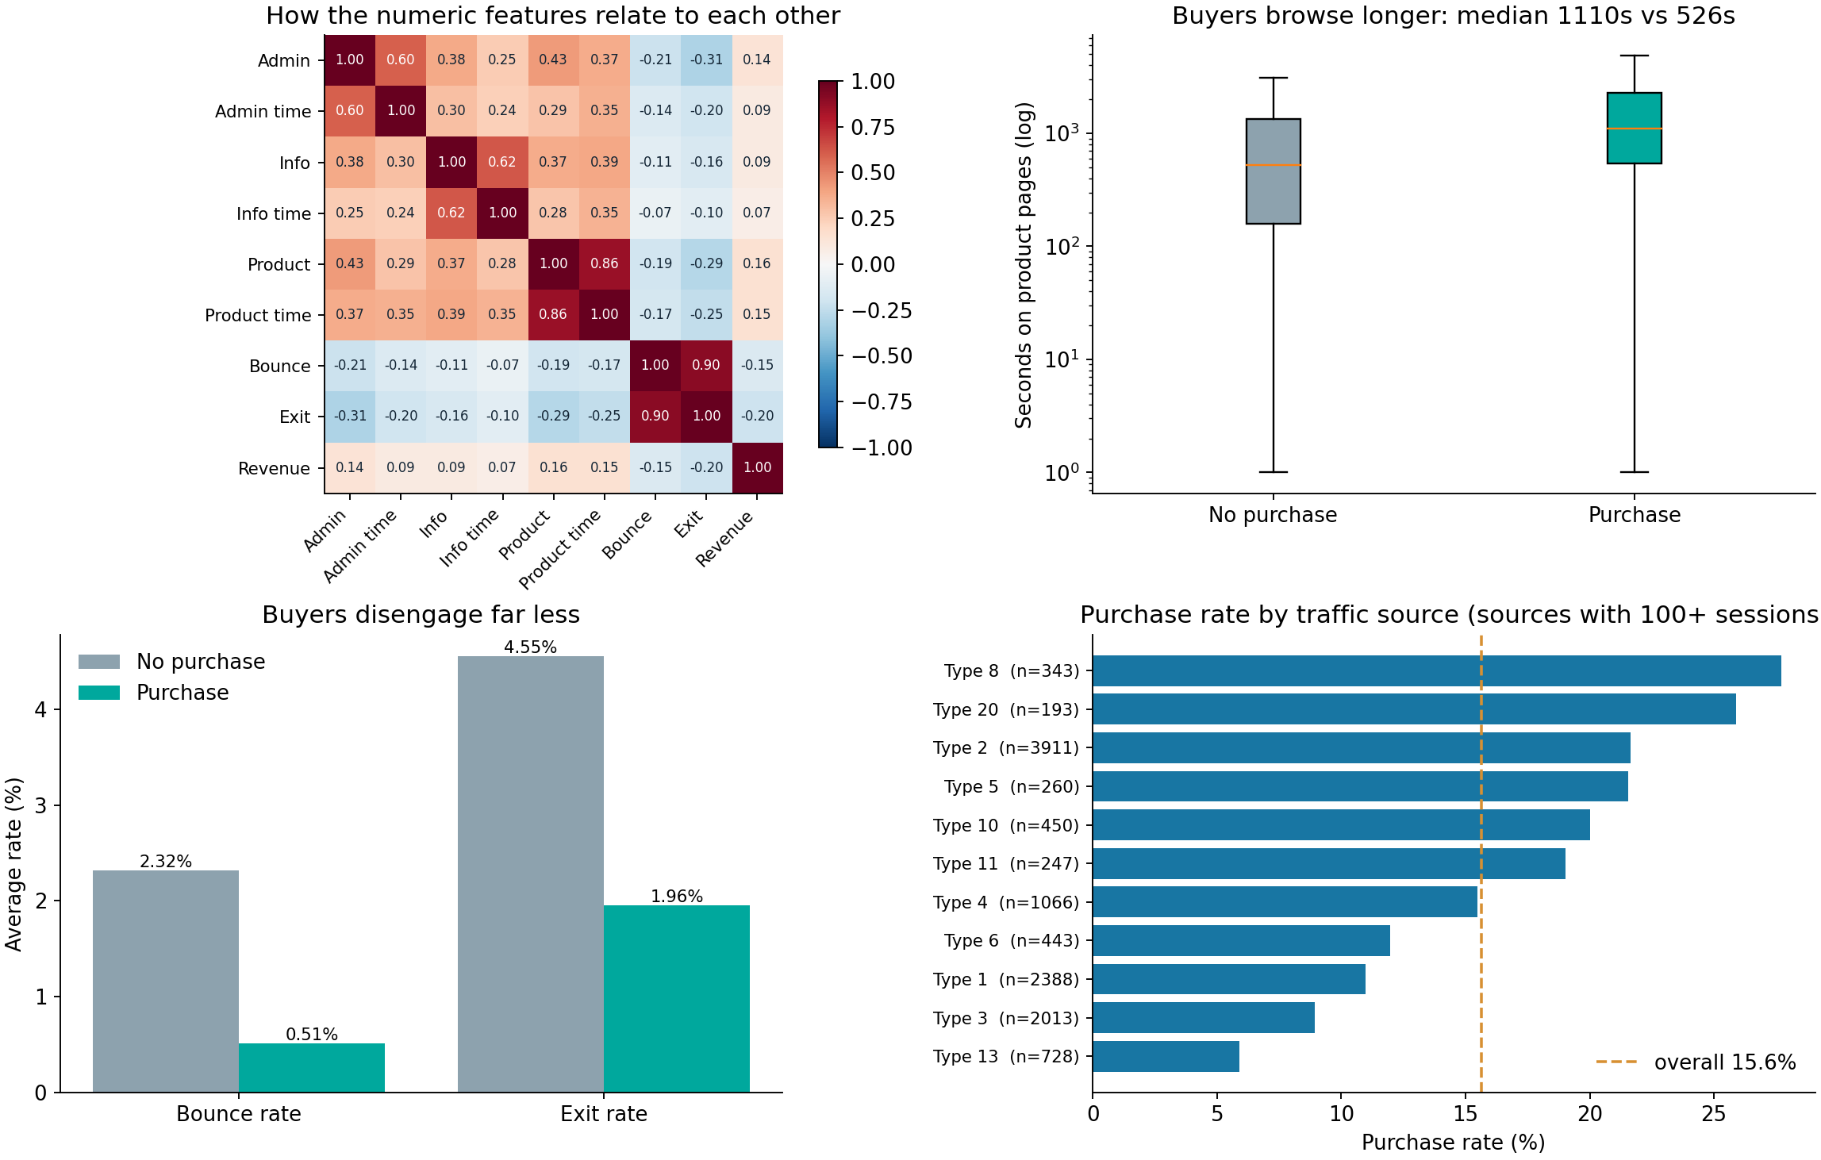
EXPLORATORY ANALYSIS
Buyers behave measurably differently
Buyers spend about twice as long on product pages (median 1,110s vs 526s) and disengage far less (exit rate 1.96% vs 4.55%). Exit rate is the numeric feature most related to buying (r = −0.20).
Computed from the 12,205 cleaned sessions. Associations, not causes. Traffic sources shown have 100+ sessions.

Slide 7
EVALUATION DESIGN
Keep the test set unseen until the end
01
Remove 125 exact duplicate rows
02
Exclude PageValues, a revenue-derived analytics feature
03
Stratified 80/20 split: 9,764 train and 2,441 test sessions
04
Four-fold cross-validation and tuning on training data only
Primary measure: average precision (AP), because purchases are uncommon.
We measured what step 02 costs: keeping PageValues would lift AP from 0.374 to 0.723. It is computed from revenue, so we treat that as leakage, not an achievement.

Slide 8
MODELS
Models for purchase classification
Logistic regression
Combines feature values into a linear score. Class weighting gives rare purchases more influence during training.
Random forest
Averages predictions from many decision trees to capture nonlinear patterns and interactions.
Gradient boosting
Adds trees sequentially to improve earlier predictions. The main pipeline uses histogram gradient boosting.
No-purchase baseline
Predicts no purchase for every session. Its high accuracy shows why purchase recall also matters.

Slide 9
PYCARET CLASSIFICATION
The same question, asked across 14 models
Low-code workflow
Same cleaned CSV, same excluded PageValues.
Top of the leaderboard (CV AUC)
Model | AUC | Recall
LightGBM | 0.7732 | 14.9%
Gradient boosting | 0.7641 | 12.8%
Random forest | 0.7495 | 12.1%
Dummy baseline | 0.5000 | 0.0%
1
setup — 80/20 split, four folds, fix_imbalance=True
2
compare_models — PyCaret's full classifier list
3
tune_model → predict_model on its own holdout
Best PyCaret AUC 0.773 against our scikit-learn 0.787. Two toolchains, one conclusion: no model pulls clearly ahead.
Saved run: artifacts/pycaret_leaderboard.csv (all 14 models). PyCaret uses its own split and preprocessing, so read it alongside — not merged into — the main results.

Slide 10
HELD-OUT RESULTS
Read the intervals, not the ranking
No-purchase baseline
0.156
0.142–0.171
Logistic regression
0.331
0.292–0.375
Random forest
0.372
0.330–0.420
Gradient boosting
0.370
0.330–0.419
Forest, tuned
0.374
0.335–0.423
The tuned forest leads by +0.0028 — 95% CI −0.008 to +0.014, winning only 68% of 2,000 bootstrap resamples. The interval crosses zero.
So we do not claim a winner. Every real model beats the baseline decisively; between themselves they are statistically indistinguishable.
Average precision on the same untouched 2,441-session test set; 95% intervals from 2,000 bootstrap resamples.

Slide 11
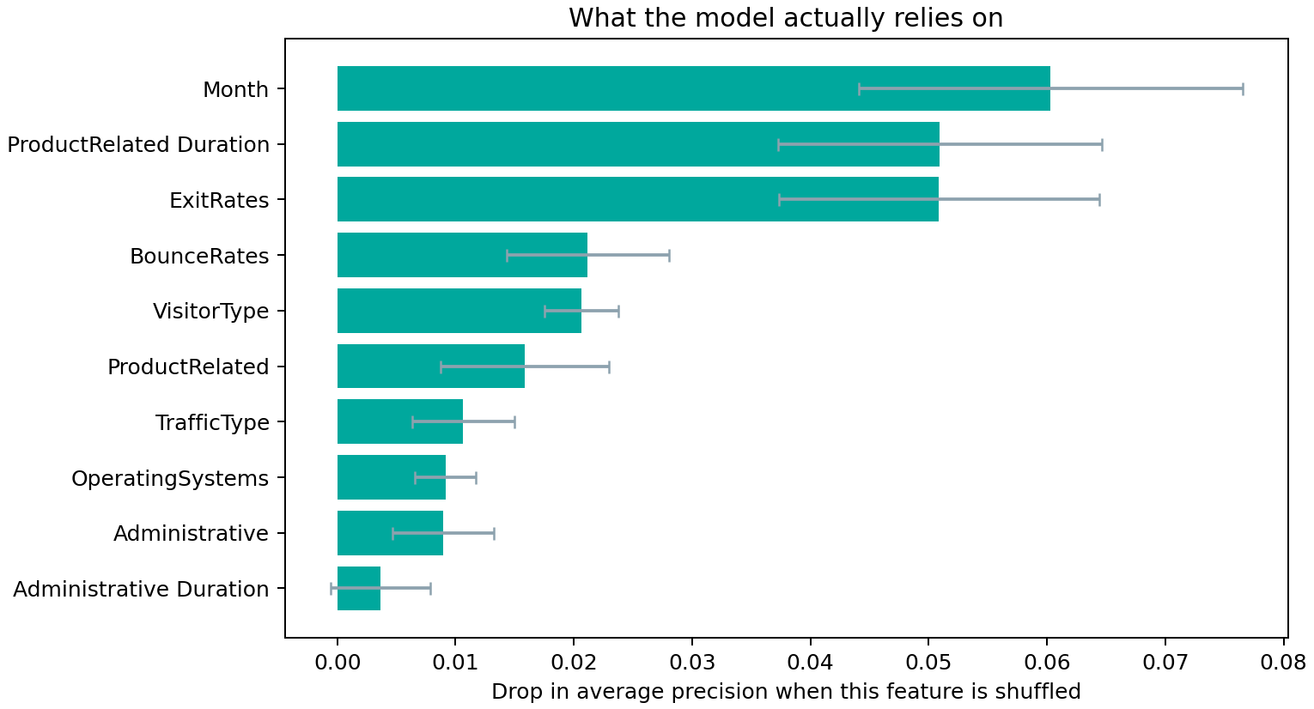
INTERPRETATION
What is the model actually using?
Drop in AP when shuffled
Feature | Impact
Month | −0.060
ProductRelated Duration | −0.051
ExitRates | −0.051
BounceRates | −0.021
VisitorType | −0.021
The top feature is Month — not a behaviour. The model has partly learned the seasonality of one store in one year.
That is a limitation we found by checking, and it is exactly why validation on a later time period is our first next step.
Permutation importance on the held-out set, 10 repeats, measured in average precision.

Slide 12
IMPROVEMENT
The threshold mattered more than the hyperparameters
Operating point | Precision | Recall | F1
0.500 — the default | 37.1% | 46.3% | 0.412
0.446 — best F1 | 34.5% | 62.3% | 0.444
0.607 — review top 10% | 43.7% | 28.0% | —
Grid-searching hyperparameters moved average precision by +0.002 — noise, as the intervals showed.
Moving the decision threshold lifted recall from 46.3% to 62.3% and F1 from 0.412 to 0.444, for free.
Thresholds were selected on the test set and would need a separate validation split before operational use.

Slide 13
SOLUTION
From a score to a worklist
1
Score every completed session.
Measured on the holdout
25
2
Rank them and take as many as the team can review.
real buyers found in the top 50 sessions, against 8 expected at random — 3.2×
Those 50 also contain 25 high-intent sessions that bought nothing. That list is the product.
Steps 1–3 run in the app today. Step 4 needs journey logs and an experiment.
3
Pull out the high scorers that did not buy.
4
Investigate those, form one hypothesis, A/B test it.
From artifacts/scored_sessions.csv: all 2,441 held-out sessions, scored once by the chosen model.

Slide 14
LIVE DEMONSTRATION
Two minutes, two screens
Score a session — held-out visitors the model never saw
#27 → 68% · bought ✓ #9 → 1% · did not buy ✓
#8 → 64% · did NOT buy ← investigate
Find lost sales — rank all 2,441 and open the worklist
Visitor #8 browsed 38 product pages over 64 minutes and never bounced — then left with nothing. That is the session an analyst should open first.

Slide 15
NEXT STEPS
Make the model more trustworthy
• Collect timestamped partial sessions for genuine live prediction.
• Validate on a later time period and another store.
• Check calibration, subgroup performance, and false positives.
• Choose an action threshold based on cost and capacity.
• Run an A/B test before claiming sales impact.

Slide 16
TEAM AND CONTRIBUTIONS
Who did what
Student ID | Name | Main contribution
6622782298 | Sirawich Narakulsookpipat | Problem research and framing
6622780342 | Chaitawat Boonkitticharoen | Dataset audit and target definition
6622782215 | Bhuchi Kumprakob | Exploratory data analysis
6622780276 | Nonthaphat Chuathong | Evaluation design and model selection
6622770657 | Kamin Sirisuwapong | PyCaret comparison and hyperparameter tuning
6622772455 | Poonnawit Wongprateepwilai | Results analysis and business solution
6622790267 | Choltawat Jullakasevi | Streamlit app, demonstration and limitations
Every member presents their own section.

Slide 17
TAKEAWAY
We can rank purchase intent.
We still need to test the intervention.
The tuned forest improves AP from 0.156 to 0.374 on held-out sessions.
Sirawich · Chaitawat · Bhuchi · Nonthaphat · Kamin · Poonnawit · Choltawat

