Slide 1
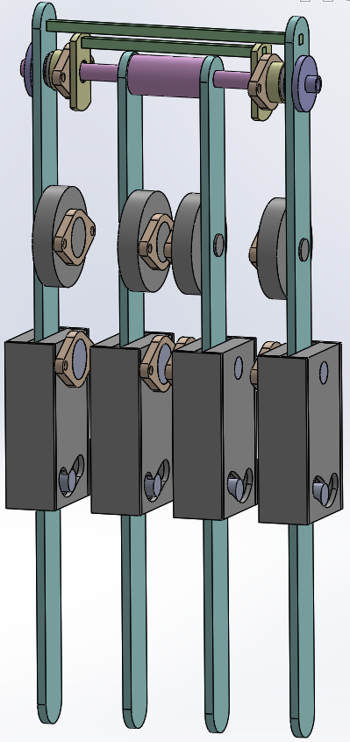
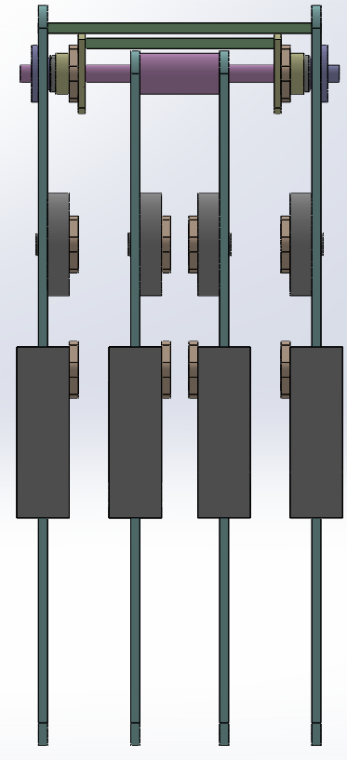
Femoral motors mount
Knee motors Τ-motor U8KV135
Knee pseudo motors
Modular knee
(4 Bar is contain or locked mechanism is contained inside)
Simple connection of the internal knees

Slide 2
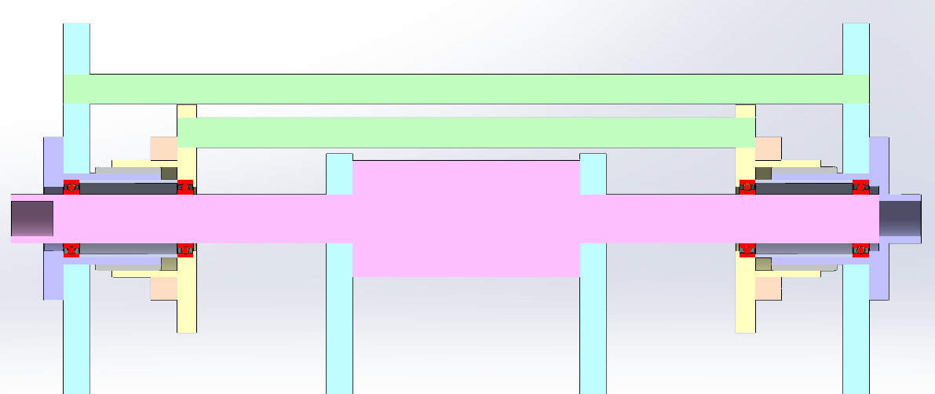
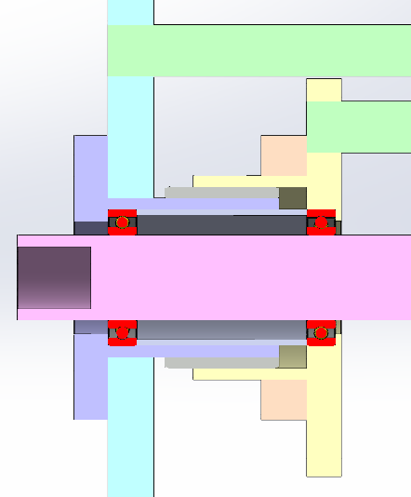
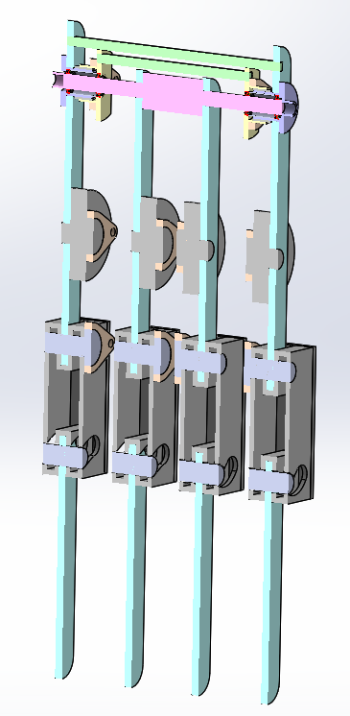
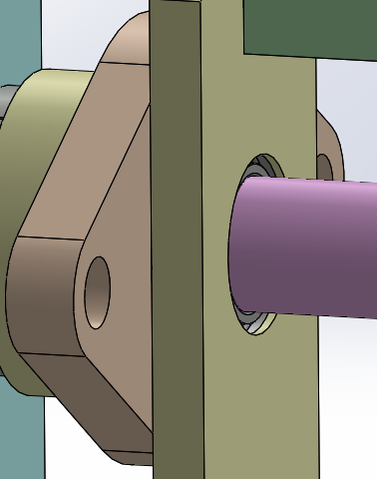
Knee rod seat
External seat A
Bushing
Knee connector seat

Slide 3
