Slide 1
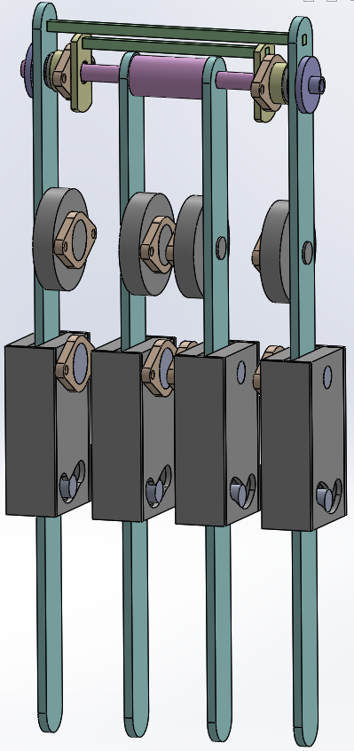
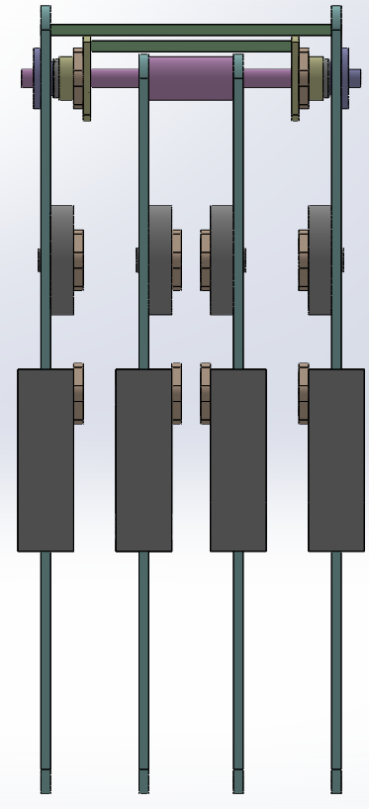
Femoral motors mount
Knee motors Τ-motor U8KV135
Knee pseudo motors
Modular knee
(4 Bar is contain or locked mechanism is contained inside)
Simple connection of the internal knees

Slide 2
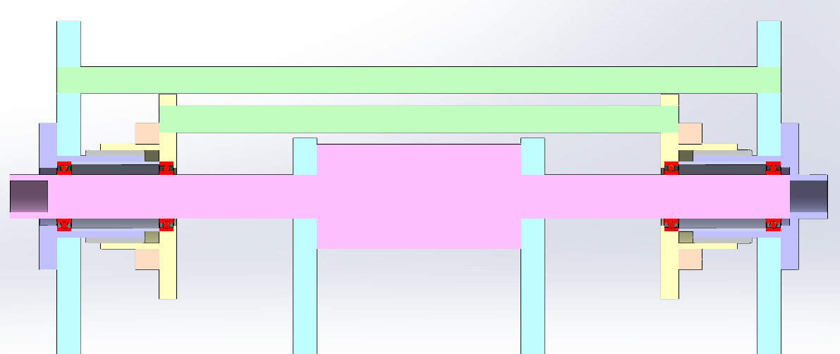
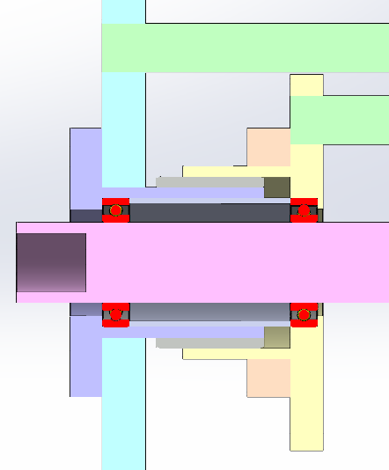
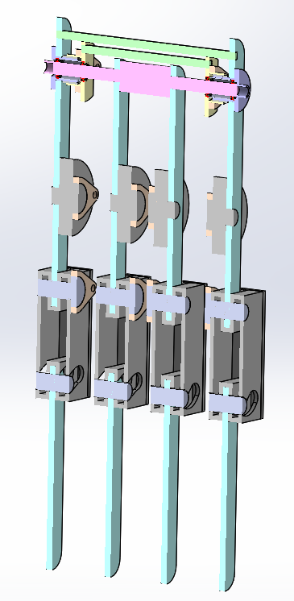
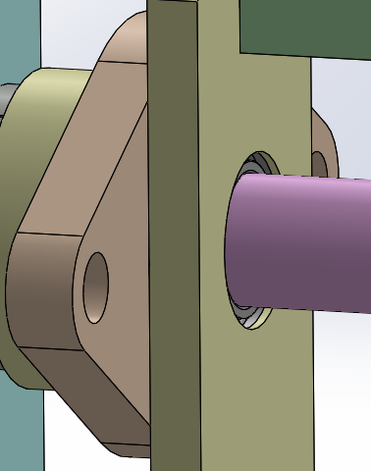
Knee rod seat
External seat A
Bushing
Knee connector seat

Slide 3
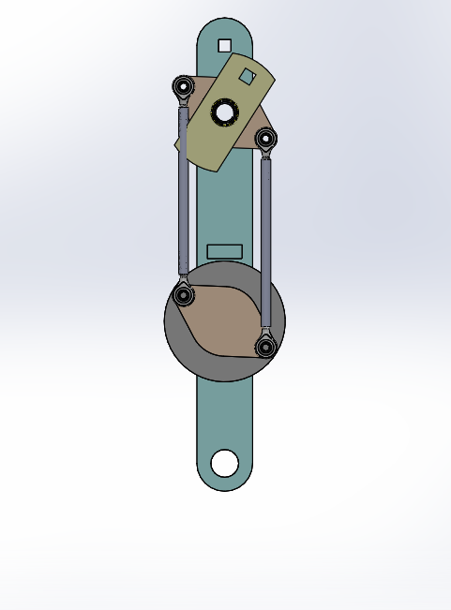
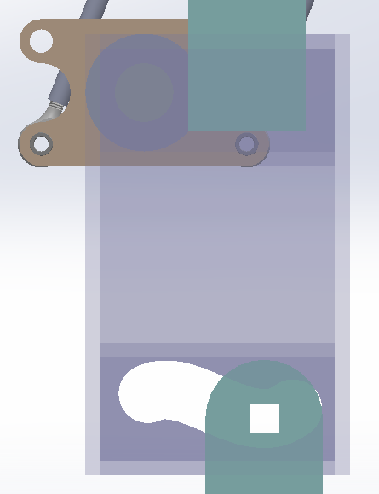

Slide 4
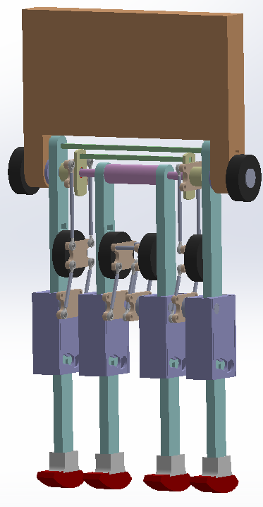

Slide 5
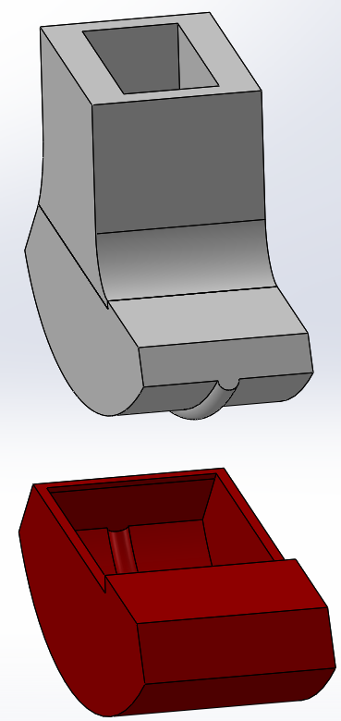
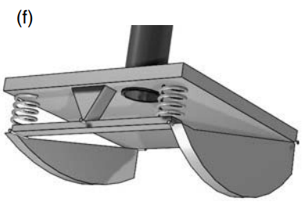
Foot from ABS
From Collins, Ruina
Used for collisional indeterminacy rejection
3d printed sock from Thermoplastic Elastomers (TPE).
Dipping in Plasti Dip. (Depends on the friction coefficient).

Slide 6
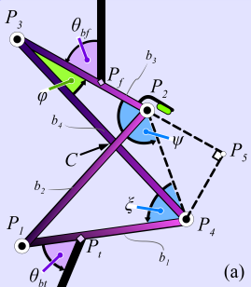

Femoral attached to the knee casing
Mechanism of the knee
$$φ$$

Slide 7
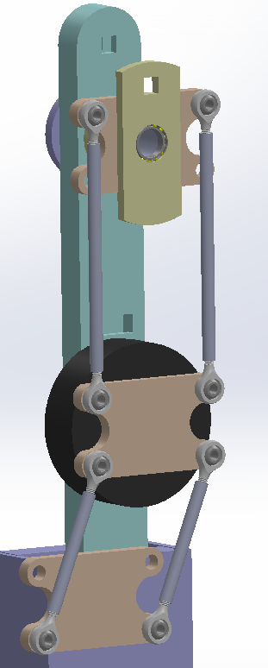
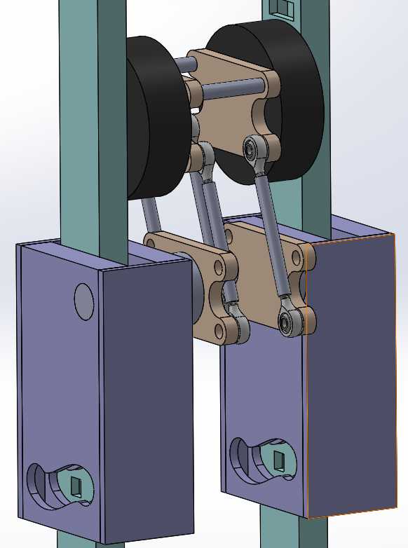
2 Four bar Mechanisms for external knees motion transfer
1st Four bar
Internal knees motion transfer mechanism
2nd Four bar

Slide 8
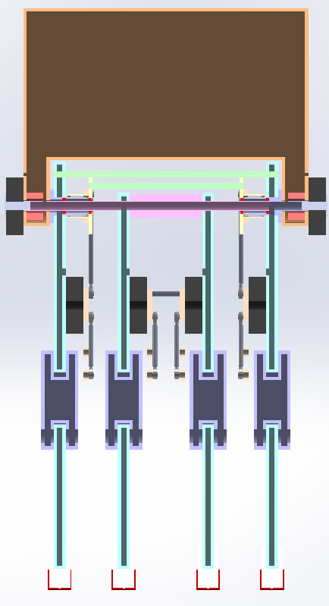
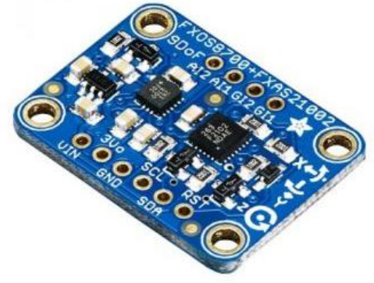
Double imu sensors are used:
To obtain data from yaw direction phenomena
To reject error on the measurements
IMU
IMU
IMU
Sensors

Slide 9
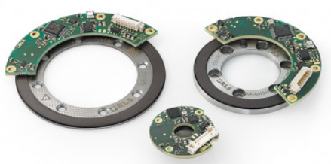
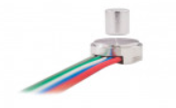
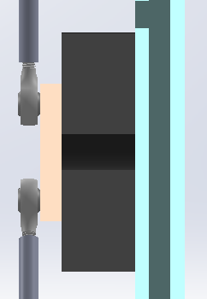
Ring or shaft magnetic encoders are used:
To obtain data for the femoral joint angle
To obtain data for the tibial joint angle
Encoders
Femoral joint angle encoders
Sensors
Enc
Enc
Operation video
Enc
Enc
Magnet axis
Or
Tibial joint encoders
Absolute vs incremental encoders?

Slide 10
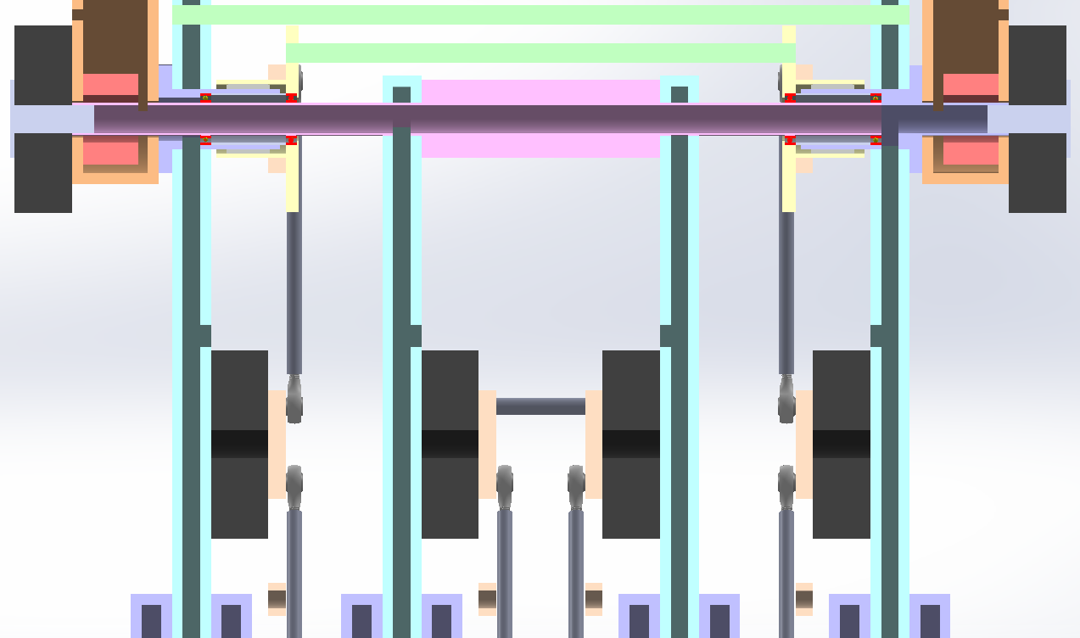
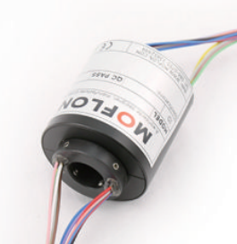
Wiring
Femoral motor wiring
Femoral encoder wiring
Tibial motor wiring
Slip ring
Tibial encoder wiring
https://www.youtube.com/watch?v=28jF3KEPAWg&ab_channel=MOFLON

