Slide 1
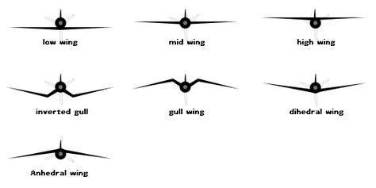

Slide 2
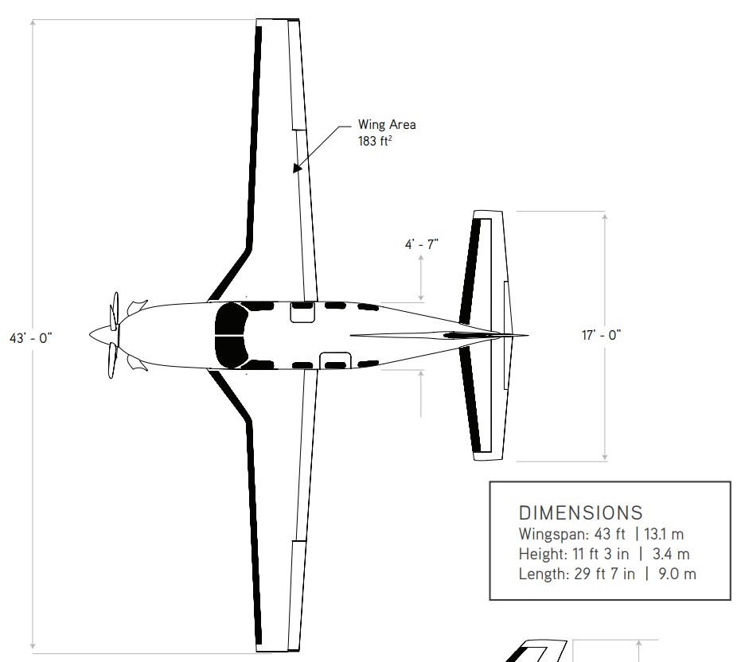

















$$9017 [mm]$$
$$C_{w_{1}}$$
$$O_{w_{12}}$$
$$C_{w_{2}}$$
$$O_{w_{13}}$$
$$C_{w_{3}}$$
$$S_{w_{3}}$$
$$C_{e_{1}}$$
$$O_{e_{12}}$$
$$C_{e_{2}}$$
$$1397 [mm]$$
$$S_{e_{1}}$$
$$d_{we_{x}}$$
$$S_{w_{2}}$$
$$S_{w_{1}}$$
$$13106 [mm]$$
$$5181 [mm]$$

Slide 3
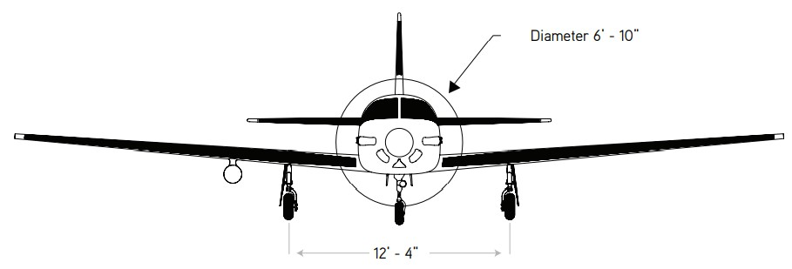








$$9017 [mm]$$
$${29}^{′}−7"$$
$${11}^{′}−3"$$
$$d_{we_{z}}$$
$$3429 [mm]$$
$$a_{w1}$$
$$z_{w1}$$
$$y_{w1}$$

Slide 4
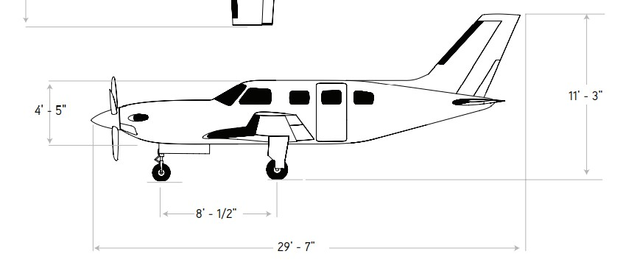







$$9017 [mm]$$
$$d_{{wf}_{x}}$$
$$C_{f_{1}}$$
$$0_{f_{12}}$$
$$C_{f_{2}}$$
$$S_{f_{1}}$$
$$3429 [mm]$$

Slide 5
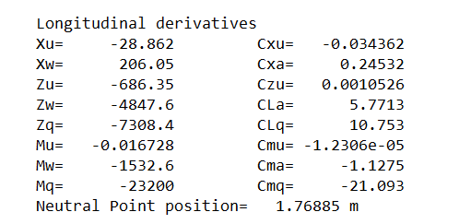
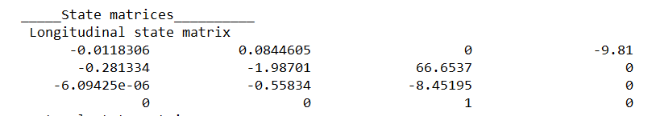

Slide 6
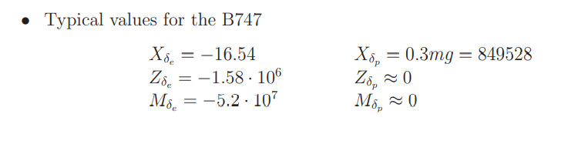
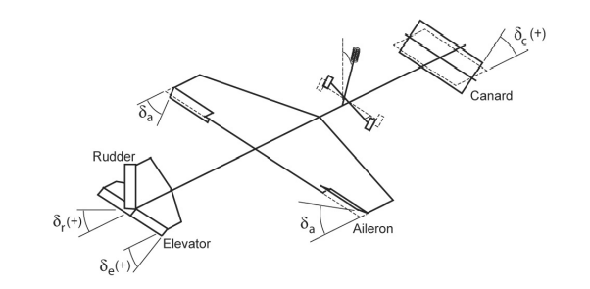
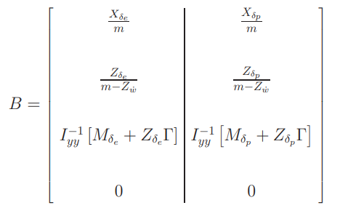
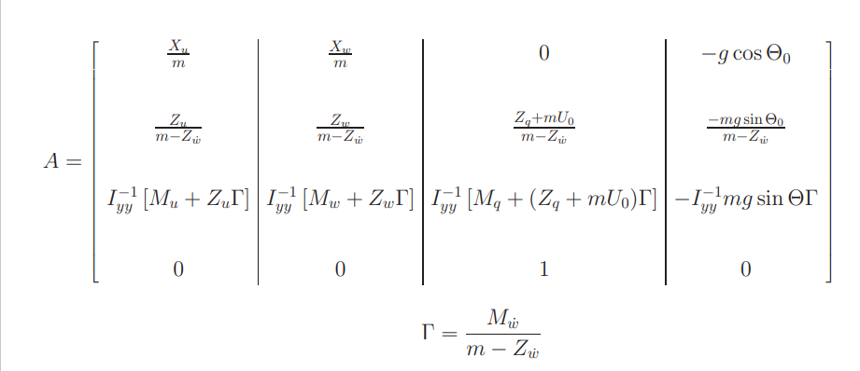

Slide 7
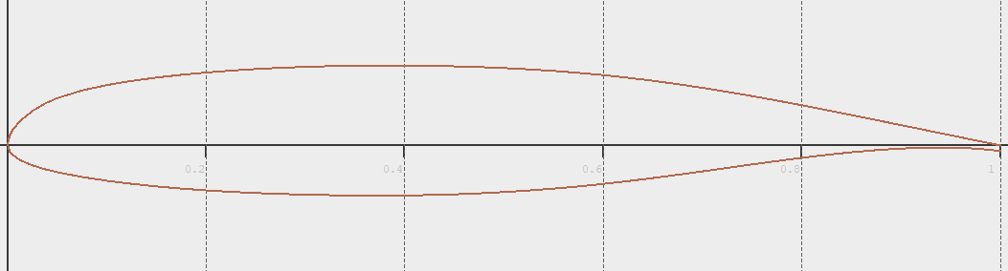
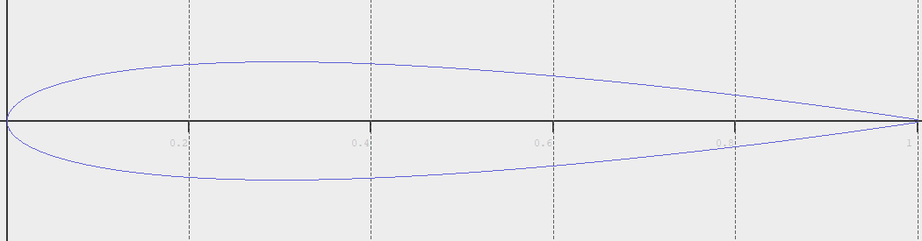
Nasa MS(1) - 0313
NACA 0013

Slide 8
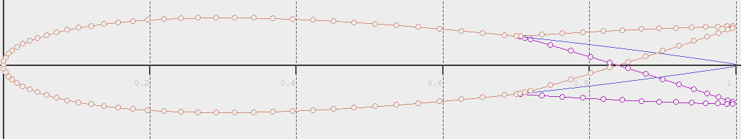
NACA with flaps

Slide 9
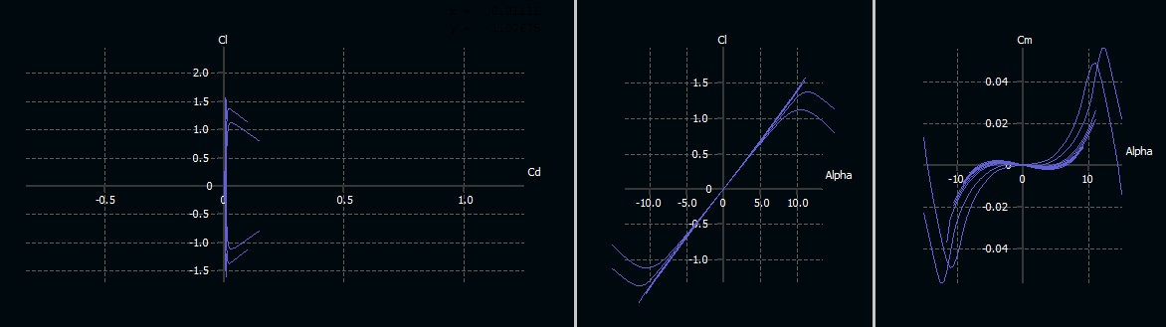

Re ${10}^{6}−{10}^{9}$
NASA 0313

Slide 10
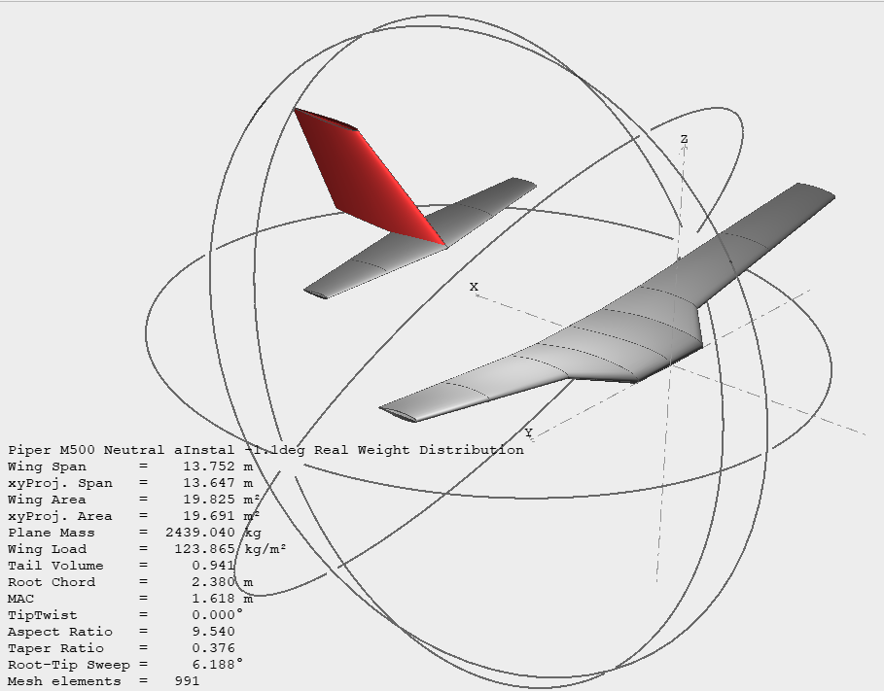
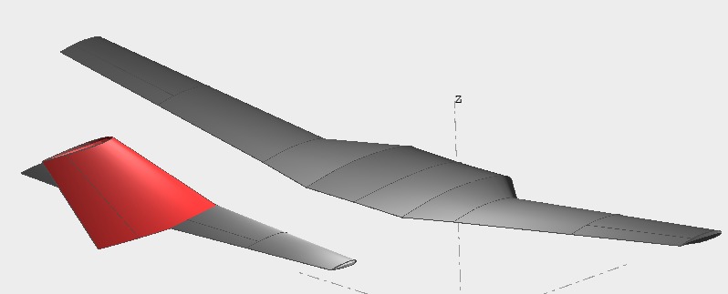
























$$9017 [mm]$$
$$9017 [mm]$$
$$d_{{wf}_{x}}$$
$$C_{f_{1}}$$
$$C_{w_{1}}$$
$$0_{f_{12}}$$
$$C_{f_{2}}$$
$$O_{w_{12}}$$
$$C_{w_{2}}$$
$$O_{w_{13}}$$
$$C_{w_{3}}$$
$$S_{f_{1}}$$
$$3429 [mm]$$
$$S_{w_{3}}$$
$$C_{e_{1}}$$
$$O_{e_{12}}$$
$$C_{e_{2}}$$
$$1397 [mm]$$
$$S_{e_{1}}$$
$$d_{we_{x}}$$
$$S_{w_{2}}$$
$$9017 [mm]$$
$$S_{w_{1}}$$
$${29}^{′}−7"$$
$$13106 [mm]$$
$$5181 [mm]$$
$${11}^{′}−3"$$
$$d_{we_{z}}$$
$$3429 [mm]$$
$$a_{w1}$$
$$z_{w1}$$
$$y_{w1}$$

Slide 11
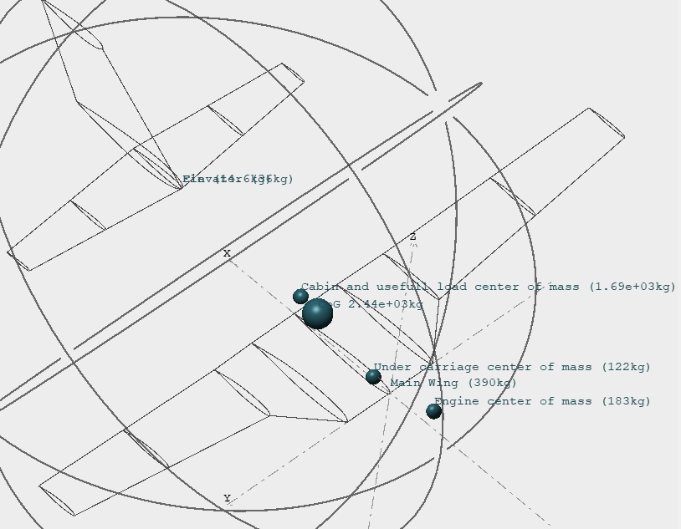

Slide 12
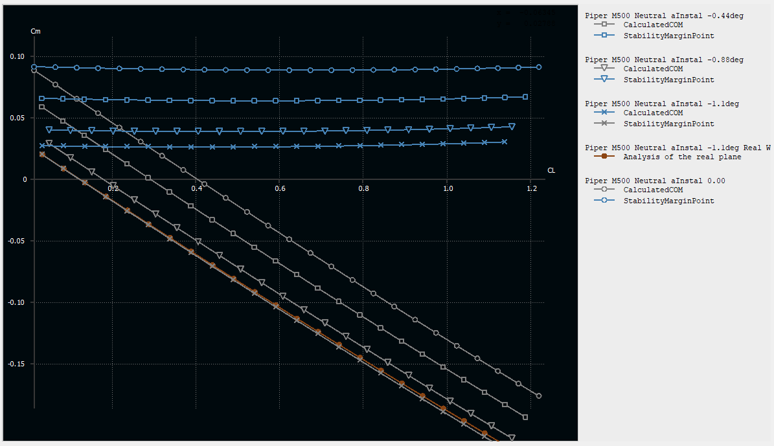

Slide 13
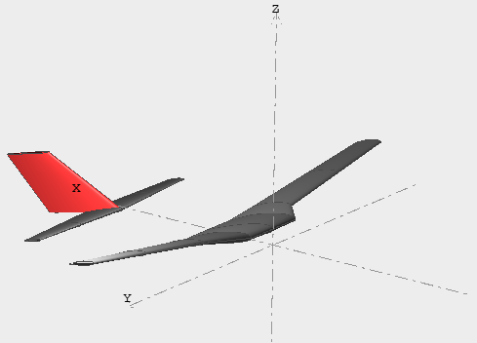
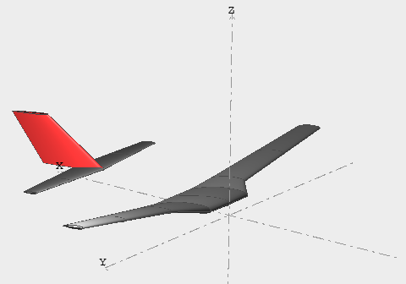

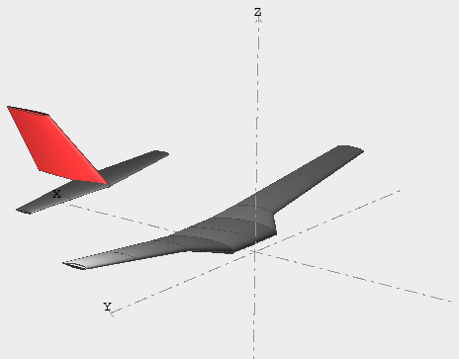
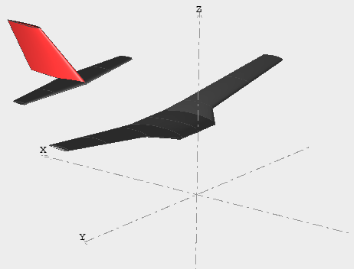

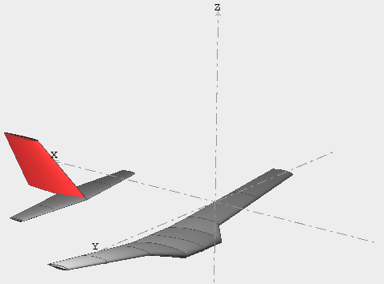
Short period mode
Phugoid mode

Slide 14
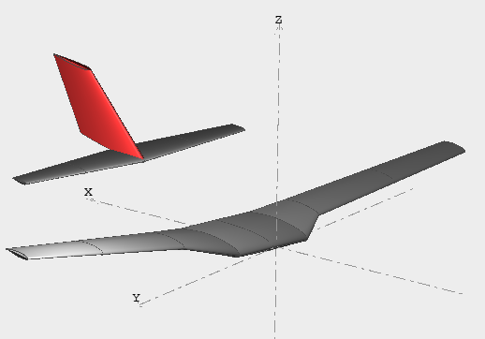
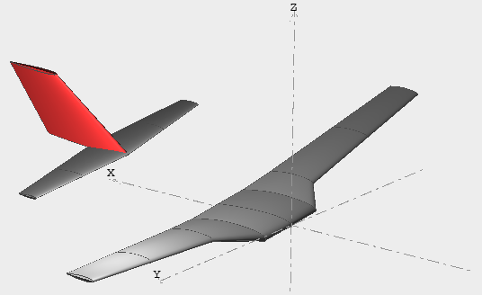
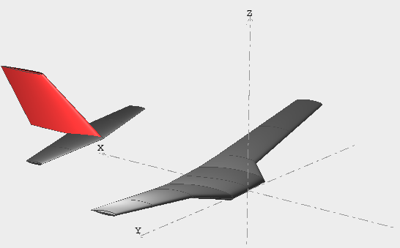

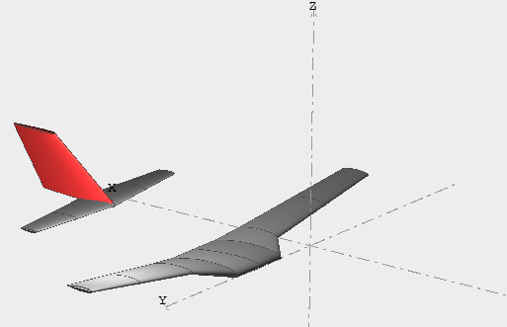
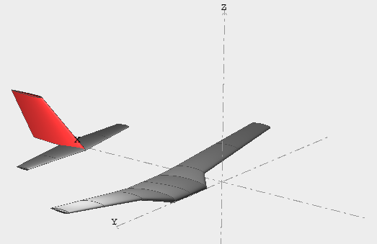
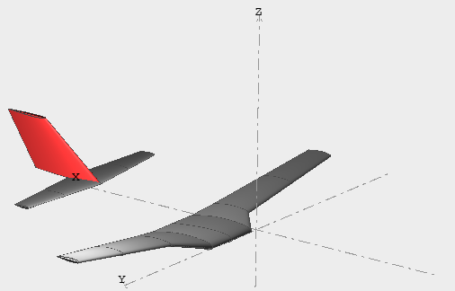

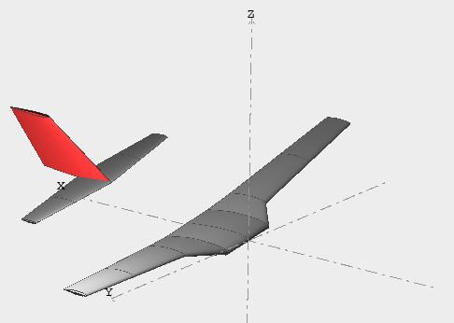
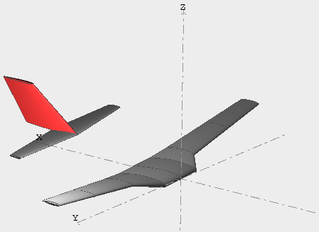

Dutch roll mode
Spiral divergence mode
Roll subsidence mode

Slide 15
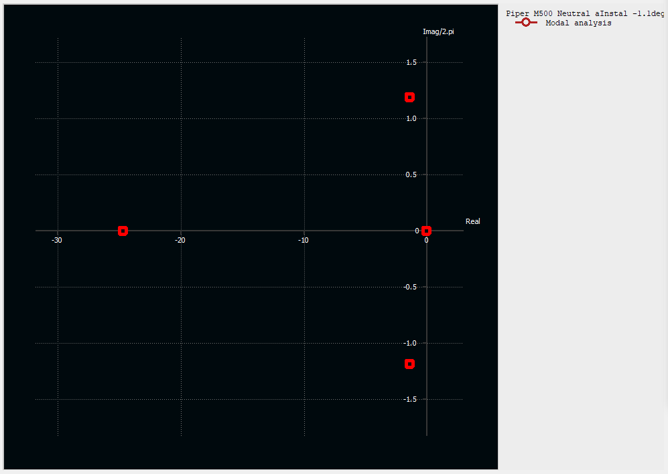
Short period mode
Dutch roll mode
Roll subsidence mode
Spiral divergence mode

Slide 16
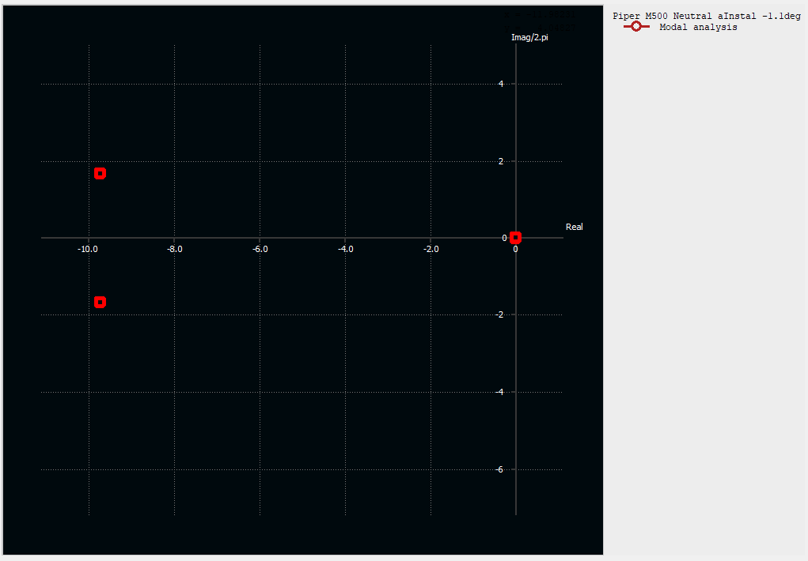
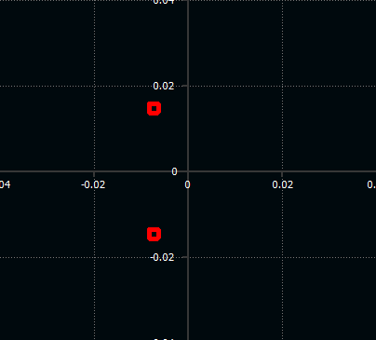
Phugoid mode
Short period mode

Slide 17
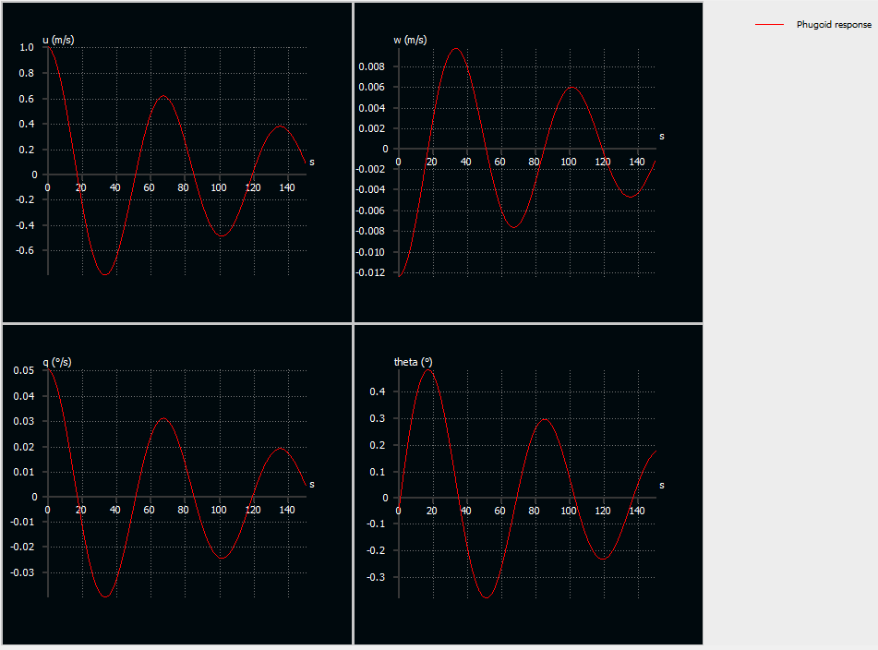

$$T\sim 66.67 [sec]$$

Slide 18
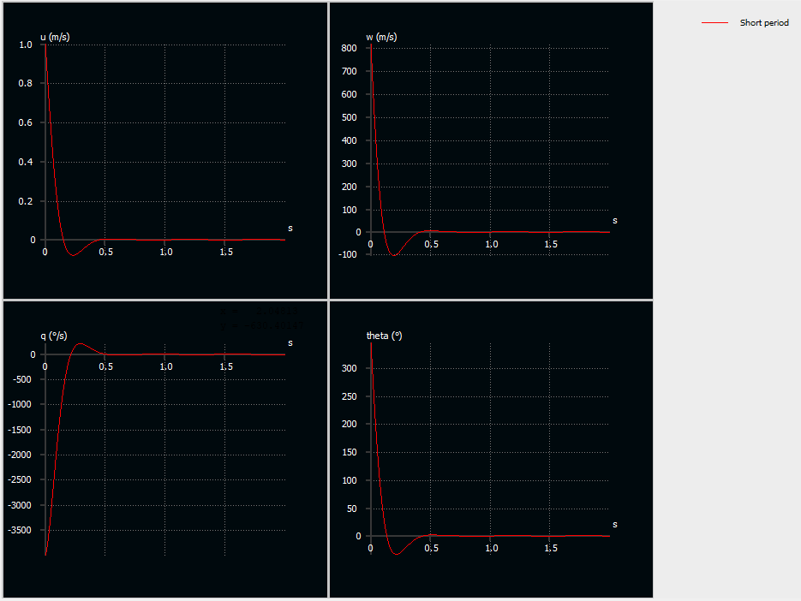








Short period
$$1) u\left[m\backslash s\right]$$
$$2) w [m/s]$$
Phugoid
$$T\sim 0.60 [sec]$$
$$T\sim 66.67 [sec]$$
$$3) \dot{θ} [deg/s]$$
$$4) θ [deg]$$

Slide 19
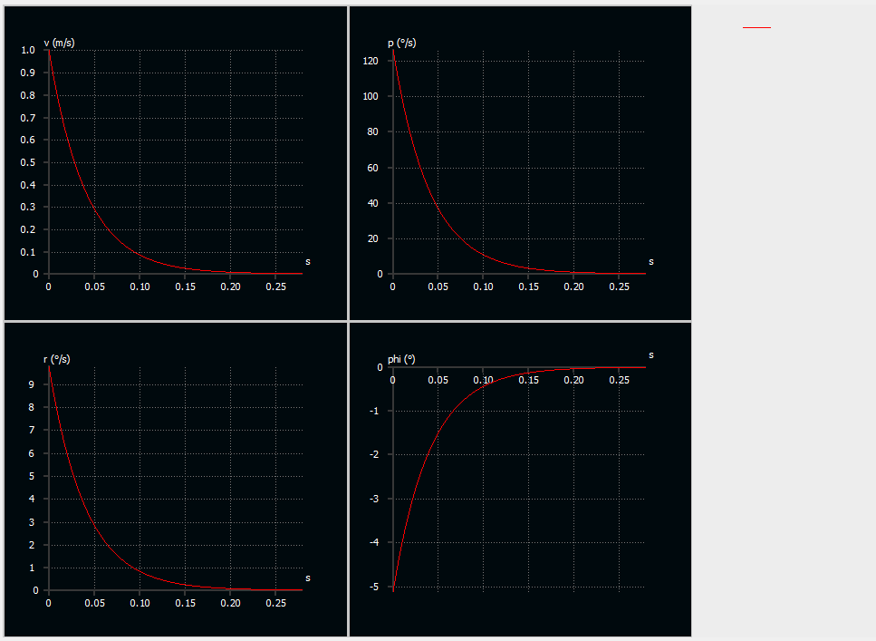
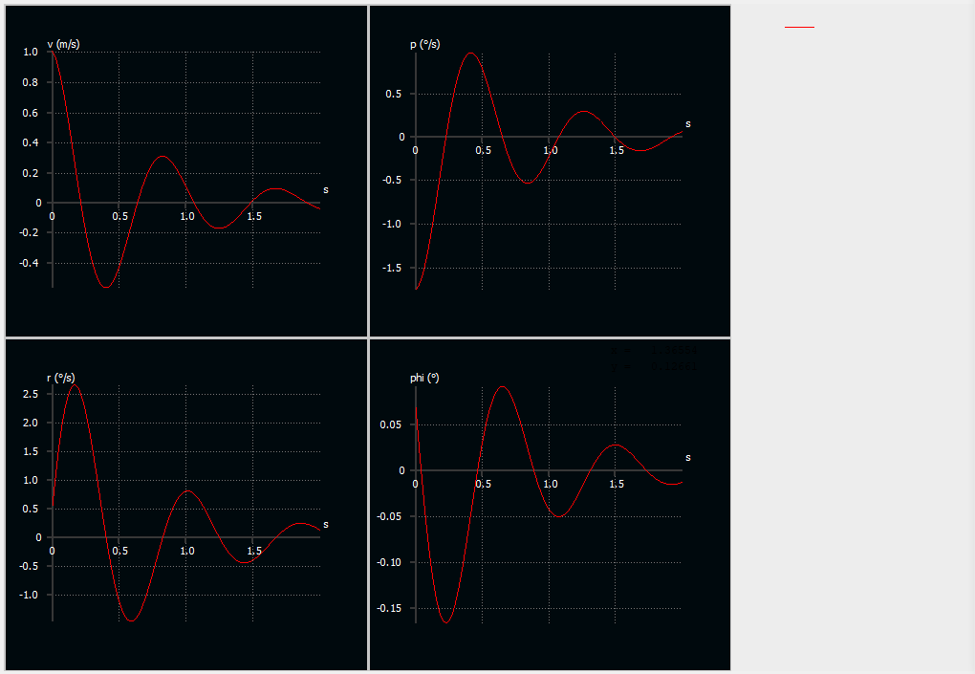
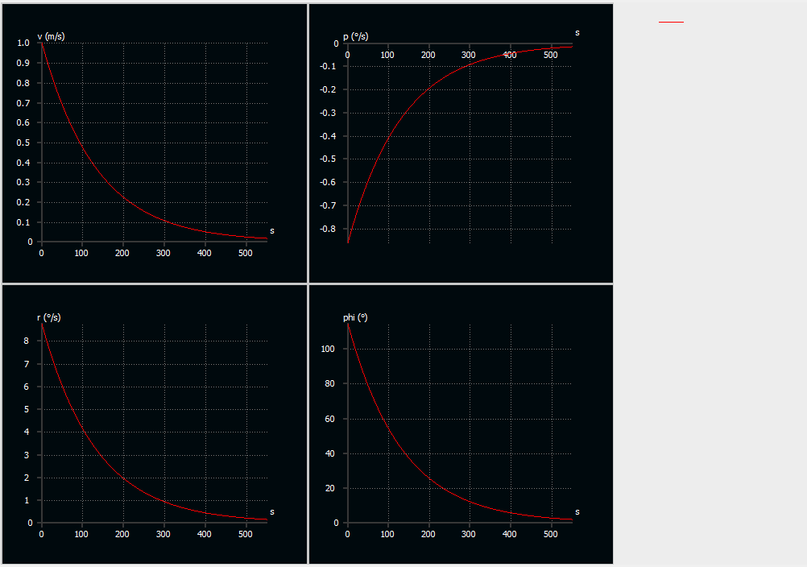










Roll subsidence mode
Dutch roll
Spiral divergence
$$1) v\left[m\backslash s\right]$$
$$2) p\left[deg\backslash s\right]$$
$$t_{s}\sim 0.028 [sec]$$
$$t_{s}\sim 0.85 [sec]$$
$$t_{s}\sim 550 [sec]$$
$$3) r\left[deg\backslash s\right]$$
$$4) φ \left[deg\right]$$

Slide 20
