Slide 1
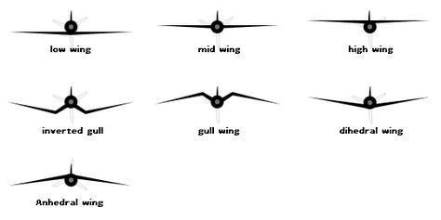

Slide 2
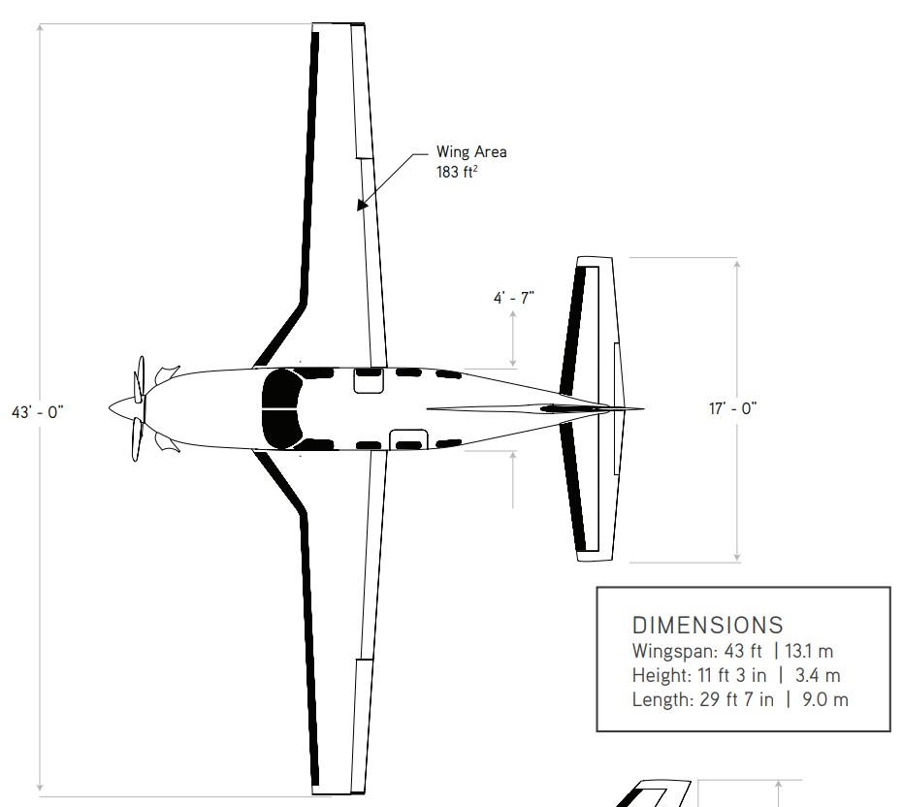

















$$9017 [mm]$$
$$C_{w_{1}}$$
$$O_{w_{12}}$$
$$C_{w_{2}}$$
$$O_{w_{13}}$$
$$C_{w_{3}}$$
$$S_{w_{3}}$$
$$C_{e_{1}}$$
$$O_{e_{12}}$$
$$C_{e_{2}}$$
$$1397 [mm]$$
$$S_{e_{1}}$$
$$d_{we_{x}}$$
$$S_{w_{2}}$$
$$S_{w_{1}}$$
$$13106 [mm]$$
$$5181 [mm]$$

Slide 3
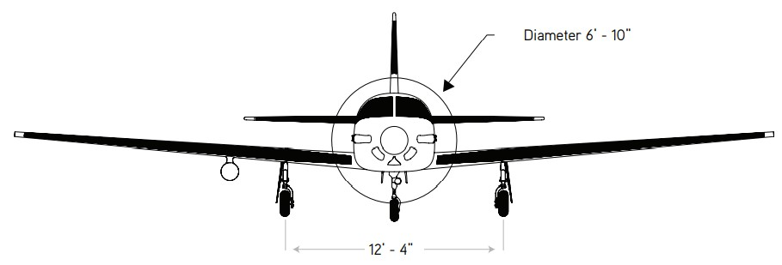








$$9017 [mm]$$
$${29}^{′}−7"$$
$${11}^{′}−3"$$
$$d_{we_{z}}$$
$$3429 [mm]$$
$$a_{w1}$$
$$z_{w1}$$
$$y_{w1}$$

Slide 4
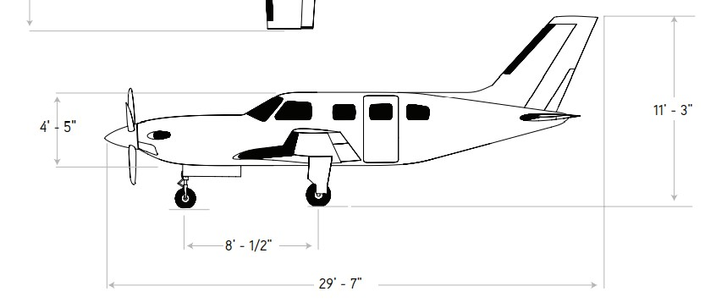







$$9017 [mm]$$
$$d_{{wf}_{x}}$$
$$C_{f_{1}}$$
$$0_{f_{12}}$$
$$C_{f_{2}}$$
$$S_{f_{1}}$$
$$3429 [mm]$$

Slide 5
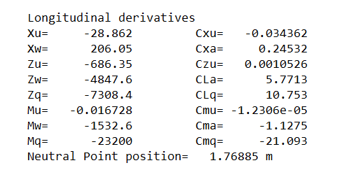
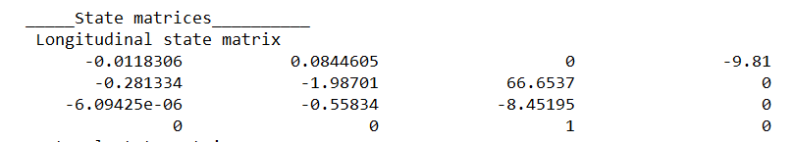

Slide 6
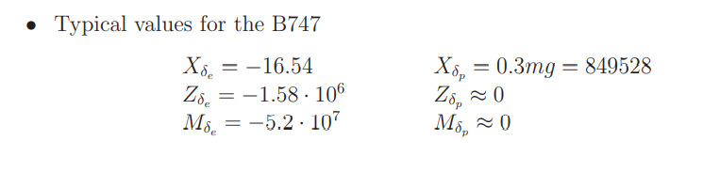
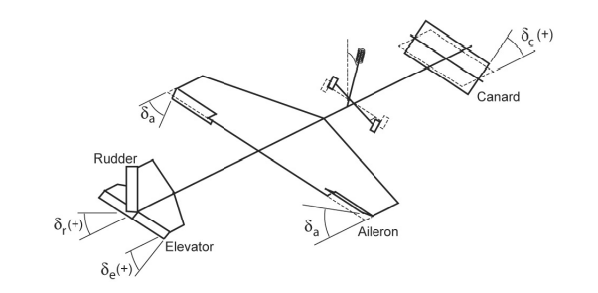
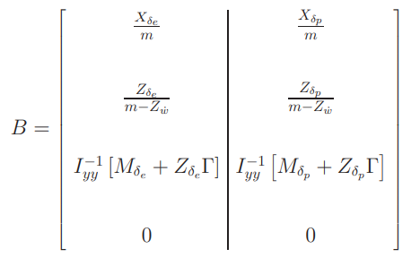
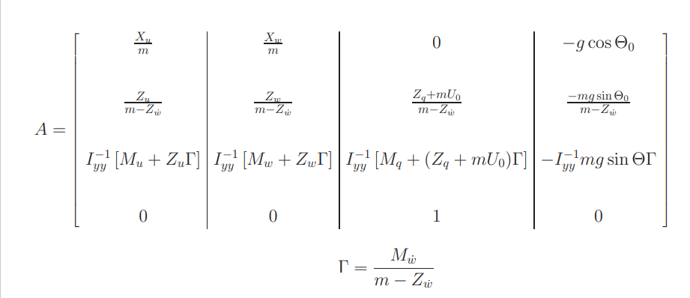

Slide 7
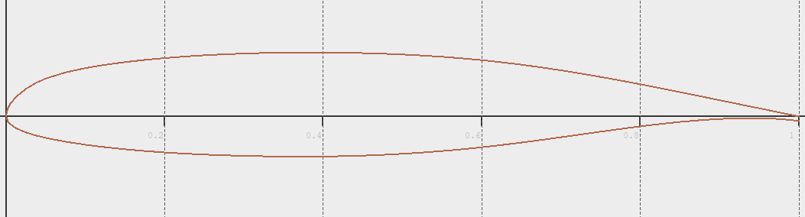
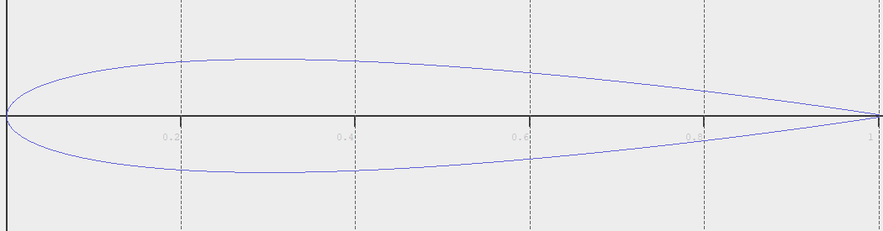
Nasa MS(1) - 0313
NACA 0013

Slide 8
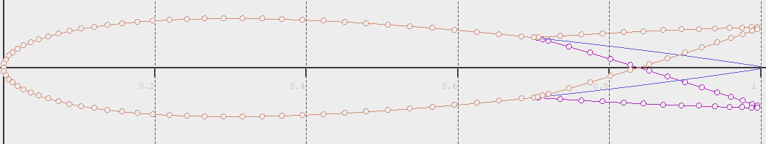
NACA with flaps

Slide 9
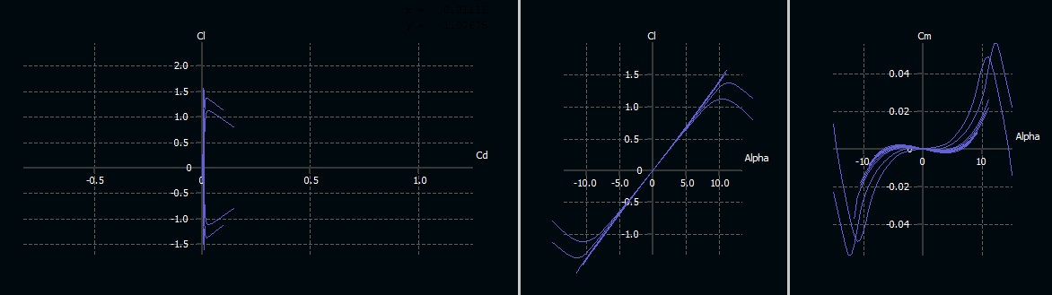

Re ${10}^{6}−{10}^{9}$
NASA 0313

Slide 10
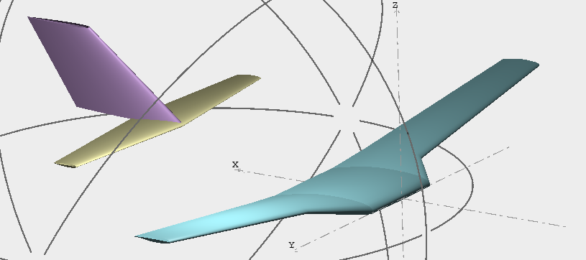
























$$9017 [mm]$$
$$9017 [mm]$$
$$d_{{wf}_{x}}$$
$$C_{f_{1}}$$
$$C_{w_{1}}$$
$$0_{f_{12}}$$
$$C_{f_{2}}$$
$$O_{w_{12}}$$
$$C_{w_{2}}$$
$$O_{w_{13}}$$
$$C_{w_{3}}$$
$$S_{f_{1}}$$
$$3429 [mm]$$
$$S_{w_{3}}$$
$$C_{e_{1}}$$
$$O_{e_{12}}$$
$$C_{e_{2}}$$
$$1397 [mm]$$
$$S_{e_{1}}$$
$$d_{we_{x}}$$
$$S_{w_{2}}$$
$$S_{w_{1}}$$
$$9017 [mm]$$
$$13106 [mm]$$
$$5181 [mm]$$
$${29}^{′}−7"$$
$${11}^{′}−3"$$
$$d_{we_{z}}$$
$$3429 [mm]$$
$$a_{w1}$$
$$z_{w1}$$
$$y_{w1}$$

Slide 11
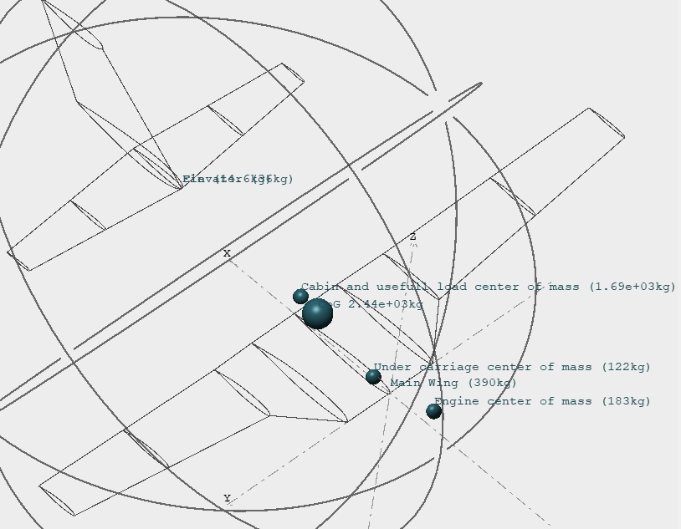

Slide 12
