Slide 1
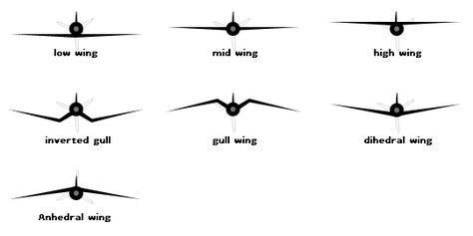

Slide 2
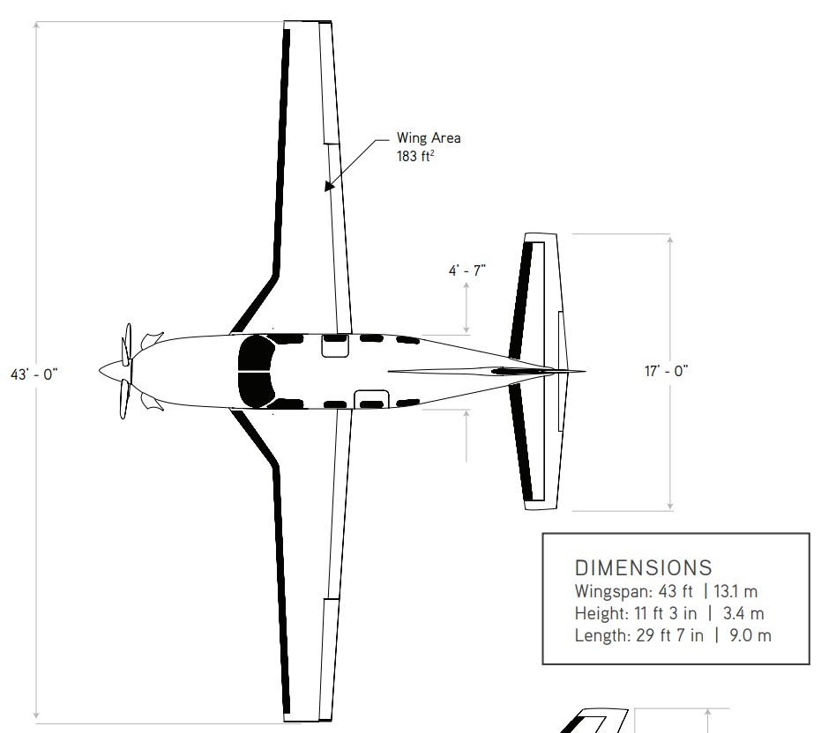

















$$9017 [mm]$$
$$C_{w_{1}}$$
$$O_{w_{12}}$$
$$C_{w_{2}}$$
$$O_{w_{13}}$$
$$C_{w_{3}}$$
$$S_{w_{3}}$$
$$C_{e_{1}}$$
$$O_{e_{12}}$$
$$C_{e_{2}}$$
$$1397 [mm]$$
$$S_{e_{1}}$$
$$d_{we_{x}}$$
$$S_{w_{2}}$$
$$S_{w_{1}}$$
$$13106 [mm]$$
$$5181 [mm]$$

Slide 3
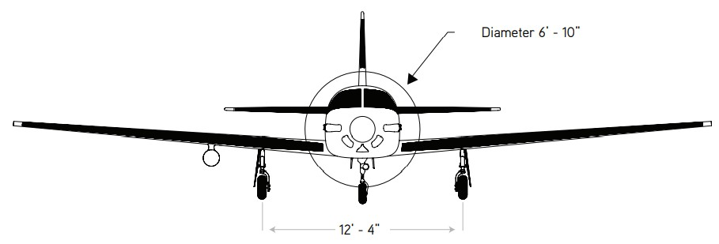








$$9017 [mm]$$
$${29}^{′}−7"$$
$${11}^{′}−3"$$
$$d_{we_{z}}$$
$$3429 [mm]$$
$$a_{w1}$$
$$z_{w1}$$
$$y_{w1}$$

Slide 4
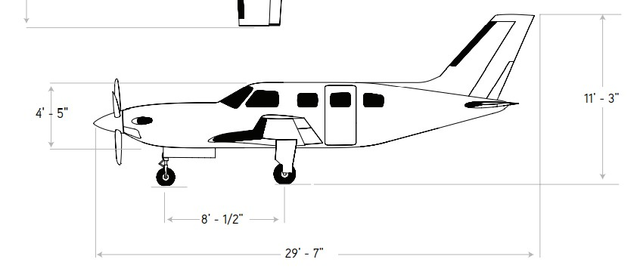







$$9017 [mm]$$
$$d_{{wf}_{x}}$$
$$C_{f_{1}}$$
$$0_{f_{12}}$$
$$C_{f_{2}}$$
$$S_{f_{1}}$$
$$3429 [mm]$$

Slide 5
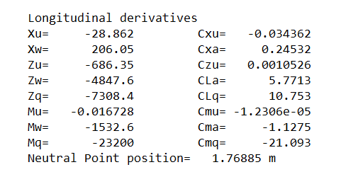
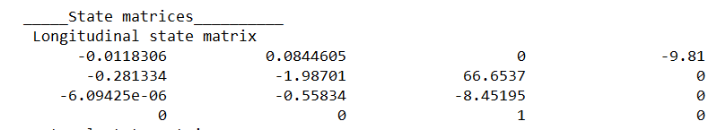

Slide 6
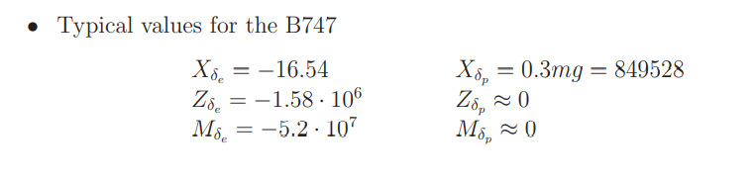
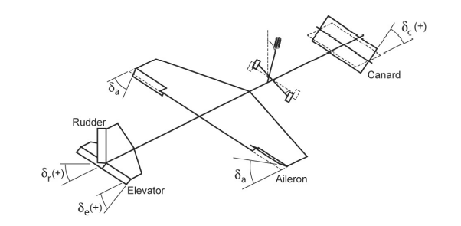
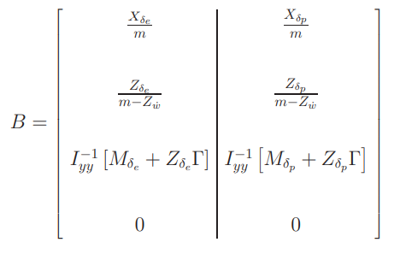
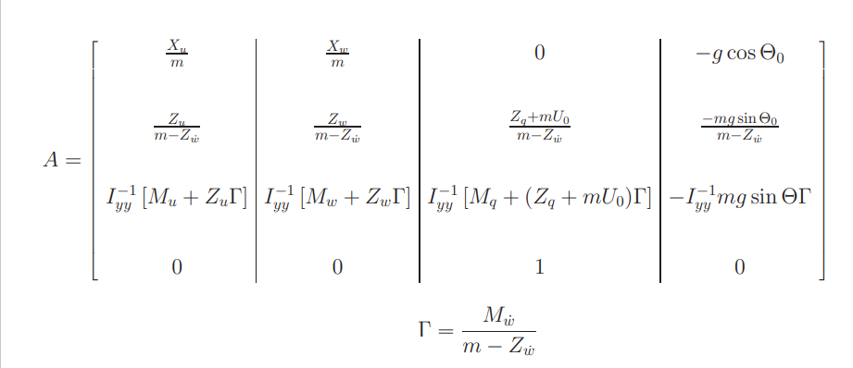

Slide 7
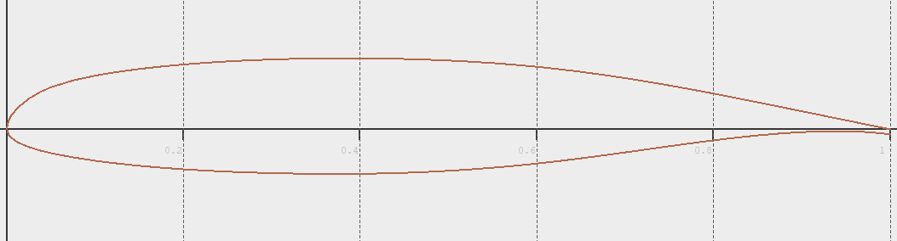
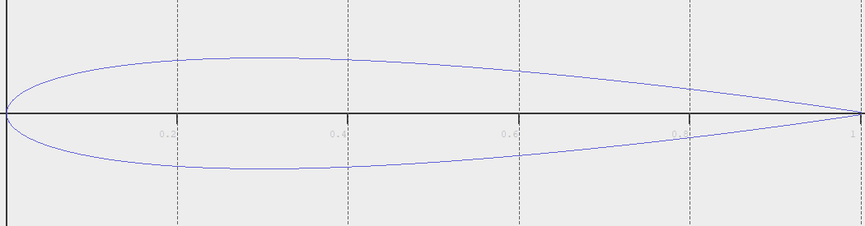
Nasa MS(1) - 0313
NACA 0013

Slide 8
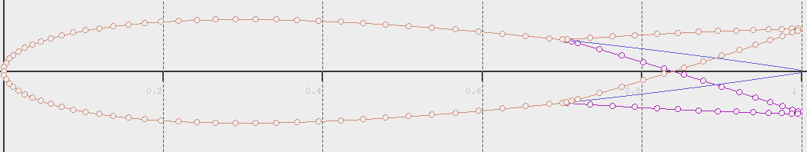
NACA with flaps

Slide 9
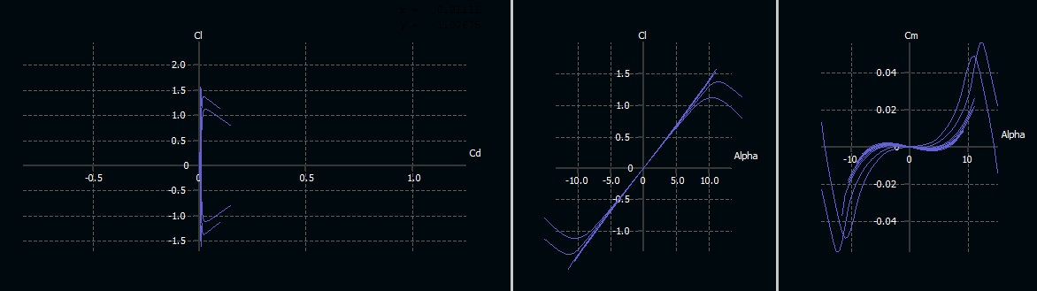

Re ${10}^{6}−{10}^{9}$
NASA 0313

Slide 10
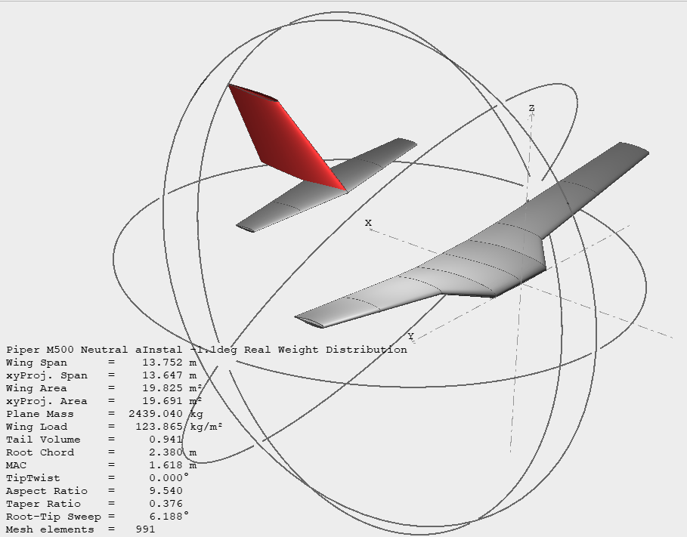
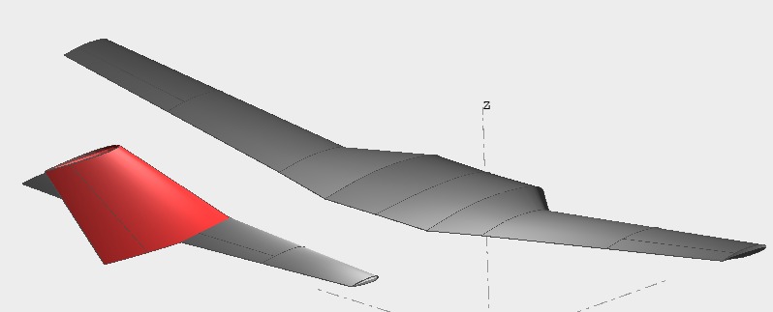
























$$9017 [mm]$$
$$9017 [mm]$$
$$d_{{wf}_{x}}$$
$$C_{f_{1}}$$
$$C_{w_{1}}$$
$$0_{f_{12}}$$
$$C_{f_{2}}$$
$$O_{w_{12}}$$
$$C_{w_{2}}$$
$$O_{w_{13}}$$
$$C_{w_{3}}$$
$$S_{f_{1}}$$
$$3429 [mm]$$
$$S_{w_{3}}$$
$$C_{e_{1}}$$
$$O_{e_{12}}$$
$$C_{e_{2}}$$
$$1397 [mm]$$
$$S_{e_{1}}$$
$$d_{we_{x}}$$
$$S_{w_{2}}$$
$$9017 [mm]$$
$$S_{w_{1}}$$
$${29}^{′}−7"$$
$$13106 [mm]$$
$$5181 [mm]$$
$${11}^{′}−3"$$
$$d_{we_{z}}$$
$$3429 [mm]$$
$$a_{w1}$$
$$z_{w1}$$
$$y_{w1}$$

Slide 11
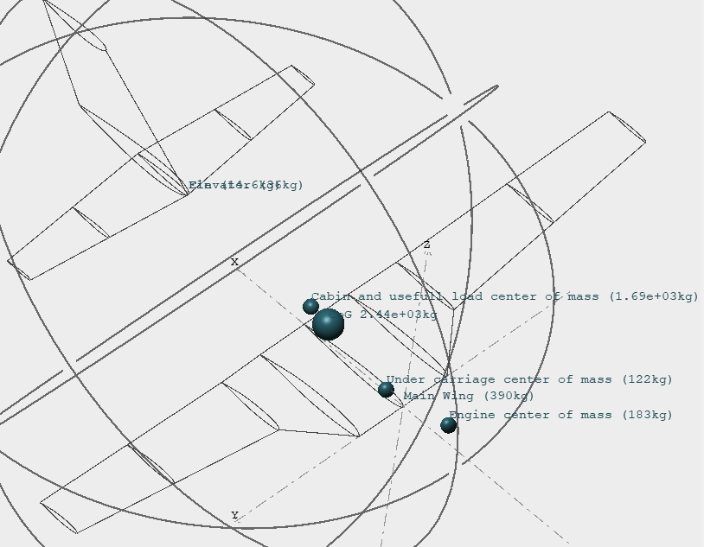

Slide 12
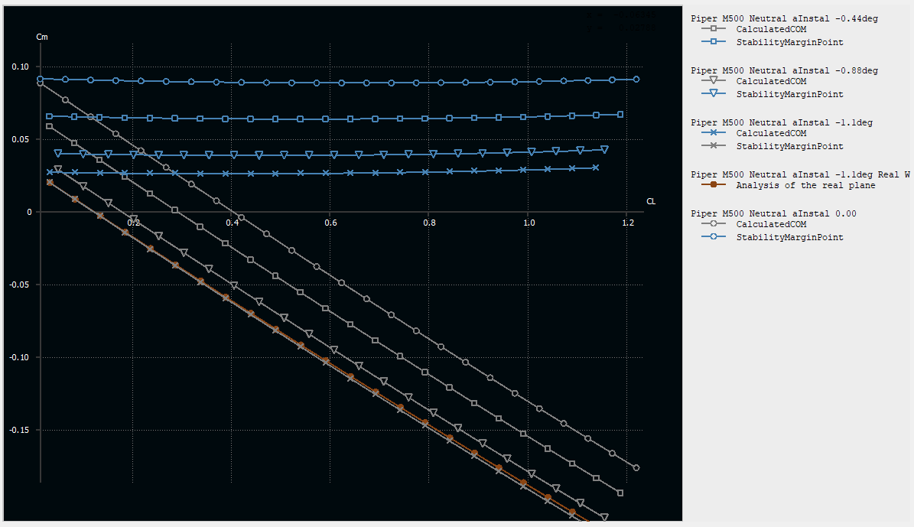

Slide 13
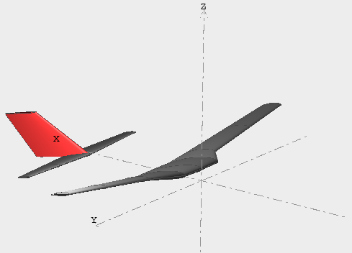
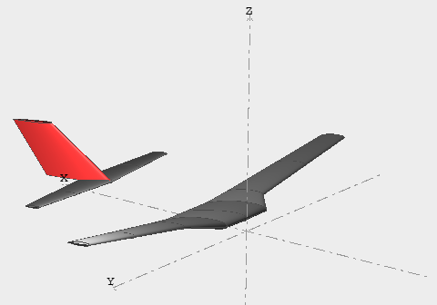

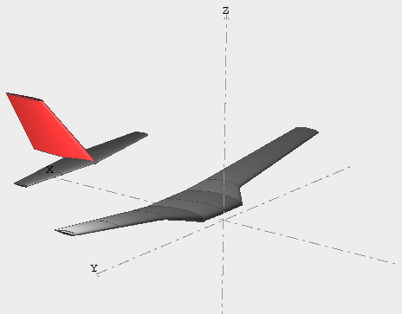
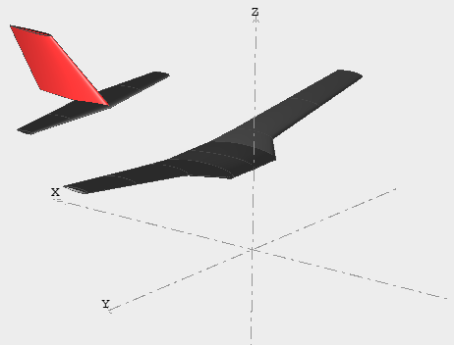

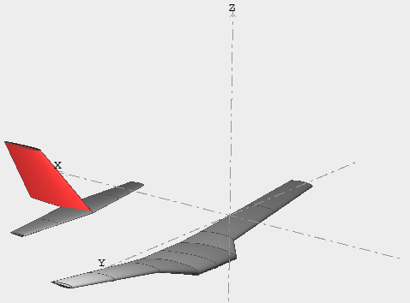
Short period mode
Phugoid mode

Slide 14
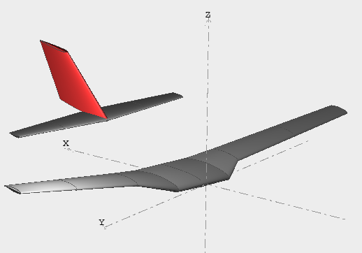
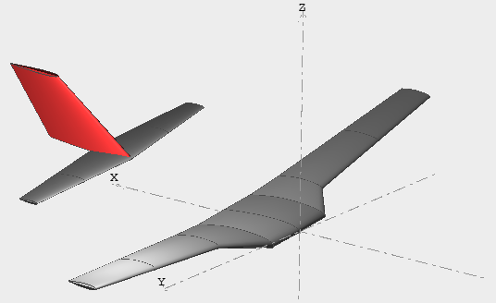
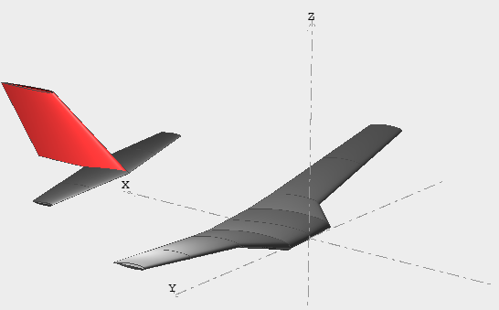

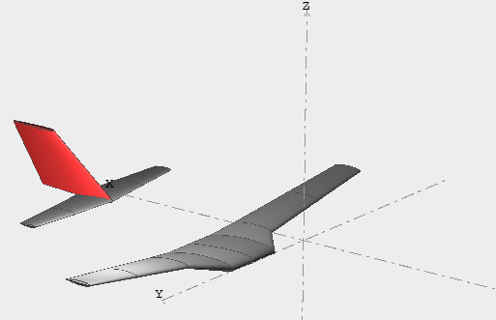
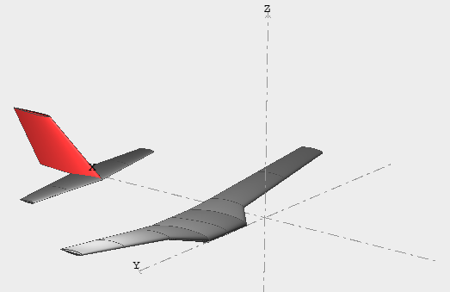
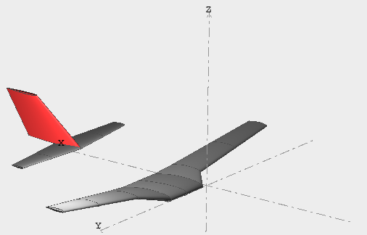

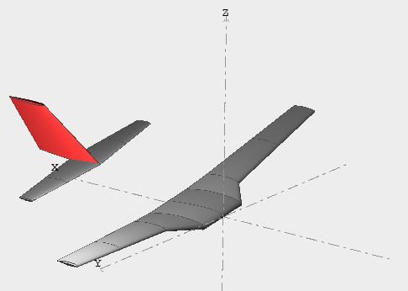
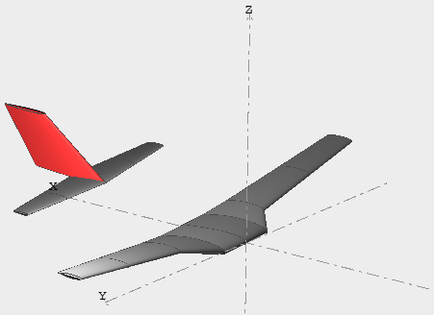

Dutch roll mode
Spiral divergence mode
Roll subsidence mode

Slide 15
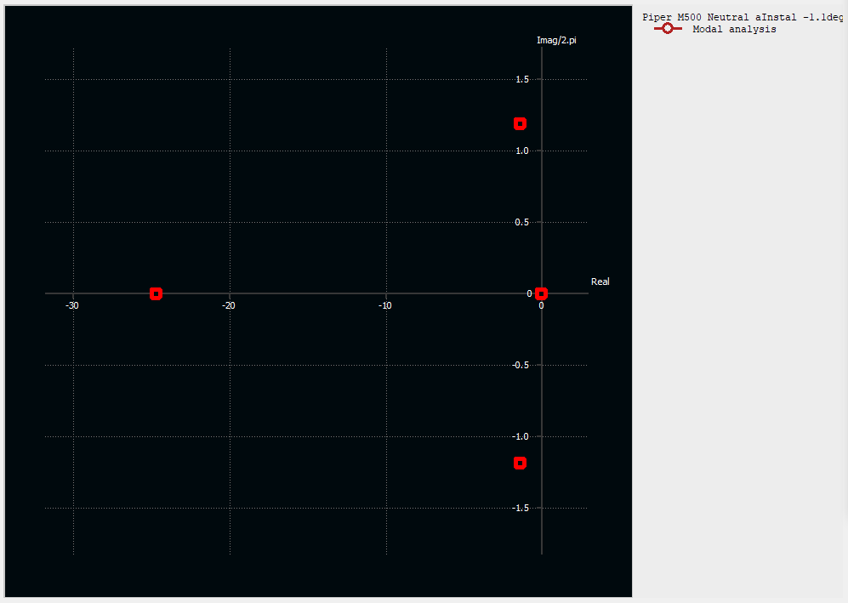
Short period mode
Dutch roll mode
Roll subsidence mode
Spiral divergence mode

Slide 16
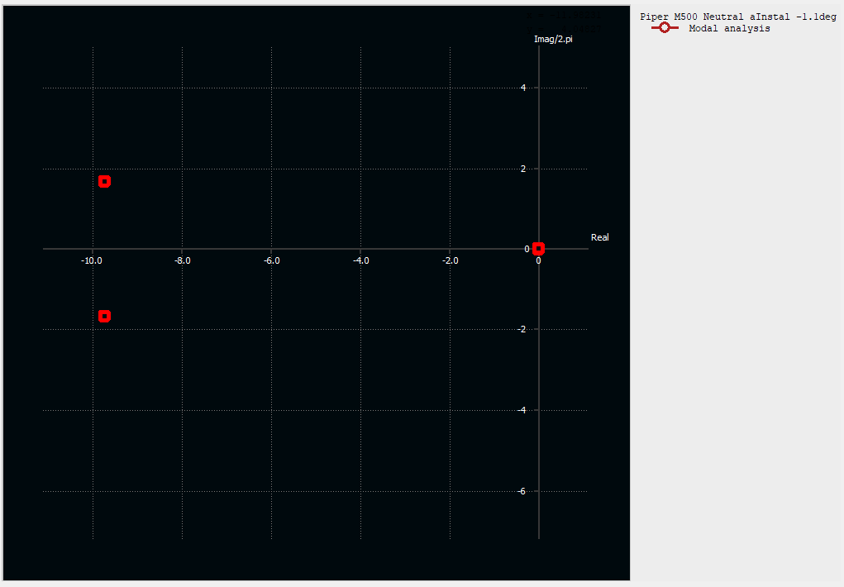
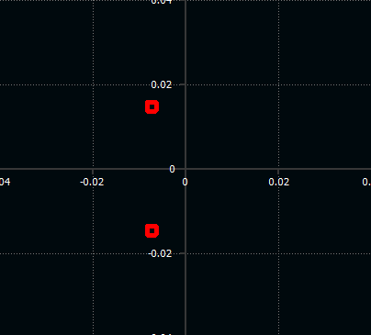
Phugoid mode
Short period mode

Slide 17
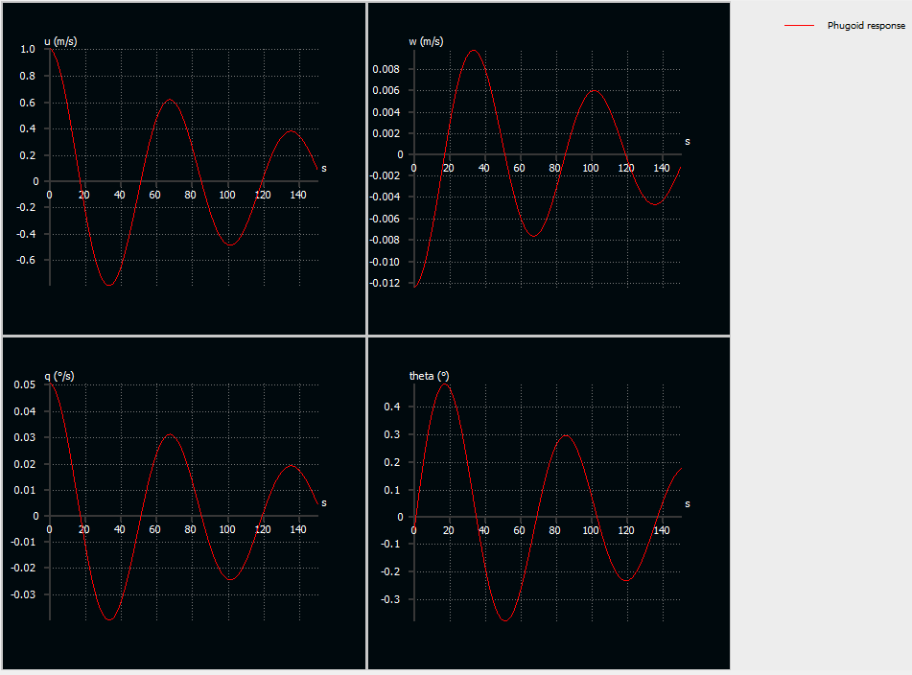

$$T\sim 66.67 [sec]$$

Slide 18
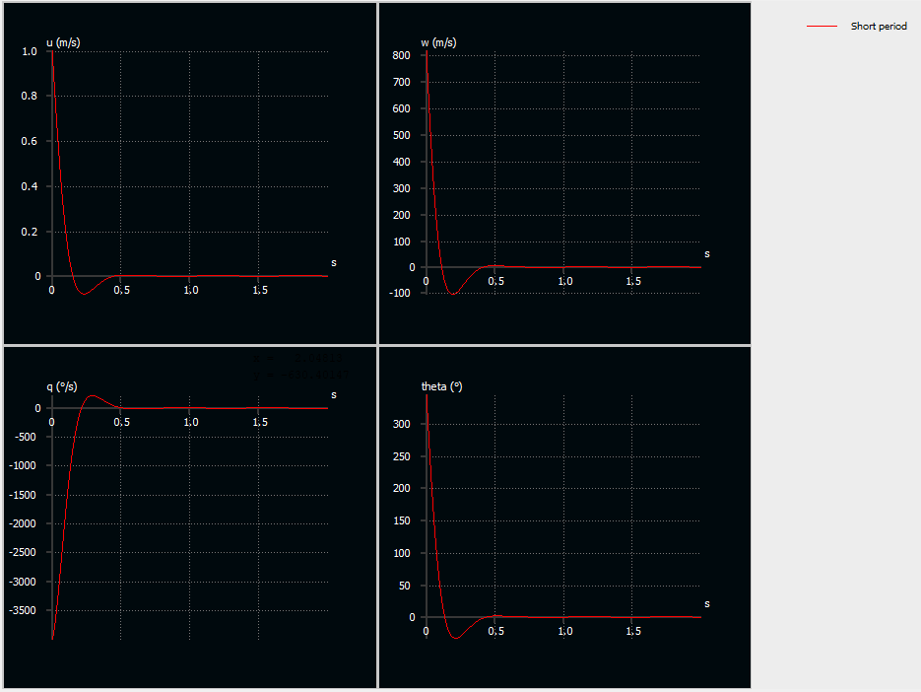








Short period
$$1) u\left[m\backslash s\right]$$
$$2) w [m/s]$$
Phugoid
$$T\sim 0.60 [sec]$$
$$T\sim 66.67 [sec]$$
$$3) \dot{θ} [deg/s]$$
$$4) θ [deg]$$

Slide 19
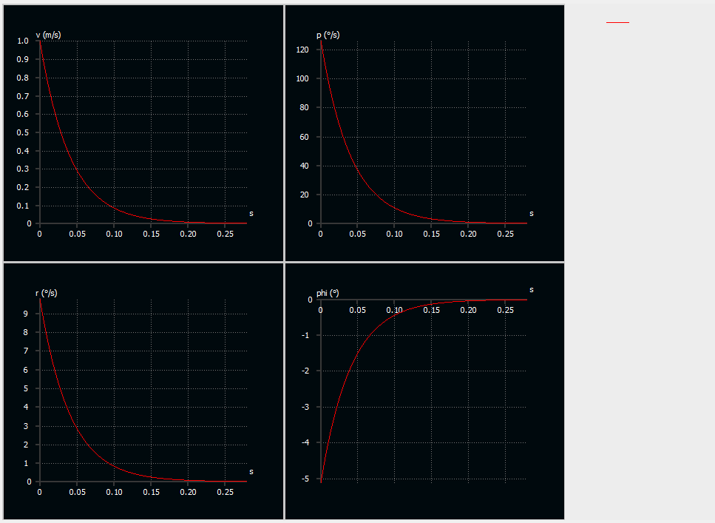
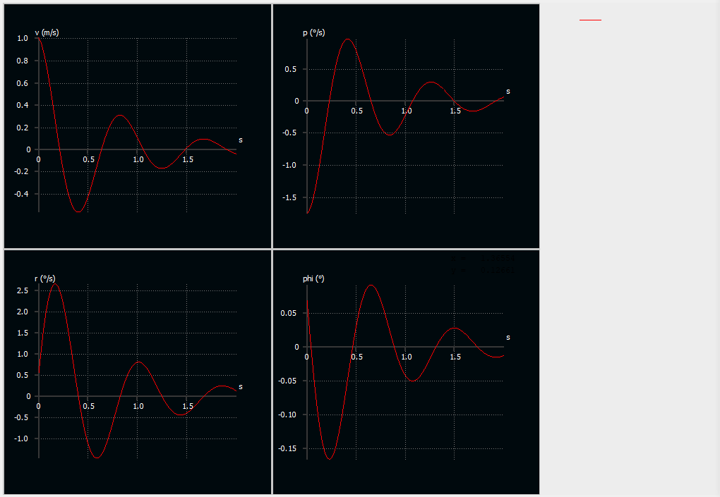
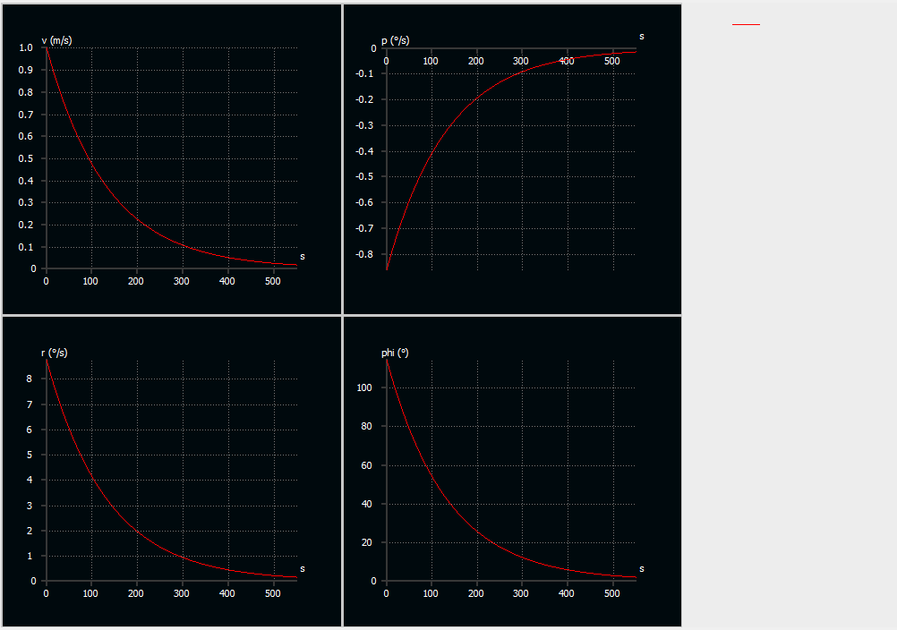










Roll subsidence mode
Dutch roll
Spiral divergence
$$1) v\left[m\backslash s\right]$$
$$2) p\left[deg\backslash s\right]$$
$$t_{s}\sim 0.028 [sec]$$
$$t_{s}\sim 0.85 [sec]$$
$$t_{s}\sim 550 [sec]$$
$$3) r\left[deg\backslash s\right]$$
$$4) φ \left[deg\right]$$

Slide 20
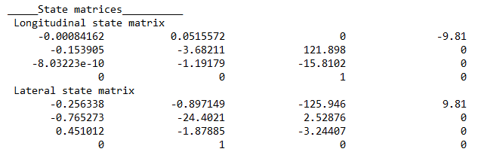

Slide 21
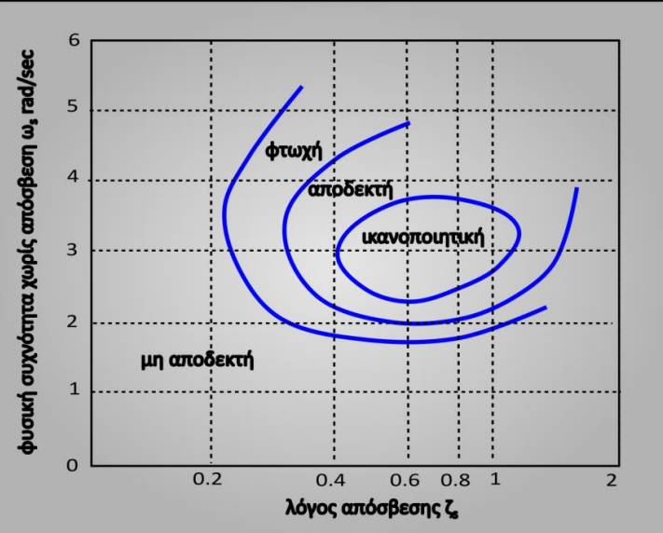

Slide 22
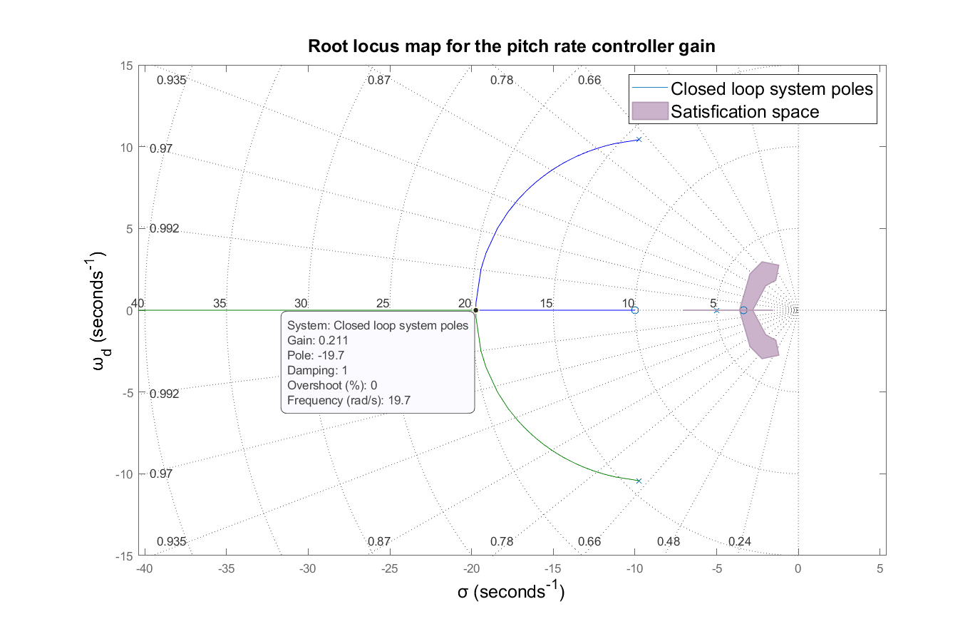
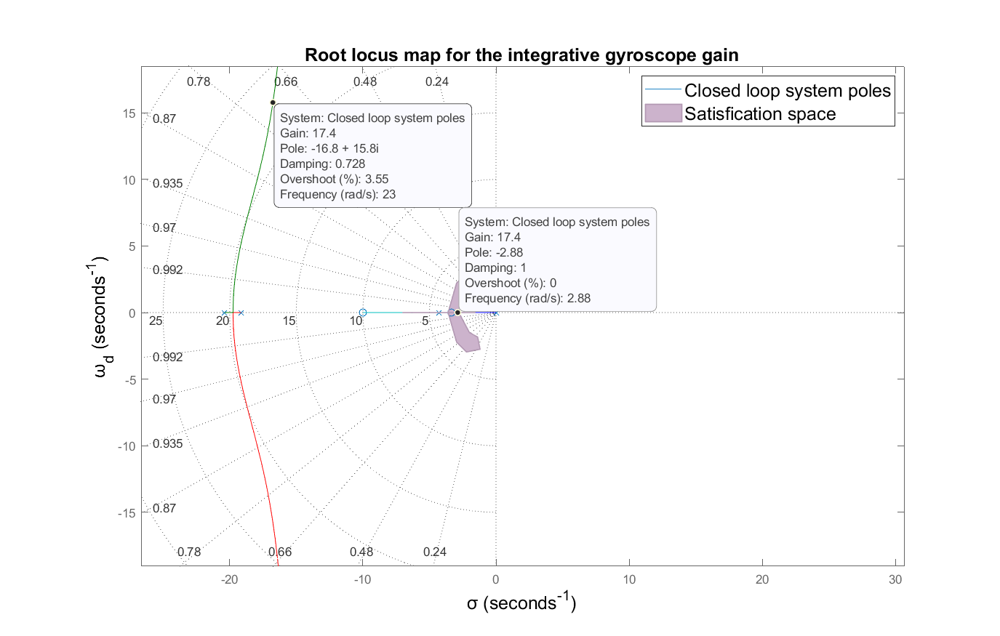

Slide 23
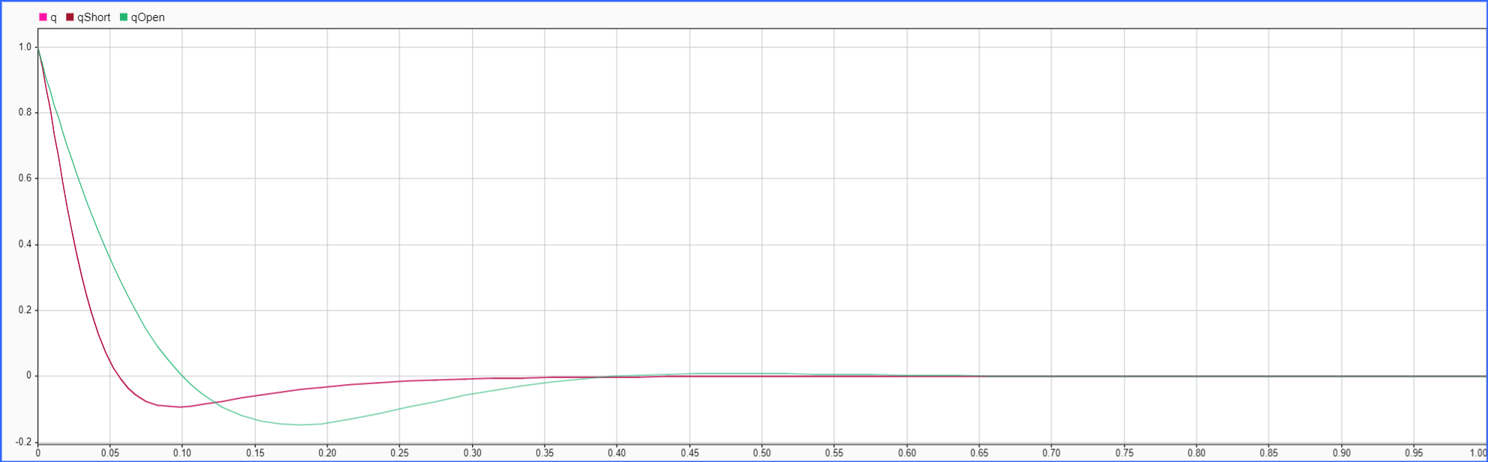
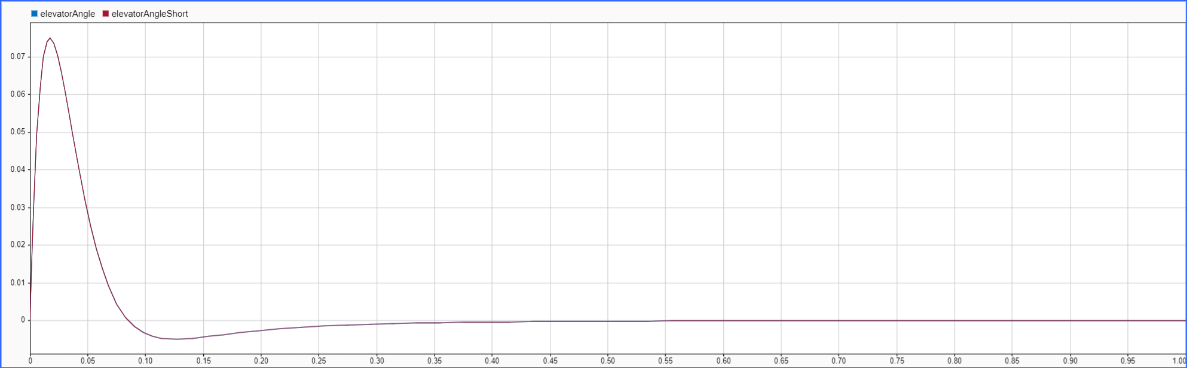
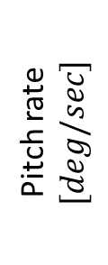
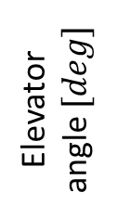
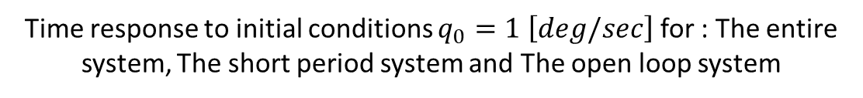
Time response to initial conditions $q_{0}=1 \left[deg/sec\right]$ for : The entire system, The short period system and The open loop system
Pitch rate $[deg/sec]$
Elevator angle $[deg]$
Time $[sec]$

Slide 24
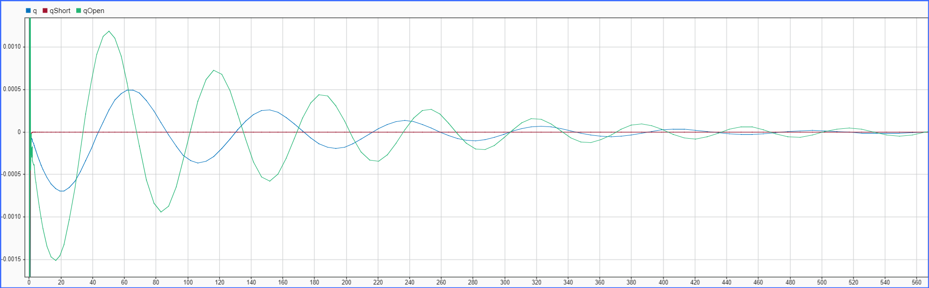
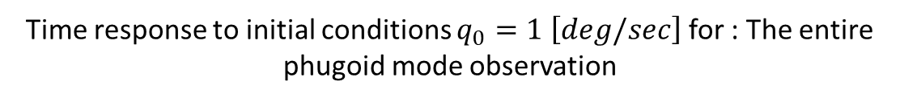

Time response to initial conditions $q_{0}=1 \left[deg/sec\right]$ for : The entire phugoid mode observation
Pitch rate $[deg/sec]$
Time $[sec]$

Slide 25



Time response to pitch rate command. Short period system response versus total system response
Pitch rate $[deg/sec]$
Zoom in
Pitch rate $[deg/sec]$
Time $[sec]$

Slide 26







Time response to pitch rate command for the system including the integrative gyroscope
Constant error
Pitch rate $[deg/sec]$
Zoom in: No phugoid dynamics
Zoom in
Pitch rate $[deg/sec]$
Elevator angle $[deg]$
Time $[sec]$

Slide 27


Slide 28


Slide 29




Time response of Dutch roll dumper system.
Yaw rate $[deg/sec]$
Rudder angle $[deg]$
Time $[sec]$

Slide 30





Controller with and without wash out filter at the feed back comparison
Lateral velocity $[m/s]$
Rudder angle $[deg]$
Rudder angle $[deg]$
Time $[sec]$

Slide 31



