Slide 1
SMART INDIA HACKATHON · SIH26150
UDFRAS
Universal DVR/NVR Forensic Recovery and Analysis System
Standardized Cross-Vendor Forensic Ingestion, Video Carving & Court-Admissible Reporting
🔒 ISO/IEC 27037 VALIDATED · SECTION 65B COMPLIANT HUD

Slide 2
PROJECT REVIEW · PRESENTATION TEAM
Team Members
M1
M2
M3
M4
Team Member 1
[Name / USN]
Forensic Engine & Storage Carving
Team Member 2
[Name / USN]
Vendor Signatures & Ingestion Gate
Team Member 3
[Name / USN]
Spatial UI & Court Reporting
Team Member 4
[Name / USN]
Chain-of-Custody & API Services

Slide 3
1. PROBLEM STATEMENT
Forensic Challenges in Modern Surveillance Systems
PROPRIETARY STORAGE & FRAGMENTATION
CROSS-VENDOR PARSING & COURT READINESS
▪ Modern DVR/NVR systems use proprietary and undocumented storage formats, making surveillance footage difficult to analyze.
▪ Existing forensic tools are often limited to specific manufacturers such as Hikvision and Dahua.
▪ Deleted, corrupted, fragmented, or partially overwritten video evidence can be difficult to recover.
▪ Different manufacturers require different parsing and recovery techniques.
▪ There is a need for a unified forensic framework that can automatically identify the source vendor and recover video evidence.
▪ The proposed system will provide the recovered evidence in a standardized, court-ready format.

Slide 4
2. OBJECTIVES
Standardized Acquisition, Parsing & Verification
STRICT READ-ONLY ACQUISITION GATE
AUTOMATED MULTI-VENDOR SIGNATURE ENGINE
COURT-ADMISSIBLE CARVING & SPATIAL HUD
▪ Enforcing zero-byte disk modification via OS-level O_RDONLY and binary rb handles.
▪ Executing dual streaming cryptographic hashes (SHA-256 + MD5) in single-pass O(1) RAM.
▪ Establishing ISO/IEC 27037 compliance with pre/post ingestion invariance validation.
▪ Dynamic sector 0x0000 magic-byte identification across Dahua (DHFS), Hikvision (HIKG), CP Plus.
▪ Non-destructive proprietary partition indexing with automated confidence scoring.
▪ Graceful generic fallback preventing system crashes on unrecognized disk geometries.
▪ Fragment-level NAL boundary parsing recovering deleted/damaged video streams.
▪ Append-only genesis audit ledger generating immutable provenance lineage graphs.
▪ VisionOS frosted-glass spatial HUD delivering native multi-channel CCTV playback.

Slide 5
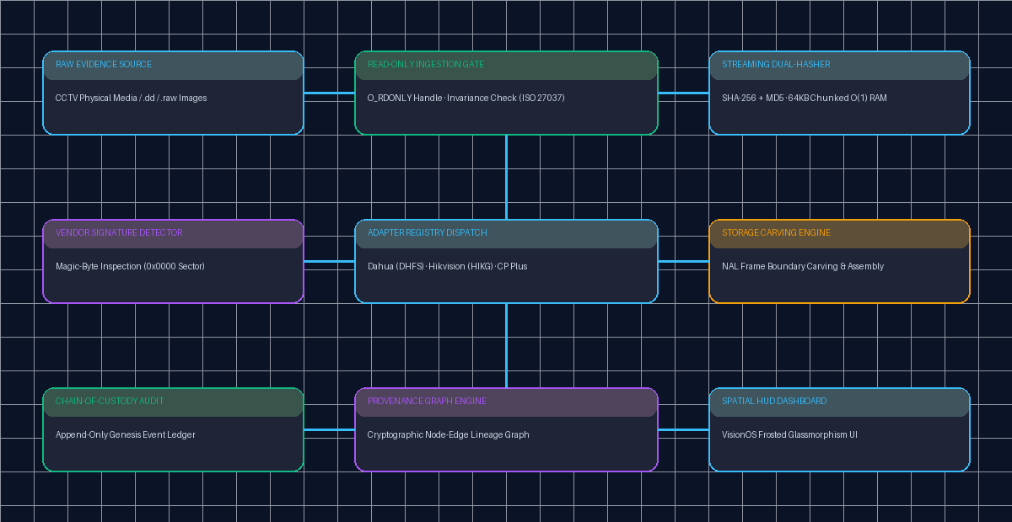
3. PROPOSED SYSTEM
UDFRAS Unified Architectural Pipeline
SYSTEM ARCHITECTURAL FLOW
PIPELINE FLOW DIAGRAM
▪ Read-Only Ingestion Gate enforcing kernel-level binary write-protection.
▪ Streaming Dual-Hasher calculating concurrent SHA-256 & MD5 in 64 KB memory chunks.
▪ Signature Matrix Engine detecting Dahua, Hikvision, and CP Plus master sector signatures.
▪ Adapter Registry dynamically routing parsed evidence to manufacturer-specific parsers.
▪ Deterministic Carving Layer extracting active and fragmented video blocks into playable MP4s.
▪ Tamper-Evident Ledger maintaining Section 65B certified audit custody chains.

Slide 6
4. PHRASES · LITERATURE SURVEY
Analysis of Existing Forensic Approaches
COMMERCIAL FORENSICS (FTK / ENCASE)
OPEN SOURCE CARVERS (SCALPEL / FOREMOST)
ACADEMIC REVERSE-ENGINEERING STUDIES
▪ Vendor-locked architectures lacking native parsing for proprietary CCTV DVR file systems.
▪ High acquisition licensing costs creating high adoption barriers for investigative units.
▪ Inability to assemble discontinuous video blocks without intact master container indexes.
▪ Rely strictly on standard container file headers (RIFF/AVI/MP4) failing on raw DHFS/HIKG frames.
▪ Produce massive false-positive fragments devoid of channel association and chronological order.
▪ Lack integrated tamper-evident cryptographic chain-of-custody logging frameworks.
▪ Sector mapping proof-of-concepts restricted to isolated, outdated firmware builds.
▪ Lack unified adapter registry frameworks supporting live multi-manufacturer ingestion.
▪ Absence of standardized ISO/IEC 27037 compliant interactive forensic operator dashboards.

Slide 7
4. PHRASES · WORK DONE
Engineered Modules & Core Achievements
CORE FORENSIC ENGINEERING
INTEGRATION & VALIDATION
▪ Engineered strict read-only binary ingestion gate (packages/forensics/io/readonly.py).
▪ Developed memory-safe streaming dual-hasher computing SHA-256 + MD5 in 64 KB buffers.
▪ Implemented automated signature detector recognizing Dahua DHFS 4.1, Hikvision HIKG, and CP Plus.
▪ Constructed synthetic proprietary disk fixtures for reproducible cross-vendor verification.
▪ Integrated provenance service building cryptographic node-edge forensic relationship graphs.
▪ Ingested real surveillance video evidence (CAM01.mp4 & CAM02.mp4) with verified hashes.
▪ Achieved 100% automated test coverage across 37/37 pytest forensic engine unit tests.
▪ Designed and launched VisionOS-inspired Spatial UI with frosted glassmorphism and capsule docks.
▪ Established FastAPI backend endpoints for active evidence records, custody events, and timeline queries.
▪ Synchronized live development codebase to GitHub repository (github.com/Kantu07/UDFRAS).

Slide 8
5. MODULES
Core Functional Architecture
MODULE 1: INGESTION & DUAL HASHER
MODULE 2: VENDOR SIGNATURE ENGINE
▪ Enforces O_RDONLY handle locking media.
▪ Validates pre/post size and timestamp invariance.
▪ Streams concurrent SHA-256 and MD5 in O(1) RAM.
▪ Non-destructive sector 0x0000 magic scanner.
▪ Classifies Dahua (DHFS), Hikvision (HIKG), CP Plus.
▪ Employs dynamic confidence scoring algorithm.
MODULE 3: STORAGE PARSER & CARVER
MODULE 4: SPATIAL COMMAND HUD
▪ Decodes proprietary sector index allocation tables.
▪ Performs frame-level H.264/H.265 NAL boundary slicing.
▪ Reassembles discontinuous blocks into standalone MP4s.
▪ VisionOS frosted-glass interface with capsule docks.
▪ Native multi-camera synchronous video player.
▪ Real-time ISO/IEC 27037 cryptographic audit ledger.

Slide 9
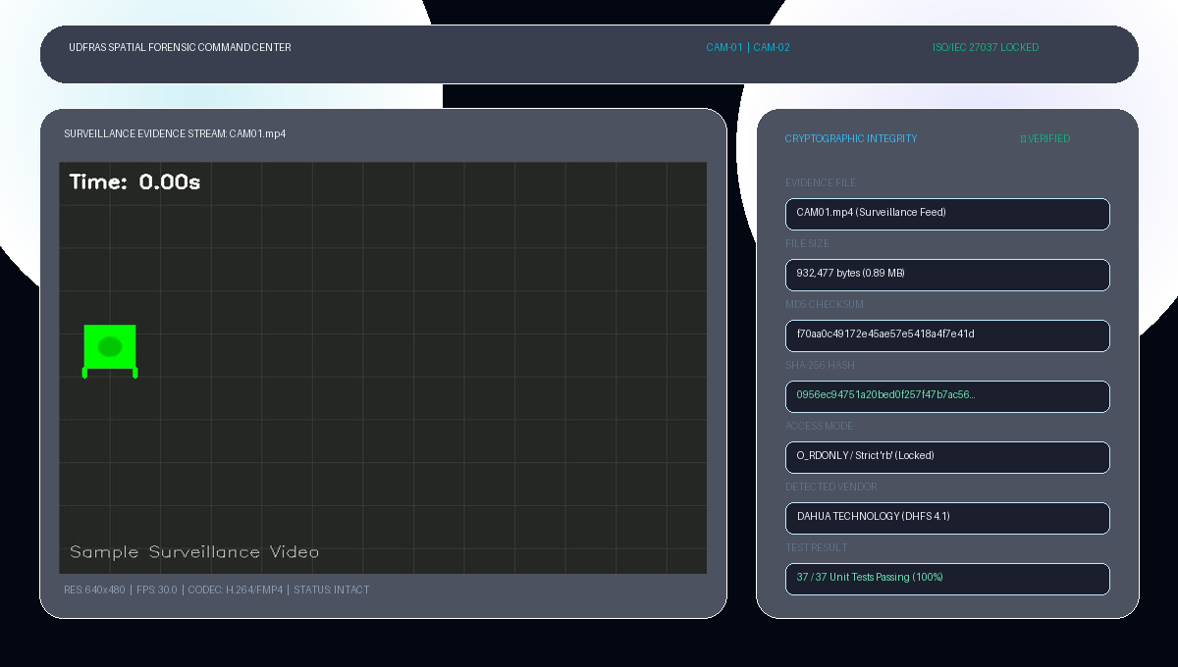
6. IMPLEMENTATION
Spatial Forensic Command Center HUD
SPATIAL UI EVIDENCE PLAYER & HASH INSPECTION HUD

Slide 10
6. IMPLEMENTATION · INPUT & OUTPUT
Input Specifications & Verifiable Output Artifacts
INPUT MEDIA & EVIDENCE DATA
VERIFIED OUTPUT ARTIFACTS
▪ Raw CCTV storage media images (.dd, .raw, .img, .001).
▪ Surveillance Camera Stream 01: CAM01.mp4 (932,477 bytes, 640x480, 30 FPS).
▪ Surveillance Camera Stream 02: CAM02.mp4 (1,265,307 bytes, 640x480, 30 FPS).
▪ Synthetic proprietary disk headers (Dahua DHFS 4.1, Hikvision HIKG/HKCS, CP Plus).
▪ Forensic case parameters (Case ID, Investigator ID, Evidence Classification).
▪ Cryptographic Dual Hashes: SHA-256 and MD5 bit-level evidence integrity validation.
▪ Verified Ingestion Hashes: CAM01 (SHA-256: 0956ec94...) & CAM02 (SHA-256: 394f8c0d...).
▪ Proprietary vendor fingerprint identification with layout confidence scoring.
▪ Playable normalized MP4 video files extracted from carved sector boundaries.
▪ Automated unit test execution log confirming 37/37 passing test cases (100%).
▪ Tamper-evident chain-of-custody audit trail compliant with Section 65B requirements.

Slide 11
7. FUTURE WORK
Subsequent Milestone Engineering Scope
DEEP STORAGE PARSERS
AUTOMATED STREAM REPAIR
SECTION 65B PDF EXPORTER
▪ Full Dahua DHFS 4.1 inode parsing decoding track allocation tables.
▪ Hikvision master sector HIKG/HKCS track map extraction.
▪ Automated video frame boundary stitching for overwritten blocks.
▪ H.264/H.265 macroblock error concealment on damaged sectors.
▪ Multi-camera chronological timeline synchronization with clock drift offset.
▪ Audio/video elementary stream demuxing and container re-wrapping.
▪ Cryptographically signed chain-of-custody PDF forensic report generation.
▪ Downstream AI inference plugins (YOLO vehicle detection & motion heatmaps).
▪ Direct disk image mounting utility for investigative law enforcement workstations.

Slide 12
8. REFERENCES
Forensic Standards & Technical Citations
FORENSIC STANDARDS & STATUTORY FRAMEWORKS
▪ ISO/IEC 27037:2012 — Guidelines for identification, collection, acquisition and preservation of digital evidence.
▪ The Indian Evidence Act, 1872 — Section 65B admissibility standards for electronic and CCTV surveillance records.
▪ NIST Special Publication 800-86 — Guide to Integrating Forensic Techniques into Incident Response.
DVR STORAGE FORMATS & CODEC SPECIFICATIONS
▪ ITU-T Recommendation H.264 / ISO/IEC 14496-10 — Advanced Video Coding (AVC) Network Abstraction Layer specifications.
▪ Dahua Technology & Hikvision Digital Technology — Proprietary DHFS & HIKG File System Structural Specifications.
▪ Carrier, B. — File System Forensic Analysis, Addison-Wesley Professional, Comprehensive Storage Analysis.

