Slide 1
Movie Analysis
Project
Ed Haracz & Chadwick Balloo

Slide 2
Overall Goal:
Past Future
Can we look at 2018 to determine which genres in what markets will perform best?
What genres produce the most revenue?
How does foreign vs domestic market affect revenue?
Can we choose what genre we should produce based on the revenues of 2018 films?
Will certain genres generate more in domestic vs. foreign markets?

Slide 3
Process
Planning
Data Collection
Parsing
Databasing
Exploration
Presentation Creation

Slide 4
Data Collection
The Movie Database - API Call
All 2018 movies
Genre
Rating
Rating Count
Release Date
Box Office Mojo - Webscrape
Top grossing movies of 2018
Revenue (Foreign & Domestic)
Market percentages

Slide 5
Parsing
Data Extraction
Exploration
Parse Function
Insert Function
Pagination Script

Slide 6
Databasing
Database Creation
Table Creation
SQL Inserts
Joining
Both datasets and Genre Id/Genre Name table
Export to CSV

Slide 7
Exploration/Visualizations
Import
Pandas
Dataframe Creation
Groupby
Correlation
Visualization Creation

Slide 8
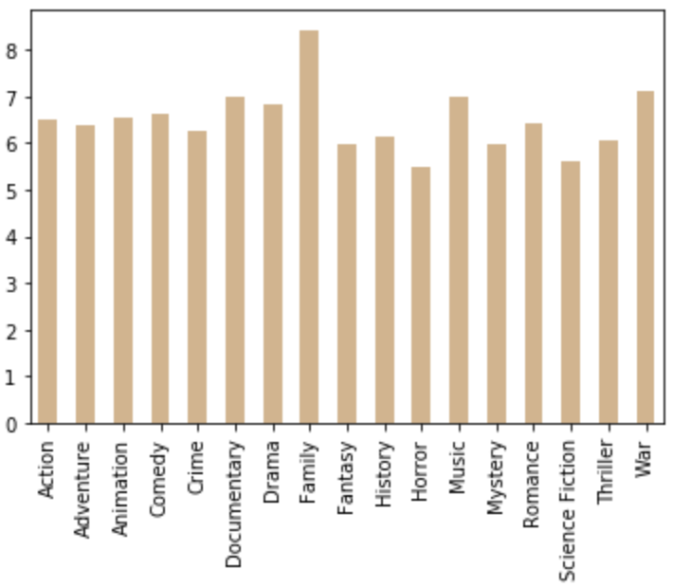
Average Rating by Genre
Family is the highest rated
Horror is the lowest
Rating
Genre

Slide 9
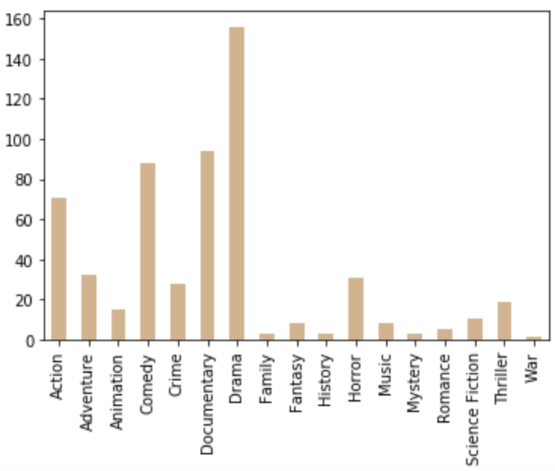
Count of Movies by Genre
Drama has the most produced
War had the fewest
Count
Genre

Slide 10
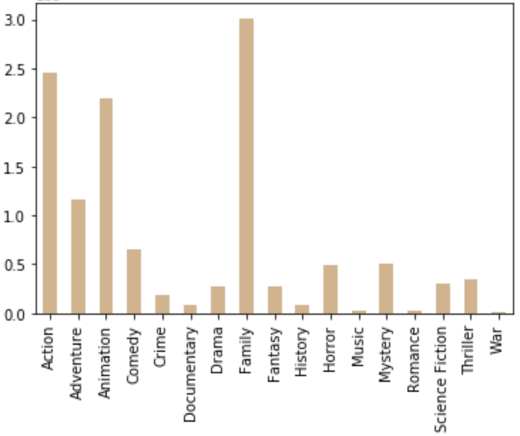
Average Revenue by Genre
On average Family produces the most revenue per movie.
Large drop-off between the top three (family, action, animation) and the remaining genres
Rev
(Avg)
Genre

Slide 11
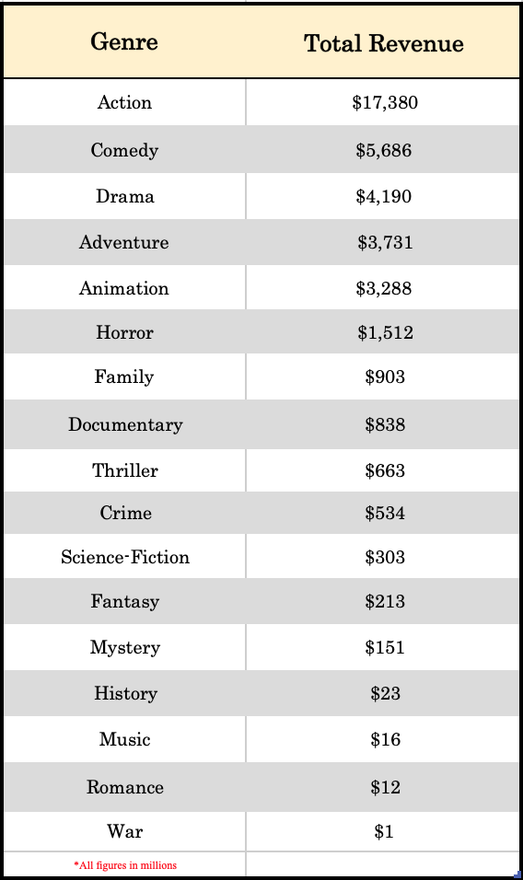
Revenue Breakdown
The highest grossing genres:
Action ($17.3bn)
Comedy ($5.7bn)
Drama ($4.2bn)
Adventure ($3.7bn)
Animation ($3.3bn)

Slide 12
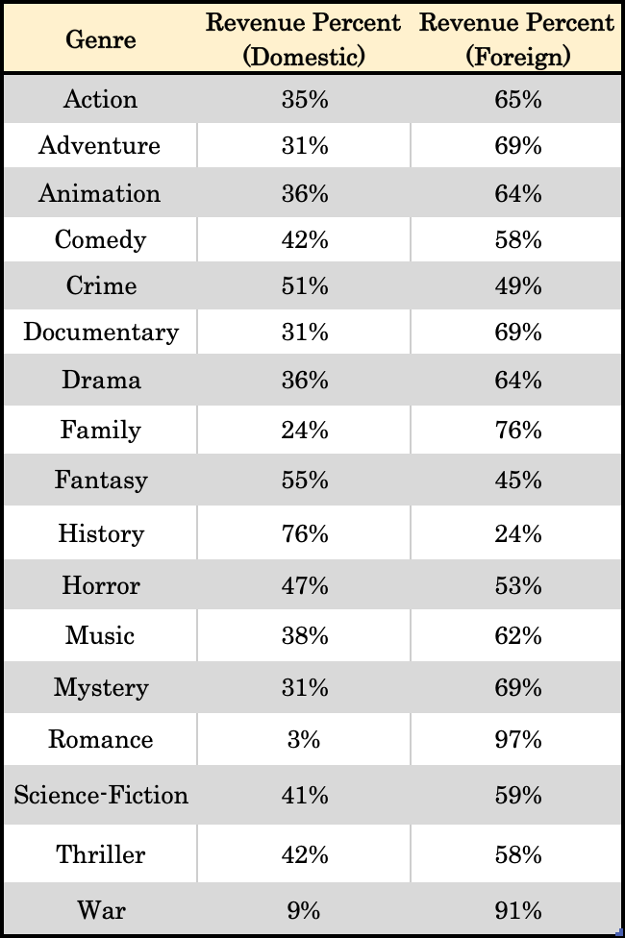
Revenue Breakdown
Movie genres produce the majority of their revenue in foreign
Except:
History (76%)
Fantasy (55%)
Crime (51%)

Slide 13
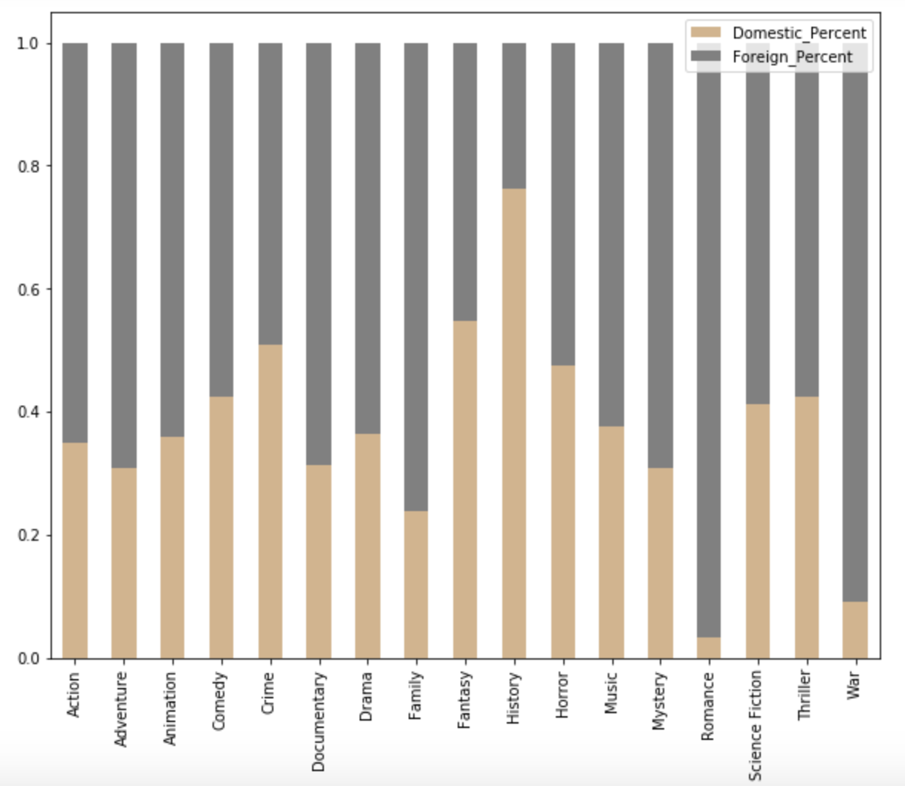
Revenue
Breakdown
Foreign or Domestic?
%
Genre

Slide 14
Conclusions
Largest Market Based on 2018 revenue, by far the largest market for movies is in the action genre
Ratings Based on rating, the most successful movie would be a family film, and horror films should be avoided
Highest Revenue per Movie by Genre The Family Genre had the highest average revenue. (This could be due to a small sample size however). Action and Animation follow respectively.

Slide 15
Correlation
Domestic vs. Foreign
.88
Strongest correlation we observed
Rating vs. Revenue
.13
Rating Count vs. Revenue
.68
There is a much stronger correlation between the amount of user ratings versus the actual rating itself

Slide 16
Moving Forward….
Our project would be useful to analyze what genres perform the best and in which markets, however, there are a few improvements needed to get the most out of it:
Improvement 1 More data is needed to make conclusions. Data is not normalized. There are not enough points for each genre.
Improvement 2 Uniform movie IDs to alleviate join/merge issues.
Improvement 3 Budget would be a very useful datapoint to add.

