Slide 1


Capstone Project On Sentiment Analysis
By Kanwal Arora
September 2020
Notes:
Microsoft sees all the big companies creating original video content, and they want to get in on the fun. They have decided to create a new movie studio, but the problem is they don’t know anything about creating movies. They have hired you to help them better understand the movie industry. Your team is charged with doing data analysis and creating a presentation that explores what type of films are currently doing the best at the box office. You must then translate those findings into actionable insights that the CEO can use when deciding what type of films they should be creating.

Slide 2

Problem Statement
In this section I am going to shed a light on main issues to get the better understanding of how a reviews put impact on the sale of any product or any department and how we can maximize profit by understating the nature of review. We will discuss some problems and solution in next few slides.

Slide 3

Business Values
Here we will touch some most crucial aspects to grow in this industry.
Some major aspects to understand.
Understand the sentiment of review.
Will predict the how department or product will perform in future
Most Important is sentiment of the audience.
We will touch the surface of other important aspects.

Slide 4




Methodology
Load & analyze the data
Kaggle Amazon Review Database
IMDB Movie Review Database
Organizing Data Using
Train model using different Machine Learning and Deep Learning Models for highest accuracy
Use Stats Tools
We will extract the solutions using averages, totals, and will use graphs to paint a better picture.
Notes:
Genres and movie success are corelated.
The five genres with highest rates of successful movies are : Animation, Adventure, Sci-Fi, Mystery and Comedy.
By contrast, the 5 genres with the worst rate of success are: Documentary, Musical, Sport, War and Western.

Slide 5
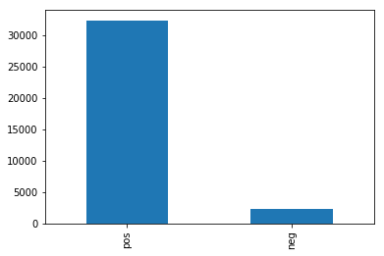
Methodology
• Data Cleaning • Feature Engineering • Logistic Regression • Bernouli NB • Multinomial NB • Naïve Bayes
• TFIDF
• NLTK
Notes:
Data comes from websites:
Box Office Mojo IMDB Rotten Tomatoes TheMovieDB.org
From tn.movie_budgets.csv, we analyzed the profitability of 4617 movies. For these movies, we used the budget and gross income data. We asked ourselves if the movie business is a good business to invest in. Considering all the available movies - good or bad -, how profitable are them on average? Can we expect to make a profit as a starting inexperienced movie studio?

Slide 6
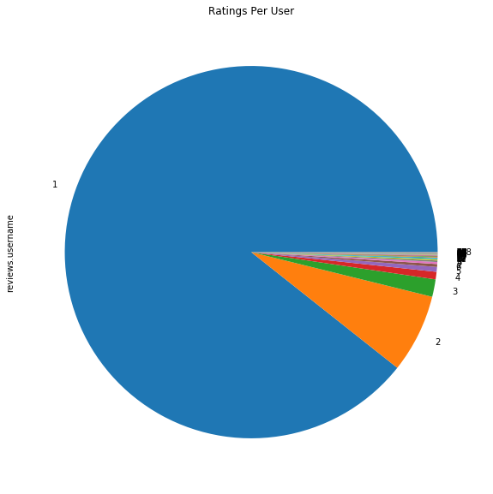
Amazon Review Sentiment Analysis:
Finding 1 -
We have learned from this section:
Only 0.55 % of the users are bulk users
Around 9 % of the ratings have been submitted by just 0.55% users - Does it seem odd to you ?
Notes:
Again we see that the movie business is quite lucrative. After 20 movies, we are almost certain to reach a profit ratio higher than 3.

Slide 7
Amazon Review Sentiment Analysis:
Multinomial NB:-
 | Precision | Recall | F1-score | Support
positive | 0.00 | 0.00 | 0.00 | 464
negative | 0.93 | 1.0 | 0.97 | 6461
accuracy |  |  | 0.93 | 6925
macro avg | 0.47 | 0.50 | 0.48 | 6925
weighted avg | 0.87 | 0.93 | 0.90 | 6925

Slide 8
Amazon Review Sentiment Analysis:
Bernoulli NB:-
 | Precision | Recall | F1-score | Support
positive | 0.33 | 0.17 | 0.23 | 464
negative | 0.94 | 0.97 | 0.96 | 6461
accuracy |  |  | 0.92 | 6925
macro avg | 0.63 | 0.57 | 0.59 | 6925
weighted avg | 0.90 | 0.92 | 0.91 | 6925

Slide 9
Amazon Review Sentiment Analysis:
Logistic Regression:-
 | Precision | Recall | F1-score | Support
positive | 0.56 | 0.33 | 0.41 | 464
negative | 0.95 | 0.98 | 0.97 | 6461
accuracy |  |  | 0.94 | 6925
macro avg | 0.75 | 0.65 | 0.69 | 6925
weighted avg | 0.93 | 0.94 | 0.93 | 6925

Slide 10
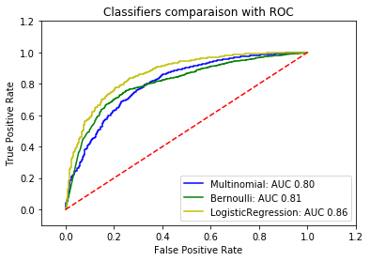
Conclusion
Now we have better understanding of the model which can give us higher area under curve to predict the sentiment of a particular product on Amazon . Concluding with following points.
Logistic Regression Model is giving us highest area under curve among all trained models with 86%.
Multinomial is with least AOC of 80%.
Bernoulli is with 81 %.

Slide 11
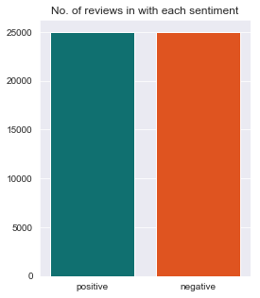
IMDB Review Sentiment Analysis:
Numbers of Positive & Negative Reviews-
We have learned from this section:
We have equal number of reviews 25000 each of positive and negative
Notes:
Again we see that the movie business is quite lucrative. After 20 movies, we are almost certain to reach a profit ratio higher than 3.

Slide 12
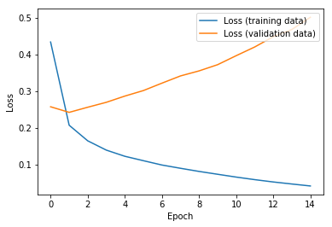
IMDB Review Sentiment Analysis:
Artificial Neural Network Loss-
We have learned from this section:
In this picture we can see loss has been reduced to 0.043 and validation loss touched 0.5017
Notes:
Again we see that the movie business is quite lucrative. After 20 movies, we are almost certain to reach a profit ratio higher than 3.

Slide 13
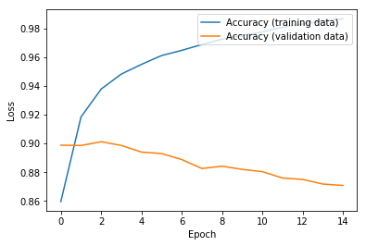
IMDB Review Sentiment Analysis:
Artificial Neural Network Accuracy-
We have learned from this section:
In this picture we can see max accuracy is 0.9866 and validation accuracy reached to 0.8708
Notes:
Again we see that the movie business is quite lucrative. After 20 movies, we are almost certain to reach a profit ratio higher than 3.

Slide 14
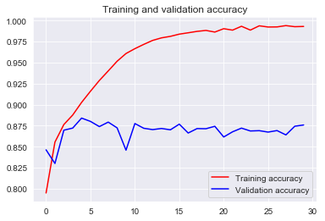
IMDB Review Sentiment Analysis:
Deep Neural Network Accuracy-
We have learned from this section:
In this picture we can see max accuracy is 0.9930 and validation accuracy reached to 0.8758
Notes:
Again we see that the movie business is quite lucrative. After 20 movies, we are almost certain to reach a profit ratio higher than 3.

Slide 15
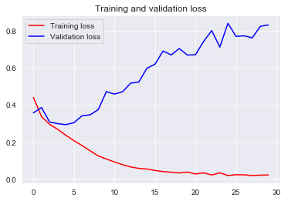
IMDB Review Sentiment Analysis:
Deep Neural Network Loss-
We have learned from this section:
In this picture we can see loss has been reduced to 0.0214 and validation loss touched 0.8758
Notes:
Again we see that the movie business is quite lucrative. After 20 movies, we are almost certain to reach a profit ratio higher than 3.

Slide 16

Future Work
Plans to dig deeper to get precise information
Understand the legitimacy of review whether its (Fake or Real)

Slide 17

Capstone Project On Sentiment Analysis
By Kanwal Arora
September 2020
Thank You
Notes:
Microsoft sees all the big companies creating original video content, and they want to get in on the fun. They have decided to create a new movie studio, but the problem is they don’t know anything about creating movies. They have hired you to help them better understand the movie industry. Your team is charged with doing data analysis and creating a presentation that explores what type of films are currently doing the best at the box office. You must then translate those findings into actionable insights that the CEO can use when deciding what type of films they should be creating.

