Slide 1

Analysis and Recommendations for Starting a Movie Studio
By Kanwal Arora
March 2020
Notes:
Microsoft sees all the big companies creating original video content, and they want to get in on the fun. They have decided to create a new movie studio, but the problem is they don’t know anything about creating movies. They have hired you to help them better understand the movie industry. Your team is charged with doing data analysis and creating a presentation that explores what type of films are currently doing the best at the box office. You must then translate those findings into actionable insights that the CEO can use when deciding what type of films they should be creating.

Slide 2
ANALYSIS
• What is the average runtime of a movie?
• What genres occur the most frequent?
• What genres had the highest budget and gross profit?

Slide 3
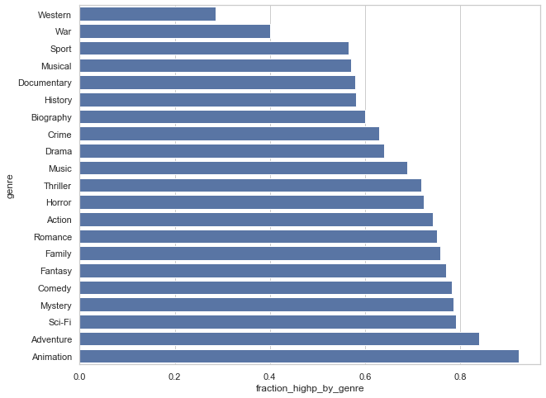
GENRES
Notes:
Genres and movie success are corelated.
The five genres with highest rates of successful movies are : Animation, Adventure, Sci-Fi, Mystery and Comedy.
By contrast, the 5 genres with the worst rate of success are: Documentary, Musical, Sport, War and Western.

Slide 4
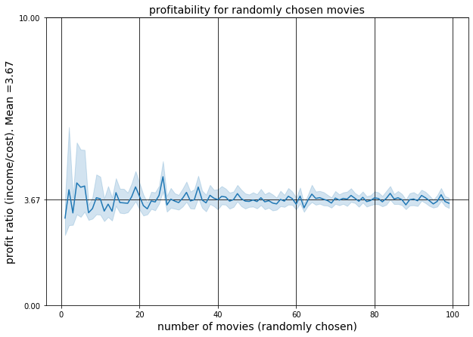
GROSS REVENUE VS. BUDGET
Notes:
Data comes from websites:
Box Office Mojo IMDB Rotten Tomatoes TheMovieDB.org
From tn.movie_budgets.csv, we analyzed the profitability of 4617 movies. For these movies, we used the budget and gross income data. We asked ourselves if the movie business is a good business to invest in. Considering all the available movies - good or bad -, how profitable are them on average? Can we expect to make a profit as a starting inexperienced movie studio?

Slide 5

Profit Ratio
Notes:
Data comes from websites:
Box Office Mojo IMDB Rotten Tomatoes TheMovieDB.org
From tn.movie_budgets.csv, we analyzed the profitability of 4617 movies. For these movies, we used the budget and gross income data. We asked ourselves if the movie business is a good business to invest in. Considering all the available movies - good or bad -, how profitable are them on average? Can we expect to make a profit as a starting inexperienced movie studio?

