Slide 1


Analysis and Recommendations for Starting a Movie Studio
By Kanwal Arora
March 2020
I am here to share my view about ”Movie Industry”. This presentation is made for Flatiron to get insight view of a movie industry, how we can maximize the profit with low risks.
Notes:
Microsoft sees all the big companies creating original video content, and they want to get in on the fun. They have decided to create a new movie studio, but the problem is they don’t know anything about creating movies. They have hired you to help them better understand the movie industry. Your team is charged with doing data analysis and creating a presentation that explores what type of films are currently doing the best at the box office. You must then translate those findings into actionable insights that the CEO can use when deciding what type of films they should be creating.

Slide 2

Problem Statement
In this section I am going to shed a light on main issues to get the better understanding of how a movie industry works and how we can get profit in this industry. We will discuss some problems and solution in next few slides.

Slide 3

Business Values
Here we will touch some most crucial aspects to grow in this industry.
Some major aspects to understand.
Relationship of Gross and Profit
How staff working in industry directly effect the gross and profit
Most Important is sentiment of the audience.
We will touch the surface of other important aspects.

Slide 4




Methodology
Load & analyze the data
Box Office Mojo
IMDB
Rotten Tomatoes
TheMovieDB.org
Organizing Data Using
Group by in different columns like Rating, Directors and Genres.
Use Stats Tools
We will extract the solutions using averages, totals, and will use graphs to paint a better picture.
Notes:
Genres and movie success are corelated.
The five genres with highest rates of successful movies are : Animation, Adventure, Sci-Fi, Mystery and Comedy.
By contrast, the 5 genres with the worst rate of success are: Documentary, Musical, Sport, War and Western.

Slide 5
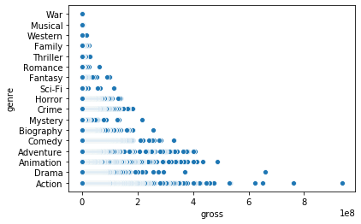
Finding 1:
Highest grossing movies genres -
As we can observe that Top 3 genres are “Action, Adventure and Animation”. We have made a good start. Now we know what genre should we start with.
Notes:
Data comes from websites:
Box Office Mojo IMDB Rotten Tomatoes TheMovieDB.org
From tn.movie_budgets.csv, we analyzed the profitability of 4617 movies. For these movies, we used the budget and gross income data. We asked ourselves if the movie business is a good business to invest in. Considering all the available movies - good or bad -, how profitable are them on average? Can we expect to make a profit as a starting inexperienced movie studio?

Slide 6
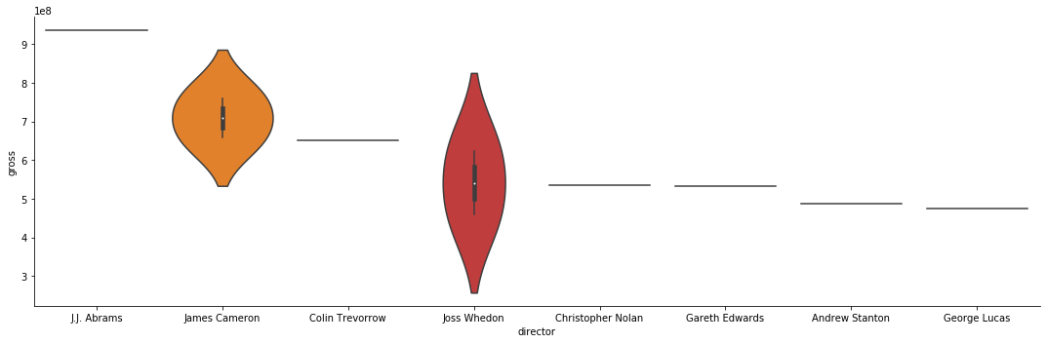
Finding 2:
Directors and Total Grossing -
We have learned from this section:
Joss Whedon & James Cameron are the directors with highest gross.
Directors with Highest Gross
Notes:
Again we see that the movie business is quite lucrative. After 20 movies, we are almost certain to reach a profit ratio higher than 3.

Slide 7

Finding 3:
Average Time and Its effect on gross-
In this finding we can clearly see that movies with average time of 110 – 120 min are getting more gross.

Slide 8
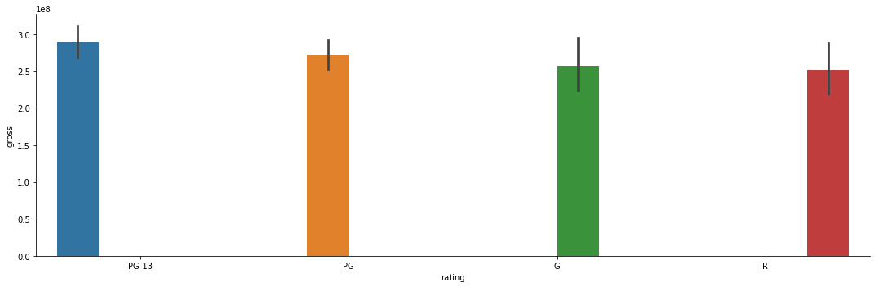
Finding 4:
Movie Rating and its effects on gross-
Rating of the movie also put impact on its gross or revenue. We can learn from the slide that Pg-13 Rating movies are getting more audience and getting more revenue

Slide 9

Finding 5:
Relation of Budget and Gross-
Most crucial role in order to get more gross is to have more budget for the movie. And we can see from the slide too. That key to get “More gross” is put “More budget”

Slide 10

Conclusion
Now we have better understanding of Movie Industry. Concluding with following points.
Better Production and budget leads to better gross.
Average runtime should be 110 – 130 minutes.
Top directors have good experience with Top 3 Genres.
PG-13 movies attract more audience

Slide 11

Future Work
Plans to dig deeper to get precise information
Changes in sentiments of the audience
Actors effecting the gross of a genre

Slide 12

Analysis and Recommendations for Starting a Movie Studio
By Kanwal Arora
March 2020
Thank You
Notes:
Microsoft sees all the big companies creating original video content, and they want to get in on the fun. They have decided to create a new movie studio, but the problem is they don’t know anything about creating movies. They have hired you to help them better understand the movie industry. Your team is charged with doing data analysis and creating a presentation that explores what type of films are currently doing the best at the box office. You must then translate those findings into actionable insights that the CEO can use when deciding what type of films they should be creating.

