Slide 1
Software construction lab 8 Interface, Graphical user interfaces and Recursive data types & its implementation

Slide 2
Objectives:
After completing this lab, students will be able to:
Implement and understand the concept of interfaces in Python, emphasizing their significance in software development.
Develop Graphical User Interfaces (GUIs) using Gradio library, mastering the creation of interactive and user-friendly applications.
Apply recursive data types to design and implement complex data structures, such as linked lists or trees, for efficient problem-solving.
Integrate interfaces, Gradio-based GUIs, and recursive data types to build sophisticated software applications.
Enhance critical thinking skills for problem-solving by analyzing and selecting suitable solutions in the context of interfaces, Gradio GUIs, and recursive data types.
Communicate effectively about the benefits and applications of interfaces, Gradio-based GUIs, and recursive data types to peers and stakeholders.

Slide 3

Introduction to Interfaces
Definition: concept of an interface as a means of interaction between different software components.
Purpose: Interfaces define a contract for methods that implementing classes must provide.
Real-World Example: Java interfaces in object-oriented programming.
Description: This code defines a simple Animal interface with eat and sound methods.

Slide 4
Why we use interfaces:
Abstraction:
Interfaces allow you to define a contract for classes, specifying a set of methods that must be implemented by any class that implements the interface.
This helps in abstracting away the implementation details and focusing on what a class should do rather than how it should do it.
Code Organization:
Interfaces help in organizing code by providing a clear structure for the methods that a class should implement.
It makes it easier to understand and navigate code, especially in larger projects.

Slide 5


Implementation of interfaces in real world application
Notes:
from abc import ABC, abstractmethod
import math
# Define a common interface for shapes
class Shape(ABC):
@abstractmethod
def area(self):
pass
@abstractmethod
def perimeter(self):
pass
# Implement the interface for a Circle
class Circle(Shape):
def __init__(self, radius):
self.radius = radius
def area(self):
return math.pi * self.radius**2
def perimeter(self):
return 2 * math.pi * self.radius
# Implement the interface for a Square
class Square(Shape):
def __init__(self, side_length):
self.side_length = side_length
def area(self):
return self.side_length**2
def perimeter(self):
return 4 * self.side_length
# Implement the interface for a Triangle
class Triangle(Shape):
def __init__(self, base, height, side1, side2, side3):
self.base = base
self.height = height
self.side1 = side1
self.side2 = side2
self.side3 = side3
def area(self):
return 0.5 * self.base * self.height
def perimeter(self):
return self.side1 + self.side2 + self.side3
# Example usage
circle = Circle(radius=5)
square = Square(side_length=4)
triangle = Triangle(base=3, height=6, side1=4, side2=5, side3=7)
# Displaying the properties of each shape
print(f"Circle - Area: {circle.area()}, Perimeter: {circle.perimeter()}")
print(f"Square - Area: {square.area()}, Perimeter: {square.perimeter()}")
print(f"Triangle - Area: {triangle.area()}, Perimeter: {triangle.perimeter()}")

Slide 6
Formula used in the given example:
Circle:
Area: π×radius^2
Perimeter (Circumference): 2×π×radius
Square:
Area: side_length^2
Perimeter: 4×side_length
Triangle:
Area: 0.5×base×height
Perimeter: side1+side2+side3

Slide 7
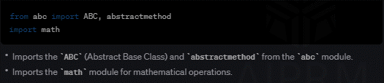
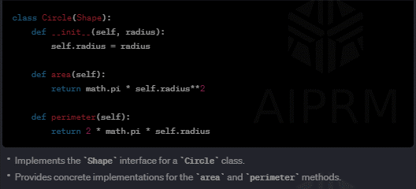
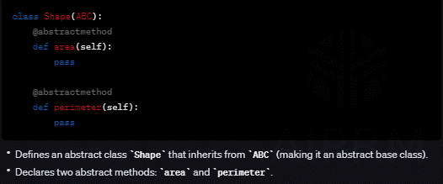
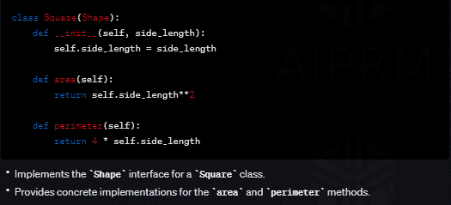
Import statements:
Implement Interface for Circle:
Define Common Interface - Shape:
Implement Interface for Square:

Slide 8
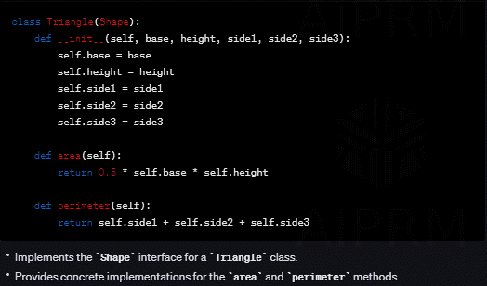
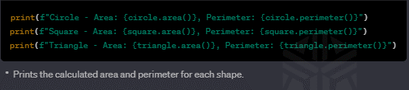
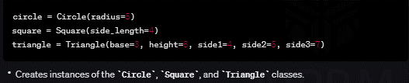
Implement Interface for Triangle:
Print the calculated area:
Creating Instances:
Notes:
from abc import ABC, abstractmethod
import math
# Define a common interface for shapes
class Shape(ABC):
@abstractmethod
def area(self):
pass
@abstractmethod
def perimeter(self):
pass
# Implement the interface for a Circle
class Circle(Shape):
def __init__(self, radius):
self.radius = radius
def area(self):
return math.pi * self.radius**2
def perimeter(self):
return 2 * math.pi * self.radius
# Implement the interface for a Square
class Square(Shape):
def __init__(self, side_length):
self.side_length = side_length
def area(self):
return self.side_length**2
def perimeter(self):
return 4 * self.side_length
# Implement the interface for a Triangle
class Triangle(Shape):
def __init__(self, base, height, side1, side2, side3):
self.base = base
self.height = height
self.side1 = side1
self.side2 = side2
self.side3 = side3
def area(self):
return 0.5 * self.base * self.height
def perimeter(self):
return self.side1 + self.side2 + self.side3
# Example usage
circle = Circle(radius=5)
square = Square(side_length=4)
triangle = Triangle(base=3, height=6, side1=4, side2=5, side3=7)
# Displaying the properties of each shape
print(f"Circle - Area: {circle.area()}, Perimeter: {circle.perimeter()}")
print(f"Square - Area: {square.area()}, Perimeter: {square.perimeter()}")
print(f"Triangle - Area: {triangle.area()}, Perimeter: {triangle.perimeter()}")

Slide 9
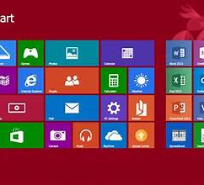

Graphical User Interfaces (GUIs)
Definition: GUIs are interfaces that allow users to interact with electronic devices through graphical icons and visual indicators.
Components: elements like buttons,
text fields, images, inputs & outputs.
Real-World Application: Everyday applications like Microsoft Word or the macOS interface.

Slide 10

What Is Gradio:
Gradio is a Python library that simplifies the process of creating user interfaces for machine learning models. It allows you to build interactive and user-friendly interfaces for your models without requiring extensive knowledge of web development. Gradio supports various input and output types, making it versatile for different types of machine learning tasks.

Slide 11
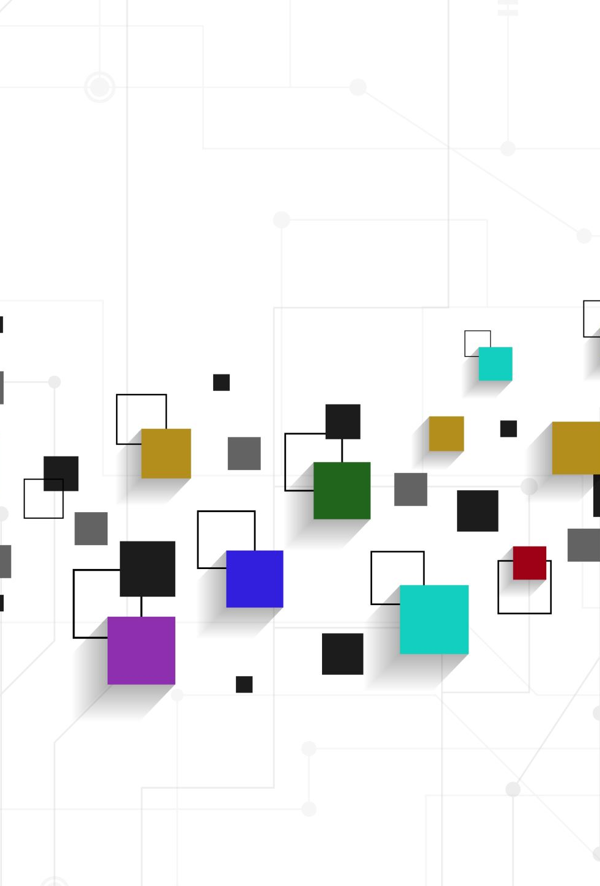
Benefits of Gradio:
Easy Interface Creation:
Gradio makes it simple to create interfaces using a few lines of code.
It supports various input types such as text, images, audio, and more.
Support for Different Frameworks:
Gradio is framework-agnostic, meaning you can use it with popular machine learning frameworks like TensorFlow, PyTorch, and scikit-learn.
Wide Range of Input and Output Components:
Gradio supports a variety of input components like textboxes, image uploaders, and sketchpads, and output components like text displays, images, and more.
Cloud Deployment:
Gradio provides options for deploying your interfaces to the cloud, making it accessible to a broader audience.

Slide 12
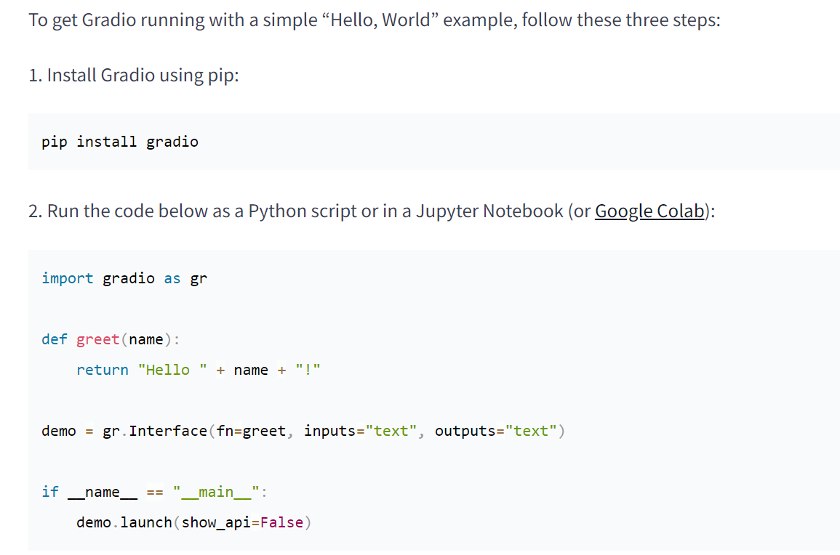
Gradio gui in python:
Notes:
import gradio as gr
def greet(name):
return "Hello " + name + "!"
demo = gr.Interface(fn=greet, inputs="text", outputs="text")
if __name__ == "__main__":
demo.launch(show_api=False)

Slide 13
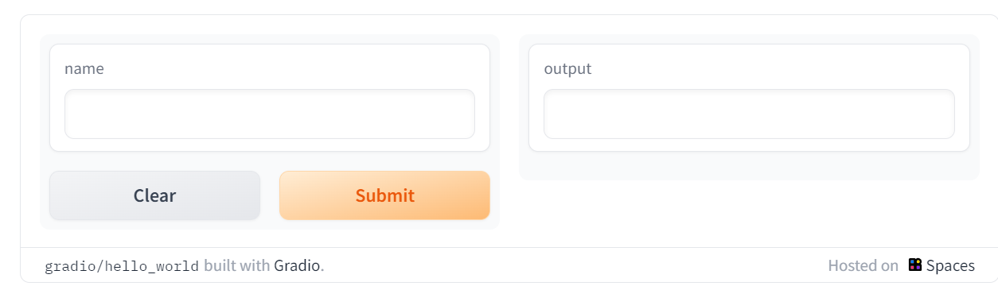
How it looks like;

Slide 14
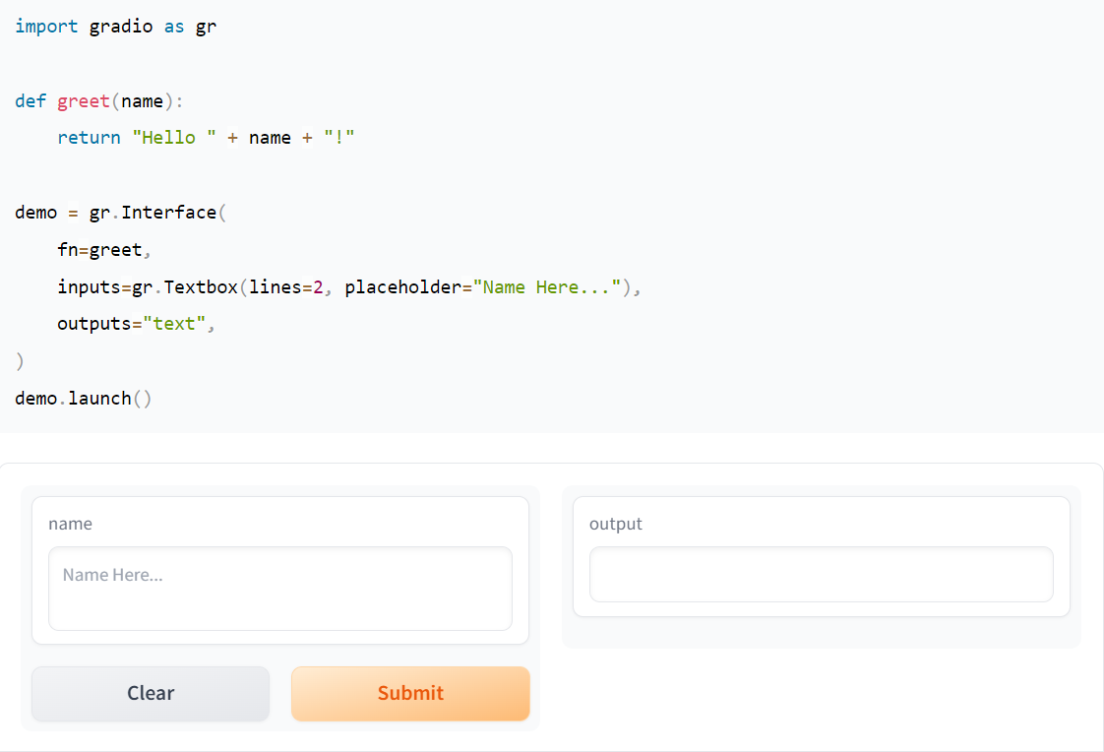
Another example:
Notes:
import gradio as gr
def greet(name):
return "Hello " + name + "!"
demo = gr.Interface(
fn=greet,
inputs=gr.Textbox(lines=2, placeholder="Name Here..."),
outputs="text",
)
demo.launch()

Slide 15
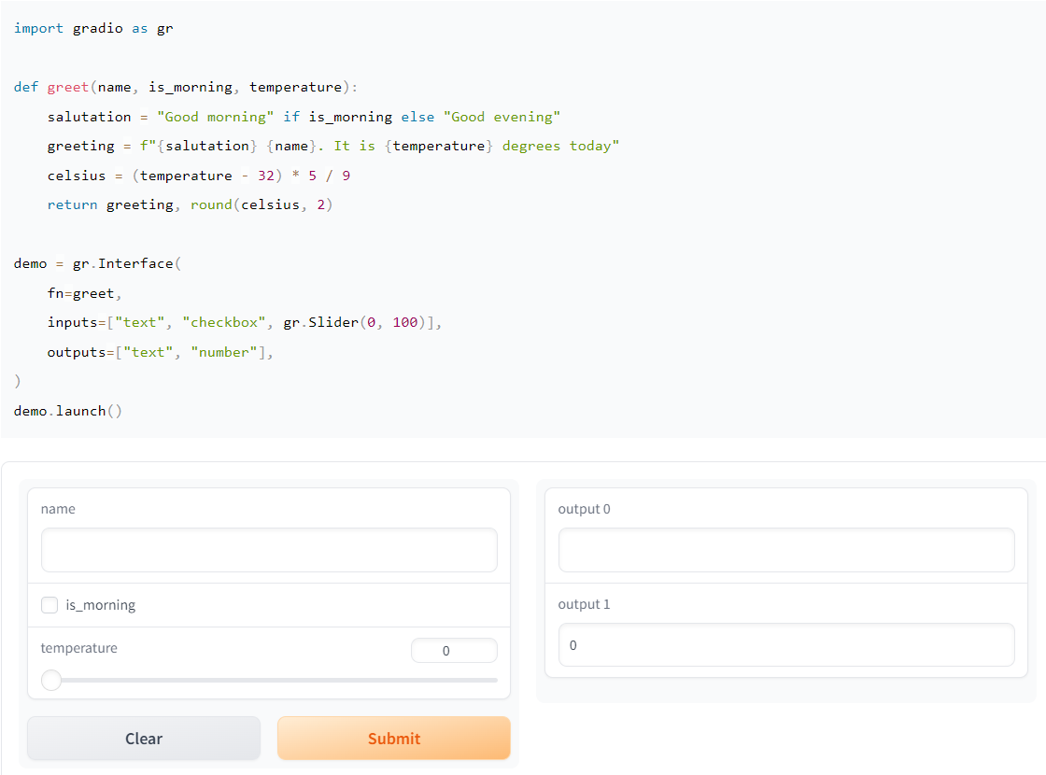
Another example:
Notes:
import gradio as gr
def greet(name, is_morning, temperature):
salutation = "Good morning" if is_morning else "Good evening"
greeting = f"{salutation} {name}. It is {temperature} degrees today"
celsius = (temperature - 32) * 5 / 9
return greeting, round(celsius, 2)
demo = gr.Interface(
fn=greet,
inputs=["text", "checkbox", gr.Slider(0, 100)],
outputs=["text", "number"],
)
demo.launch()

Slide 16
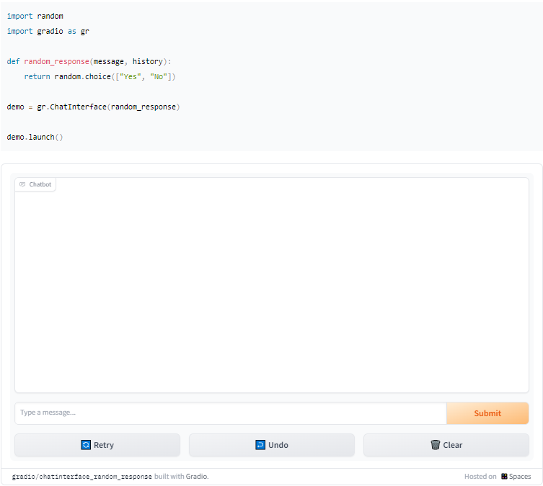
Chatbot in Gradio
Notes:
import random
import gradio as gr
def random_response(message, history):
return random.choice(["How may I help you", "I'm fine", "thanks for your time", "I'm thinking......."])
demo = gr.ChatInterface(random_response)
demo.launch()

Slide 17
Blocks in Gradio:
Blocks, a low-level API for designing web apps with more flexible layouts and data flows. Blocks allows you to do things like feature multiple data flows and demos, control where components appear on the page, handle complex data flow
Blocks are made with a with clause, and any component created inside this clause is automatically added to the app.
Components appear vertically in the app in the order they are created.

Slide 18
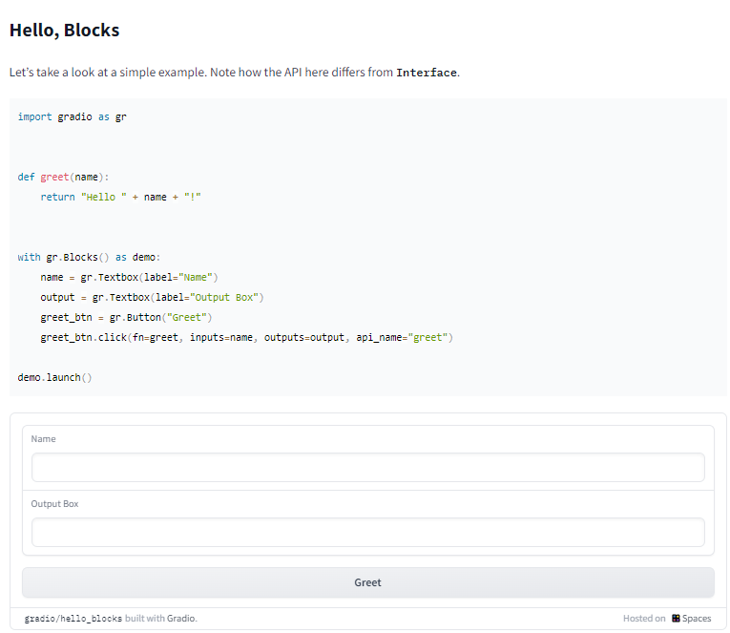
Hello blocks:
Notes:
import gradio as gr
def greet(name):
return "Hello " + name + "!"
with gr.Blocks() as demo:
name = gr.Textbox(label="Name")
output = gr.Textbox(label="Output Box")
greet_btn = gr.Button("Greet")
greet_btn.click(fn=greet, inputs=name, outputs=output)
demo.launch()

Slide 19
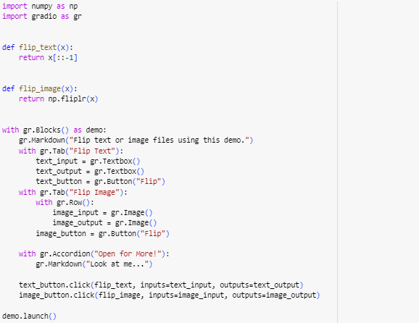
Gradio tabs:
Notes:
import numpy as np
import gradio as gr
def flip_text(x):
return x[::-1]
def flip_image(x):
return np.fliplr(x)
with gr.Blocks() as demo:
gr.Markdown("Flip text or image files using this demo.")
with gr.Tab("Flip Text"):
text_input = gr.Textbox()
text_output = gr.Textbox()
text_button = gr.Button("Flip")
with gr.Tab("Flip Image"):
with gr.Row():
image_input = gr.Image()
image_output = gr.Image()
image_button = gr.Button("Flip")
with gr.Accordion("Open for More!"):
gr.Markdown("Look at me...")
text_button.click(flip_text, inputs=text_input, outputs=text_output)
image_button.click(flip_image, inputs=image_input, outputs=image_output)
demo.launch()

Slide 20
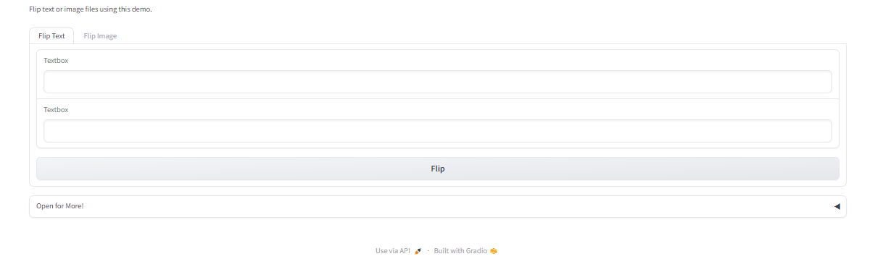
Flip text

Slide 21
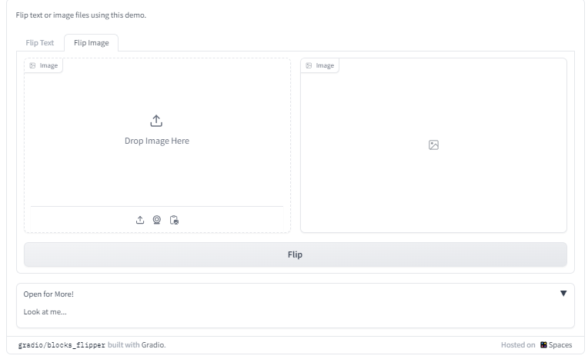
Flip image:

Slide 22
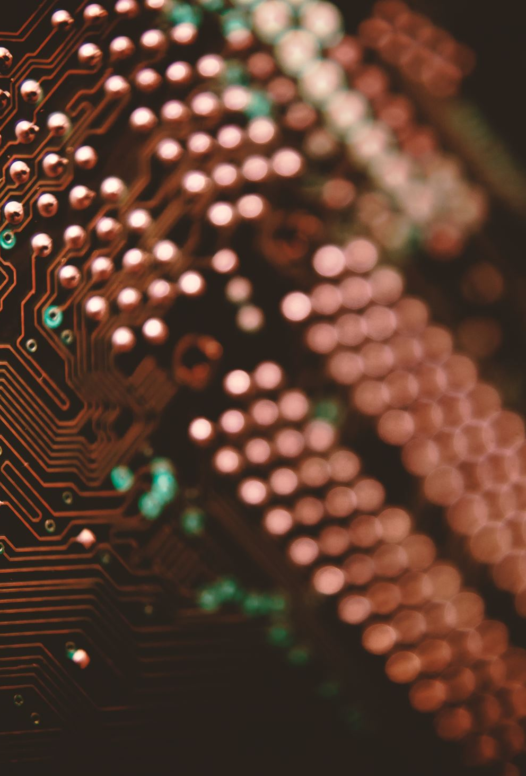
Recursive data types:
Recursive data types are structures that can be defined in terms of themselves, usually to handle inherently recursive data. Below are their aspects and real-world implementation details:
Real-world Examples:
File Systems: Directories can contain subdirectories, which in turn can contain more, creating a recursive structure.
Social Networks: Users have friends who are users themselves, each with their own network.

Slide 23

Challenges:
Complexity: Understanding and working with recursion can be conceptually challenging.
Memory Overhead: Improper implementation can lead to high memory usage or stack overflows.
Debugging Difficulty: Tracing through recursive calls can be more difficult than iterative solutions.

Slide 24
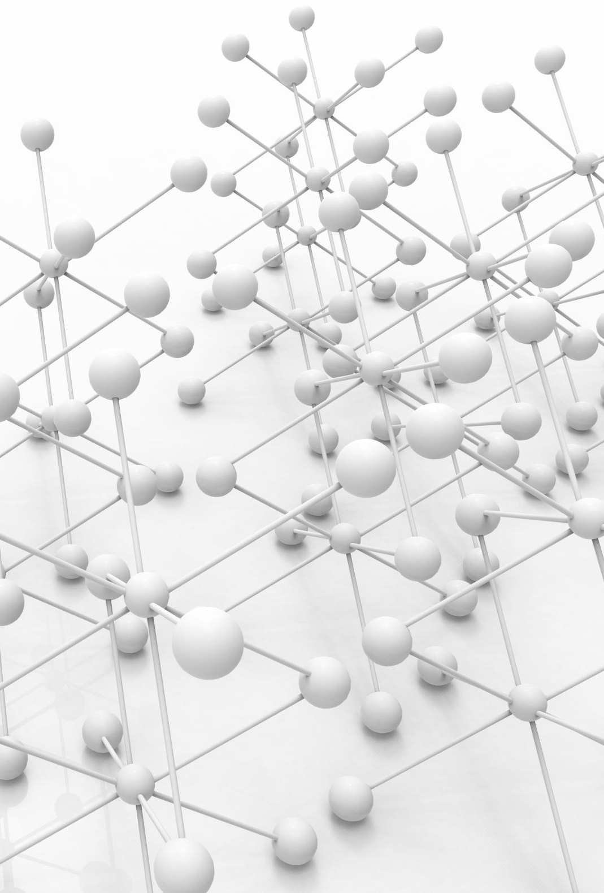
Implementation in Real-world Scenarios:
Organizational Charts: Representing the structure of an organization, where each division is made up of smaller divisions.
Data Parsing: Parsing nested data formats like XML or JSON in programming.
Component Trees in Web Development: Frameworks like React use a component tree where components can contain other components.

Slide 25
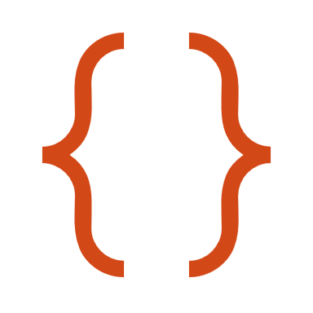
Code examples

Slide 26

Factorial calculation
def factorial(n):
if n == 0 or n == 1:
return 1
else:
return n * factorial(n-1)
# Example usage:
result = factorial(5)
print("Factorial of 5:", result)

Slide 27
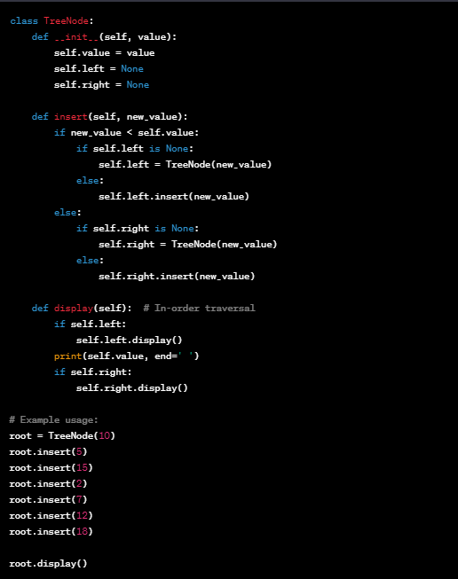
Recursive data type: (tree)
This code snippet defines a Tree Node class, which represents each node in a binary tree. The insert method is recursive and places new values in the correct location in the binary tree. The display method is also recursive, performing an in-order traversal to print all the values in the tree.
Notes:
class TreeNode:
def __init__(self, value):
self.value = value
self.left = None
self.right = None
def insert(self, new_value):
if new_value < self.value:
if self.left is None:
self.left = TreeNode(new_value)
else:
self.left.insert(new_value)
else:
if self.right is None:
self.right = TreeNode(new_value)
else:
self.right.insert(new_value)
def display(self): # In-order traversal
if self.left:
self.left.display()
print(self.value, end=' ')
if self.right:
self.right.display()
# Example usage:
root = TreeNode(10)
root.insert(5)
root.insert(15)
root.insert(2)
root.insert(7)
root.insert(12)
root.insert(18)
root.display()

Slide 28

Tools:
Google colab

Slide 29
Tasks:
Task 1: Banking Interface
Implement a command-line application using interface for a banking system.
Details: Students will create app where users can type commands to check balances, deposit, and withdraw money.

Slide 30
Tasks:
Task 2: Gradio Library Management System
Objective: Design a Gradio interface for managing a library system. Details: Using Gradio, students will develop a GUI for entering new books, searching the catalog, and managing borrowings.

Slide 31
Tasks:
Task 3: Gradio Recursive File Search Interface
Objective: Create a Gradio interface that allows users to search files recursively.
Details: Students will develop a Gradio app that provides a user interface for specifying a directory and file type, then displays a list of all matching files found through recursive search.

Slide 32
Tasks:
Task 4: Gradio-based Calculator
Objective: Build a calculator with a graphical user interface using Gradio.
Details: Students will use Gradio to create a web-based calculator that performs basic arithmetic operations and displays the results on the GUI.

Slide 33
Tasks:
Task 5: Binary Tree Traversal
Create a Python program that defines a binary tree as a recursive data type. Implement functions for in-order, pre-order, and post-order traversals of the binary tree. Test your program with a sample binary tree and display the results of each traversal.

Slide 34
Tasks:
Task 6: Directory Structure Analysis
Design a program that models a directory structure using a recursive data type. Each node in the structure represents either a file or a directory. Implement a function that calculates the total size of the directory, considering the sizes of all files and subdirectories. Test your program with a sample directory structure and display the total size.

