Slide 1

TECHNICAL REVIEW
Gerry's Docks
Live deployed quote management system
Backend APIs | Microservices | Azure AKS | CI/CD
Live URL
http://20.175.132.45
Gerry's Docks technical review
01
Notes:
[Sources]
Local project asset: presentation-assets/gerrys-webpage-in-laptop.png
Deployment URL from project demo context.

Slide 2
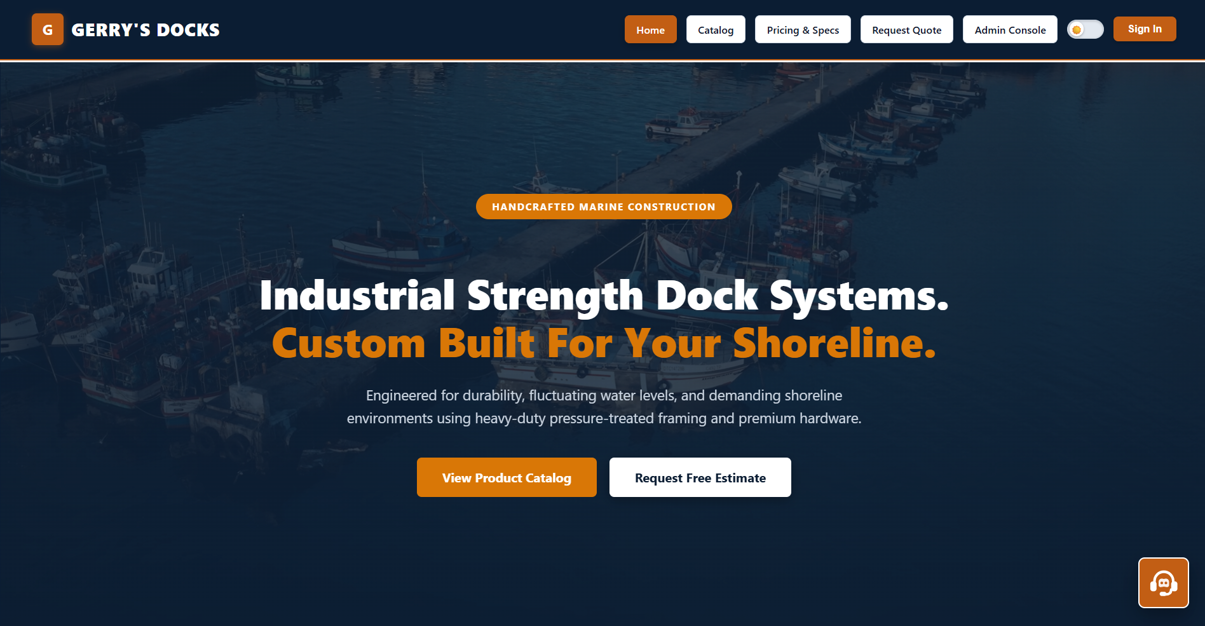
LIVE PATH
Show the best user journey first
1
2
3
4
Browse
Request
Admin
Verify
Catalog + pricing
Submit quote
Login + review
Saved data appears
Presenter cue
Use keyboard shortcuts while moving through the live site.
Gerry's Docks technical review
02
Notes:
[Sources]
Local project asset: presentation-assets/gerrys-current-homepage-chatbot.png

Slide 3
BACKEND
Frontend actions map to API services
Frontend action
API route
Service
Catalog loads
Quote submitted
Admin logs in
Product changed
Quotes reviewed
GET /api/products
POST /api/quotes
POST /api/admin/login
POST/PUT/DELETE /api/products
GET /api/quotes
product-service
quote-service
admin-service
product-service
quote-service
Protected admin actions require a JWT token before database changes are allowed.
Gerry's Docks technical review
03
Notes:
[Sources]
Local code mapping from frontend src pages and services routes.

Slide 4
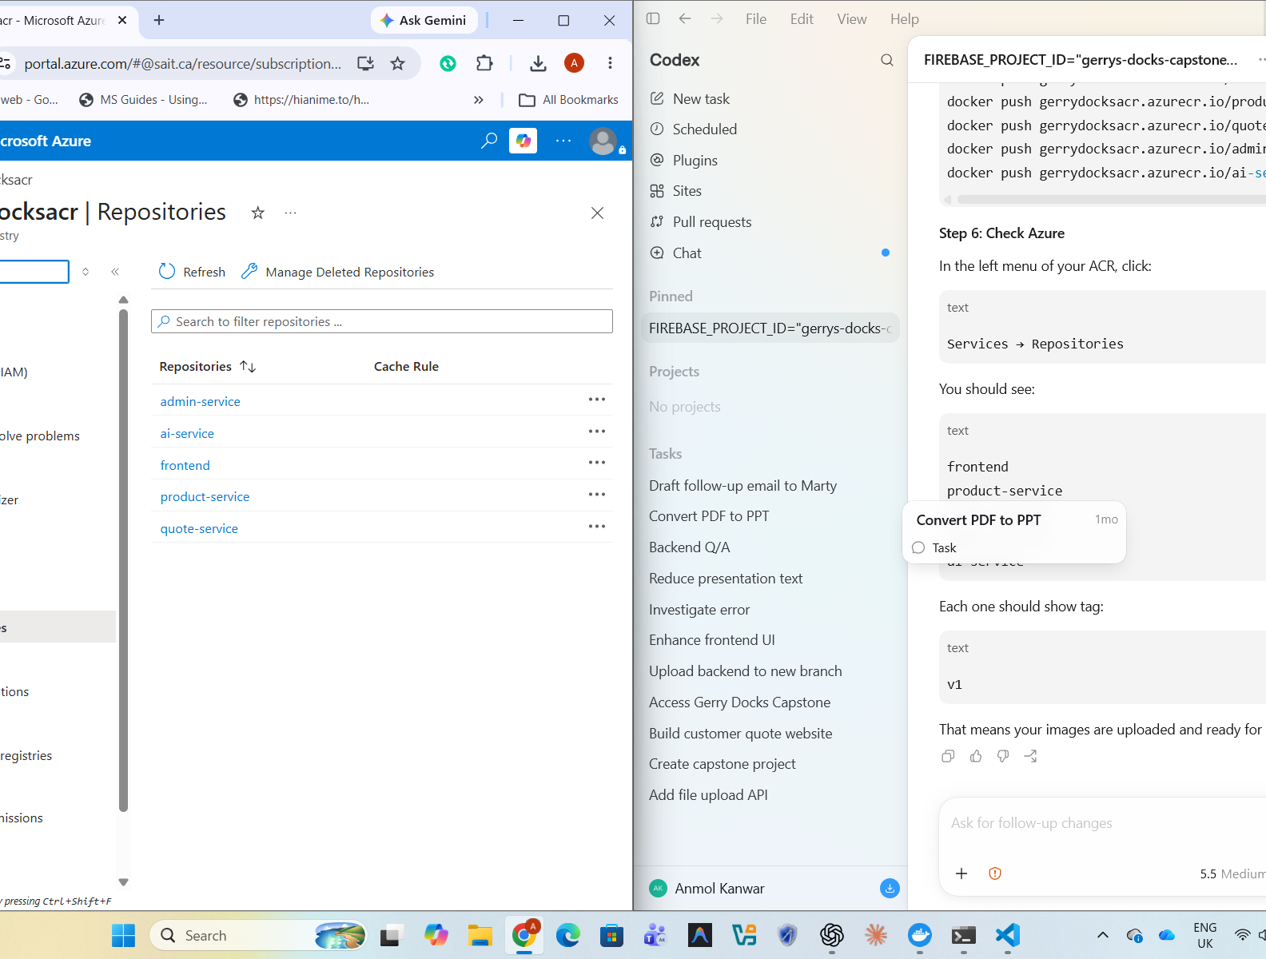
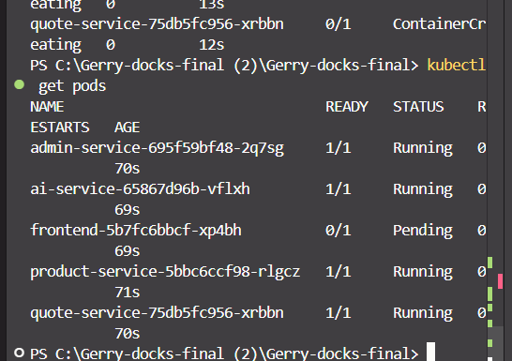
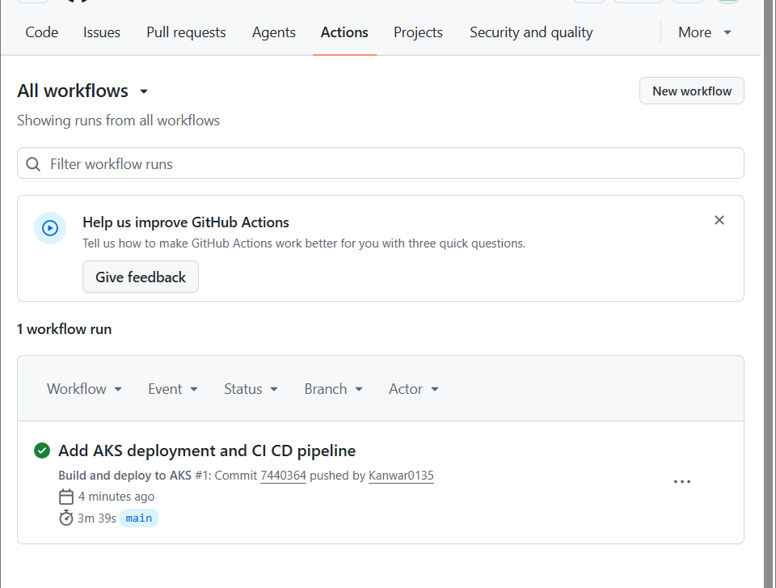
CLOUD
Deployment evidence is visible in Azure
ACR images
AKS pods
CI/CD run
GitHub push → Docker build → Azure Container Registry → Azure Kubernetes Service
Gerry's Docks technical review
04
Notes:
[Sources]
Local evidence screenshots: ACR repositories, kubectl pods, GitHub Actions workflow.

Slide 5
READY FOR CLIENT SUBMISSION
What the demo proves
Deployed
Integrated
Automated
Live cloud-hosted website
Frontend, APIs, database, AI
Docker + AKS + GitHub Actions
Contribution focus
Kanwar: backend, microservices, Azure, CI/CD
Moin: frontend UX
Davinderdeep: database
Simranjit: AI assistant + support
Gerry's Docks technical review
05
Notes:
[Sources]
Team role summary from project discussion.

