Slide 1


MICROSOFT MOVIE STUDIO INSIGHT
Members:
Calistus Mwonga
Samwel Kipkemboi
Brian Kanyenje
Hannah Nyambura
Kelvin Mutua
DATE: 02/05/2025

Slide 2
OVERVIEW
This project aims to guide a Microsoft Movie Studio making data-driven decisions about which movie films to produce by analyzing key factors that drive box office success. The analysis explores movie genres, viewer rating, director and actor influence and budget impact on revenue. The insights got from these analysis then help provide business recommendations to help the studio make right decision which would lead to the company’s success.

Slide 3
OUTLINE
Business problem
Objectives
Data overview
Data cleaning and preparation
Visualizations and Results
Business recommendations
Conclusions
Contacts

Slide 4
BUSINESS PROBLEM
The company has decided to create a new movie studio, but they don’t know anything about creating movies. Our task was exploring what types of films are currently doing the best at the box office then translate those findings into actionable insights that the company can use to help decide what type of films to create.

Slide 5
OBJECTIVES
To determine which movie genres, perform highly in terms of revenue and viewer rating.
To determine the top talents (directors and actors) that are linked to the highest performing movies.
To determine whether movie budget affects the overall performance of a movie.

Slide 6
DATA OVERVIEW
Datasets used are:
1. IMDb (Database)
2. tn.movie_budgets.csv

Slide 7
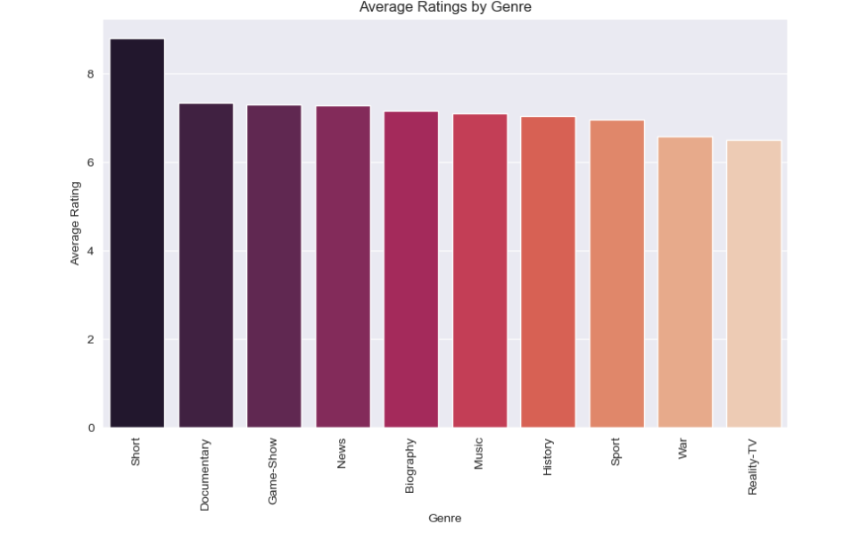
VISUALIZATIONS
Determining movie genres perform based on average viewer rating rating
Insights:
Genres with high average ratings are: Short films, Documentary and Game-shows

Slide 8
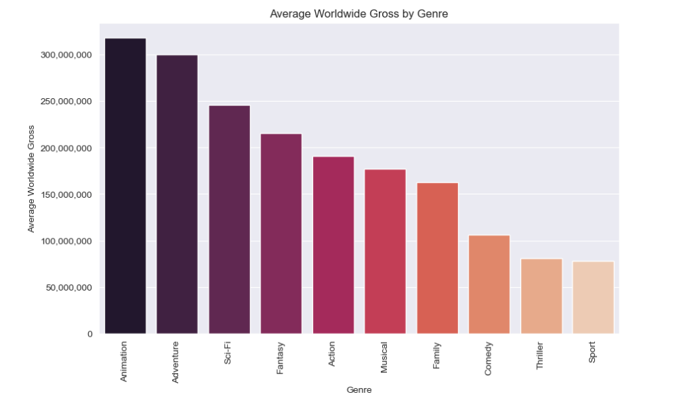
VISUALIZATIONS
Determining movie genres perform based on average viewer rating
Insights:
Top 3 Genre in terms of worldwide gross are: Animations, Adventure and Sci-Fi

Slide 9
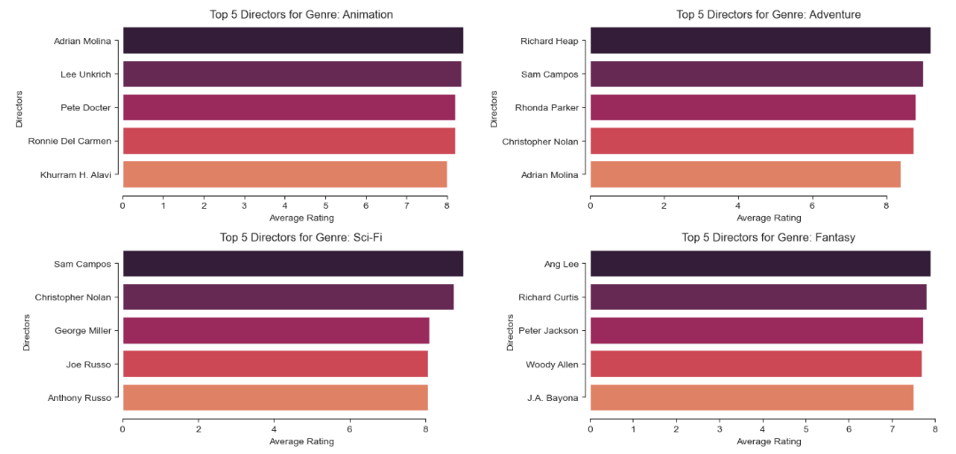
Top directors linked to the highest performing movies
Insights: The chart shows the names of the top directors linked to the highest performing movies

Slide 10
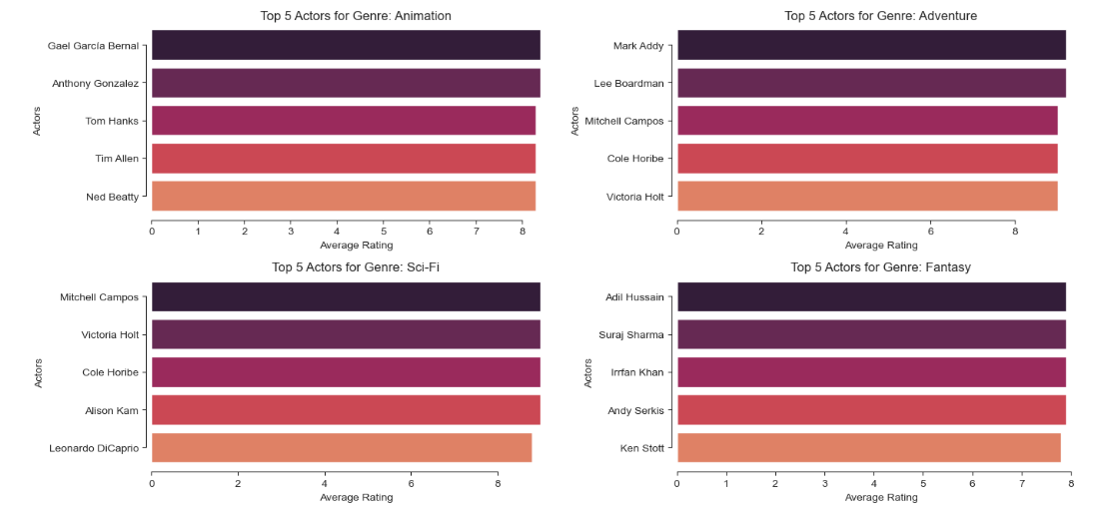
Top actors linked to the highest performing movies
Insights: The chart shows the names of the top actors linked to the highest performing movies

Slide 11
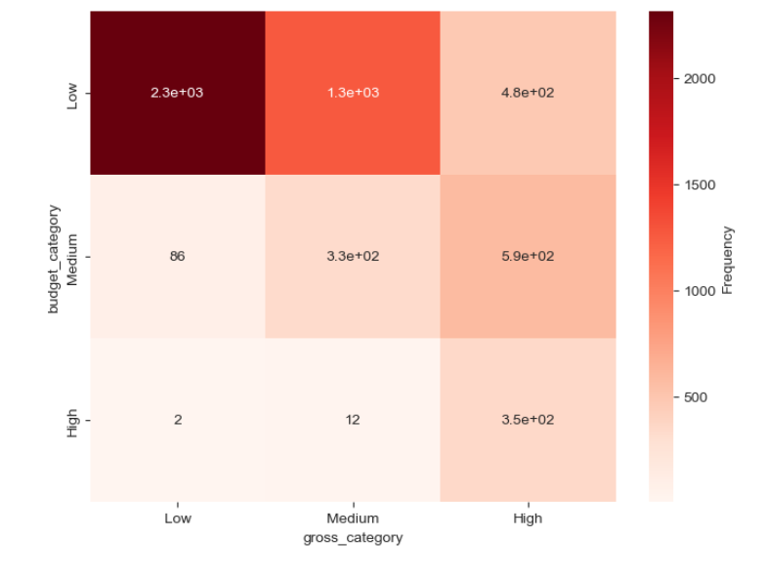
Relationship between movie production budget and worldwide gross categories
Insights:
- The heatmap shows that production budget is significantly associated with worldwide revenue

Slide 12
BUSINESS RECOMMENDATION
The studio should focus on producing films in the genre of Animations, Adventure and Sci-Fi because they have the highest worldwide revenue potential
The studio should focus on producing films that have higher viewer satisfaction/rating which are Short films, Documentary and Game-Shows
The studio should focus on working with top actors and directors that excel in their respective fields
The studio should consider investing in higher budget movies, as there is statistical evidence to show that higher-budget films are linked to an increased revenue potential. This can maximize financial returns thus ensuring a successful production.

Slide 13
CONCLUSION
This analysis provides valuable insights into movie success factors, helping Microsoft Movie Studio make data-driven decisions on film production
Future work can include creating predictive models which consider these factors (genre, budget, director, and actor ) to estimate box office success. These models can help refine decision-making for movie production ensuring even higher chances of success.

Slide 14
CONCLUSION
For any additional questions, please contact these members:
Calistus Mwonga, calistusmwonga@gmail.com
Samwel Kipkemboi, samkemboi201@gmail.com
Brian Kanyenje, bkanyenje@gmail.com
Hannah Nyambura, anngachuhipg1@gmail.com
Kelvin Mutua, kelvinmutua787@gmail.com

Slide 15
THANK YOU

