Slide 1
SOFTWARE DEVELOPMENT
LIFE CYCLE
SDLC
By Sevim Surucu
Notes:
Hi, my name is Sevim Surucu.
I own a small business owner. I do art fairs, art exhibitions, workshops, classes and selling my own Marbling Studio brand products online.
Since I have my own company for 4 years. When I started the company, I had to built an e commerce website to market my products and services. I made a research and I find a web development platform called “Wix.com”
I will tell their story that “how they start?” and “how they become a billion dollar company in 14 years?” and “how their application works?”
Wix.com is a software application that helps people to build their own websites with cool features and also you can add their mini applications to your website so easily.
Every software application starts with an idea or idea of solving a problem. Wix.com solved a problem of coding while you are creating your website. They bring new approach to web development. They introduce “drag and drop” features to build an application.
https://www.youtube.com/watch?v=_4WlGoafXCU
Wix.com first established 2006 with an idea of making website
possible for everyone.
us show their timeline About us Wix.com
When you think about a software application , you need to think that the application has many components.
Wix.com components
Wix Stores - you can add an e commerce
Wix Bookings - you can let your customers schedule your calendar
Wix Restaurants - you can get an online order from your customers
Wix Video - you can upload sell your videos, you can make live stream you can have your own channel
Wix Music - you can add your musics, podcasts and such
Wix ShoutOut - you can market yourself with their automated marketing tools, you can do email marketing or you can post on Social Media
Wix Code - also gives you a opportunity that you can customize your own code for your website you don’t like their form then you can change it
Wix Developer - you are creating an app for their app market they provide you SDK software development kit creation of house
and API application programming interface cables for phone lines
show their dev environment
And also they gave you analytics about how many visitors you have and how can be ranked higher on Google. They are really improving on Search Engine Optimization called SEO.
As an end user of this app I saw in 4 years how they grow how they implement new features to their application to satisfy their customers.
I created a couple ticket that I told them what I want as a new feature then when they add it they let me know about it.
show your website and show dashboard
Now, they are helping their customers with their various needs.

Slide 2
OUTLINE
01 SOFTWARE DEVELOPMENT LIFE CYCLE (SDLC)
Software Development Phases
02 AGILE ENVIRONMENT
Agile Methodology
Scrum Team Members
Agile Ceremonies
03 SOFTWARE TESTING LIFE CYCLE (STLC)
Test Types
QA Engineer Roles

Slide 3
SOFTWARE DEVELOPMENT LIFE CYCLE
SDLC CYCLE:
Requirements
Design
Development
Testing
Deployment / Release
Review / Maintenance
Development
Testing
Design
Deployment
Requirements
Review

Slide 4
Business Requirements Document (BRD)
contains expectations of the end user
outlines the features and intended behavior of a software application
Business Analysts
gather information from a client
analyze and document
Notes:
SRS, Software Requirement Specification,
is a document that contains all the requirements of the end user.
Business Analysts gather information from a client,
then analyze and document them.

Slide 5
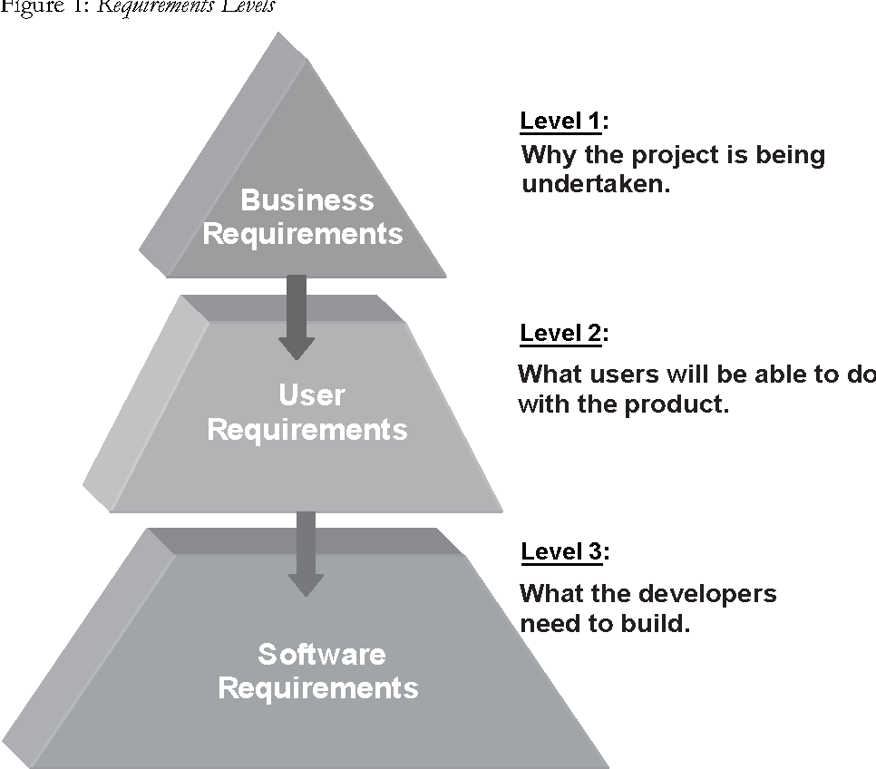

Slide 6
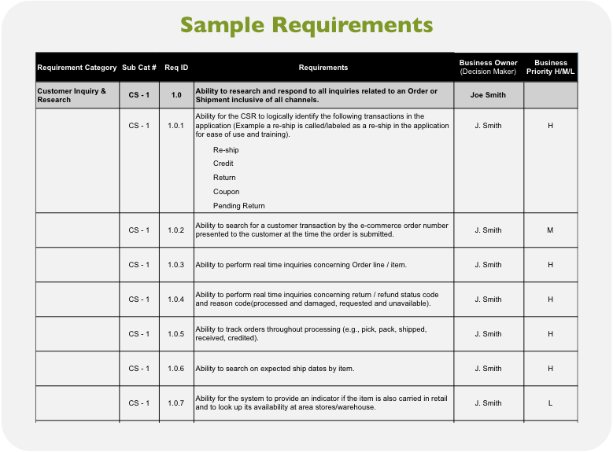

Slide 7
Software Design is how the application will be built.
It is a structure of the software application
Software architects are responsible for laying out the overall design approach for a software solution
Notes:
Software design is how the application is built, or the structure of the application
(it’s like the blueprint of a house construction).

Slide 8
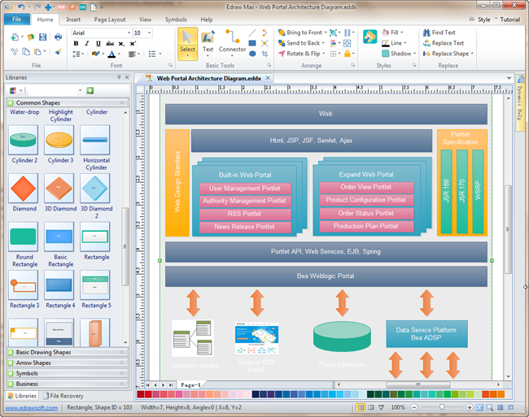

Slide 9
Software Testing
is the process of validating and verifying a software application
QA Engineers
make sure that the application works properly,
whether the actual results match the expected results
they ensure that the software system is defect free
manually or automated
Notes:
Software testing is the process of validating and verifying a software.
QA Engineers make sure that
the application works properly,
whether the actual results match the expected results
and they ensure that the software system is defect free.
Testing can be either done manually or using automated tools.

Slide 10
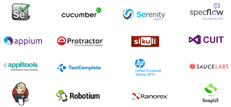

Slide 11
Software Release is the distribution of the final version of an application.
A software release
public or private
Every company has their own release cycles. It can be monthly or quarterly.
pre -alpha
alpha
beta versions of the software.
Notes:
Software release is the distribution of the final version of an application,
it can be either public or private
Alpha version, beta version (explain)

Slide 12
Software Maintenance is the process of modifying and updating a software application after delivering it to correct faults and to improve performance.
Notes:
Software Maintenance is the process of
modifying and
updating a software application
after delivering it to correct faults
and to improve performance.

Slide 13
OUTLINE
01 SOFTWARE DEVELOPMENT LIFE CYCLE (SDLC)
Software Development Phases
02 AGILE ENVIRONMENT
Agile Methodology
Scrum Team Members
Agile Ceremonies
03 SOFTWARE TESTING LIFE CYCLE (STLC)
Test Types
QA Engineer Roles

Slide 14
AGILE METHODOLOGY
“The literal meaning of AGILE is to be able to move quickly and easily”
Agile methodology is a type of project management process. It is a mixture of both methodology and technology.
It is mainly used for software development,
where demands and solutions evolve through the collaborative effort of self-organizing and cross-functional teams.
iterative development processes
product improves continuously
interactions > processes and tools
working software > comprehensive documentation
customer collaboration > contract
responding to change > following a plan
requirements change is acceptable

Slide 15
SCRUM
Scrum is an agile framework for project management that helps the development team work together.
teamwork, accountability and iterative progress toward a well-defined goal
Scrum team consists of 5-7 team members. Everybody gets involved in the project and teams up. Scrum team has the plan for each sprint where a number of tasks are defined.

Slide 16
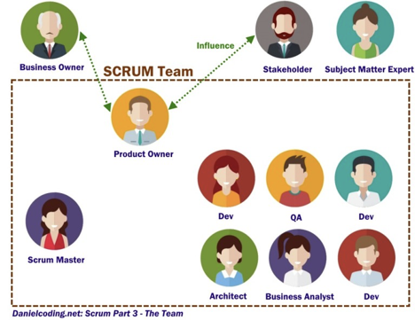
SCRUM TEAM
PRODUCT OWNER
SCRUM MASTER
DEVELOPERS
BUSINESS ANALYST
QA ENGINEERS

Slide 17
STAKEHOLDER - BUSINESS OWNER
In agile development stakeholders can be represented by a wide range of people interested in the project results, such as:
People funding the project;
Business Managers and Business Architects;
Data Architects and Database Administrators;
Portfolio and Project Managers;
Direct and indirect Users;
Account and Sales Managers;
Developers’ team including Engineers, Designers and Product Manager/ Business Analyst etc.

Slide 18
PRODUCT OWNER
A product owner is familiar with business requirements and knows the goal he wants to accomplish
Maximizes the value of the software product and the Development Team’s performance.
Creates and maintain Product Backlog items. Ensuring that the Product Backlog is visible, transparent, and clear to all
Defines and prioritizes user stories in the product Backlog
Participates in the daily Scrums, Sprint Planning Meetings, Sprint Reviews, and Retrospectives.
The Product Owner must continuously engage the customer and stakeholders to ensure the Team is building the right product and therefore delivering the ROI (return on investment) expected of it.
The Product Owner has the opportunity to steer the team in a different direction

Slide 19
SCRUM MASTER
The Scrum Master is a coach of the Scrum team.
Helps the Scrum team to do its best to accomplish the goal, and removes blockers.
Runs daily meetings
Encourages self-organization in a team
Scrum master has no authority over the scrum team, but he has authority over the scrum process
The Scrum Master should never be assigning tasks to team members under any circumstances
They oversee day-to-day functions,
maintain the Scrum board,
check in with team members,
makes sure tasks are being completed on target

Slide 20
DEVELOPER
Deals with researching, designing, implementing, and managing software programs
Testing and evaluating new programs
Writing and implementing an efficient code
Determining operational practicality
Deploying software tools, processes and metrics
Maintaining and upgrading existing systems
Working closely with other developers, UX designers, business, systems analysts and QA Engineers

Slide 21
BUSINESS ANALYST
A business analyst creates user stories and their acceptance criteria
Prepares well-written acceptance criteria (AC)
help avoid unexpected results in the end of a development stage
ensure that all stakeholders and users are satisfied with what they get

Slide 22
QA ENGINEER
QA Engineer is a person whose primary concern is maximizing the quality of the final product with verification and validation.
The QA Engineer tracks the development process of a software application from start to finish.
They oversee production and they test each part of the application
Notes:
the QA engineer uses verification and validation
to maximize the quality of the final product.
They are involved in the whole process of software development
from start to finish.

Slide 23
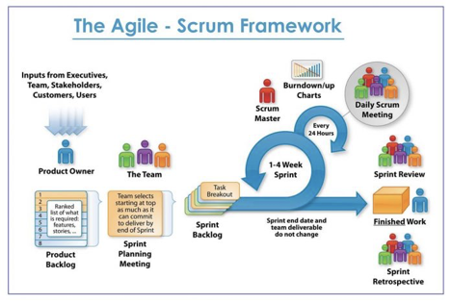
AGILE TEAM WORK

Slide 24
AGILE CEREMONIES
01
02
03
14
2 weeks Sprint
SPRINT PLANNING
First day of the Sprint(2 hours)
Product Owner, Scrum team and Stakeholder
Active Sprint
SPRINT DEMO /REVIEW
3rd day of the Sprint (1 hours)
Scrum Team
Previous Sprint
DAILY STAND UP
Every Day (15 mins)
Scrum Team
Active Sprint
SPRINT GROOMING / PRE-PLANNING /BACKLOG REFINEMENT
14th day of the Sprint (1 hours)
Scrum Team
Future Sprint
SPRINT RETROSPECTIVE
2nd day of the Sprint (1 hours)
Scrum Team
Start - Stop - Continue Doing
Previous Sprint

Slide 25
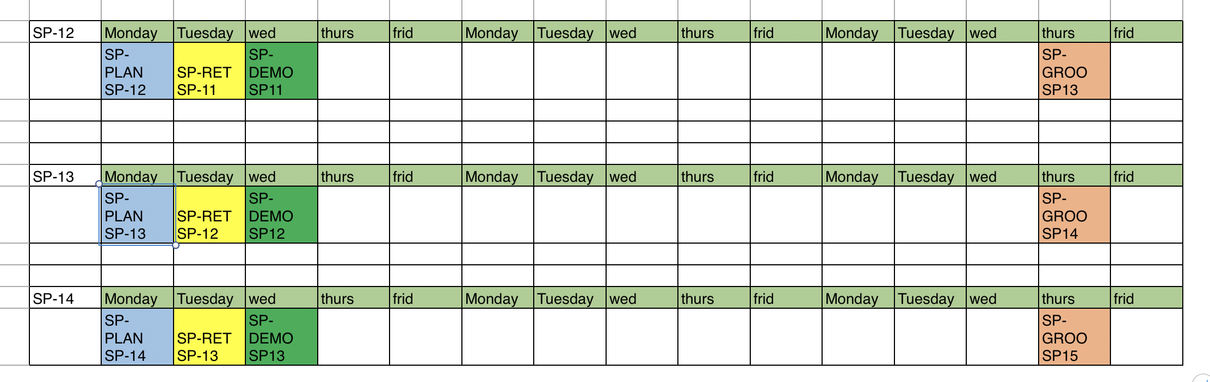
Example of 3 weeks Sprint

Slide 26
ADDITIONAL MEETINGS
QA status meeting with QAs
Mid -sprint review meeting with scrum team
Quarterly meeting with IT department
Catch up meeting with off -shore team
Launch and learn
Assignment meeting - Tasks sharing meeting

Slide 27
OUTLINE
01 SOFTWARE DEVELOPMENT LIFE CYCLE (SDLC)
Software Development Phases
02 AGILE ENVIRONMENT
Agile Methodology
Scrum Team Members
Agile Ceremonies
03 SOFTWARE TESTING LIFE CYCLE (STLC)
QA Engineer Roles
Test Types

Slide 28
SOFTWARE TESTING LIFE CYCLE
STLC CYCLE:
Requirements Analysis
Test Planning
Test Case Development
Environment Setup
Test Execution
Test Reporting
Bug Logging - Tracking
Test Case
Development
Environment
Setup
Test
Planning
Test
Execution
Requirements
Analysis
Test Cycle
Closure

Slide 29
QA ENGINEER ROLES
Develops standards and procedures to determine the product quality and releases readiness
Researches and analyzes product features being tested
Identifies any potential problems that users might encounter
Performs and documents risk analysis
Creates test plans
Documents test cases
Performs manual and automated testing
Codes automated tests
Discovers bugs within software
Identifies, isolates, and tracks bugs throughout testing
Records and reports test progress and results
Drives innovation and streamline overall testing processes
Researches new tools, technologies, and testing processes
Reviews user interfaces for consistency and functionality

Slide 30
TESTS DONE BY WHO?
FUNCTIONAL TESTING
NON FUNCTIONAL TESTING
DEVELOPER
QA ENGINEER
QA ENGINEER
USER
UNIT TESTING (COMPONENT TESTING) Done by developers
SMOKE TESTING Done by testers
REGRESSION TESTING Done by testers
END TO END TESTING Done by testers
SYSTEM TESTING Done by tester
AD-HOC TESTING Done by testers
ALPHA-BETA TESTING
PERFORMANCE TESTING Done by testers
LOAD TESTING Done by testers
STRESS TESTING Done by testers
SECURITY TESTING Done by testers
USABILITY TESTING Done by UI designer
ACCEPTANCE TESTING Done by end users
Done by client
INTEGRATION TESTING Done by developers

Slide 31

Idea: Help people create their own websites?
requirements
design

Slide 32
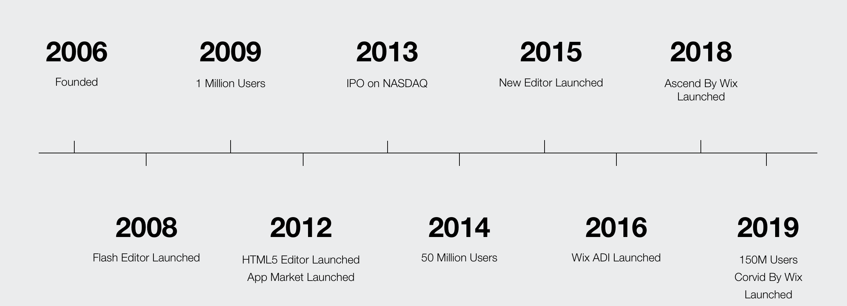
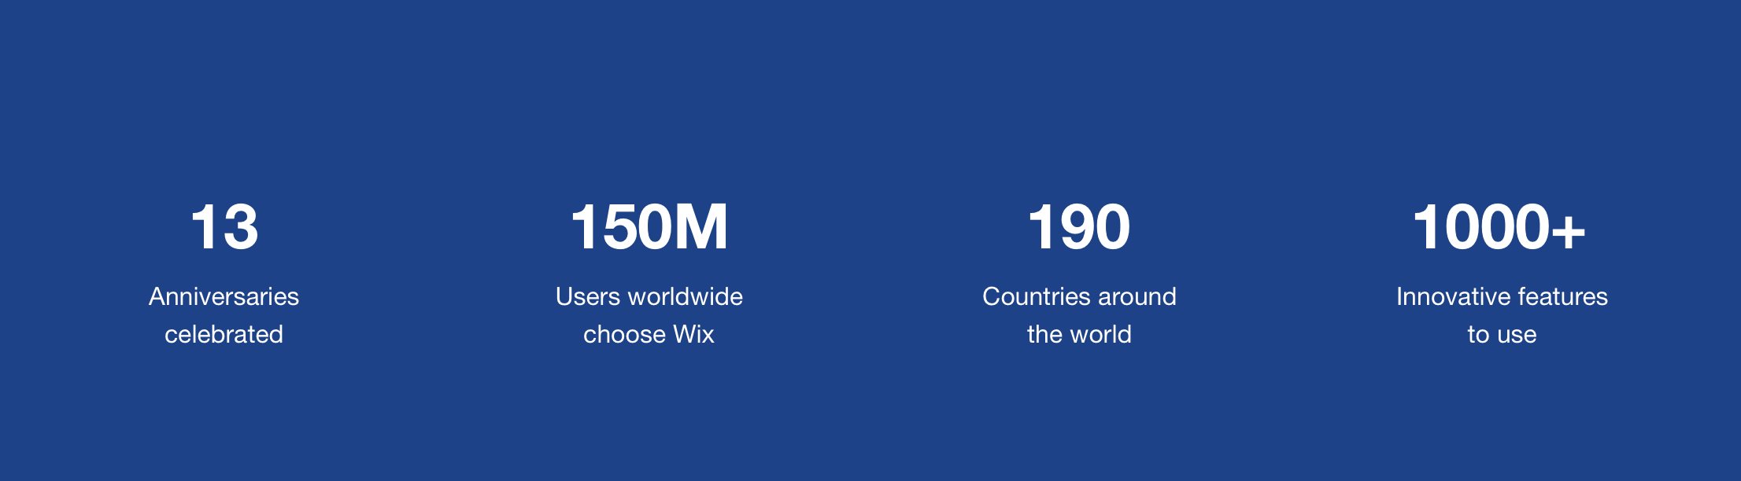
Wix.com

Slide 33
CUSTOMER NEEDS AND APP FEATURES
https://www.wix.com/features/main

Slide 34
THANKS!
any questions?

