Slide 1
System Testing

Slide 2
What Types of System Testing Should Testers Use?

Slide 3
Testing types depend on next factors:
Who the tester works for
Time available for testing
Resources available to the tester
Software Tester's Education
Testing Budget

Slide 4
What do you verify in System Testing?

Slide 5
System Testing involves testing the software code for following
Testing the fully integrated applications including external functional in order to check how components interact with one another and with the system as a whole. This is also called End to End testing scenario.
Verify if every input in the application to check for desired outputs.
Testing of the user's experience with the application.

Slide 6
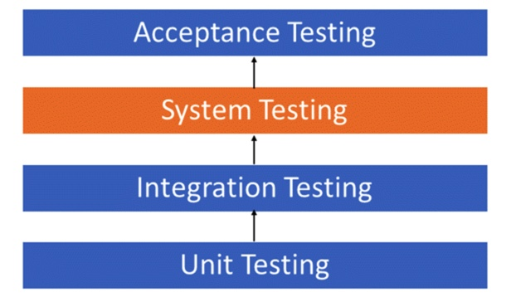
Software Testing Hierarchy

Slide 7
Unit testing - testing performed on each module or block of code during development. Unit testing is normally done by the programmer who writes the code. Integration testing - testing done before, during and after integration of a new module into the main software package. This involves testing of each individual code module. One piece of software can contain several modules which are often created by several different programmers. It is crucial to test each module's effect on the entire program model. System testing - testing done by a professional testing agent on the completed software product before it is introduced to the market. Acceptance testing - beta testing of the product done by the actual end users.

Slide 8
Different Types of System Testing

Slide 9
Usability Testing - mainly focuses on the user's easy to use the application, flexibility in handling controls and ability of the system to meet its objectives
Load Testing - is necessary to know that a software solution will perform under real-life loads.
Regression Testing - involves testing done to make sure none of the changes made over the course of the development process have caused new bugs. It also makes sure no old bugs appear from the addition of new software modules over time.
Recovery Testing - Recovery testing is done to demonstrate a software solution is reliable and can successfully recap from possible crashes.
Migration Testing - Migration testing is done to ensure that the software can be moved from older system infrastructures to current system infrastructures without any issues.
Functional Testing - It is a test to check whether each and every functionality of that application is working as per the requirement. In this test, the Test Cases are ‘executed’.
Hardware/Software Testing - IBM refers to Hardware/Software testing as "HW/SW Testing". This is when the tester focuses his/her attention on the interactions between the hardware and software during system testing.

