Slide 1
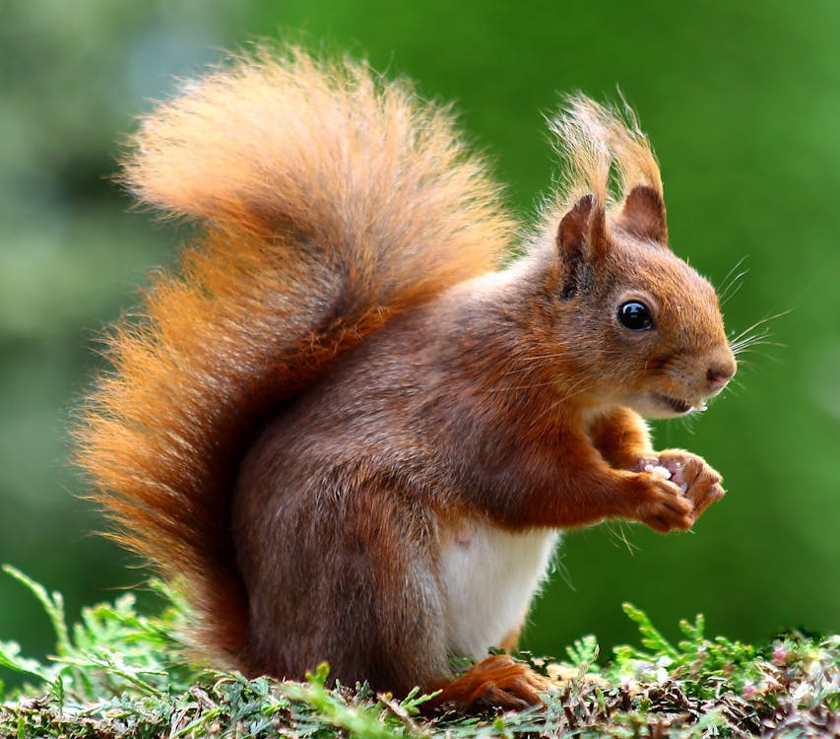
Animal Detection System
Submitted to Mr. Waqar

Slide 2
Group Members
Muhammad Hassaan Raza 22-NTU-CS-1362
Kanza Kashaf 22-NTU-CS-1350

Slide 3
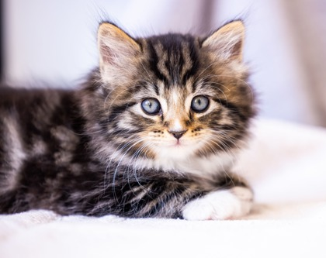
No. Of Classes
We uses three class of animals to train over model. These are:
Cat
Dog
Squirrel

Slide 4
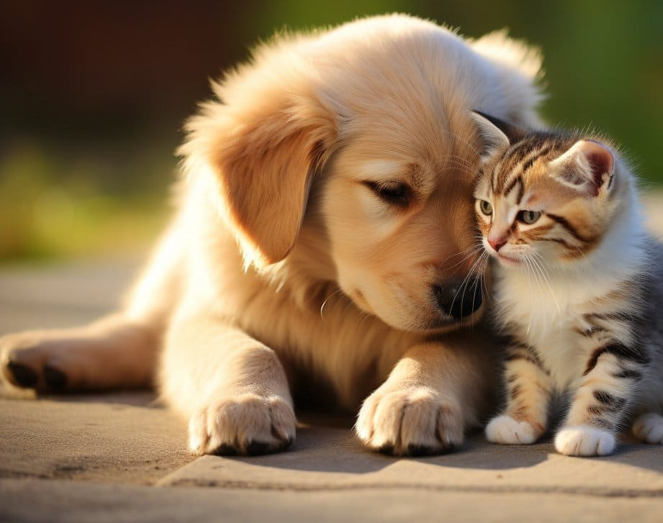
Dataset
We uses Kaggle website to collect over training and testing data. We split it into 80% of training data and 20% of testing data.
Total Data:
More then 6000 images.
For Training Data:
More then 2000 images.
For Testing Data:
More then 400 images.

Slide 5
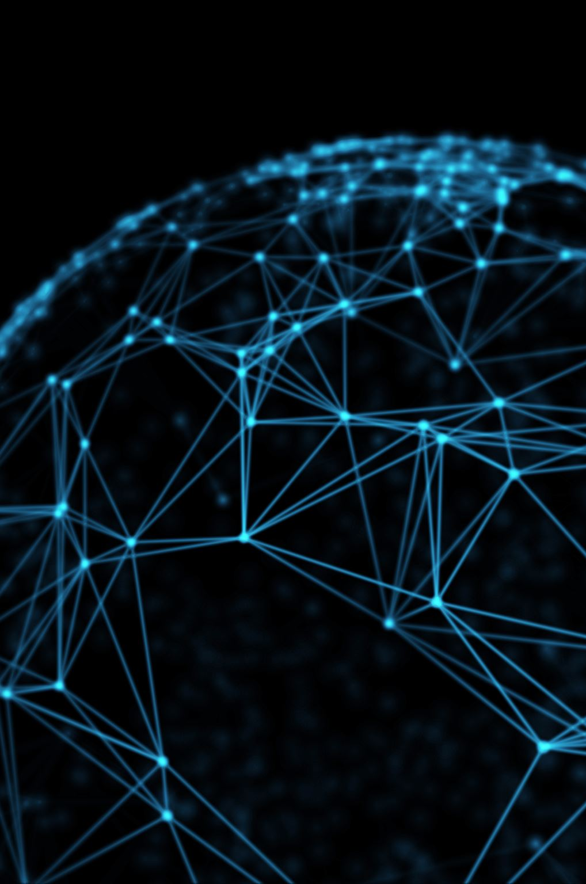
How we trained our Model?
We train over model by using Conventional Neural Network with different multi layers. We uses 120 of epochs to calculate weights to make over output more accurate.

Slide 6
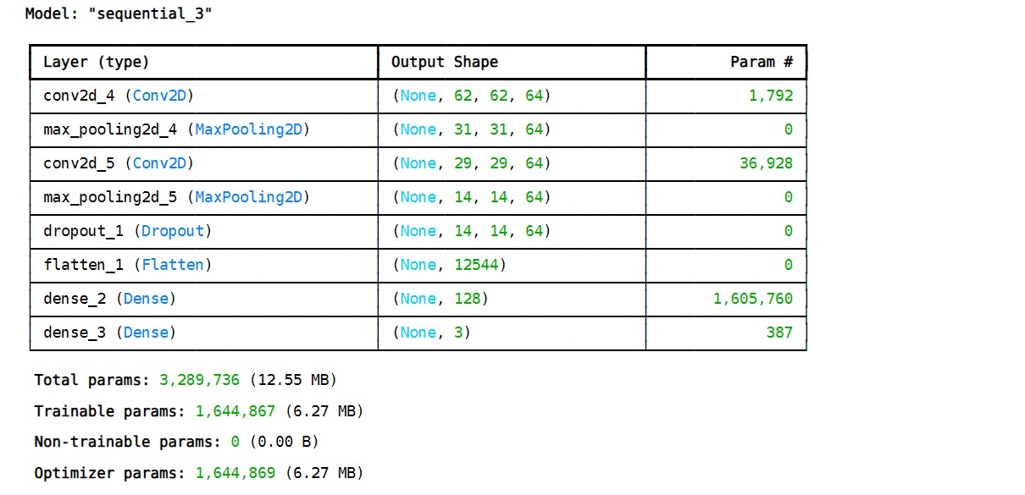
Layers
The first Conv2D layer has 32 filters, each of size 3x3, and uses the ReLU activation function. The input_shape is set to [64, 64, 3] to match the size of the input images.
MaxPooling2D layers reduce the spatial dimensions of the feature maps.
A second Conv2D layer is added with 64 filters to capture more complex features.
The Flatten layer converts the 2D feature maps into a 1D vector.
A fully connected (Dense) layer with 128 units and ReLU activation is added.
The final Dense layer uses the Softmax activation function to output probabilities for each class (specified by number_of_classes).

Slide 7
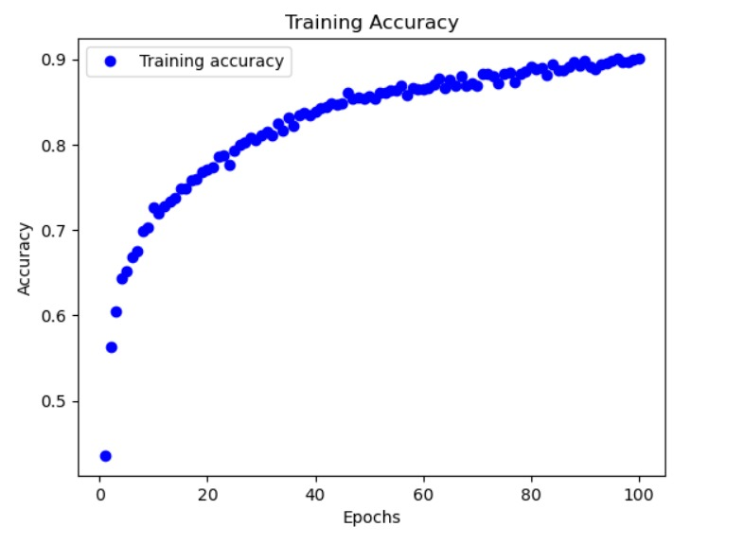
Accuracy And Loss
Training Data:
Our accuracy on training data is 0.93%
Our loss on training data is 0.19%

Slide 8
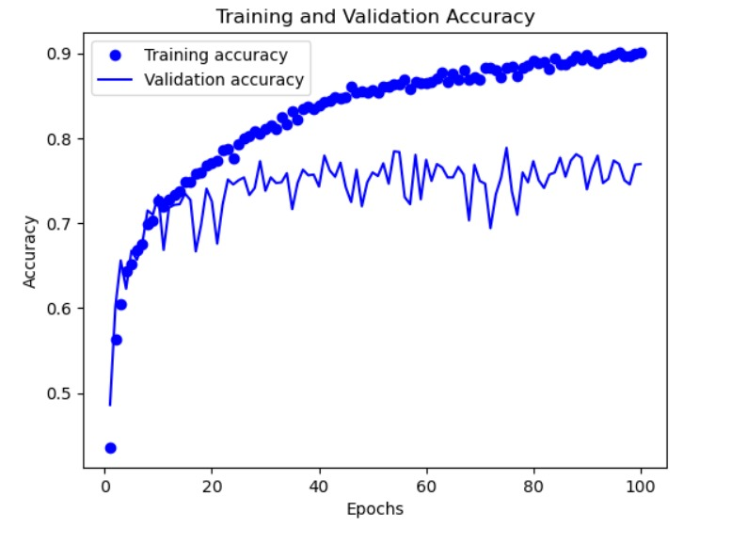
Accuracy And Loss
Testing Data:
Our accuracy on testing data is 0.75%
Our loss on testing data is 0.88%

Slide 9
Thanks!!

