Slide 1

Sorting Algorithms
Submitted By:
Kanza Kashaf 22-NTU-CS-1350
Muhammad Hassaan Raza 22-NTU-CS-1362

Slide 2
Sorting Algorithms: An Overview
Insertion Sort
Quick Sort
A simple, comparison-based algorithm that builds the sorted array one element at a time.
A divide-and-conquer algorithm that partitions the array around a pivot and recursively sorts the subarrays.
Heap Sort
Counting Sort
Utilizes a binary heap data structure to repeatedly extract the maximum element and rebuild the heap.
A non-comparison-based algorithm that counts the frequency of each element and places them in their correct positions.
c

Slide 3
Performance Analysis: Sorting Time
Size
Insertion Sort
Quick Sort
Heap Sort
Counting Sort
10
0.0000
0.0000
0.0000
0.0000
50
0.0000
0.0000
0.0000
0.0000
100
0.0000
0.0333
0.1000
0.0000
1000
1.3000
0.4000
0.5000
0.0000
5000
9.3000
0.3667
0.9333
0.0667
10000
N/A
0.8667
2.2000
0.1000
100000
N/A
11.0667
28.3000
1.9667
1000000
N/A
211.3333
444.0333
N/A

Slide 4
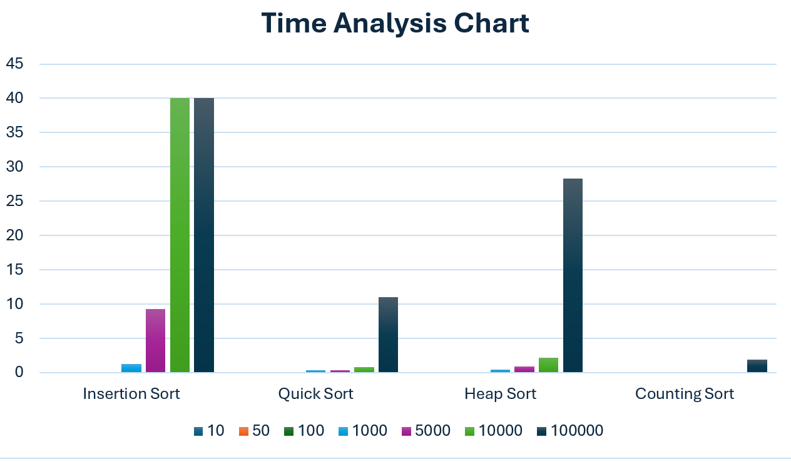
Performance Analysis: Sorting Time

Slide 5
Observations
Insertion Sort
Insertion Sort exhibits a rapid performance degradation as input size increases. It is efficient for small sizes, but it cannot handle sizes above 5,000.
Quick Sort
Quick Sort maintains consistent efficiency across all input sizes. Execution time increases logarithmically as size grows.
Heap Sort
Heap Sort effectively handles larger inputs but is slower compared to Quick Sort.
Counting Sort
Counting Sort exhibits exceptional performance when the range of values is small, but it cannot handle very large input sizes, like 1,000,000.

Slide 6
Thanks!

