Slide 5

Introduction of OCP
One of the leading exporters of phosphate rock, phosphoric acid and phosphate fertilizers in the world.
The group has several subsidiaries in and outside of Morocco.
1

Slide 6
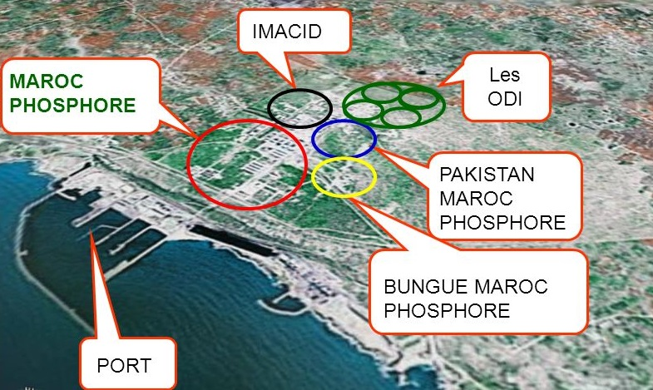
Introduction to IMACID
was created in 1997 in Jorf Lasfar
It holds a phosphoric acid production unit of a capacity of 430,000 tons P2O5
Creation
Production
2

Slide 7
Workshops of IMACID
COMBUSTION
S
O2
OXIDATION
SO2
ABSORPTION
SO3
H2O(H2SO4)
½ O2
Sulfuric Workshop
Sulfuric workshop
Phosphoric workshop
Workshop for utilities
3

Slide 8
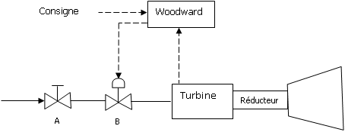
Description
4

Slide 9
Lubrification system
5

Slide 10
Issues
Frequency of the system lagging
It became obsolete
Shut-downs
Fall behind in progress
Increase the realibility
Make The system 100% obtainable
Remove the failures
Upgrade the control-command system of the turboblower
6

Slide 11
The start
06
Perspectives
05
Technical-economic study
04
Solution suggestions
03
FMEA Method
02
Functional Analysis
01
Program Analysis
7

Slide 13
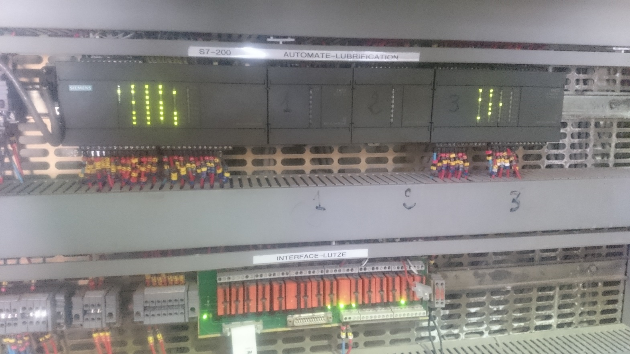
The Siemens 6ES7216-2AD00-0XB0
Simatic S7-200 range.
Small memory.
It can be out of stock.
8

Slide 14
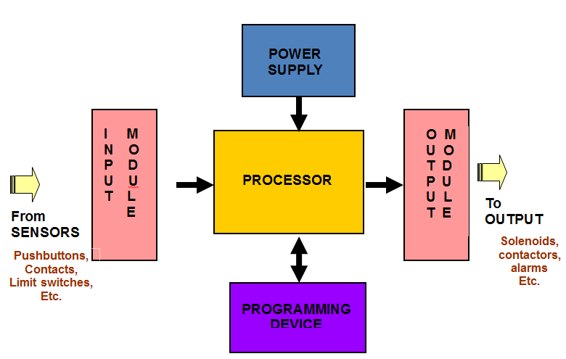
PLC Components
9

Slide 15
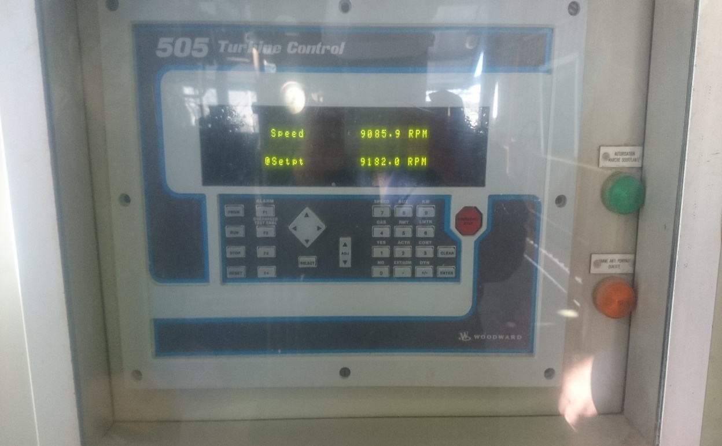
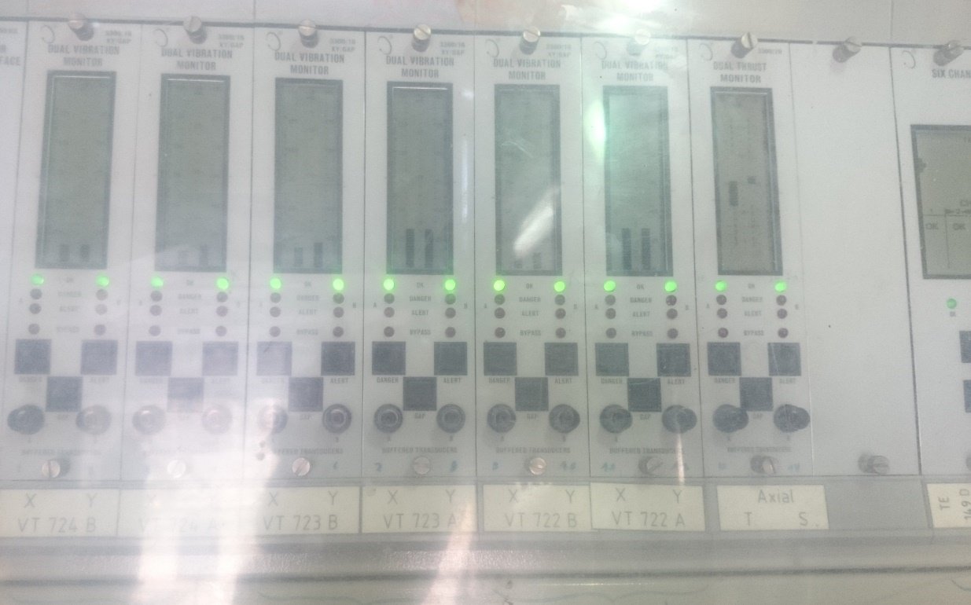
Woodward 505
Bently Nevada 3300
10

Slide 16

Programming with STEP 7
Ladder diagram (LD), graphical
Function block diagram (FBD), graphical
Structured text (ST), textual
Sequential function chart (SFC), has elements to organize programs for sequential and parallel control processing.
Instruction list (IL), textual (deprecated in 3rd edition of the standard ^{[1]})
It defines two graphical and two textual programming language standards:
11
Notes:
IEC 61131 deals with basic software architecture and programming languages of the control program within PLC

Slide 17
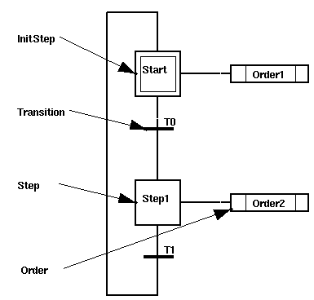
Introduction To SFC
A Grafcet is graph which is composed of steps and transitions, connected between them by connections or directed arcs.
12

Slide 18
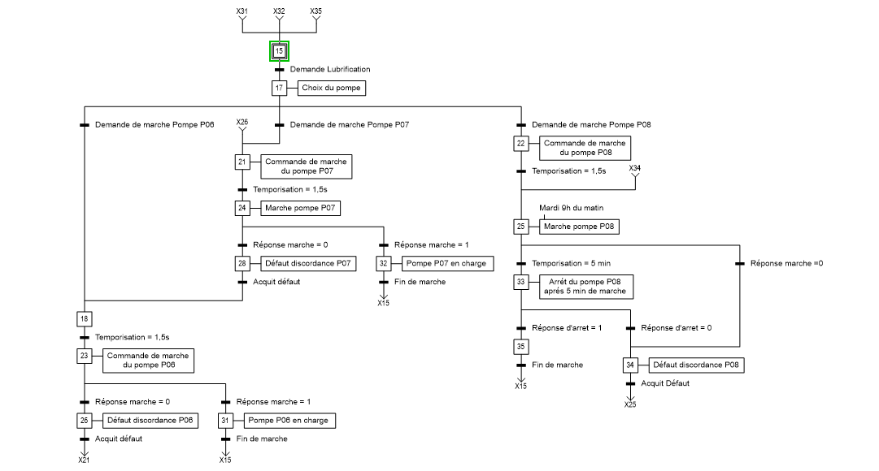
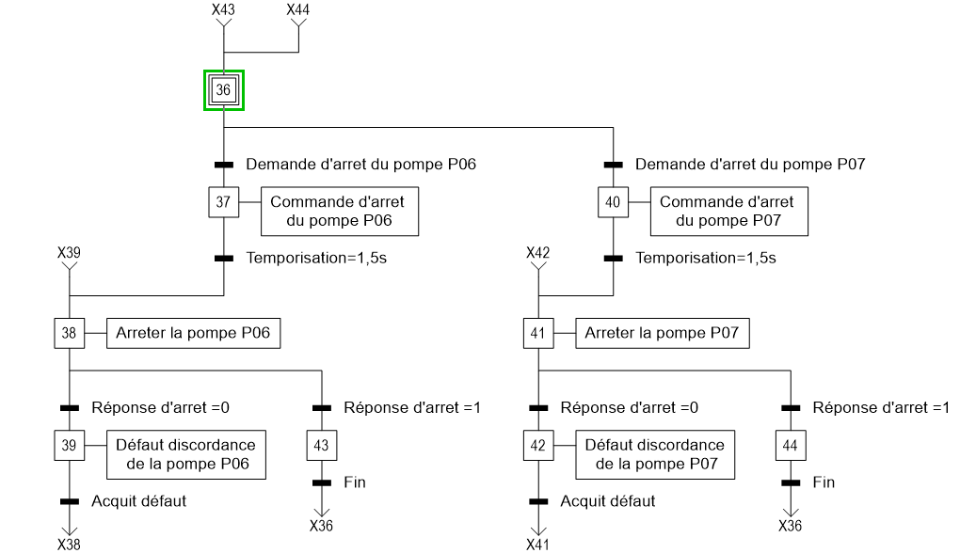
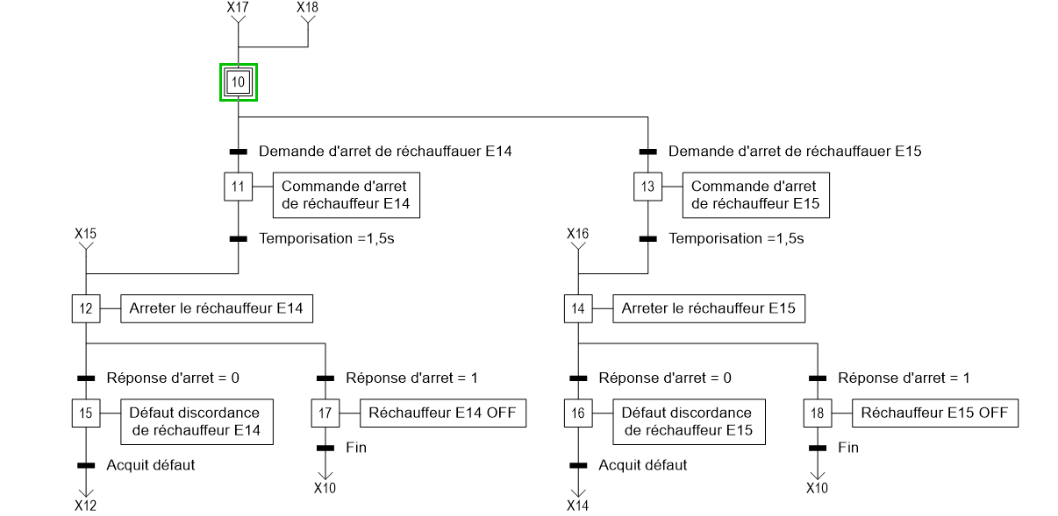
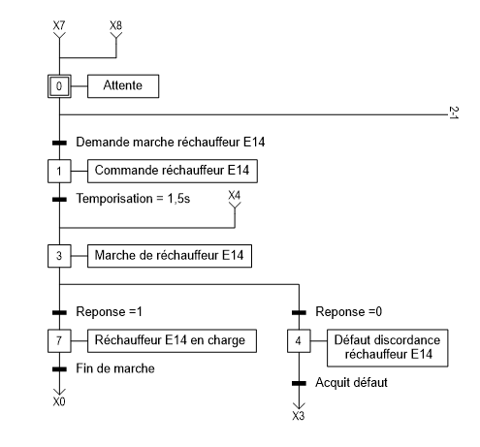
Activation of one of the heaters
Deactivation of one of the heaters
Activation of pumps
Deactivation of Pumps
13

Slide 20
Functional Analysis
Identify the functions of your scope
Determination of all functions and factors that are related to the system
A step-by-step approach for spotting all possible failures in a design or a product …
FMEA
Identifying all possible failures and its causes
14

Slide 21
Environment Diagram
15

Slide 22
Functional decomposition diagram
Turboblower
Turbine
Blower
Cabinet of control-command system
Woodward governor
PLC Siemens
Protection system
Power control unit
Speed sensors
CPU Woodward
Vibration sensors
Rack Bently Nevada
Temperature sensors
Power supply
CPU
Input/Output module
Connexion
Relays
Memory
Microprocessor
Program
Speed reducer
16

Slide 23
FMEA RESULTS
Problem | Cause | Effect | Severity | Occurance | Detection | Criticity | Visibility
Heating problem in CPU | Full Memory | Lag of PLC. Shut down of the system | 2 | 4 | 2 | 16 | Visuel
Shut down of CPU | Shut down of the Microprocessor. Shut down of the Power Supply | Shut down of the system | 2 | 4 | 2 | 16 | Visuel
Lag of program | Errors in the program. Bad upload of the program | Bad functionning of the system | 4 | 1 | 2 | 8
17

Slide 24
The state of our system
Control-Command system
Old Brand
Small RAM
The smallest controller
High frequency of lagging
18

Slide 25
Some moves to take
Keep AC signals separtated from DC Signals
Minimize the possibility
Electrical noise pickup
All controller components should be mounted
in a vertical position
Allow maximum coding
Enclosures and Shielded cables
Prevent Dust – Water – Oil
Better communication
19

Slide 26
Main Check List
Power led is turned OFF?
Is power supply operating
Is the voltage withing the rated power
Run indicator not lit
Is the ERR/ALM indicator lit
Is a fatal error displayed
Is ERR/ALM indicator flashing
Check the program
Is a non fatal error indicated
Is the fuse blown
Is the power supply cable connected
Over current devide activated
Is PC mode displayed on programming device
Program cannot be written
Is the mode setting switch set to the remote stop
Is ERR led blinking
20

Slide 28
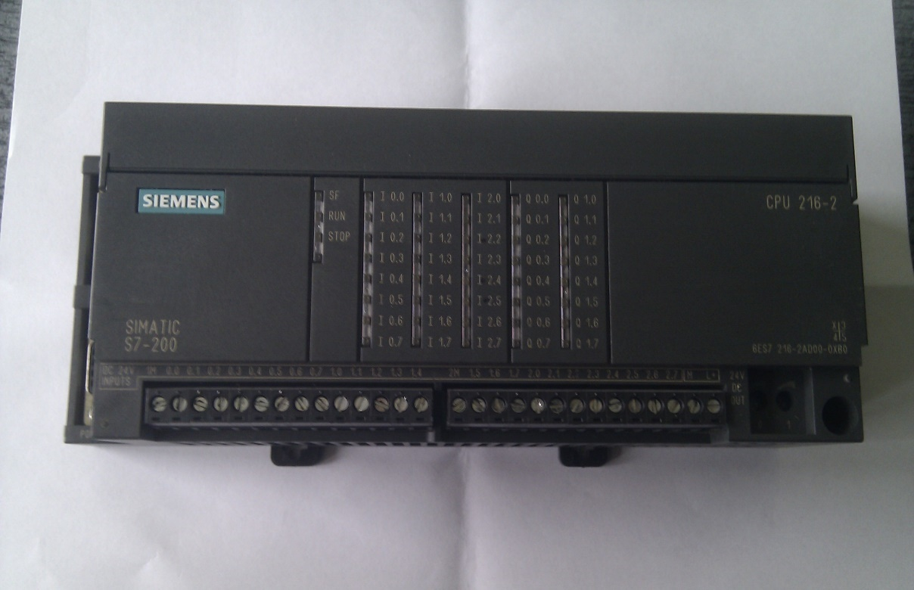
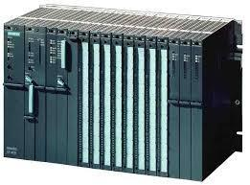
The suggested solutions
Change the CPU 216
Change the whole PLC
21

Slide 29
Conditions
Power Supply
Number of inputs and outputs
Size of the enclosure
22

Slide 30
What will be the best ?
SOLUTIONS | ADVENTAGES | DESADVANTAGES
Solution 1 | Small cost | Old System
Solution 2 | Get rid of the failures Make the system 100% available and in good conditions and functioning | High cost
27

Slide 31


Which brand should we get ?
OR
28

Slide 32
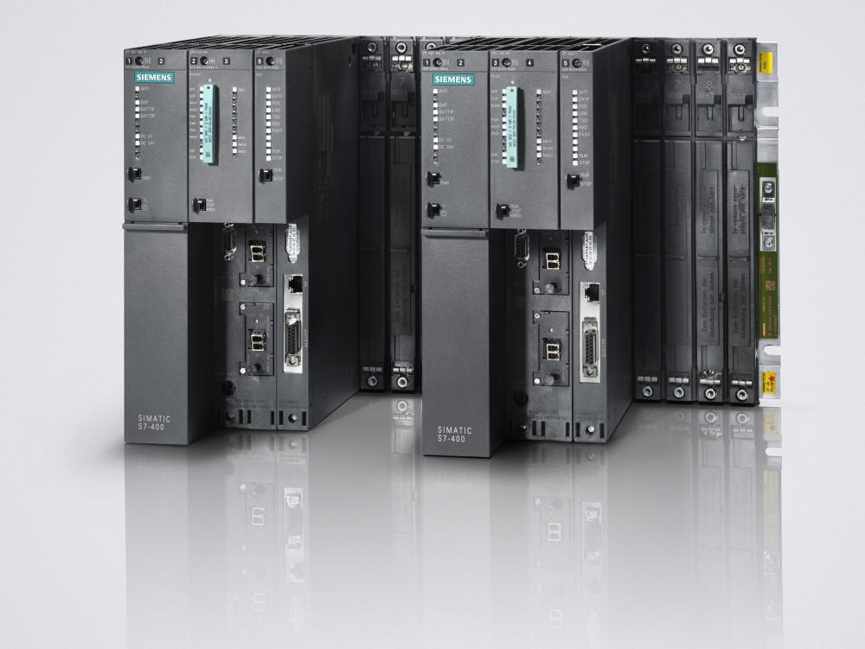
The PLC chosen
Module from the Simatic range S7 400
Reference : CPU 417-4 (6ES7417-4XT05-0AB0)
29

Slide 33
Cost and efficiency
The cost of the CPU chosen is
150 916.08 MAD
The budget offered By the company is
200 000.00 MAD
49083,92 MAD
30

Slide 34
Profit Loss
Product | Production during ONE DAY
Sulfuric Acid | 3800 tons mh/day
Phosphoric Acid 54% | 1500 tons P2O5/day
Energy | 600 MW /day
If we ever supposed that we had a shutdown for 8 hours because of the CPU defected , The results will be the loss of:
31

Slide 35
Profit Loss
1266,66 tons mh
200 MW
500 tons P2O5
31

Slide 37
Context of the project
Program Analysis
Critical Study
Suggestion of solutions
32

Slide 38



Dependability study of the solution suggested
Renovation of the control-command system
Add a program for the velocity regulation of the turbine and the control of vibration and temperature
33

