Slide 1
DocExtract
Intelligent Document Processing
Project 4, AI Project Topic Offering, President University
Offered by LapisAI and Xquisite AI
Team: Fazza Arrantisi, Fadhil, Gifari Madia, Yazid
Period: 24 June to 30 July 2026
Notes:
Good afternoon. I am presenting DocExtract, our Project 4 build for the AI Project Topic Offering at President University, done for the brief set by LapisAI and Xquisite AI. The four of us split the work across data and business case, backend and extraction, frontend and model configuration, and evaluation and performance. We built this between 24 June and 30 July 2026. I will walk through the problem, what we built, the choices we made, and finish with a bonus feature we added once the core pipeline was solid.

Slide 2
Background and problem
Finance and operations teams spend hours manually keying data from invoices, purchase orders, receipts and forms into their systems. The work is slow, costly and error prone, and it scales badly as volume grows.
Xquisite AI asked students to build an intelligent document processing pipeline that uses a multimodal LLM to read a document and output clean structured data, with validation and a human review step before export.
Notes:
This is the problem statement straight from the official brief, not our own framing. Manual data entry from invoices, purchase orders and receipts is slow and error prone, and it gets worse as the document volume grows. Xquisite AI's ask was specific. use a multimodal model to read the document directly, validate what it returns, and keep a human reviewing before anything is exported. That last part, the human review step, is a constraint we kept all the way through, it shows up again on slide seven and nine.

Slide 3
Solution and the six deliverables
A document is uploaded, a vision model reads the image directly and returns structured JSON, business rules validate it, a human reviews and corrects it, an admin approves it, and the data is exported.
1
Upload and structured field extraction per document type: invoice, PO and receipt.
Complete
2
Validation rules that flag issues: totals reconcile, required fields present, format checks.
Complete, 9 rules
3
Human in the loop review screen to correct and approve.
Complete
4
Export to CSV/JSON and a mock API endpoint.
Complete, extended to PDF, Word and Excel
5
Field level accuracy evaluation against ground truth labels.
Complete, 60 documents
6
Cost benefit business case versus manual data entry.
Complete
Bonus, outside the brief: a RAG assistant for asking questions about the extracted documents, with answers citing their source documents. Built after the main pipeline was solid.
Notes:
One sentence covers the whole pipeline, upload, extraction, validation, human review, approval, export. All six deliverables from the brief are complete. I want to flag two of them specifically. deliverable two has nine validation rules behind it, and deliverable four went further than the brief asked, we export to PDF, Word and Excel on top of CSV, JSON and the mock API. The RAG assistant at the bottom is explicitly outside the six deliverables. We built it after the core pipeline was working, it is a bonus, not something the brief graded us on, and I will come back to it on the last slide.

Slide 4
Technology choices
Area | Brief recommended | What we chose | Reason
Document loading | PyMuPDF or pdf2image | PyMuPDF | Followed the recommendation.
Structured output | pydantic | pydantic | Followed the recommendation.
Model | OpenAI GPT-4o vision, or a vision capable local model via Ollama | Local model through LM Studio | Financial documents never leave the machine, and per document compute cost is close to zero, which is what makes our business case hold.
Review UI | Streamlit | React with Vite and Tailwind | We needed layered roles, guarded routes, and the source document shown side by side with the extracted fields, which Streamlit does not do well.
Backend | Not specified in the brief | FastAPI
Storage | Not specified in the brief | SQLite
The vision model IS the OCR. There is no Tesseract and no separate OCR engine. The model reads the image and returns structured fields in a single step.
Notes:
This table matters because it shows the deviations from the brief were deliberate, not accidental. Document loading and structured output follow the brief exactly, PyMuPDF and pydantic. The two real deviations are the model and the review interface. We moved off OpenAI and Ollama onto a local model served through LM Studio, because it keeps financial documents on our own machine and keeps compute cost close to zero, which is the foundation of our business case on slide five. We also moved off Streamlit onto React, because we needed real role based routing and a side by side view of the source document and the extracted fields, which Streamlit does not handle well. And one thing to say plainly here, there is no separate OCR step anywhere in this pipeline. The vision model reads the image and returns structured fields directly.

Slide 5
Models used
Three profiles the user can pick from at upload time
1
qwen/qwen3-vl-4b
LM Studio, local. This is the default.
100%
2
minicpm-v4.6
Ollama, local. Kept as a comparison.
field level accuracy
3
Gemini
Google API, hosted. Deliberately not the default: it sends documents to Google, which breaks two claims in our business case, near zero compute cost and data never leaving the machine.
60 of 60 documents fully correct
60 documents, 10 fields each, compared against ground_truth.csv.
Spread: 25 invoices, 20 purchase orders, 15 receipts.
text-embedding-nomic-embed-text-v1.5
Serves the bonus RAG feature, loaded in the same LM Studio instance, so embeddings stay local too.
Limitation: this figure is a ceiling. These 60 documents come from the same set used while writing the prompt, and there is no separate held out test set.
Worth stating: the model must be loaded with roughly 16k context, since one rendered document image costs about 4,000 to 5,000 tokens.
Notes:
At upload time the user can pick one of three model profiles. qwen3 vl 4b through LM Studio is local and is our default. minicpm v4.6 through Ollama is also local, we kept it as a comparison point. Gemini is hosted through the Google API, and we deliberately did not make it the default, because sending documents to Google breaks two claims our business case depends on, near zero compute cost and documents never leaving the machine. A fourth model, a local embedding model, powers the bonus RAG feature, so even that stays on our machine. On the right is our evaluation result, 100 percent field level accuracy across 60 documents and 10 fields each, checked against ground_truth.csv, spread across invoices, purchase orders and receipts. I want to be upfront about the limitation here, that number is a ceiling, not a generalization claim, because those 60 documents are the same ones we used while writing the extraction prompt. We do not have a separate held out test set yet.

Slide 6
Project structure
backend/app (11 Python modules)
main.py routes
schemas.py pydantic models
extraction.py the model call
validation.py 9 rules
loaders.py PDF to image
export.py 5 formats
auth.py roles and tokens
db.py SQLite
evaluation.py accuracy
rag.py the bonus assistant
frontend/src/pages (10 React pages)
Login, Upload, ReviewQueue, Review,
Archive, Dashboard, Audit, Settings,
Performance, Chat
SQLite (5 tables)
documents, users, settings,
audit_log, chat_sessions
Test data: 60 synthetic documents in Source/documents plus ground_truth.csv
Three roles: staff uploads and sees only their own documents, finance corrects but cannot approve, admin is the only role that can approve, and approval is what files a document into the Archive.
Notes:
Just the shape of the repo. Backend is eleven Python modules under backend/app, each one doing a single job, routes, schemas, the model call, validation, loading, export, auth, storage, evaluation, and the RAG module. Frontend is ten React pages, and the database is five SQLite tables. Our test data is 60 synthetic documents with a ground truth file, that is what feeds the accuracy number from the previous slide. And the role split at the bottom is the backbone of the whole review workflow, a staff account only sees their own uploads, finance can correct but never approve, and admin is the only role that can approve, which is also the action that files a document into the Archive.

Slide 7
Features and access by role
Feature | staff | finance | admin
All roles
Login and session | yes | yes | yes
Upload documents, single and batch | yes | yes | yes
Choose the extraction model | yes | yes | yes
See their own documents | yes | yes | yes
RAG assistant | yes | yes | yes
Finance and admin
See all documents | no | yes | yes
Review Queue with filters and pagination | no | yes | yes
Correct extracted fields | no | yes | yes
Dashboard, KPIs and ROI calculator | no | yes | yes
Archive by year and by month | no | yes | yes
Archive range export, 5 formats | no | yes | yes
Per document export, CSV and JSON | no | yes | yes
Export selected rows | no | yes | yes
Admin only
Approve and reject documents | no | no | yes
Delete a document | no | no | yes
Audit Log | no | no | yes
Validation settings | no | no | yes
User management | no | no | yes
Run the accuracy evaluation | no | no | yes
Model Speed page | no | no | yes
These limits are enforced in two places, in the interface and again on the server, so hiding a menu item is never the only protection.
Notes:
This is the full access matrix. Everyone can log in, upload, pick a model, and use the RAG assistant. Finance sits above that, they can see every document, work the review queue, correct fields, and export, but they cannot approve anything. Approval, deletion, the audit log, validation settings, user management, and running the evaluation are all admin only. The line at the bottom is important, we do not just hide a menu item on the frontend, every one of these checks is re-enforced on the server, so a finance account cannot reach an admin route by guessing a URL.

Slide 8
Pipeline and architecture
HTTP
React + Vite
FastAPI
LM Studio
qwen3-vl-4b
interface
extraction, validation,
export, authentication
vision model
SQLite
React only talks to FastAPI. Only FastAPI touches the model.
1
2
3
4
5
6
7
Upload
Loading
Extraction
Parsing
Validation
Review
Approve and export
PDF or image
PyMuPDF renders the PDF to PNG at zoom 3.0
image sent as base64 at temperature 0, JSON schema embedded in the prompt
markdown fences stripped, then validated by pydantic
9 business rules, producing errors or warnings
a human corrects, validation re runs immediately
to CSV, JSON, PDF, Word, Excel and the mock API
Notes:
Three layers, thin boxes and arrows, nothing fancier than that. React and Vite is presentation only. It talks over HTTP to FastAPI, and FastAPI is where extraction, validation, export and authentication all live. FastAPI is also the only thing that talks to the model, which is served through LM Studio, and the only thing that writes to SQLite. That boundary is intentional, React never touches the model directly. Below that is the seven step path a single document takes, from upload, through rendering the PDF at a high zoom so small digits stay readable, through extraction at temperature zero, parsing and validation, a human review step, and finally approval and export in five formats plus the mock API.

Slide 9
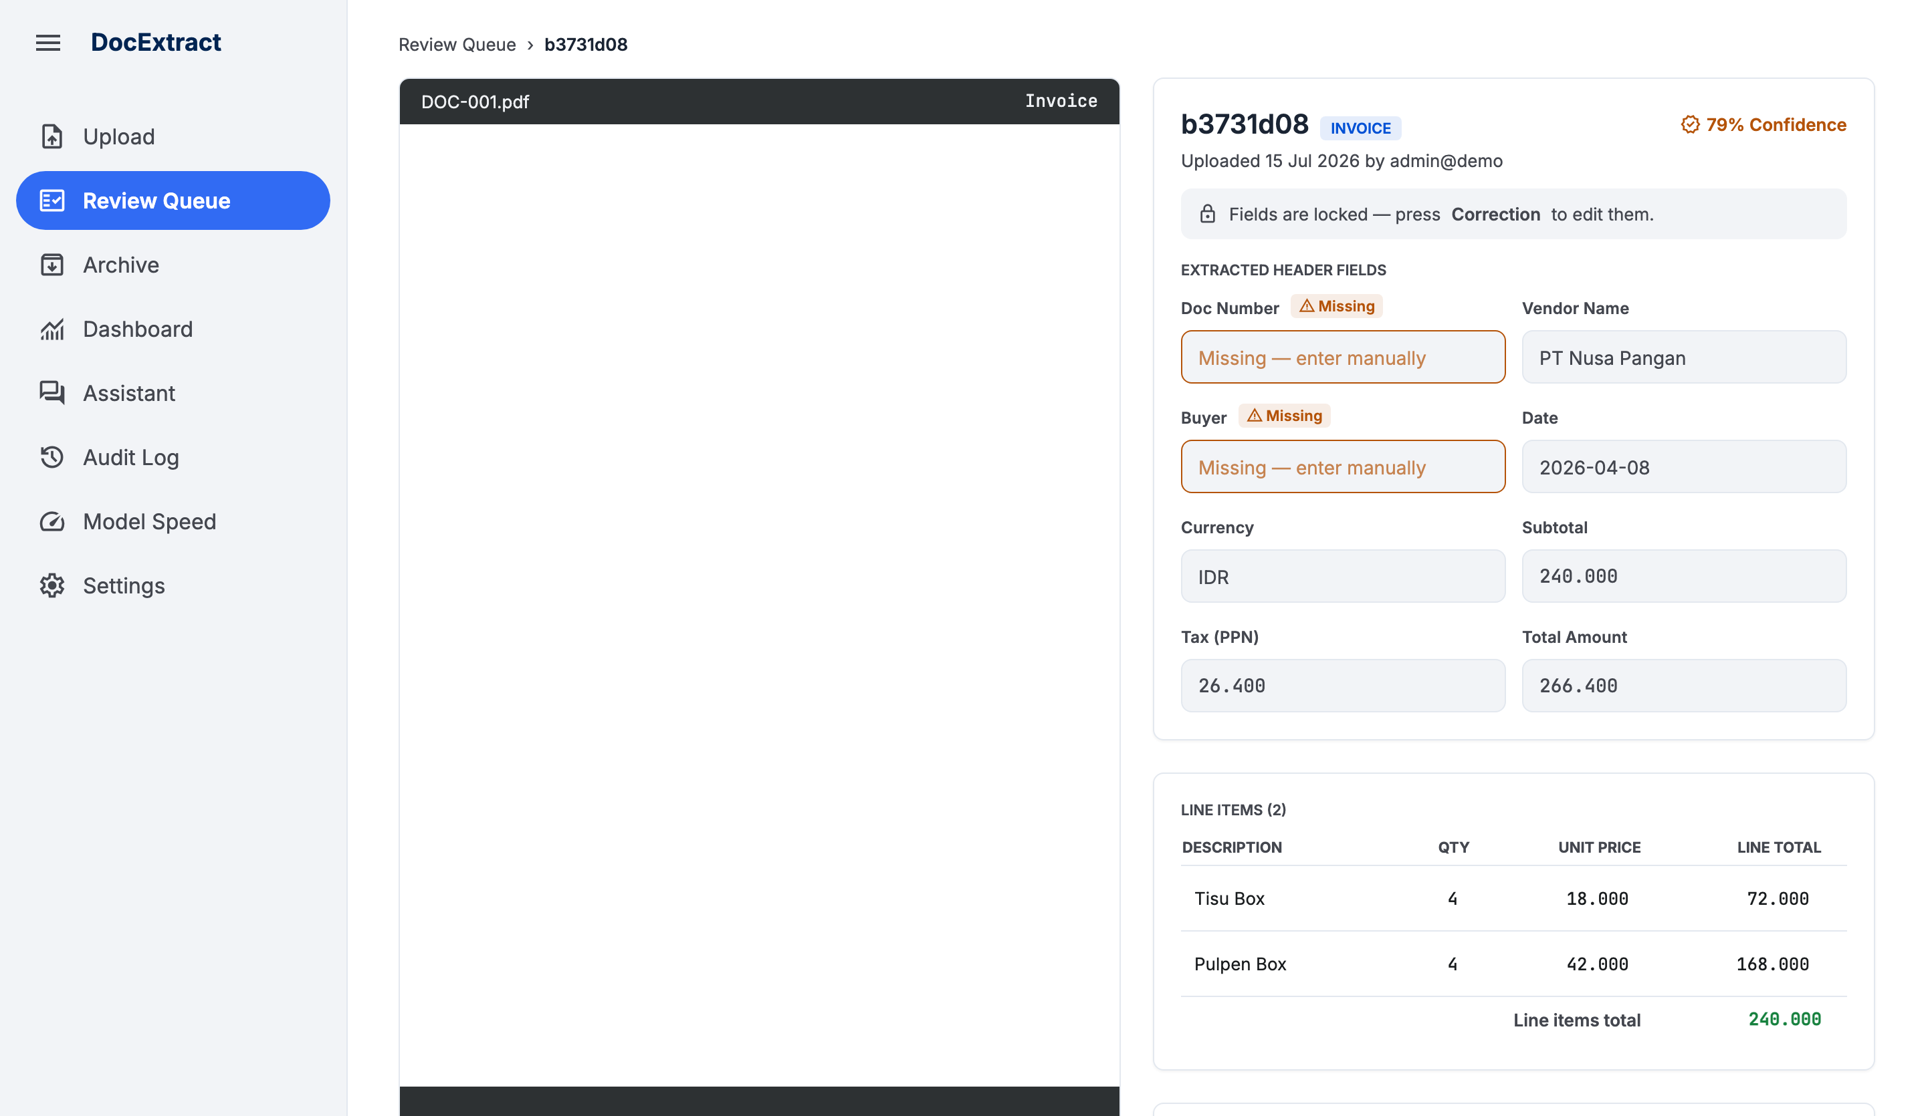
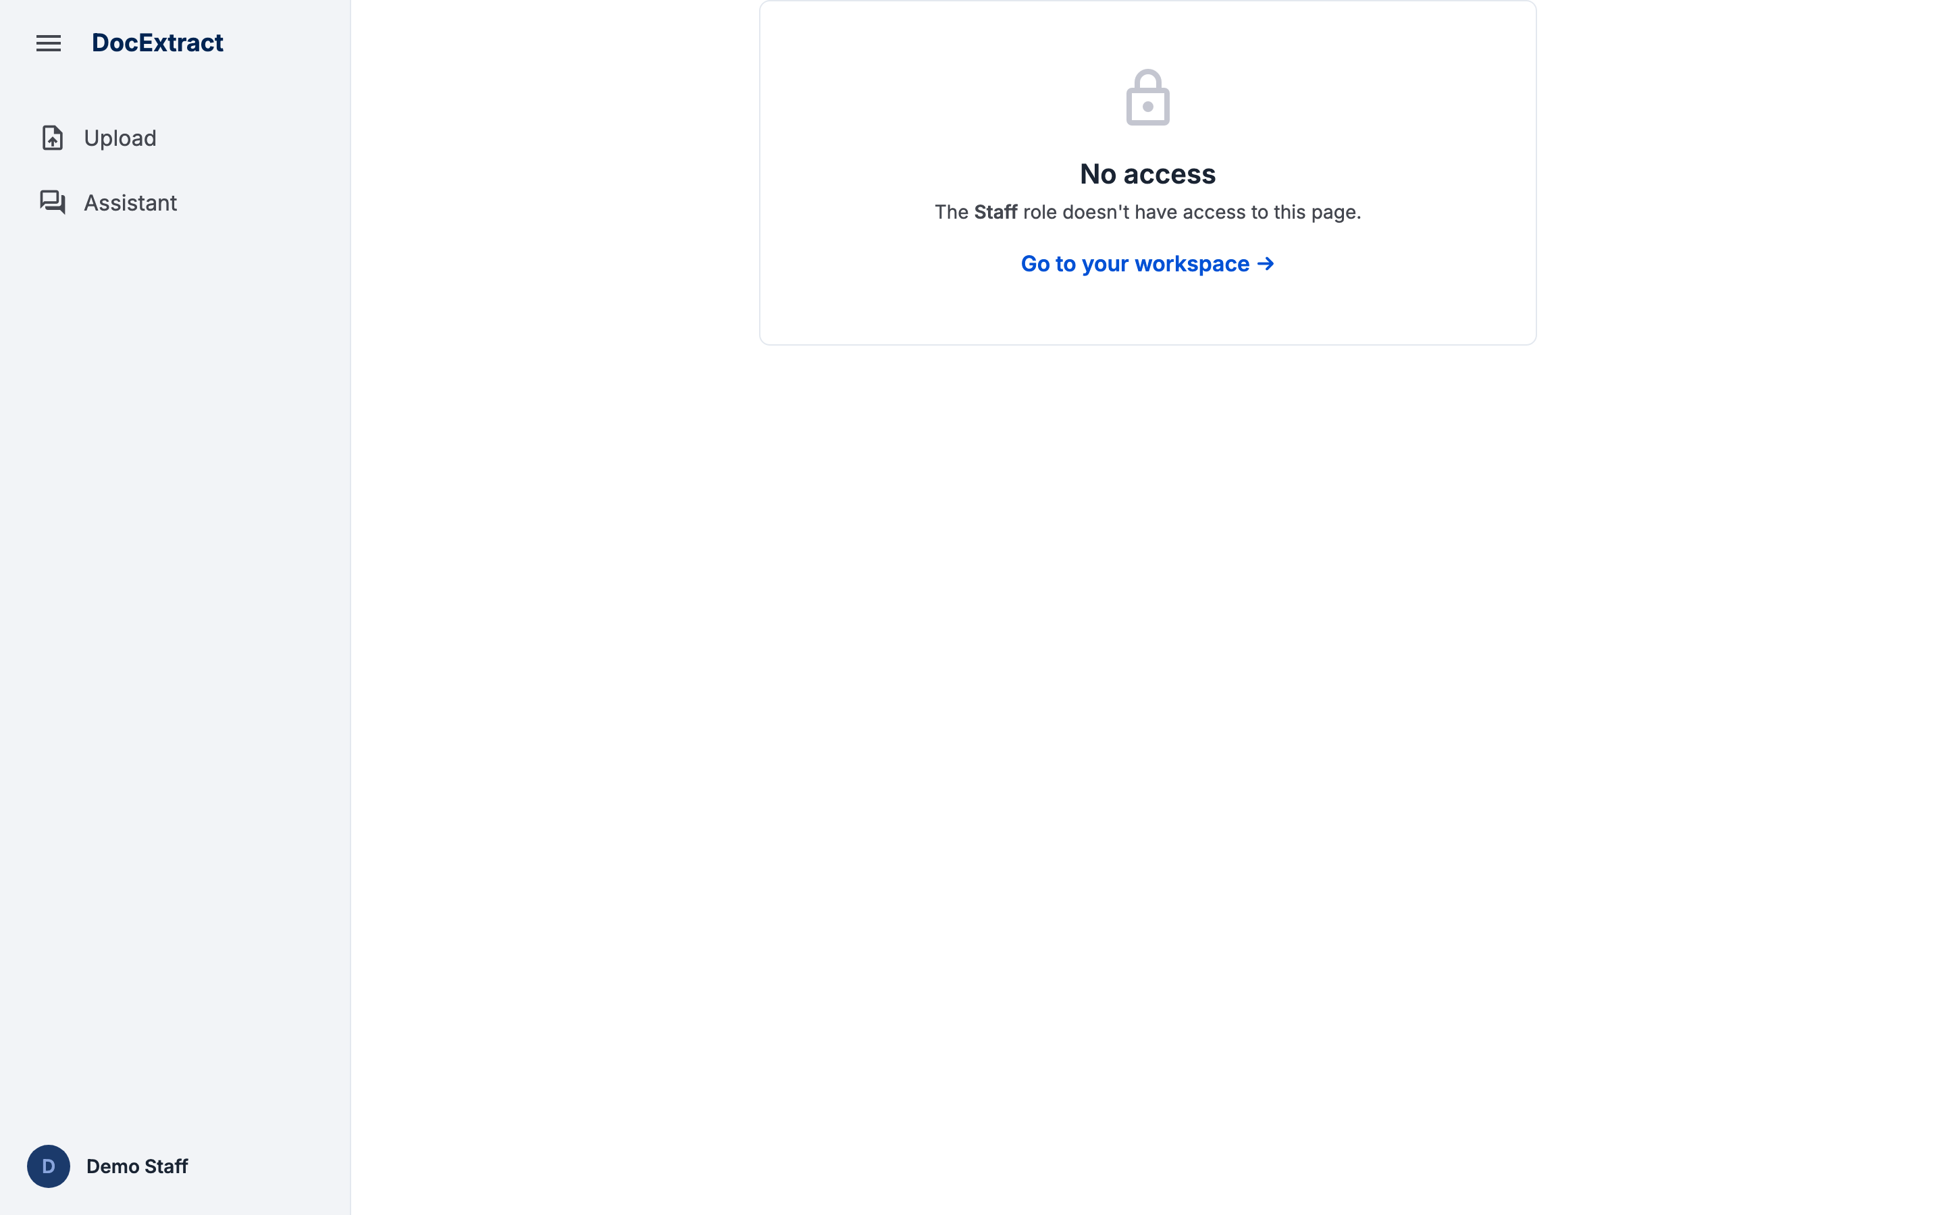
End to end flow
Staff
uploads
System extracts
and validates
Finance corrects
a flagged document
Admin approves
and exports
Document enters
the Archive
Period export,
5 formats
Every action hits
the Audit Log
Status moves through extracted, in_review or flagged. Finance has no Approve button at all, the approval time is stamped when admin approves, and the Archive groups documents by their approval date.
Admin: full review detail, decision controls available
Staff: refused the page entirely
This separation is what ensures the person who enters the data is not the person who releases it.
Notes:
This is the full lifecycle of one document, and who is responsible at each step. A staff member uploads, the system extracts and validates and sets a status, finance opens anything flagged, presses Correction, fixes the fields and saves, and finance has no Approve button anywhere in the interface. Admin is the one who reviews and presses Approve and Export, that action stamps the approval time and files the document into the Archive by that date. From there a whole period can be exported, and every action along the way lands in the Audit Log. The two screenshots make the point faster than I can explain it. on the left, the admin view of a review detail page with decision controls. on the right, the exact same kind of page for a regular staff account, a flat No access screen. The person entering the data is structurally not the person who can release it.

Slide 10
BONUS
outside the six deliverables
The RAG assistant
Ask a question in plain language about the extracted documents and get an answer that cites the documents it came from.
A question
arrives
60 documents
or fewer:
all summaries
go into context
Above 60:
embeddings and
cosine similarity,
top 12 retrieved
The model answers,
citing its sources
Why 60: a document summary costs roughly 150 tokens, so 60 documents is about 9,000 tokens, still comfortable in context. Below that threshold, feeding everything in is more accurate for aggregate questions such as how many documents are flagged, where top k retrieval can miss a relevant document.
DocExtract keeps every document on the team's own machine, with a human deciding what actually gets released.
Notes:
Last thing, and I want to be clear this sits outside the six graded deliverables, we built it after the core pipeline was solid. It lets you ask a plain language question about the documents you have extracted, and it answers with citations back to the source documents. The routing decision is simple, at 60 documents or fewer we just put every document summary into context, above that we switch to embeddings and cosine similarity and retrieve the 12 most relevant. The 60 document threshold is not arbitrary, a summary costs about 150 tokens, so 60 of them is around 9,000 tokens, which still fits comfortably, and below that line, feeding everything in beats top k retrieval for aggregate questions like how many documents are flagged. That is DocExtract. Every document stays on our machine, and a human still decides what gets released.

