Slide 1
SCHOLARSHIP SOLUTIONS
Student Name & ID :
Ashif Reza 180104107
Shaiuf Sadique 180104111 (Presenting)
Fabliha Nahid 180104116
Alphi Shahrin 180104121

Slide 2
PURPOSE BEHIND INFORMATION GATHERING & INTERVIEW
Our primary purpose behind this survey was to –
Ensure the best possible service to the people who will be using our platform.
Make our platform more realistic and user friendly by analyzing the view of the targeted audience.
Point out the inconveniences they were facing so we can make the process smoother and reduce the hassle.
Gather relevant and realistic data.
28-Jul-2021 Group no – 6 Slide no - 1

Slide 3
QUESTIONNAIRES AND INTERVIEW PATTERN
We collected opinions from both the Students and the Professors on their situations and how they wanted to deal with the matter of receiving and providing funding for study and research purposes.
Below are the set of questions we had for the students:
Basic information (i.e. name, e-mail).
The degree that they were looking to pursue.
Their desired funding preferences.
Their CGPA in undergraduate degree.
Interested field for research purposes.
The standardized and language efficiency test they preferred.
If they had any ongoing research.
If they preferred a website dedicated only for finding scholarships.
The country they are from.
And lastly if they had liked to suggest any particular feature for this website.
28-Jul-2021 Group no – 6 Slide no - 2

Slide 4
QUESTIONNAIRES AND INTERVIEW PATTERN
And here we have the questions that were for the Professors:
The type of student they usually prefer.
How much funding can they could provide to each student.
Their current expected students guidance limit.
The number of students they were leading at that moment.
The research fund amount that they received in the last 5 years.
If they had any preferred region when looking for a student.
If they preferred a website dedicated only for finding scholarships.
And lastly if they had liked to suggest any particular feature for this website.
28-Jul-2021 Group no – 6 Slide no - 3

Slide 5
Selection of Interview Personnel
Why we selected some of these personnel particularly?
Abrar, Arman, Asifur, Tasnim, Rumana, Fardeen, Palash for students. The targeted audience were mostly students who just completed their bacherlor degree and are looking for universities, where they can apply for higher education with their preferable funding amount.
Dr. Rofiqul, Dr.Anika, Dr.Ross, Dr.Minato, Dr.Ramsey for professors. They are all professors who receive research funds from various industries and institutions and are looking for students who are interested and capable enough to help them with their research.
28-Jul-2021 Group no – 6 Slide no - 4

Slide 6
Total Interview procedure [Questions & Answers]
For Students :
Author : Shaiuf Sadique | Date : 24/7/21 | Time : 10:15 am | Duration : 30 minutes
1. What is your desired funding preference?
Participants : Comments : Abrar, Arman, Asifur, Tasnim, The majority of participants here were Rumana, Fardeen, Palash looking for a fully funded scholarship.
28-Jul-2021 Group no – 6 Slide no - 5

Slide 7
Author : Ashif Reza | Date : 24/7/21 | Time : 11:30 am | Duration : 40 minutes
2. Do you currently have any ongoing research?
Participants : Abrar, Arman, Asifur, Tasnim, Rumana, Fardeen, Palash | Comments : Here most of the participants stated that they didn't have any ongoing research at that moment and were looking forward to take part in a research program as soon as they could .
Author : Alphi Shahrin | Date : 24/7/21 | Time : 12:30 pm | Duration : 30 minutes
3. Do you prefer a website dedicated only for finding scholarships or not?
Participants : Abrar, Arman, Asifur, Tasnim, Rumana, Fardeen, Palash | Comments : Here all the participants agreed and stated that it would be really helpful for them as they face many inconveniences while applying for different universities.
28-Jul-2021 Group no – 6 Slide no - 6

Slide 8
Total Interview procedure [Questions & Answers]
For Professors:
Author : Fabliha Nahid | Date : 24/7/21 | Time : 1:30 pm | Duration : 30 minutes
1. What kind of student do you usually prefer?
Participants : Comments : Dr. Rofiqul, Dr.Anika, Dr.Ross, Here, half of the participants stated that they prefer Dr.Minato, Dr.Ramsey both type of student whether they advance in academic qualities or in extra curricular activities.
28-Jul-2021 Group no – 6 Slide no - 7

Slide 9
Author : Alphi Shahrin | Date : 24/7/21 | Time : 2:30 pm | Duration : 30 minutes
2. Do you prefer a website dedicated only for finding interested students or not?
Participants : Dr. Rofiqul, Dr.Anika, Dr.Ross, Dr.Minato, Dr.Ramsey | Comments : All the participants agreed to this and they said it would really be a good approach as it would reduce the hasssle they face in every academic session.
Author : Shaiuf Sadique | Date : 24/7/21 | Time : 3:30 pm | Duration : 30 minutes
3. Would you like to see any specific feature for this website that would really feel helpful to you?
Participants : Dr. Rofiqul, Dr.Anika, Dr.Ross, Dr.Minato, Dr.Ramsey | Comments : Most of the participants agreed upon a feature where they can check all the information of a student in an organized way.
28-Jul-2021 Group no – 6 Slide no - 8

Slide 10
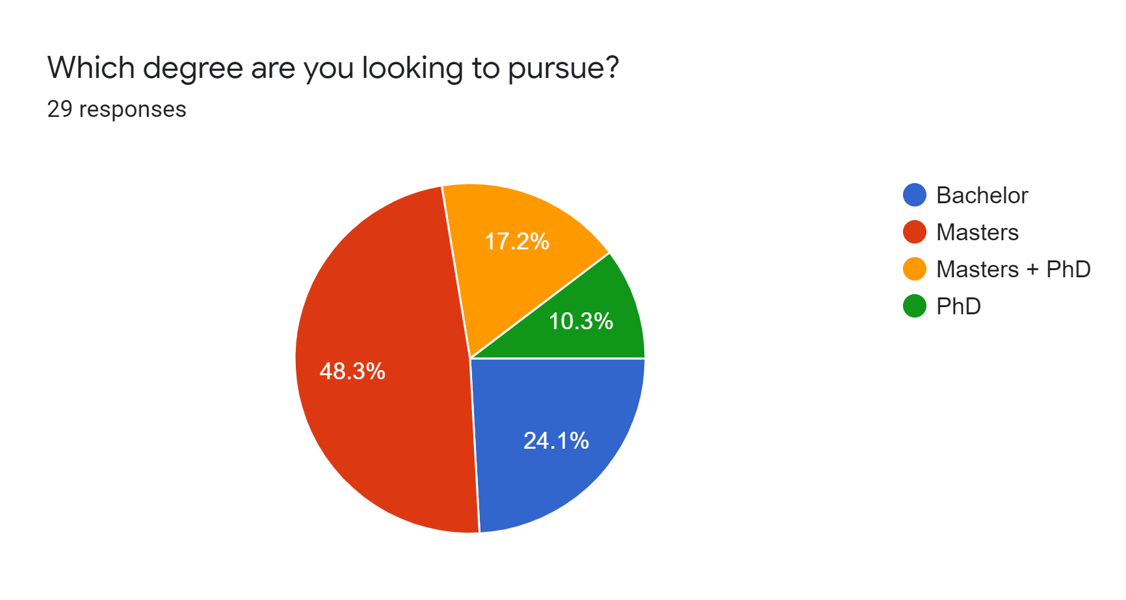
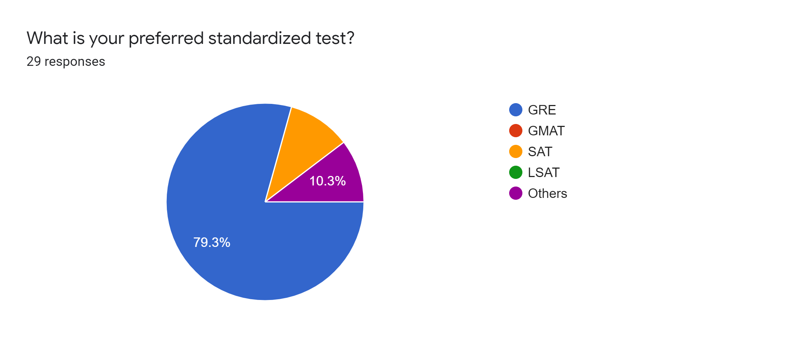
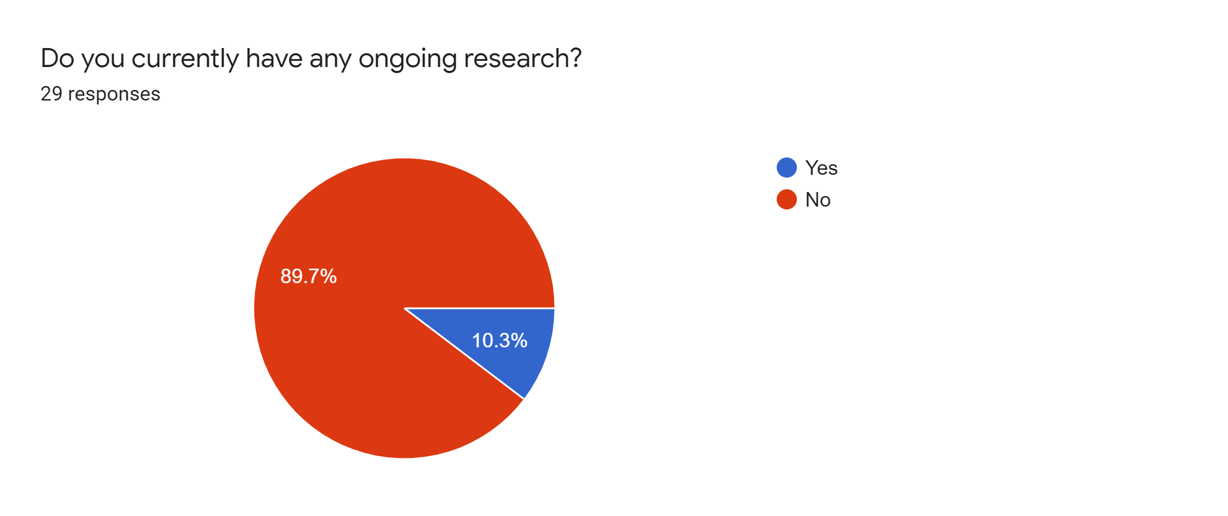
DATA COLLECTION (Students)
28-Jul-2021 Group no – 6 Slide no - 9

Slide 11
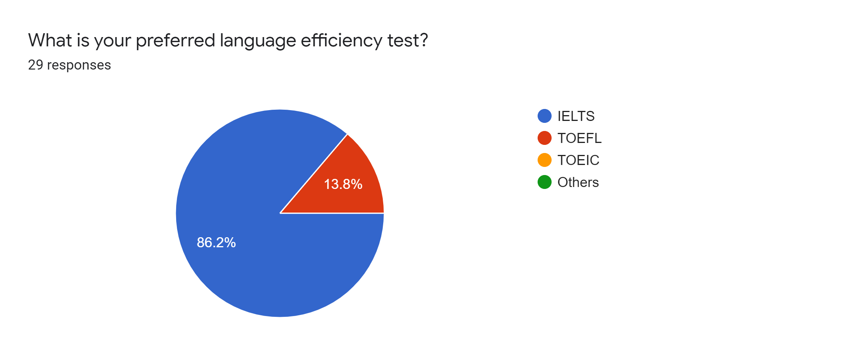
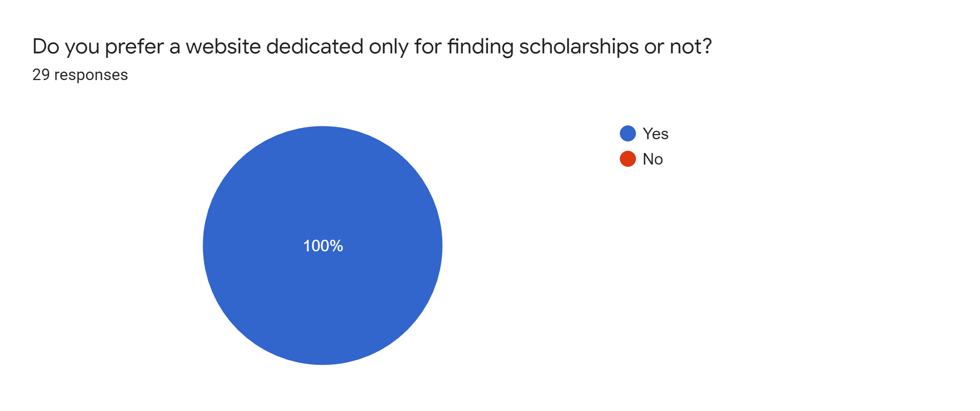
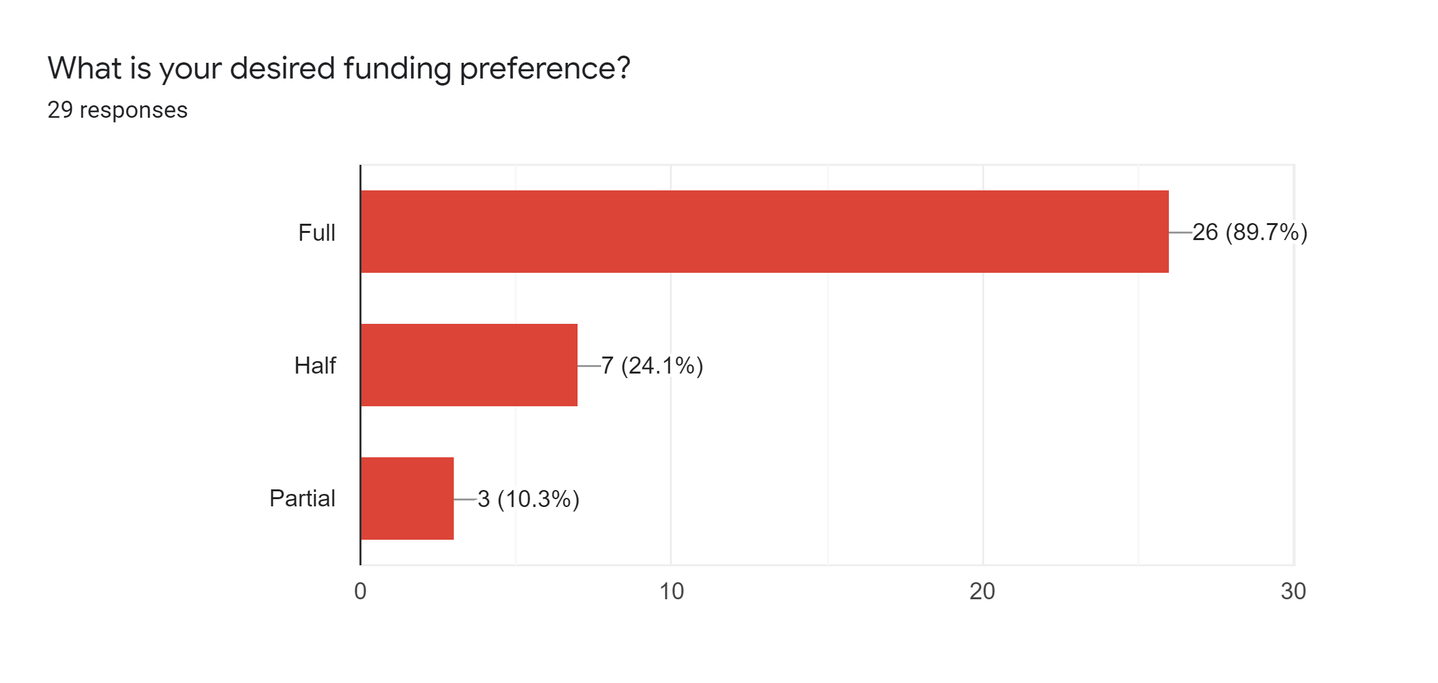
28-Jul-2021 Group no – 6 Slide no - 11

Slide 12
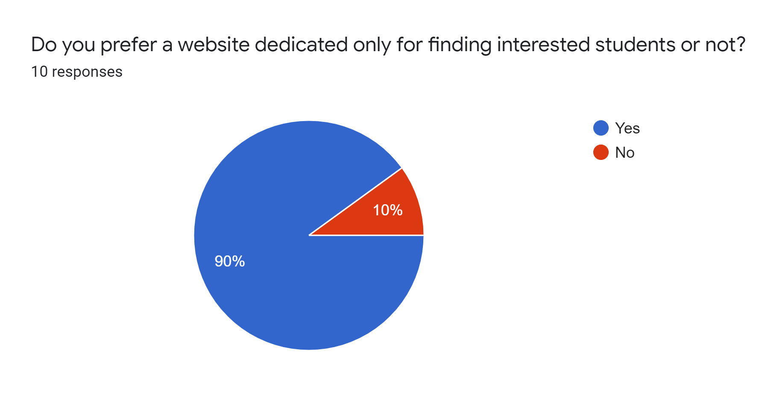
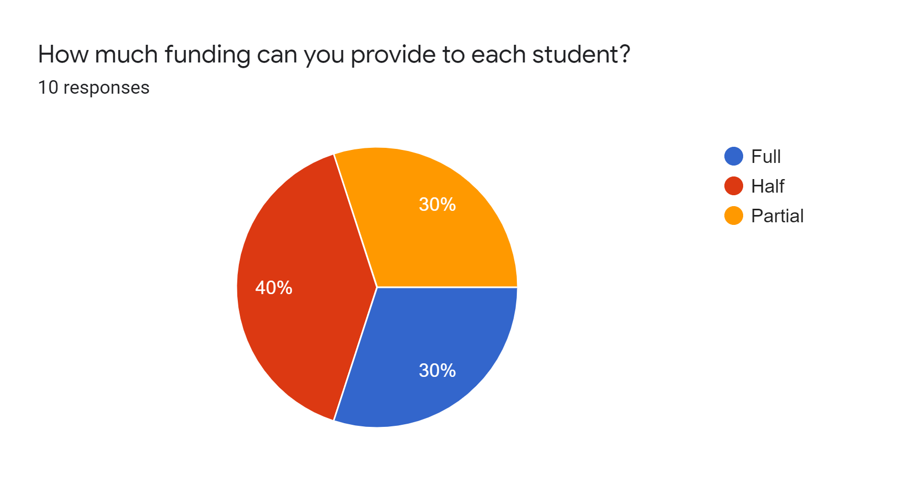
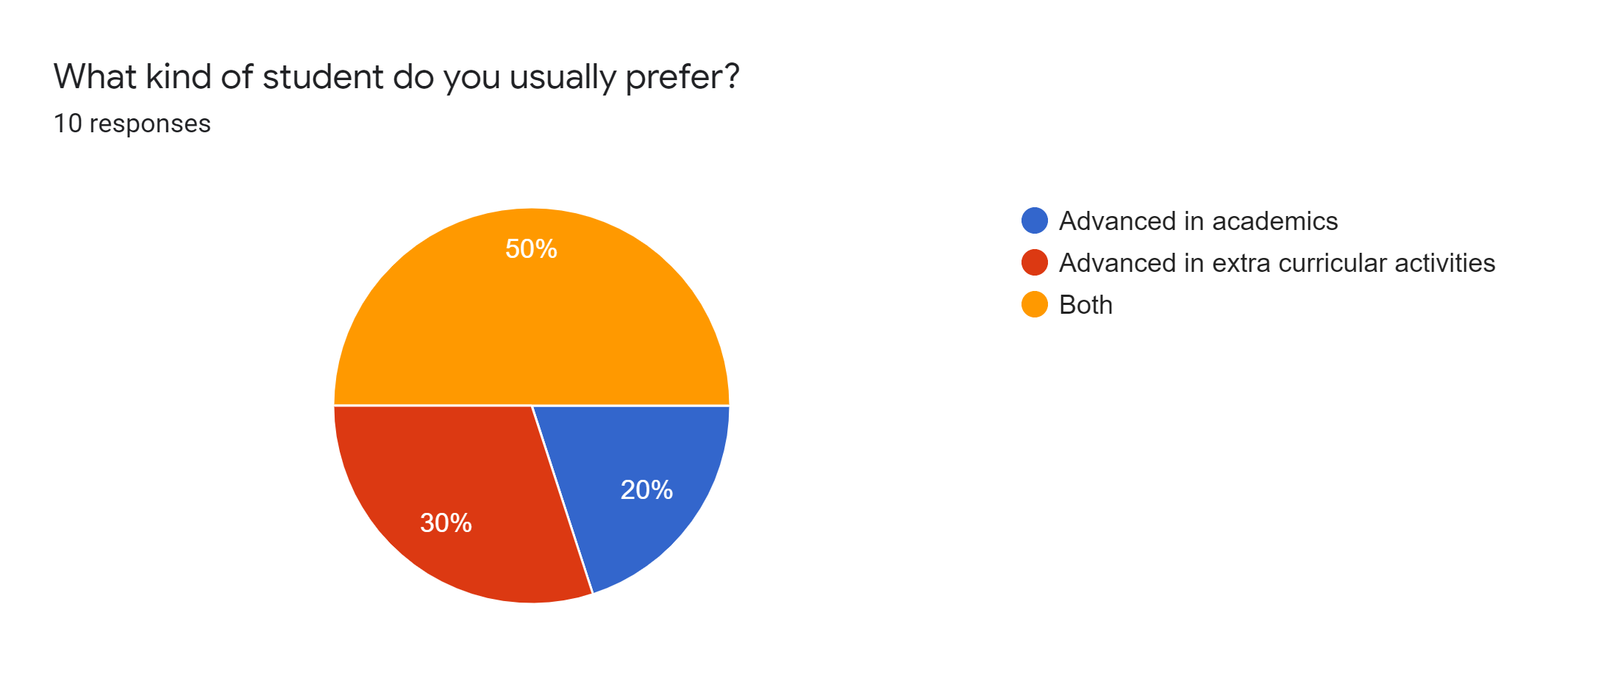
DATA COLLECTION (Professors)
28-Jul-2021 Group no – 6 Slide no - 10

Slide 13
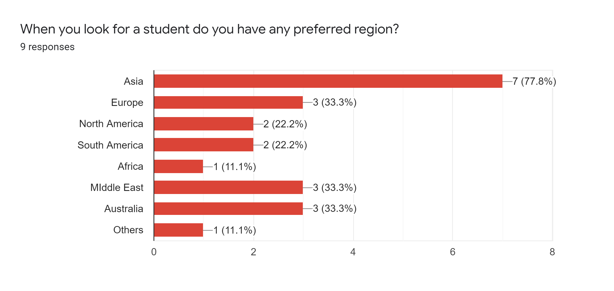
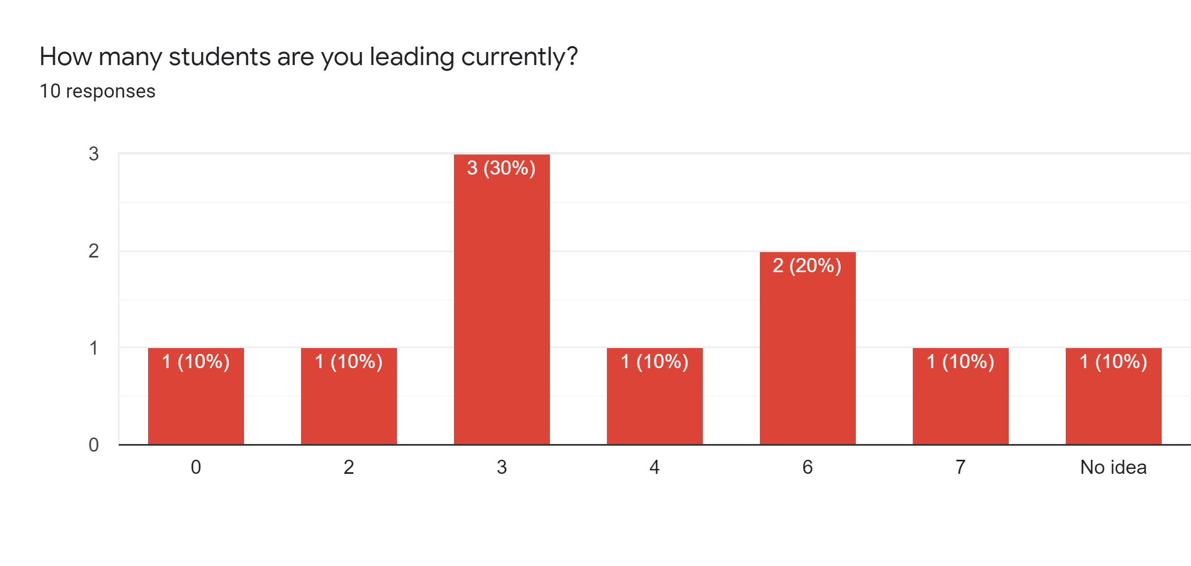
28-Jul-2021 Group no – 6 Slide no - 12

Slide 14
REVISED REQUIREMENT ANALYSIS AFTER COLLECTION OF DATA
O
T
After collecting all the data we can see that our requirements are almost the same as before.
We’ll be looking to make a website using C#, html, css, java script, bootstrap and mysql database.
28-Jul-2021 Group no – 6 Slide no - 13

Slide 15
SUMMARY THE TOTAL INFORMATION AND PREPARE THE LIST OF ACTIVITIES
A platform specifically designed for scholarship purposes is a part and parcel in modern time.
Features that make the platform more efficient and user friendly are highly demanded.
The audience highly appreciates the idea of the website.
28-Jul-2021 Group no – 6 Slide no - 14

Slide 16
LIST OF ACTIVITIES
Layout and UI designing.
Creating user profile according to their accounts
Student section implemented with all the features.
Professor section implemented with all the features.
Testing and finalization.
28-Jul-2021 Group no – 6 Slide no - 15

Slide 17

CONCLUSION
Finally, we can see that many people who
want a scholarship, who take part in the
survey, wants a platform dedicated only
to the scholarship.
Almost the same view is held by most of the target audience on this website.
Thus, we expect to create a system to meet the needs of students in search of scholarships and to motivate students with mediocre grades.
28-Jul-2021 Group no – 6 Slide no - 16

Slide 18
THANK YOU!
28-Jul-2021 Group no – 6 Slide no - 17

