Slide 1
Harmonization Demo
Research into harmonizing data from clinical studies
Chris Roeder, Feb 2019

Slide 2
Contents
Requirements: What are we trying to solve? What not?
Kao Lab
PMP
Data Tour
Tables: study, OMOP, Analysis Matrix
Mappings: import, derived variables, export
Budding UI Tour
Issues Moving from Kao-lab to wide-spread PMP use.
Notes:
Idea is to frame the discussion and draw distinction between the ADAPT-HF grant and the PMP. Its a slippery slope. I work dual -roles, but have very limited time and resource.

Slide 3
Requirements: Kao Lab
Sophisticated Informatics Users
Produce data for papers in lab
Speed harmonization process
Ease transparency, reproducibility
table-driven
use of controlled vocabularies
Open door to EHR data through OMOP/OHDSI
Based on a prior implementation, immediately available customer: Dave
informal: personal interaction and reverse engineering
Enable collaboration with data owners (McMurray, Juhnd)
be able to run under their control, on their hardware, limited data access

Slide 4
Requirements: Additional from PMP (less ADAPT-HF, more NHLBI-Pilot)
Make usable by others, less technical others
Need more than a UI over SQL inserts and queries
Simple tasks need aggregated and streamlined, demand less familiarity with OMOP
Incorporate computer aids from NCBO (Musen, Graybeal et. al)
ontology recommendation
concept recommendation
Make usable by groups, not just individuals
Harmonization standards development is a community process.
Current schema allows for only a single mapping per study.
no mechanism for comparing or merging two mappings
limits options for collaboration
Current schema doesn’t address different data permissions
The Kao lab uses data beyond BioLINCC that isn’t as freely available
Import and harmonize study metadata
Search for studies using study-level metadata
Notes:
This is not my focus. Points here are speculation.

Slide 5
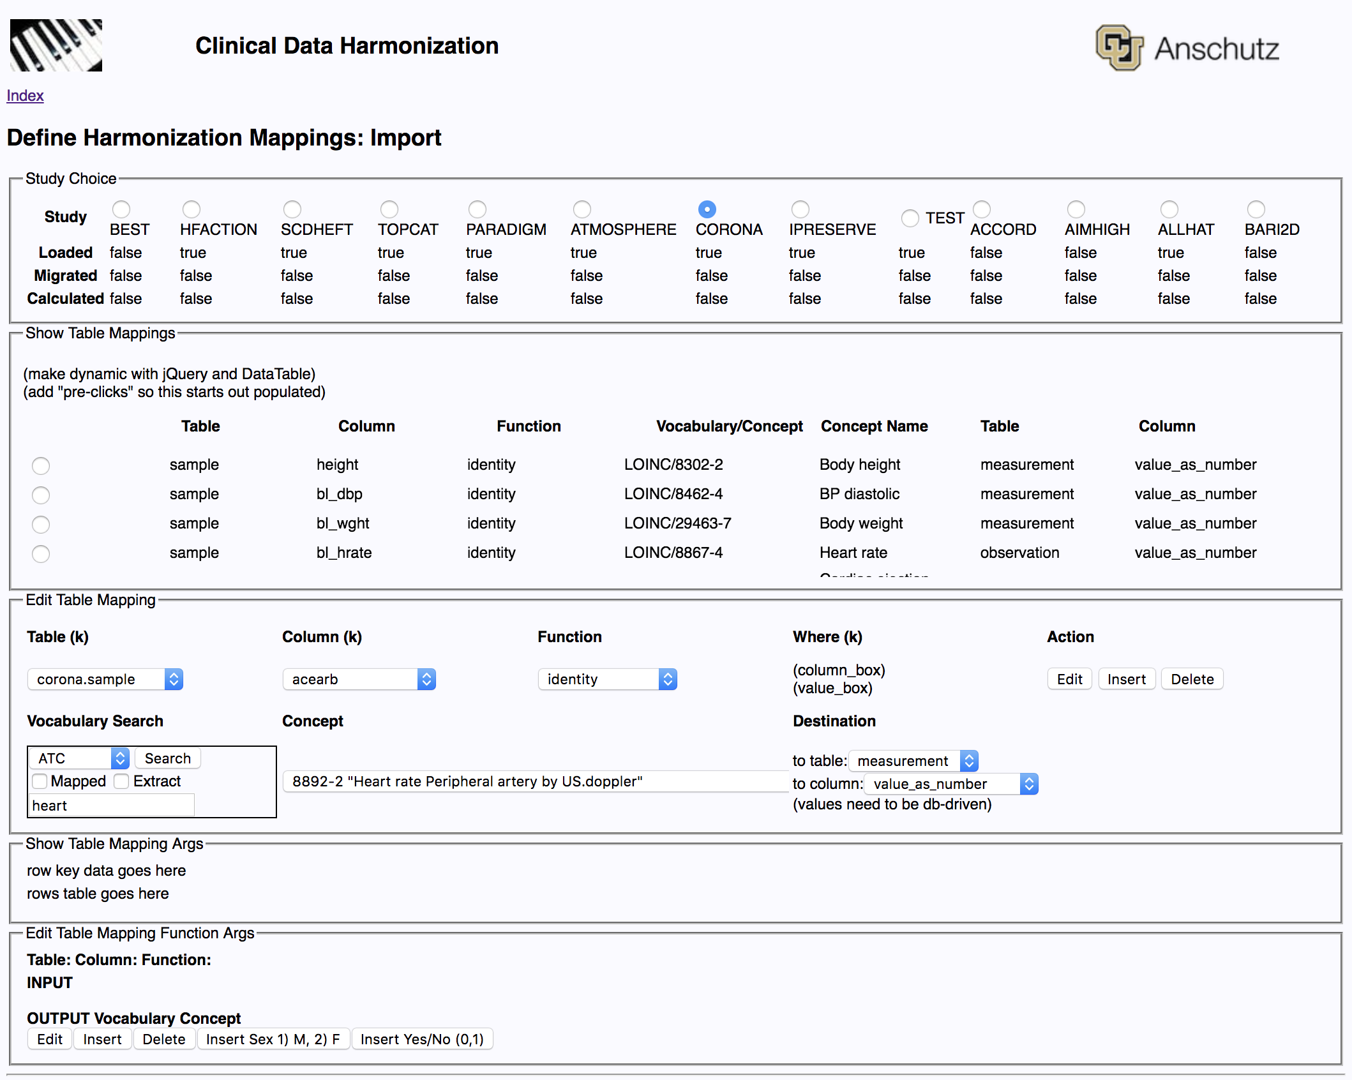

Slide 6
Demo of Development environment
Work in progress
at least 2 bugs present
presentation is unfinished,
data is being produced

Slide 7
Data Level: Intro
3 slides describing the structure of the data to frame
3 slides describing the mapping between structures
Fully aware that this is very detailed
Will require careful UI design to lighten the load on less IT focused users
the data type: string/number/concept distinction
largely handled by passing triples around and depending on alignment between concepts and functions
the destination: person, visit, observation, measurement, others
can be driven by the concept’s domain_id (TBD)

Slide 8
Harmonization Process
2
1
OHDSI/OMOP
3
Study Data
Harmonization Interface
Extraction Interface
Analysis Matrix
ata
AnalysisMatrix.CSV
Harmonization Mappings
Extraction Specifications

Slide 9
Data Level: Study Tables Ex. ACCORD
ACCORD_KEY, 10 variables including cvd_hx, age and female
BLOODPRESSURE_201604, 6 variables including hr, sbp, dbp
CONCOMITANTMEDS, ~40 variables includine acei, beta_blocker, cox2
F01_INCLUSIONEXCLUSIONSUMMARY, ~40 variables cabg, gender
F07_BASELINEHISTORYPHYSICALEXAM, >50 variables alcohol, cigarett
LIPIDS_201604, 8 variables, hdl, ldl, trig, chol, visit
OTHERLABS_201604, 12 variables, potassium, gfr, etc.

Slide 10
Data Level: OMOP tables
person
visit occurrence
measurement
observation
death
drug_exposure
condition_ occurrence
etc.
Person: A row represents a whole person. person_id gender_id dob_id race_id ethnicity_id etc 00000001 457660034 01/02/73 4185154 2000000011
Observation: a row represents the value, includes much context: person_id observation_id concept_id date time visit_occurrence_id provider_id

Slide 11
Data Level: Analysis Matrix
Used as input to R or SAS
Tuned for specific analysis plan
Typically one row per subject/patient
Columns for variables of interest
Values optionally categorized
Simplified Events
drug exposure as a simple True/False
single values at a common point in time
perhaps change in value over a predetermined interval

Slide 12
Harmonization example
Male
Study A
Sex
ID | Age | weight_pounds | Gender
1 | 55 | 205 | M
2 | 71 | 143 | F
Harmonized, Combined
ID | 30525-0 | LP18015-5 | 46098-0
1 | 55 | 93 | 703117000
2 | 71 | 65 | 703118005
3 | 82 | 98 | 703117000
4 | 46 | 57 | 703118005
Study B
ID | ageyrs | wt_kg | sex
3 | 82 | 98 | 1
4 | 46 | 57 | 2
Age in years
Weight in kg
Female

Slide 13
Data Level: OMOP import mapping (Study to OMOP)
study_to_ohdsi_mapping
from_table, from_column:
function_name:
vocabulary_id, concept_code, to_table, to_column
etc. (this assumes a simple wide table, some labs go a step towards narrow..)
study_mapping_arguments
linear_equation: transform_factor, transform_shift
map_number: mapped_number → to_concept_vocabulary_id, to_concept_code
map_string: mapped_string → to_concept_vocabulary_id, to_concept_code

Slide 14
Derived Values / locally calculated ( OMOP to OMOP)
ohdsi_calculation_function
module_name, function_name, expression
Ex 1:
Ex 2 (w/expression):
to_table, to_column
to_vocabulary_id, to_concept_code
function_order
ohdsi_calculation_arguments (source for input)
vocabulary_id, concept_code, from_table
argument_order, argument_name
Ex. BMI takes height and weight

Slide 15
Categorization example
Male
Male
Sex
Harmonized, Combined
Extracted, Categorized
ID | 30525-0 | LP18015-5 | 46098-0
1 | 55 | 93 | 703117000
2 | 71 | 65 | 703118005
3 | 82 | 98 | 703117000
4 | 46 | 57 | 703118005
ID | Age Cat. | Weight Cat. | Sex
1 | 2 | 3 | 1
2 | 4 | 1 | 2
3 | 4 | 3 | 1
4 | 1 | 1 | 2
Age in years
Weight in kg
Age rank
Weight rank
Female
Female

Slide 16
Data Level: OMOP Export (OMOP to Analysis Matrix)
Dual Purpose:
map from concepts to strings or numbers
create small number of categories from a continuous variable
Ex. Weight 173.4 → low/med./high at 150/200/250
categorization_function_metadata
function_name
long_name, short_name (abbreviation)
from_vocabulary_id, from_concept_code
from_table (from_colmn part of function_choice)
categorization_function_parameters
value_limit (from_integer)
from_string
from_concept_id

Slide 17
Budding UI
Defining Mappings
Import Mapping Screen
Derived Value / Calculation Screen (TBD)
Export Mapping Screen (incomplete)
Reports
Import Coverage Grid, Text, CSV
Export Coverage Grid, Text, CSV
?
Running Mappings
overly granular for debugging/development
DQ and other functionality
Setup (TBD)

Slide 18
Issues – Future Work
See PMP Requirements
Simplistic Events Mapping
limited outcomes
crude handling of changes in values
need to solve mapping from named visits to varying dates or offset times for different patients on different dates for the same study-visit
Ex. 3 month visit may happen at 89 days for one, 94 for another, on dates months apart
Ex. A dataset may include studies that have slightly different observation times: 3 and 4 month. Sometimes it may be possible to match them up. How to do it, how to document it?
Multi-User
individual sets of data, sharing and comparing data
Logins, user_id within a workspace

Slide 19
Issues – Integration with More Users
Mapping configuration exists in a postgresql database with no concept of individual users. There is only one mapping. Options to explore for solutions extending the context to multiple users include:
multiple databases
multi-tenant database architecture
adding a user-id to the key of most tables is a non-trivial challenges to OMOP
Cohort Search – values in separate tables presents more challenging query
dates also an issue: SBP measured when?
likely need a datamart focused on search
Graybeal has suggested pre-calculated query results
Mapping configuration merge/comparison

Slide 20
Install Requirements
Python 3
PostgreSQL 9.6 (RDS)
Packages listed in a requirements.txt file for automatic install
OHDSI OMOP starter database
wide open license, will be part of the source package in BitBucket (git)
Concepts from OHDSI Athena
licenses need investigated regarding redistribution
worst case, it’s a separate registration and download

Slide 21
Links
http://www.ohdsi.org
DDL: https://github.com/OHDSI/CommonDataModel/tree/master/PostgreSQL
get vocabulary from Athena: http://athena.ohdsi.org/vocabulary/list
Go with the defaults, but remove RxNorm Extension. We don’t use it and its huge.
ATLAS for cohort creation: https://github.com/OHDSI/Atlas
Aphrodite for phenotyping: https://github.com/OHDSI/Aphrodite

