Slide 1
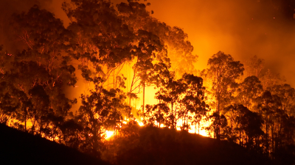
Early-Fire-Detection
Deep-learning
Torchvision

Slide 2
Problem definition: Early fire detection
Fire is the most dangerous abnormal occurrence, because failure to control it at an early stage can lead to huge disasters, leading to human, ecological and economic losses.
Conventional technology based on particle sampling, temperature sampling and smoke analysis has high false alarm rates and needs proximity.
Optical approaches are increasingly appropriate alternatives

Slide 3
Visual sensors advantages and problems
Advantages:
-Low cost due to the existing set up of installed cameras for surveillance
-Monitoring larger regions
-Fast response due to the elimination of waiting time for heat diffusion
-Fire confirmation without visiting location, less human interaccion
-Availability of details such as size, location and degree
Problems:
-Scenes complexity
-Objects and people looking like fires
-Irregularity of lighting
-Lower images quality due to network constrains: Use high quality images when probability of fire is higher

Slide 4
Solution : Pre-Trained Models for Image Classification
CNN have exhibited state of the art performance in a variety of computer vision tasks
Multiple feature extraction stages can automatically learn representations from the data
Some architectures with highest results in vision:
ResNet50
Inceptionv3
VGG-16

Slide 5
How the solution will be used in practice - how will I interact with it?
Access webcams and predicting whether each frame contains fire or not
Real time detection
We can detect fire from images or videos at an early stage
Assistance to disaster management teams in managing fire disasters on time, preventing huge losses.
In a smart city, forests and parks, in landfills, in airports and railway stations.

Slide 6
Models fit to data are:
A basic CNN architecture
Pre-trained models: Resnet and inception
-Load the batches of images, feed forward loop, calculate the loss function and use the optimizer to apply gradient descent in back-propagation.
-freeze the pre-trained layers, so we don’t backprop through them during training
-re-define the final fully-connected layers, the ones to train our images. Fine-tuning with our dataset keeping a slower learning rate. The slow learning rate allows the previously learned parameters to be minimally adjusted
-Learns details at small scale enabling detection in the early stages

Slide 7
CNN model contains:
Three Conv2D-MaxPooling2D layers pairs
Followed by 3 Dense layers.
To overcome the problem of overfitting we will also add dropout layers. Fully connected layers are very prone to overfitting. Due to the large number of parameters.
The last layer is the softmax layer which will give us the probability distribution the classes
Batch Normalization

Slide 8
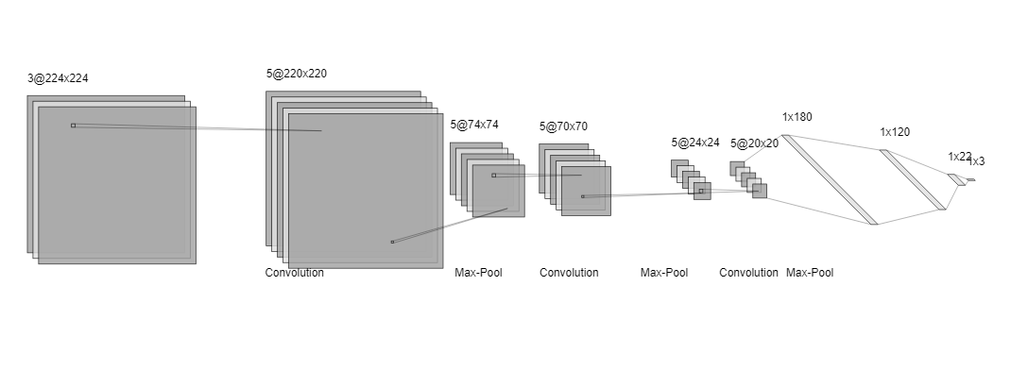
CNN Architecture

Slide 9
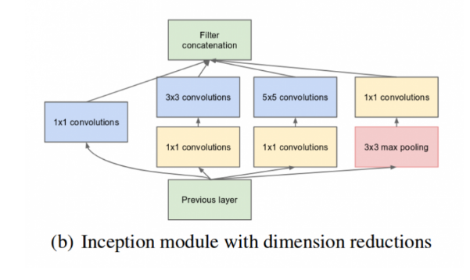
Inceptionv3
Branching within a layer allows abstraction of features at different spatial scales
In simple terms, the Inception Module just performs convolutions with different filter sizes on the input, performs Max Pooling, and concatenates the result for the next Inception module. The introduction of the 1 * 1 convolution operation reduces the parameters drastically.
Though the number of layers in Inceptionv1 is 22, the massive reduction in the parameters makes it a formidable model to beat.
Inceptionv3 model has a few more improvements on v2. The following are the major improvements included:
-Introduction of Batch Normalisation
-More factorization
-RMSProp Optimiser

Slide 10
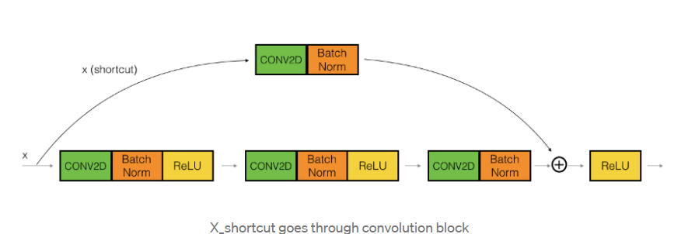
Resnet50
The concept of skip connections was introduced by ResNet. adding the original input to the output of the convolution block.
Convolution + batch norm operations are done in a way that the output shape is the same, then we can simply add them
23 million trainable parameters.
It trains extremely deep neural networks with 150+layers successfully.
Helps mitigating the vanishing gradient problem
The higher layer will perform at least as good as the lower layer, and not worse

Slide 11
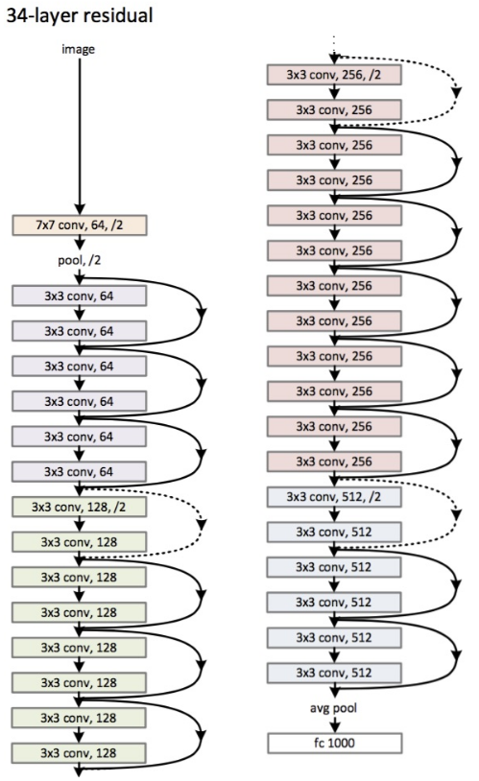
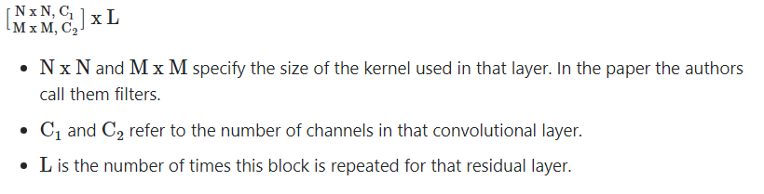
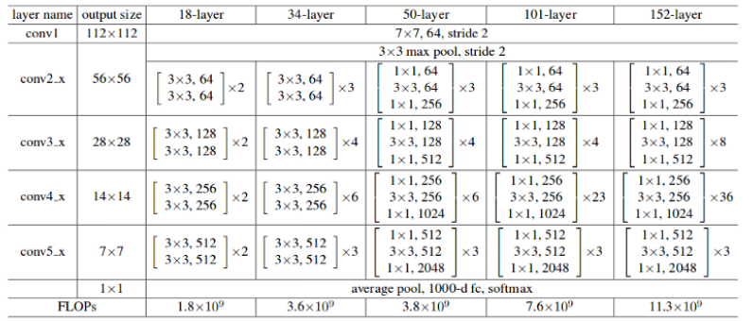

Slide 12
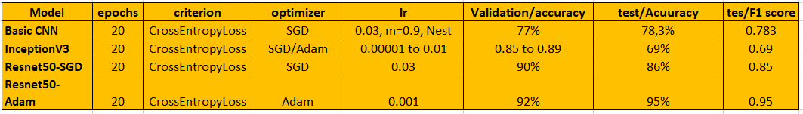
Experiment models/parameters recorded and logged

Slide 13
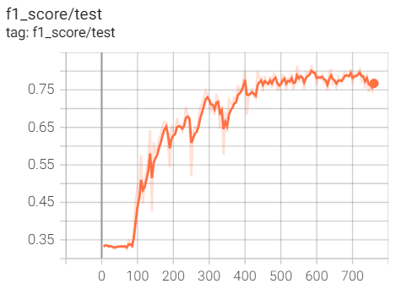
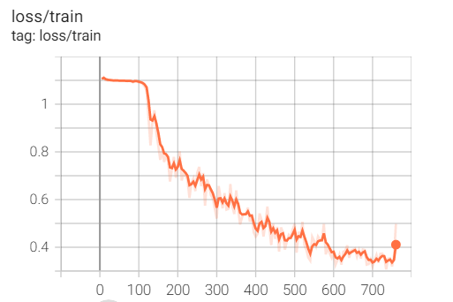
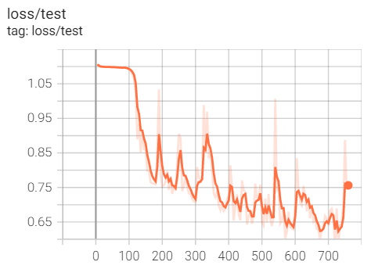
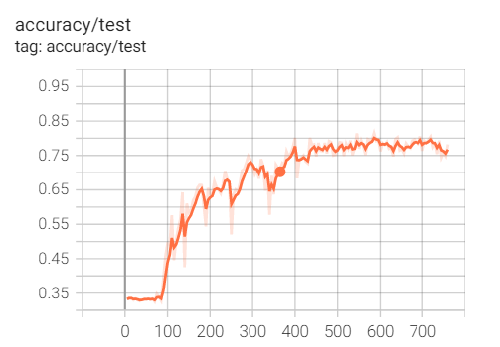

CNN / SGD / lr=0.03 test loss is bigger than training loss: underfitting

Slide 14
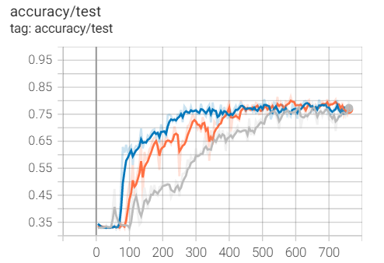
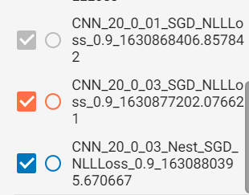
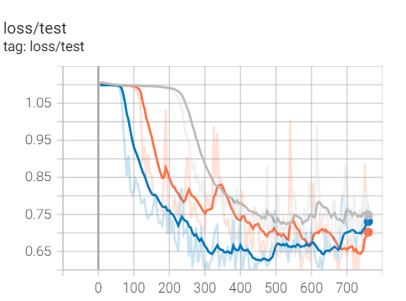
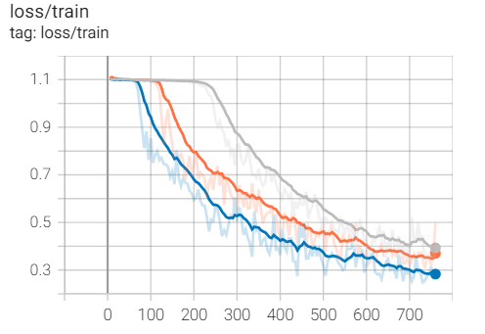
Different learning rate and the effect of using Nesterov

Slide 15
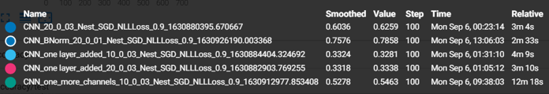
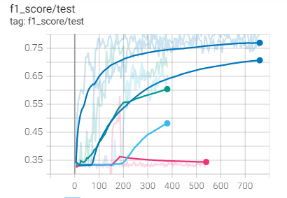
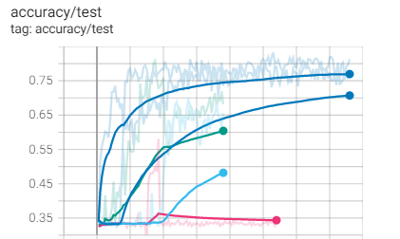
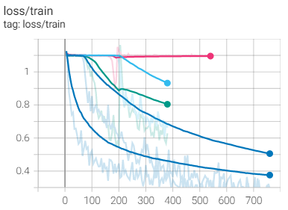
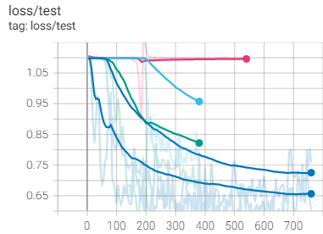
-One layer added -More channels, more filters (much slower) -Batch Normalization

Slide 16
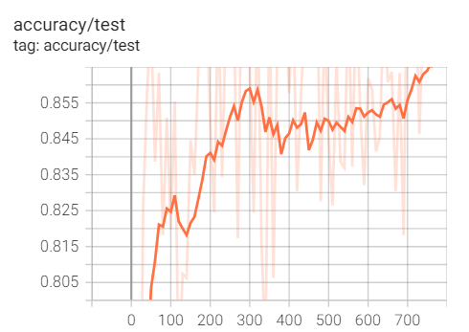
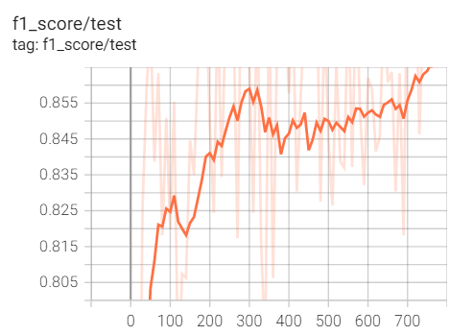
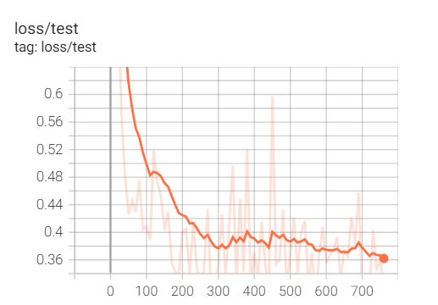
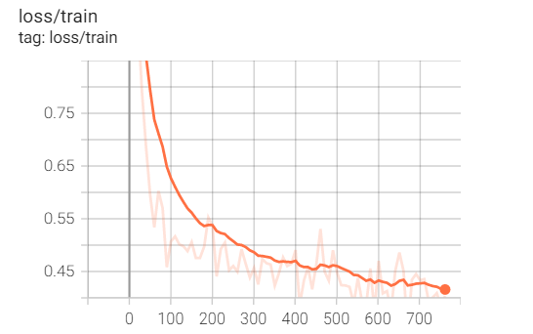
Inception tensorboard runs_inception_part1_0_001_64_Adam_CrossEnt

Slide 17
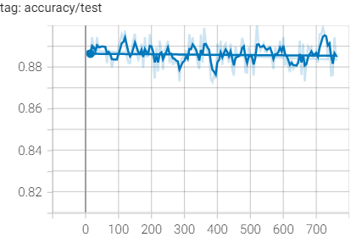
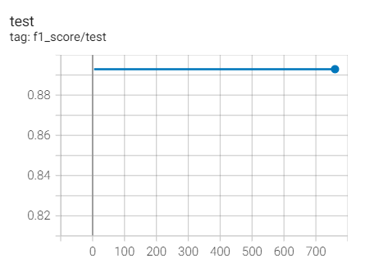
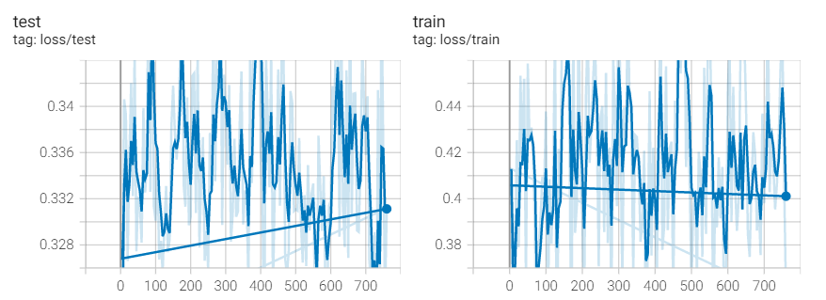

Inception tensorboard runs_inception_part120_001_64_Adam_CrossEnt

Slide 18
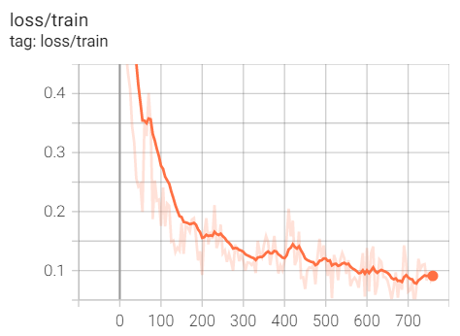
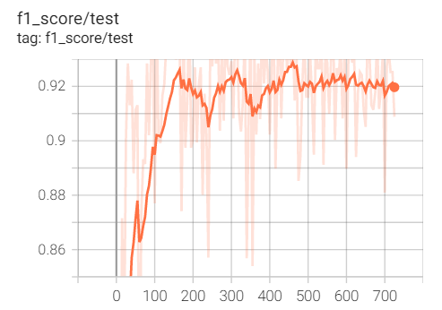
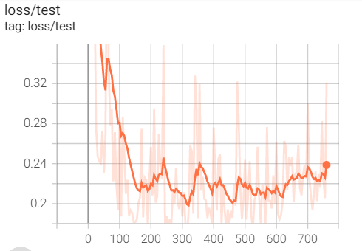
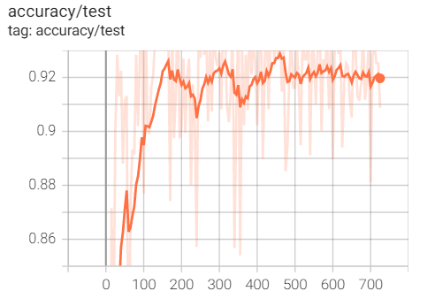

No overfitting as the loss curves are very close in test and training data

Slide 19
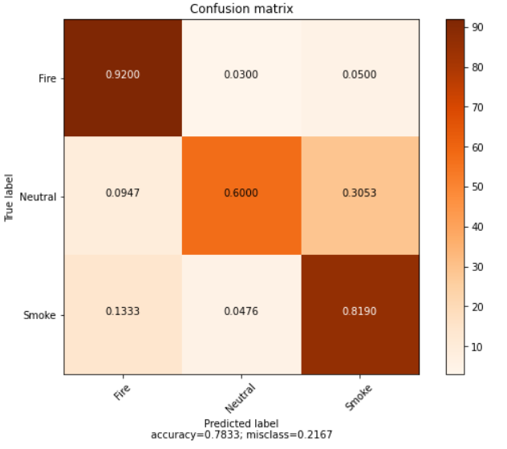
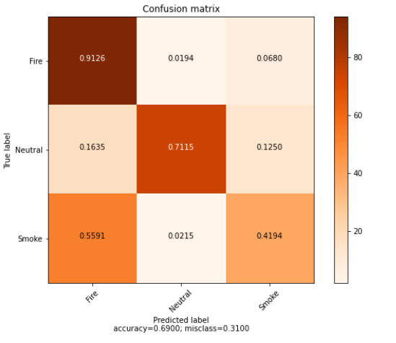
Basic CNN 30 epochs lr =0.01
InceptionV3

Slide 20
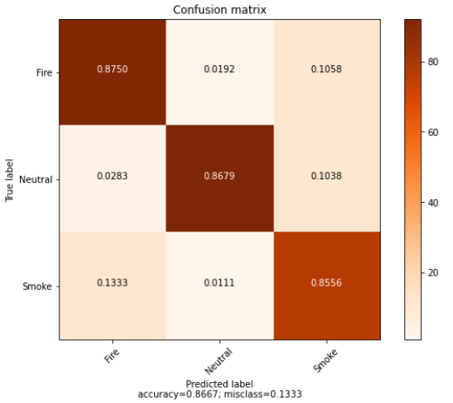
Performance evaluated on test set: Resnet50 SGD

Slide 21
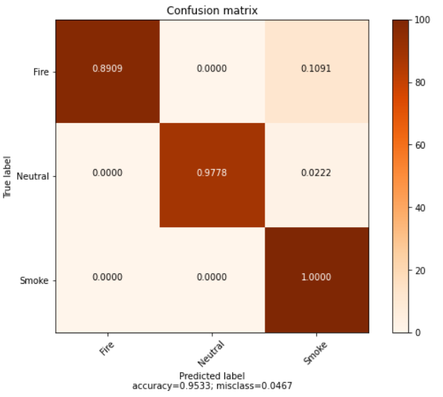
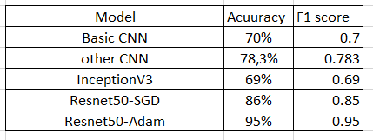
Performance evaluated on test set: Resnet50 with Adam optimiser / lr=0.001is our final model as it has the highest F1 score and accuracy
Accuracy and F1 score all models

Slide 22
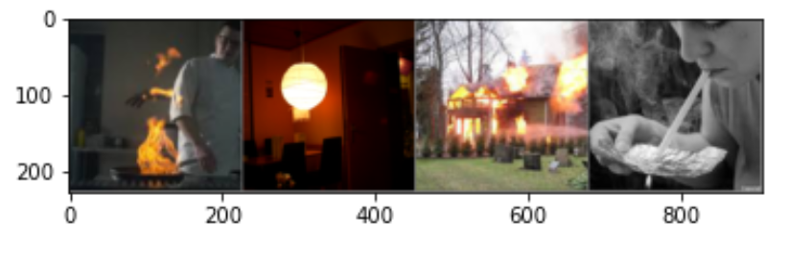

Visualization test data Resnet50

Slide 23
To do:
Timing each layer
Readme
Using a bigger dataset available
Implementing class dataset
Tensor board in colab
Use CNN from article khan Muhammad
Real time testing implementation
Using data augmentation techniques : flipping/rotation/high shifting/zooming
Hyperparameter search
Random seed applied for repeatability
feature importance using standard procedures like iterative Lasso regularization
Test OOP implemented
EfficientNet
VGG-16
Business value Measure of success defined

Slide 24
Other approaches
by detecting motion, color and shape or dynamic feature
To identify moving pixels in the scene then filters for colors consistent with fire, apply growth rate analysis, use Lukas –kanade optical flow pyramid. Wavelet analysis. Temporal analysis, pixels in dynamic regions
Frizzi et al. used CNN for detecting smoke and fire within the video (Frizzi et al. 2016). In Frizzi’s approach, CNN architecture not only extracts salient features but also performs the classification task

