Slide 1

Web-scraping Yoga mats
Python-Selenium-RDS-S3

Slide 2
Three main points of the process are:
Finding the perfect yoga mat.
Collecting data to compare specifications, color, the range of prices, the level of care and the ratings. Two websites have ben scraped: Lululemon and Amazon
Define function to collect all URLs to scrape
1
Define functions to collect features
2
Initiate driver, and run all functions.
3

Slide 3
Aspects considered while running the script:
Handling errors: where error nan
will be inserted
01
Counting and assign a unique name to each product
02
Saving instances continuously and uploading images continuously
03

Slide 4
Examples of targeted elements

Slide 5
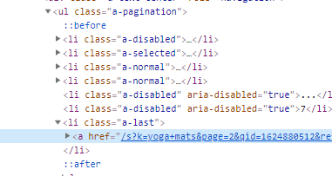
One more examples of targeted elements
class_pagination = driver.find_element_by_class_name('a-pagination')
click_next = class_pagination.find_element_by_xpath('//*[@class="a-last"]/a').click()

Slide 6


Data cleaning
Example While web-scraping
Example After web-scraping
import re
regex = re.compile(r'\b(alt="\w+)\b')
df['other_colors_and_prices_cleaned'] = df['other_colors_and_prices'].str.extract(regex)

Slide 7
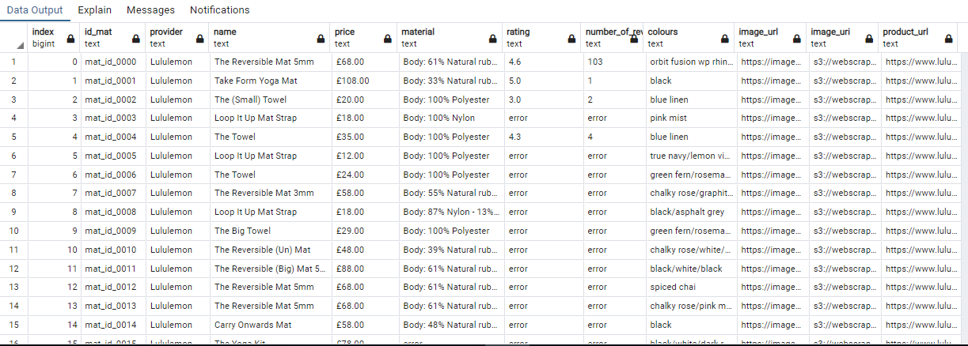
RDS database PostgreSQL/pgAdmin
Creating and saving data in a database in amazon RDS
Visualizing and querying the data through pgAdmin using AWS as

Slide 8
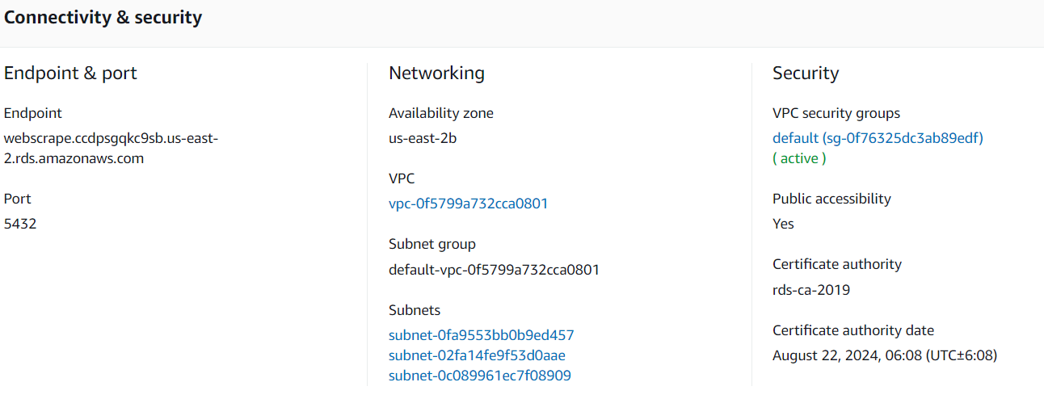
Considerations while creating Database to be able to connect:
Make sure you give name to the database in additional configuration
The security must be public
Change inbound rules to anywhere
You can change the port in additional configuration too
Use Endpoint as host in pgAdmin

Slide 9
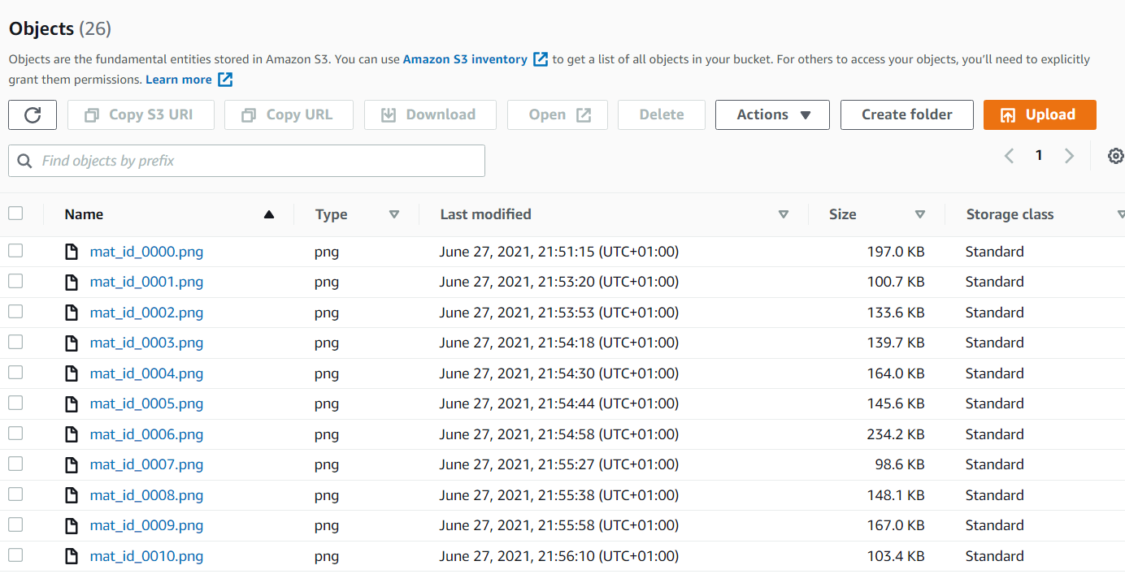
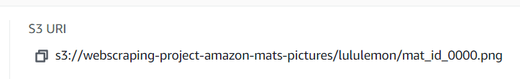
S3 bucket to store images:

Slide 10
Variables to predict
Predict the price depending on the other features: material, colour and provider
Predict rating through the reviews , material, price and provider
Results
Collection of 1000 yoga mats in 5221 seconds from Amazon. Using multithreading. Appending continuously.
Uploading continuously the images from Lululemon to a bucket in s3. At the end it saves all data to a database in Amazon RDS.

Slide 11
