Slide 1
Crimes UK Pipeline
Kaoutar Nahli Yahloul

Slide 2
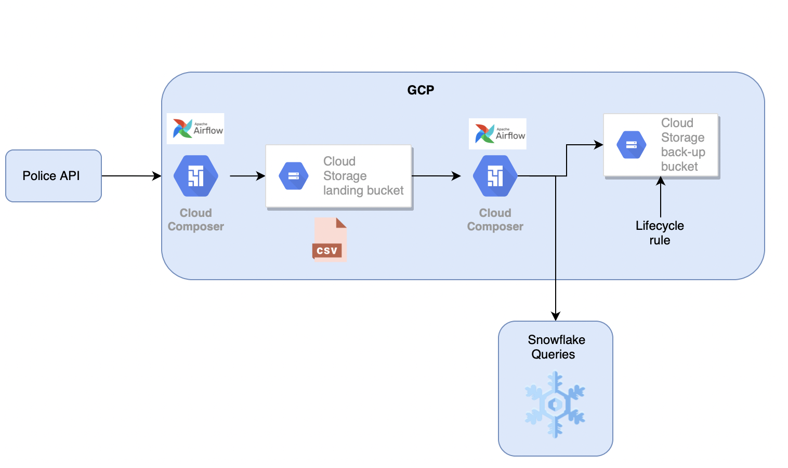
High Level Design

Slide 3
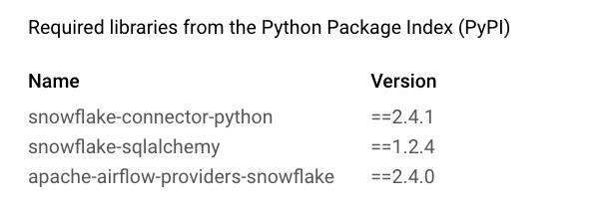
Cloud Composer
Fully managed orchestration service built on airflow.
Create new service account and grant required permissions: admin for storage and composer
Create a new composer(1.17.8) environment with airflow(2.1.4)
Install following packages snowflake
Configure connection between airflow and snowflake

Slide 4
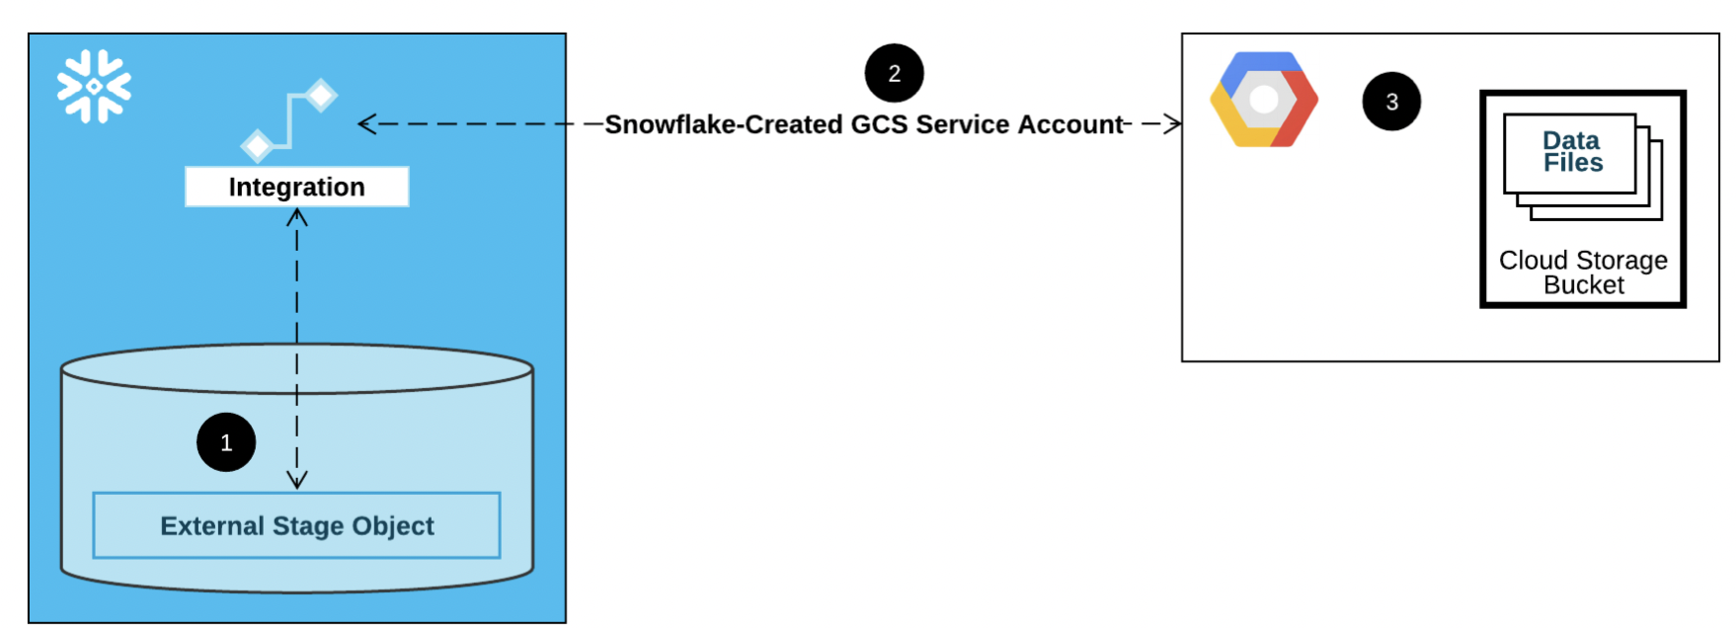
Integration for Google Cloud Storage in snowflake
Step 1: Create a Cloud Storage Integration in Snowflake
Step 2: Retrieve the Cloud Storage Service Account for your Snowflake Account
Step 3: Grant the Service Account Permissions to Access Bucket Objects
Step 4: Create an External Stage

Slide 5
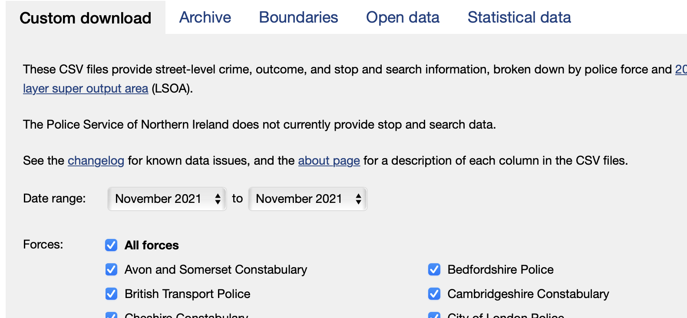
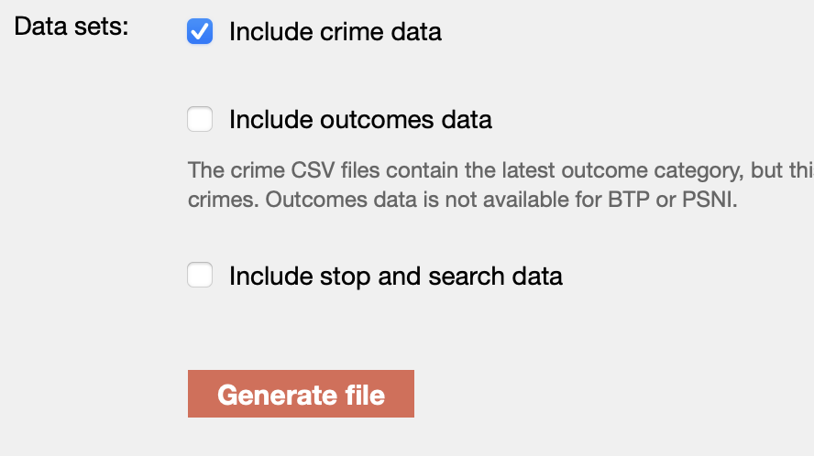
Custom Download
-Using CSV: range date, crime data, it generates a csv file per force

Slide 6
API Police.
Libraries: requests, json, pandas, police_apis
Forces
List of all the police forces available via the API except the British Transport Police
Neighbourhoods
List for neighbourhoods in a force
Boundaries
Join latitude and longitude in the right format to request street level crimes using poly
Street level crimes
400 status code in response to a GET request longer than 4094 characters. Use Post instead

Slide 7
Considerations over the data:
Location is anonymous so it will be approximate using interesting points and Ordnance Survey points.
Master points have more than 8 or 0 zip codes, are at the center of the street or a hightlighed place such as shopping center or a nightclub.
Missing data all data with no Location and data with other crimes. No locations could mean 20 km far from any master point.
Requests to be repeated every month. Data is downloaded as a json that we can transform to csv.
Test validation to get the latest month available to avoid duplicates: Make sure the last month is a new one

Slide 8
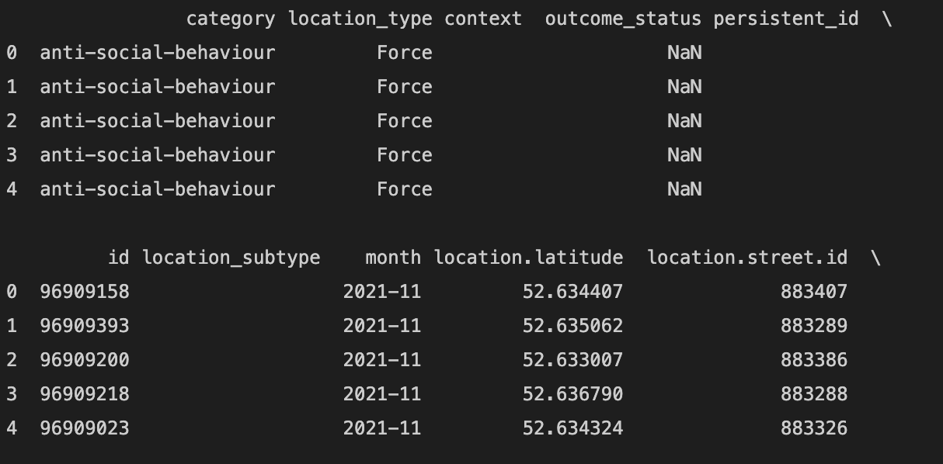
Example of DataFrame for a neighbourhood: pd.json_normalize(data): crime type, approximate location(anonymous), month

Slide 9

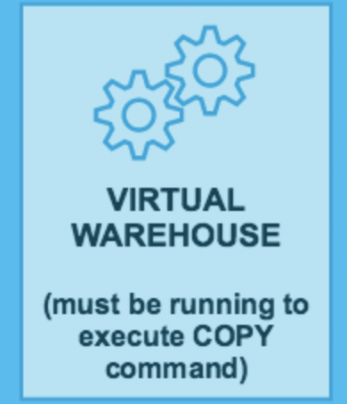
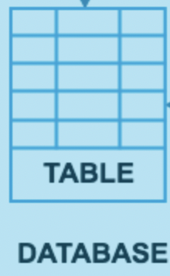
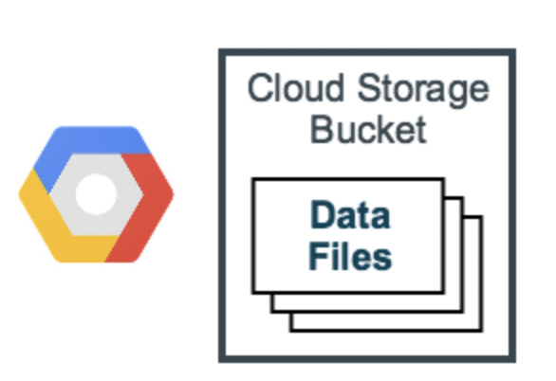

Loading bulk data to snowflake
Preparing files into optimal format: csv comma separated, No commas on the names.
Stage the data: make snowflake aware of the existence of the data
Create database and table with the appropriate schema: History table
Copy the data into the table: snowflake won’t reload data that has been already loaded. Schedule loads at the beginning of each month by creating a task or schedule through airflow
After the load completes, use the REMOVE command to remove the files in the stage.

Slide 10
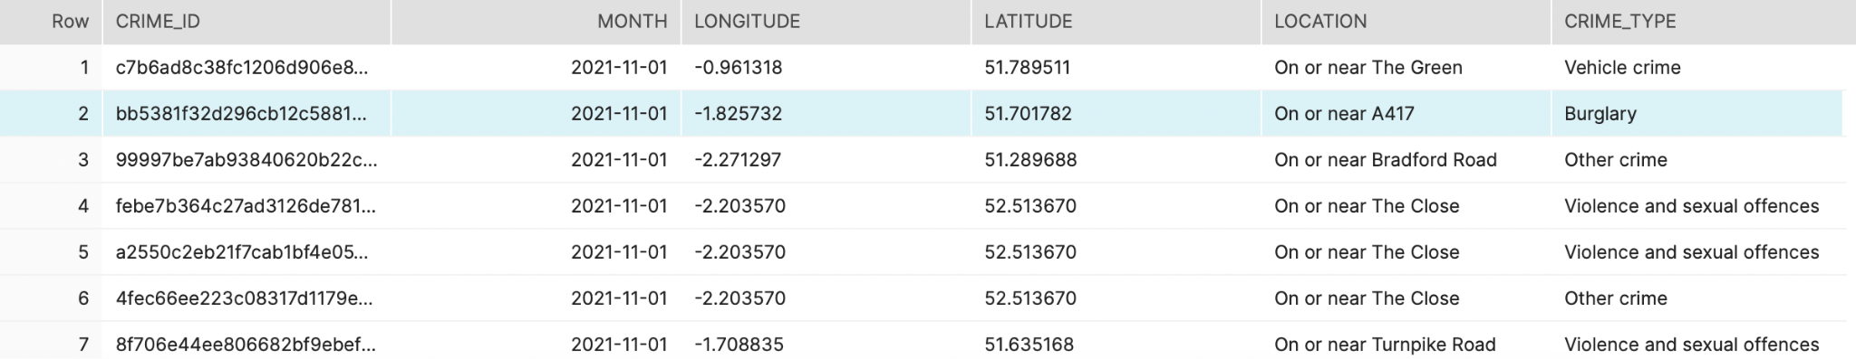
Table History in Snowflake
-Uploading column month as date
-Uploading only relevant columns

Slide 11
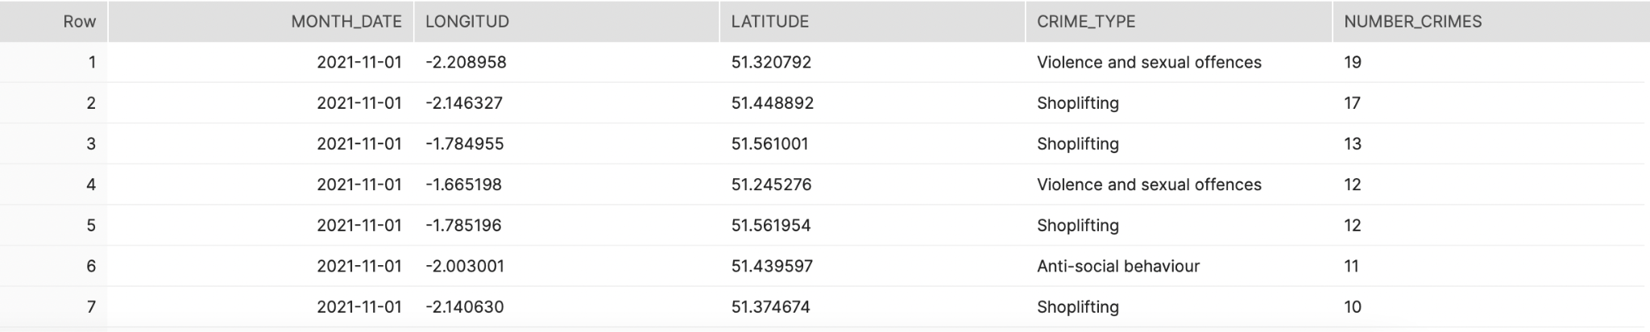
Data analytics on snowflake
Number of crimes by type and location each month

Slide 12
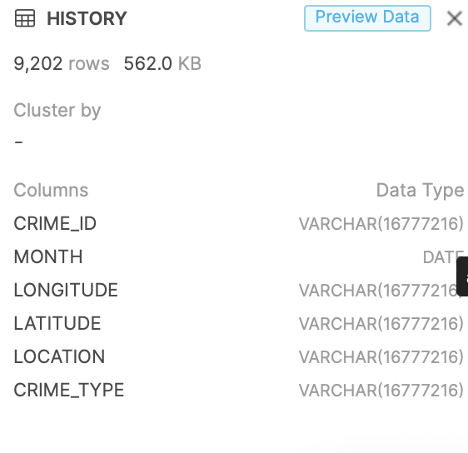
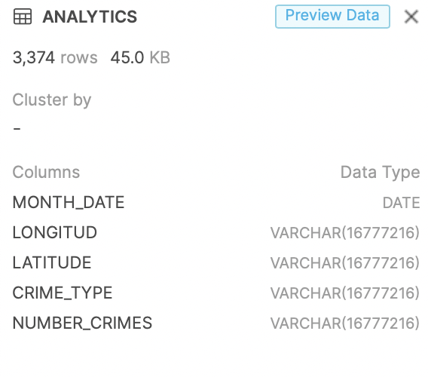
Comparing history to analytics

Slide 13
Thank you!

