Slide 1
Startup Graveyard: A Data-Driven Post-Mortem
Analyzing why startups fail using real-world data across sectors, survival time, and failure types.
Created in Tableau · Presented by Pradnesh Kapte

Slide 2
Project Objective
• Identify the most common reasons startups fail.
• Explore survival time trends based on failure types.
• Understand sector-specific patterns.
• Create a compelling, multi-page dashboard experience in Tableau.

Slide 3
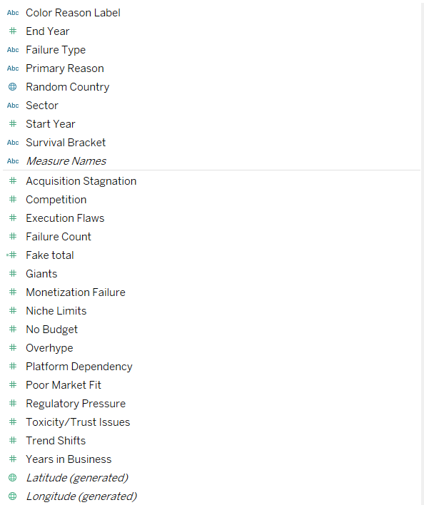
Map: Global Startup Failures

Slide 4
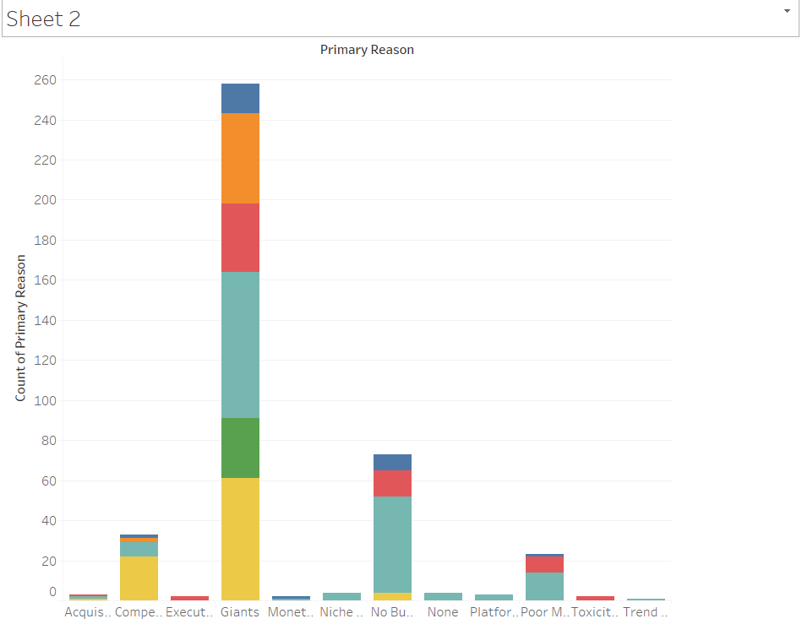
Stacked Bar: Failure Reasons
This chart compares failure reasons across different sectors:
'Giants' (large competitors) and 'No Budget' are the most dominant reasons across almost all industries.
Sectors like Finance and Healthcare show higher regulatory and market-related risks.

Slide 5
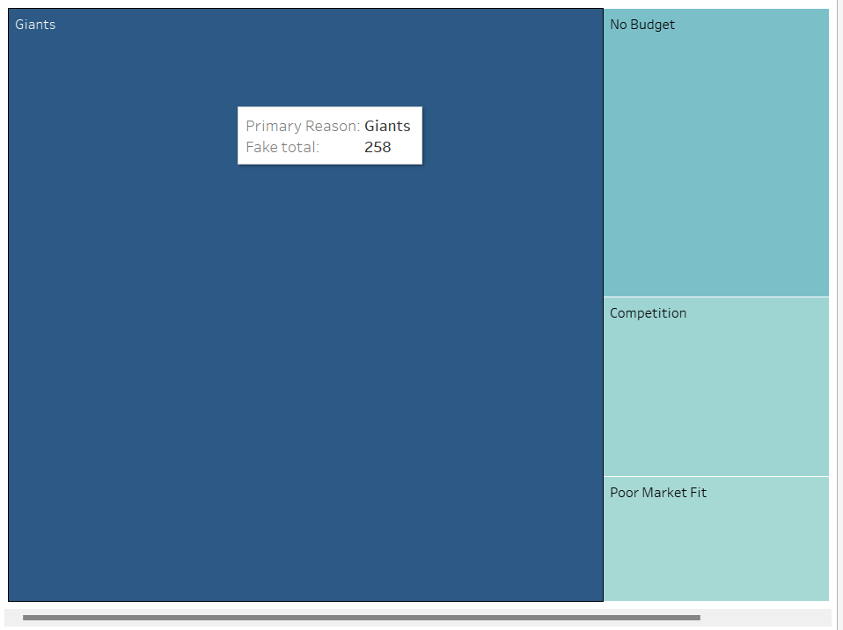
Treemap: Failure Reason Dominance
5. Treemap: Failure Reason Dominance
The treemap visually emphasizes how heavily concentrated failures are around certain factors:
'Giants' (major competition) dominate startup failures.
Financial constraints ('No Budget') and poor market positioning ('Poor Market Fit') are close behind.

Slide 6
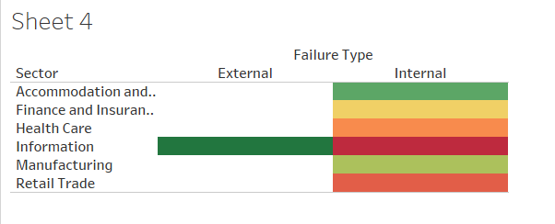
Heatmap: Sector vs Failure Type
6. Heatmap: Sector vs Failure Type
The heatmap separates Internal vs External failures across industries:
Internal causes (execution flaws, no budget) dominate startup deaths.
External causes like 'Regulatory Pressure' mainly impact sectors like Finance and Health.
It shows that controllable factors are often deadlier than external forces.

Slide 7
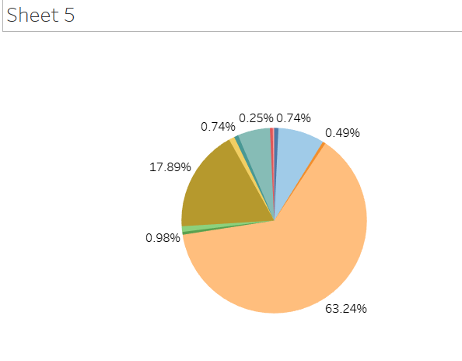
Donut Chart: Reason Share
This chart provides a proportional view:
Over 60% of startup failures are because of just three factors: 'Giants', 'No Budget', and 'Competition'.
It visually compresses complex failure data into a simple, understandable story.

Slide 8
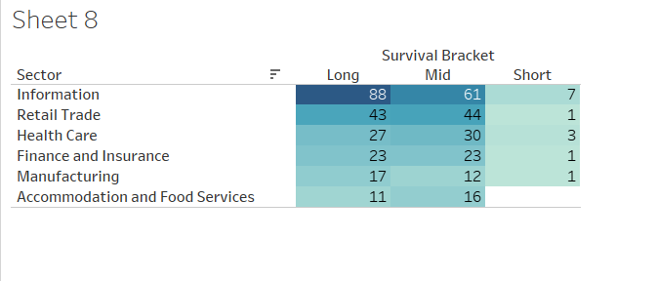
Survival Bracket by Sector
This table shows how long startups survive before failing, by sector:
The Information sector has the highest proportion of long-surviving startups.
Other sectors like Retail and Food Services show quicker death patterns.
Sector maturity and market stability are reflected here.

Slide 9
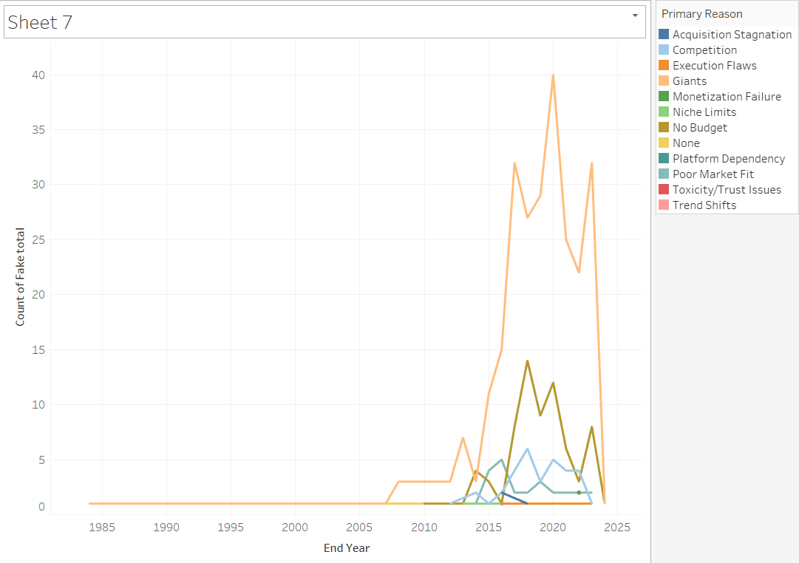
Line Chart: Failure Trend Over Time
This trend line shows the number of startup failures per year:
Sharp increase after 2010, peaking between 2015–2020.
Reflects effects of rapid tech expansion, funding bubbles, and external shocks like the pandemic.
Startup ecosystems became riskier post-2010.

Slide 10
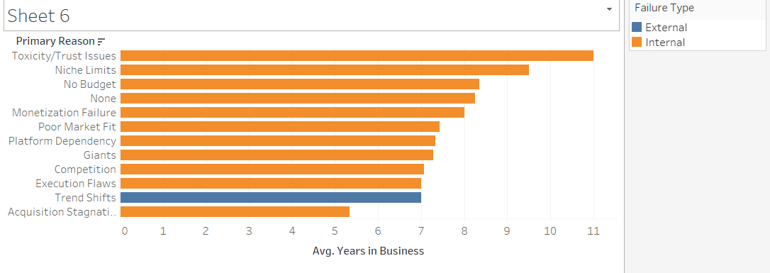
Avg Survival by Reason
This bar chart shows average years survived based on failure reason:
Startups failing due to 'Toxicity/Trust Issues' or 'Niche Limits' tend to survive longer.
Quick collapses happen more with 'Trend Shifts' and 'Acquisition Stagnation'.
Chronic problems kill slower, acute problems kill faster.

Slide 11
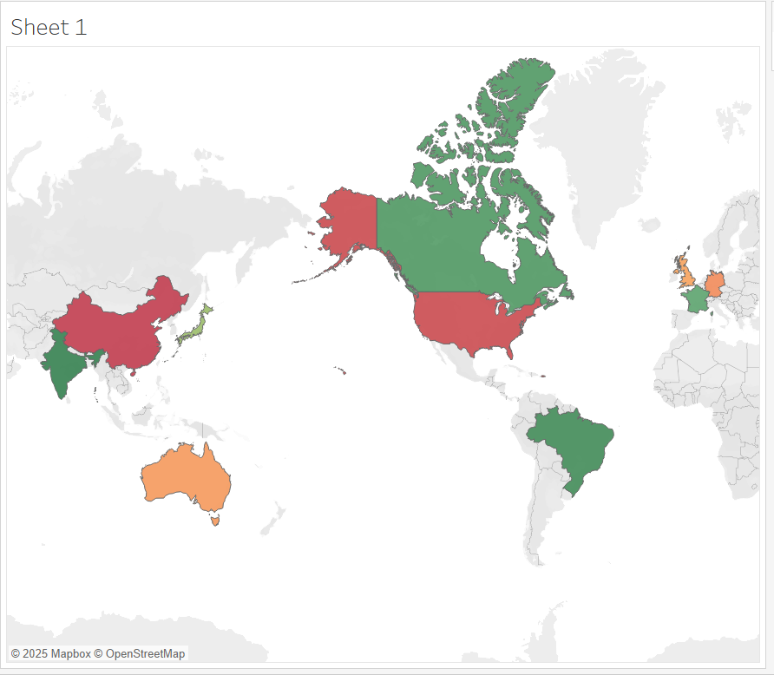
Global impact
This world map showcases the geographic distribution of startup failures based on the dataset.
High failure concentration is observed in major entrepreneurship hubs like the United States, India, and China.
These countries also have larger startup ecosystems, which explains why absolute failure counts are higher there.
Smaller clusters appear in regions like Europe (UK, Germany, France) and parts of South America (Brazil), suggesting global entrepreneurial activity — but also risk.
Key Insight: While startups are a global phenomenon, the highest risk — and highest volume of failures — still resides in the most mature startup ecosystems. This points toward market saturation, hyper-competition, and economic pressures being bigger contributors in developed entrepreneurial markets.

Slide 12
Key Insights & Takeaways
• Giants and No Budget are top failure reasons across sectors.
• Startups failing due to niche or trust issues tend to survive longer.
• Internal factors dominate failure causes over external ones.
• Information sector has the highest long-survivors before failure.
• Clear trends visible post-2010 in global startup collapse frequency.

Slide 13
Dashboard Structure & Navigation
• Multi-page dashboard with interactive buttons.
• Page 1: Overview (Donut, Treemap, Heatmap, Map)
• Page 2: Trends & Time Analysis (Line Chart, Avg. Bar, Heat Table)
• Page 3: Deep Dive by Failure Reason (Bubble, Stacked Bar, Pie)
• Page 4: Bonus: Sector Exploration & Filters
• Buttons used for navigation with clean layout.

Slide 14
So what should you do?
1. 🛡️ Prepare for Competition Ruthlessly (Giants Will Come)
The data shows that 'Giants' — dominant competitors — are the #1 reason startups fail.
What You Should Do:
Founders must plan for competition early — not after launching.
Build defensible advantages: brand, technology, niche positioning.
Never assume your startup is too small to be noticed by giants.
2. 💸 Manage Finances with Military Discipline: 'No Budget' is the second most common failure reason.
What You Should Do:
Treat cash like oxygen.
Always know your runway (months of survival left).
Fundraise before you run out, not when desperate.
3. 🧠 Control Internal Execution Before Blaming External Factors: Internal problems kill far more startups than external shocks like regulations or market trends.
What You Should Do:
Focus on execution excellence: team management, delivery, customer obsession.
Avoid wasting time fearing external changes you can't control.
80% of success lies inside the team, not outside

Slide 15
So what should you do?
4. 🛤️ Adapt Fast to Market Trends (Or Die Quickly): Startups that failed due to 'Trend Shifts' failed faster than those with chronic internal issues.
What You Should Do:
Keep listening to your customers and market constantly.
Pivot when necessary — early detection saves companies.
Don’t fall in love with your first product idea forever.
5. ⏳ Sector Choice and Survival Patterns Matter: Some sectors like Information/Technology show longer startup survival times, while others (e.g., Retail, Food Services) are much riskier.
What You Should Do:
Pick your sector wisely — understand funding patterns, maturity, and risk appetite.
If entering high-risk sectors, be extra conservative with capital and extra aggressive with growth.

Slide 16
Thank You!

