Slide 1
Analyzing Data of resturent
By Sandhya

Slide 2
objective
This schema provides a streamlined foundation for a restaurant management system by interconnecting four essential operational pillars: Tables (physical capacity and availability), Menu (food details and pricing), Staff (employee roles and contact info), and Orders (the central transaction log). By utilizing foreign keys in the Orders table, the database ensures structural integrity, allowing you to track exactly which waiter served a specific dish to a specific table at any given time.

Slide 3
1. Tables
This table manages the physical seating within the restaurant.
Purpose: It tracks how many people can sit at a specific table and what its current state is.
Key Logic: It uses a CHECK constraint to ensure seating stays between 1 and 12, and limits the status to specific values like 'Available' or 'Occupied'.

Slide 4
2. Menu
This serves as the product catalog.
Purpose: It lists everything the restaurant sells, categorized by type (Appetizer, Dessert, etc.).
Key Logic: It ensures prices are always positive and includes a BOOLEAN flag (is_vegetarian) to help with dietary filtering.

Slide 5
3. Staff
This is the human resources component.
Purpose: It stores identifying information for employees and defines their specific roles within the restaurant.
Key Logic: It automatically records the hire_date if not specified and ensures phone numbers are unique to prevent duplicate entries.

Slide 6
4. Orders
This is the transactional hub that connects all other tables.
Purpose: It records which customer (at a Table) ordered what food (Menu item) and which employee (Staff) handled the request.
Key Logic: It uses Foreign Keys to link to the other three tables. This ensures "Referential Integrity"—for example, you cannot place an order for a menu item that doesn't exist.

Slide 7
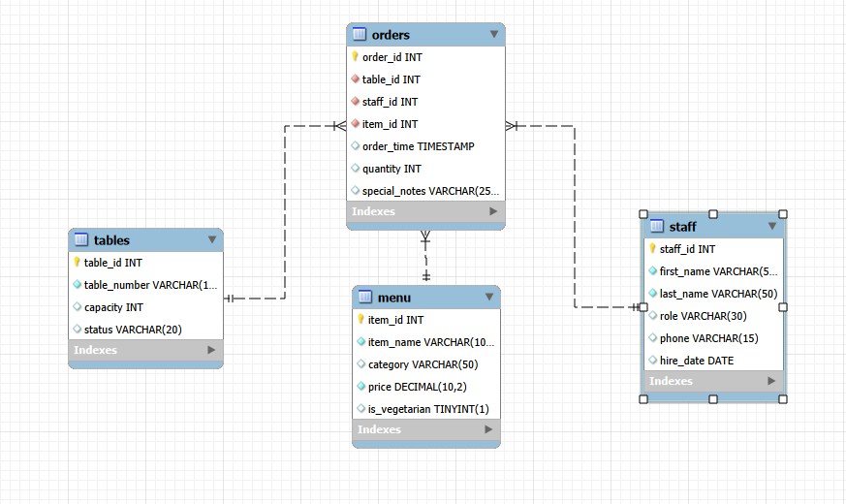
EER Diagram

Slide 8
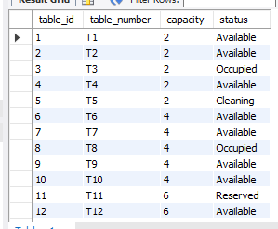
1. Tables
CREATE TABLE Tables (
table_id INT PRIMARY KEY,
table_number VARCHAR(10) UNIQUE NOT NULL,
capacity INT CHECK (capacity > 0 AND capacity <= 12),
status VARCHAR(20) DEFAULT 'Available' CHECK (status IN ('Available', 'Occupied', 'Reserved', 'Cleaning')));

Slide 9
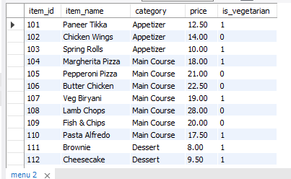
2. Menu
CREATE TABLE Menu (
item_id INT PRIMARY KEY,
item_name VARCHAR(100) UNIQUE NOT NULL,
category VARCHAR(50) DEFAULT 'Main Course' CHECK (category IN ('Appetizer', 'Main Course', 'Dessert', 'Beverage')),
price DECIMAL(10, 2) NOT NULL CHECK (price > 0),
is_vegetarian BOOLEAN DEFAULT FALSE);

Slide 10
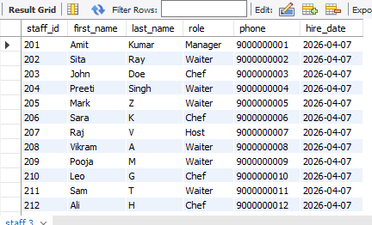
3. Staff
CREATE TABLE Staff (
staff_id INT PRIMARY KEY,
first_name VARCHAR(50) NOT NULL,
last_name VARCHAR(50) NOT NULL,
role VARCHAR(30) CHECK (role IN ('Manager', 'Waiter', 'Chef', 'Host')),
phone VARCHAR(15) UNIQUE,
hire_date DATE DEFAULT (CURRENT_DATE));

Slide 11
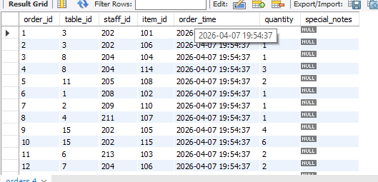
4. Orders
CREATE TABLE Orders (
order_id INT PRIMARY KEY,
table_id INT NOT NULL,
staff_id INT NOT NULL,
item_id INT NOT NULL,
order_time TIMESTAMP DEFAULT CURRENT_TIMESTAMP,
quantity INT DEFAULT 1 CHECK (quantity >= 1),
special_notes VARCHAR(255),
FOREIGN KEY (table_id) REFERENCES Tables(table_id),
FOREIGN KEY (staff_id) REFERENCES Staff(staff_id),
FOREIGN KEY (item_id) REFERENCES Menu(item_id));

Slide 12
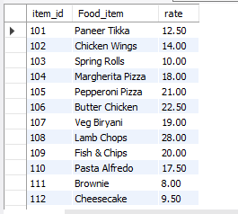
Display all menu items but rename the columns as Food_Item and Rate.
select item_id, item_name as Food_item, price as rate from menu;

Slide 13
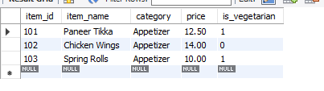
Find all menu items that belong to the 'Appetizer' category and cost less than 15.
select * from menu where category="Appetizer" and price<15;

Slide 14
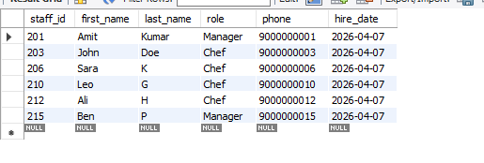
List all staff members who are either 'Managers' or 'Chefs'.
select * from staff where role="Manager" or role="chef";

Slide 15
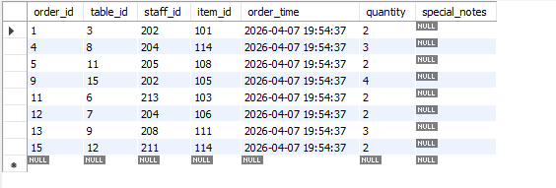
Find all orders placed where the quantity is between 2 and 5.
select * from orders where quantity between 2 and 5;

Slide 16
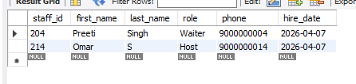
List all staff members whose last name starts with the letter 'S'.
select * from staff where last_name like "S%";

Slide 17
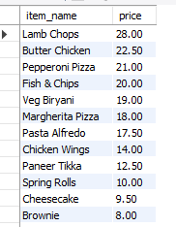
List the menu items from the most expensive to the cheapest.
select item_name,price from menu order by price desc;

Slide 18

List categories that have more than 3 items assigned to them.
select category, count(category) from menu group by category having count(category)>3;

Slide 19
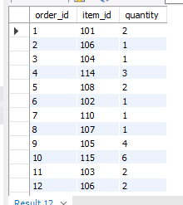
Display the order_id, item_name, and quantity for every order.
select o.order_id,m.item_id,o.quantity from orders oinner join menu m on o.item_id=m.item_id;

Slide 20
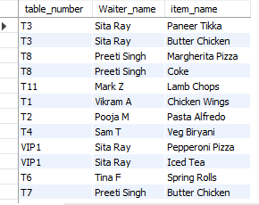
List all orders showing the table_number, the waiter_name (staff), and the item_name.
select t.table_number, concat(s.first_name," ",s.last_name) as Waiter_name, m.item_name from orders oinner join tables t on o.table_id=T.table_idinner join staff s on o.staff_id=s.staff_idinner join menu m on o.item_id=m.item_id;

Slide 21
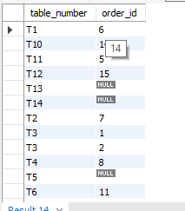
Display all tables and the orders assigned to them (including tables that have no orders).
select t.table_number, o.order_id from tables tleft join orders o on o.table_id=t.table_id;

Slide 22

Find the names of staff members who have handled orders for 'Table 15'.
SELECT first_name, last_name FROM Staff WHERE staff_id IN (SELECT staff_id FROM Orders WHERE table_id = 15);

Slide 23
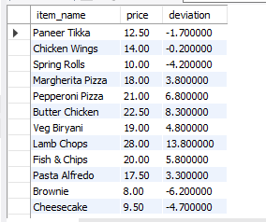
For each order, display the item name and how much its price deviates from the average menu price.
SELECT item_name, price, price - (SELECT AVG(price) FROM Menu) AS deviation FROM Menu;

Slide 24
Thank you

