Slide 1
Jurnal: Pendahuluan
Sparisoma Viridi¹, Muhammad Haris Mahyuddin²
¹Nuclear Physics and Biophysics, ²Advanced Functional Material, Research Division
¹⁻²Institut Teknologi Bandung, Bandung 40132, Indonesia
20220922-v4 | https://doi.org/10.5281/zenodo.7103265

Slide 2
Kerangka
Topik, Subtopik, Capaian Belajar 3
Bagian-bagian makalah ilmiah 6
Ukuran bagian-bagian 15
Kapan menulis penda-huluan? 17
Bagian Pendahuluan 20
Sub bagian pendahuluan 29
Langkah-langkah 40
Diskusi dan tugas 45

Slide 3
Topik, Subtopik, Capaian Belajar

Slide 4
Topik dan subtopik
Minggu 5
Topik Teknis Penulisan
Subtopik Pendahuluan
Tim Kurikulum, “Silabus Mata Kuliah NT6094 - 2019”, Direktorat Pendidikan, Institut Teknologi Bandung, url https://akademik.itb.ac.id/app/role:000000000000000000/kurikulum/silabus/44320/view [20220922]

Slide 5
Capaian Belajar
Pengetahuan tentang bagian pendahuluan jurnal ilmiah (+).
Pemahaman tata cara penulisan.
Kemampuan menuliskan jurnal ilmiah.

Slide 6
Bagian-bagian makalah ilmiah

Slide 7
Bagian-bagian makalah ilmiah
Abstract
Introduction
Methods
Results
Tables
Figures
Graphs and Histograms
Drawings and Photographs
Discussion
References
-, “BSCI 1510L Literature and Stats Guide: 3.2 Components of a scientific paper”, Jean and Alexander Heard Libraries, Vanderbilt University, 24 Aug 2020, url https://researchguides.library.vanderbilt.edu/c.php?g=69346&p=831743 [20220922].

Slide 8
Abstract
It should be a self-contained unit capable of being understood without the benefit of the text of the article.
It essentially serves as an "advertisement" for the paper that readers use to determine whether or not they actually want to wade through the entire paper or not.
They are generally freely available in electronic form and are often presented in the results of an electronic search. → It determines further action of the readers without access.

Slide 9
Introduction
It provides the background information necessary to under-stand why the described experimental / computational / theo-retical approach was conducted.
It should describe previous research on the topic that has led to the unanswered questions being addressed by experimen-tal / computational / theoretical approach
A good introduction should be fairly heavy with citations.

Slide 10
Methods
The description should be complete enough to enable some-one else to repeat the work.
If there is more than one part of the method, it would be good to present the results in the same order of the methods.
Previous published method is better cited instead of descri-bing it again.

Slide 11
Results
It is to summarize general trends in the data without com-ment, bias, or interpretation.
Tables and figures should be used when they are a more efficient way to convey information than verbal description.
They must be independent units, accompanied by explanatory captions that can be understood without reading the text.
Do not repeat in the text the information in tables and figures, but do cite them, with a appropriate summary statement.

Slide 12
Discussion
It contains at least
the relationship between the results and the original hypothesis,
an integration of your results with those of previous studies in order to arrive at explanations for the observed phenomena,
possible explanations for unexpected results and observations.
Between Results and Discussion section, avoid redundancy.
End the Discussion with a summary of the principal points you want the reader to remember.

Slide 13
References
Cite only necessary references.
Provide sufficent information for further literature searching.
Prefer to use credible source.

Slide 14
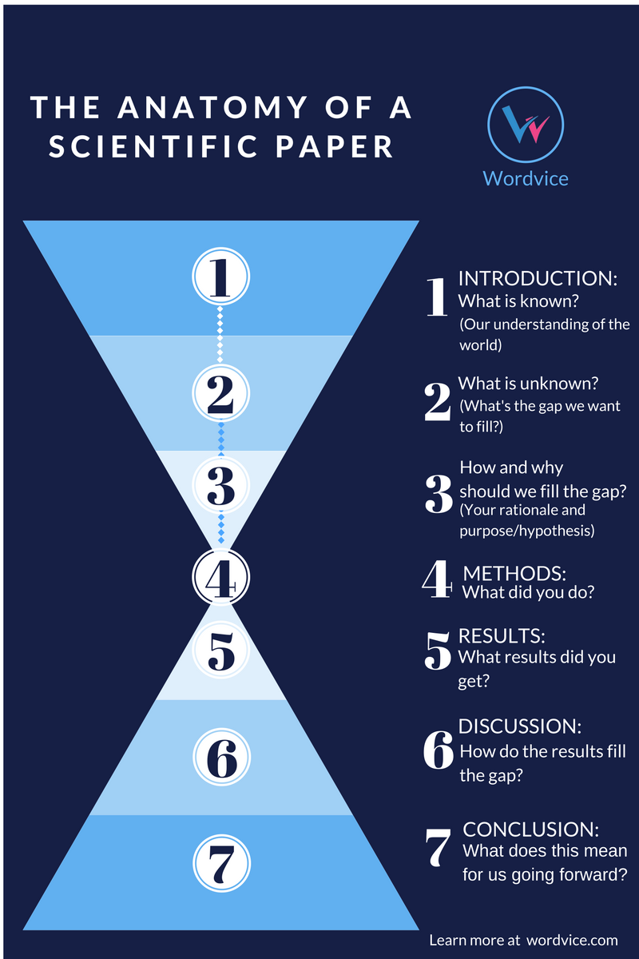
Anatomi makalah ilmiah
Wordvice HJ, “How to Write a Strong Research Paper Introduction Section”,Wordvice, 20 Oct 2016, url https://blog.wordvice.com/how-to-draft-a-compelling-introduction-for-your-journal-article/ [20220922].

Slide 15
Ukuran bagian-bagian

Slide 16
Rentang ukuran bagian-bagian
Section | Pages | Words | Paragraphs | References
Introduction | 1 (ideally) | 400 | 1-4 (ideally 3) | 5 – 10
Methods | 2 – 3 | ≤ 750 | 6 – 9 | 5 – 15
Results | 2 – 3 (+figures, +tables) | ≤ 1000 | 4 – 9 | 0
Discussion | 3 – 4 | 1000 – 1500 | ≤ 10 | 10 – 20
Claudio Gil Soares de Araújo, “Detailing the Writing of Scientific Manuscripts: 25-30 Paragraphs”, Arquivos Brasileiros de Cardiologia [Arq Bras Cardiol], vol 102, no 2, p e21-e23, Feb 2014, url https://doi.org/10.5935/abc.20140019.

Slide 17
Kapan menulis pendahuluan?

Slide 18
Tulis terakhir
Write your introduction last.
An introduction summarizes all of the things you’ve learned from your research.
While it can feel good to get your preface done quickly, you should write the rest of your paper first. Then, you’ll find it easy to create a clear overview.
Microsoft 365, “How to write an introduction for a research paper”, Microsoft, 10 Aug 2021,
url https://www.microsoft.com/en-us/microsoft-365-life-hacks/writing/how-to-write-an-introduction-for-a-research-paper [20220922].

Slide 19
Urutan penulisan makalah ilmiah
Results
Discussion
Introduction
Abstract
-, “Journal Article: Introduction”, MIT Communication Lab, Broad Research Communication Lab, Broad Institute,
url https://mitcommlab.mit.edu/broad/commkit/journal-article-introduction/ [20220922].

Slide 20
Bagian pendahuluan

Slide 21
Tujuan
Your paper’s introduction is an opportunity to provide readers with the background necessary to understand your paper: the status of knowledge in your field, the question motivating your work and its significance, how you sought to answer that question (methods), and your main findings.
A well-written introduction will broaden your readership by making your findings accessible to a larger audience.
-, “Journal Article: Introduction”, MIT Communication Lab, Broad Research Communication Lab, Broad Institute,
url https://mitcommlab.mit.edu/broad/commkit/journal-article-introduction/ [20220922].

Slide 22
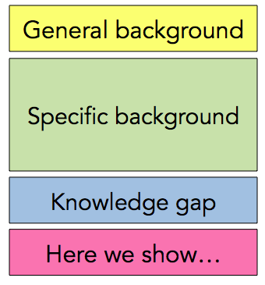
Formula bagian pendahuluan

Slide 23
Formula: General and specific backgrounds
General Background. Introduce the general area of science in which your project takes place, highlighting the status of our understanding of that system.
Specific Background. Narrow down to the sub-area that your paper will be addressing, and again highlight the extent of our understanding in this sub-area.

Slide 24
Formula: Knowledge gap
Knowledge Gap. After discussing what we know, articulate what we do not know, specifically focusing on the question that has motivated your work. The prior two components should serve as a set-up for this question. That is, the question motivating your work should be a logical next step given what you’ve described in the general and specific background.

Slide 25
Formula: Here we show…
“Here we show…” Very briefly summarize your methods and findings. Note that you may end this section with a sentence or two on the implications/novelty of your results, although this is not essential given that you will more thoroughly address these points in the discussion section.

Slide 26
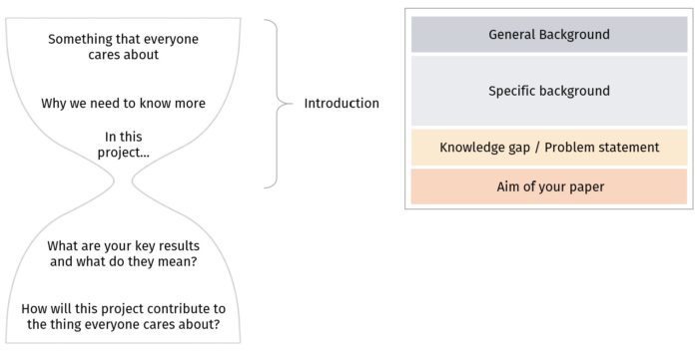
Xinyao “Anna” Liang, “Journal Article: Introduction”, Communication Lab, Nuclear Science & Engineering, MIT Communication Lab,
url https://mitcommlab.mit.edu/nse/commkit/journal-article-introduction/ [20220922].

Slide 27
Empat komponen utama
General background information.
Specific background information.
A description of the gap in our knowledge that the study was designed to fill.
A statement of study objective, and (optionally) a brief summary of study.
Charlesworth Author Services, “How to write an Introduction to an academic article”, Charlesworth Author Services, 17 Aug 2020,
url https://www.cwauthors.com/article/How-to-write-an-introduction-to-an-academic-article [20220922].

Slide 28
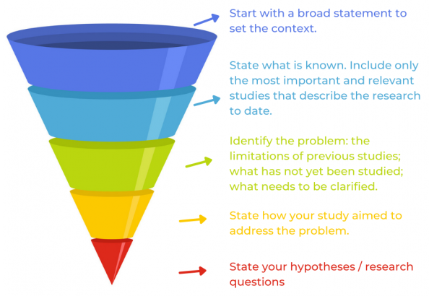
Struktur corong
Rachel Baron, “3 Fundamental Principles Of Writing An Effective Introduction To Your Journal Article”, AsiaEdit, 16 May 2019,
url https://asiaedit.com/blog/3-fundamental-principles-of-writing-an-effective-introduction-to-your-journal-article [20220922].

Slide 29
Sub bagian pendahuluan

Slide 30
Sub bagian v1
An opening statement or question that attracts the reader's attention — this is often called "the hook",
Some supporting sentences which link "the hook" to the thesis, and
A thesis statement that states the purpose and plan of the whole essay.
-, “UNIT 1 — Lesson 1A Parts of the Introduction”, English Language Centre, Division of Continuing Studies, Unversity of Victoria, url https://web2.uvcs.uvic.ca/courses/elc/Sample/Advanced/unit1/u1_l1a_1.htm [20220922].

Slide 31
Sub bagian (lanj.)
Hugh Lofting's character, Dr. Doolittle, could talk to animals and they could talk back. Many people fantasize about having such a skill. Imagine being able to talk to your household pets and getting a response back. Could it ever be possible? Language acquisition studies among primates such as gorillas, chimpanzees, and bonobo chimpanzees suggest that the answer is yes, and no.

Slide 32
Sub bagian v1 (lanj.)
Hugh Lofting's character, Dr. Doolittle, could talk to animals and they could talk back. Many people fantasize about having such a skill. Imagine being able to talk to your household pets and getting a response back. Could it ever be possible? Language acquisition studies among primates such as gorillas, chimpanzees, and bonobo chimpanzees suggest that the answer is yes, and no.

Slide 33
Sub bagian v1 (lanj.)
Hugh Lofting's character, Dr. Doolittle, could talk to animals and they could talk back. Many people fantasize about having such a skill. Imagine being able to talk to your household pets and getting a response back. Could it ever be possible? Language acquisition studies among primates such as gorillas, chimpanzees, and bonobo chimpanzees suggest that the answer is yes, and no.

Slide 34
Sub bagian v1 (lanj.)
Hugh Lofting's character, Dr. Doolittle, could talk to animals and they could talk back. Many people fantasize about having such a skill. Imagine being able to talk to your household pets and getting a response back. Could it ever be possible? Language acquisition studies among primates such as gorillas, chimpanzees, and bonobo chimpanzees suggest that the answer is yes, and no.

Slide 35
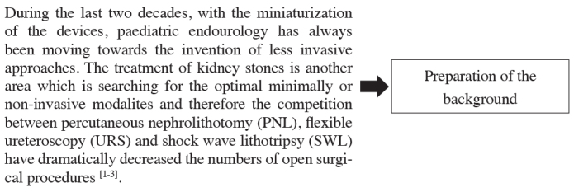
Contoh lain (berbeda paragraf)
Abdullah Armağan, “How to write an introduction section of a scientific article?”, Turkish Journal of Urology [Turk J Urol], vol 39, no 1, Suppl 1, p 8-9, Sep 2013, url https://doi.org/10.5152/tud.2013.046.

Slide 36
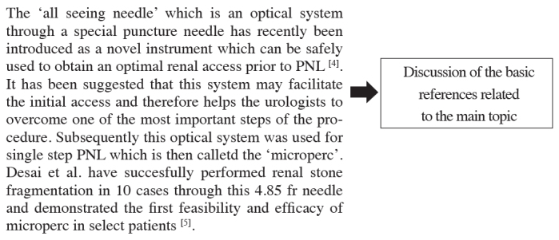


Slide 37
Sub bagian v2
An overview of the topic.
Prior research.
A rationale for your paper.
Describe the methodology you used.
A thesis statement.
An outline of the paper.
Microsoft 365, “How to write an introduction for a research paper”, Microsoft, 10 Aug 2021,
url https://www.microsoft.com/en-us/microsoft-365-life-hacks/writing/how-to-write-an-introduction-for-a-research-paper [20220922].

Slide 38
Sub bagian v3: Delapan elemen
Definition of the topic.
Historical understanding of the topic.
Current understanding of the topic.
Refutation of any of the above.
A statement of the problem.
Negative consequence(s) if is not solved.
Positive consequence(s) if it is solved.
A hint at the solution(s).
-, “Elements of an Effective Introduction”, English 101,
url https://cooperseng101.wordpress.com/syllabus-part-2-course-outline/elements-of-an-effective-introduction/ [20220922].

Slide 39
Sub bagian v4: Empat bagian penting
An Attention Grabbing Opening Statement or Question.
The Topic Statement.
Relevance Sentence.
The Main Points.
Thesis Statement.
Abir Ghenaiet, “Most Important Parts of an Essay Introduction”, INK, 1 Sep 2022,
url https://inkforall.com/ai-writing-tools/hook-writing/parts-of-an-introduction/ [20220922].

Slide 40
Langkah-langkah

Slide 41
4 langkah menulis bagian pendahuluan
Provide background information and set the context.
Introduce the specific topic of your research and explain why it is important.
Mention past attempts to solve the research problem or to answer the research question.
Conclude the Introduction by mentioning the specific objectives of your research.
Yateendra Joshi, “4 Step approach to writing the Introduction section of a research paper”, Editage Insights, 18 Sep 2018,
url https://www.editage.com/insights/4-step-approach-to-writing-the-introduction-section-of-a-research-paper [20220922].

Slide 42
4 langkah umum
Locate – situate the study in a broad context and connect this to the journal reader.
Focus – say what the paper is about in particular.
Argue / Expand – say what the paper is going to say.
Outline – lay out the steps that the paper will take and signal their order.
Pat Thomson, “writing the introduction to a journal articl”, 11 Jan 2016, url https://patthomson.net/2016/01/11/writing-the-introduction-to-a-journal-article/ [20220922].

Slide 43
5 langkah menuliskan pendahuluan esai
Step 1: Hook your reader
Step 2: Give background information
Step 3: Present your thesis statement
Step 4: Map your essay’s structure
Step 5: Check and revise
Shona McCombes, “How to Write an Essay Introduction | 4 Steps & Examples”, Scribbr, 14 Sep 2022,
url https://www.scribbr.com/academic-essay/introduction/ [20220922].

Slide 44
10 tips menulis pendahuluan yang efektif
Start broadly and then narrow down.
State the aims and importance.
Cite thoroughly but not excessively.
Avoid giving too many citations for one point.
Clearly state either your hypo-thesis or research question.
Consider giving an overview of the paper.
Keep it short.
Show, don't tell
Don't bury your readers in detail.
Check the journal requirements.
John Zepernick, “10 tips for writing an effective introduction to original research papers”, ThinkSCIENCE, 2022,
url https://thinkscience.co.jp/en/articles/effective-introductions-to-original-research [20220922].

Slide 45
Diskusi dan tugas

Slide 46
Ringkasan
Terdapat berbagai sumber mengenai bagian-bagian makalah ilmiah, dengan bagian Pendahuluan selalu disebutkan.
Sub bagian dari bagian pendahuluan setidaknya meliputi: Latar belakang umum dan khusus, kesenjangan pengetahuan, tujuan penulisan makalah ilmiah, dan kerangkanya.
Jumlah langkah-langkah membuat bagian Pendahuluan mengikuti jumlah sub bagian yang dirujuk.
Bagian Pendahuluan ditulis terakhir, bisa juga kerangkanya le-bih dahulu, baru kemudian dikoreksi setelah makalah selesai.

Slide 47
Diskusi
Silakan berdiskusi ☺.

Slide 48
Kriteria tugas
Kategori | Materi | Minimum jumlah soal
1 | Tautan ke materi daring | 1
2 | Bagian-bagian jurnal ilmiah | 1
3 | Panjang bagian pendahuluan suatu jurnal ilmiah | 1
4 | Hal-hal dalam bagian pendahuluan suatu jurnal ilmiah | 1
5 | Urutan pengerjaan bagian-bagian jurnal ilmiah | 1

Slide 49
Tautan
Edunex url https://edunex.itb.ac.id/courses/43542/preview/124039/55008
Waktu 120 menit
Jumlah 5 soal
Jenis essay

Slide 50
Pertanyaan (1-3)
Cantumkan setidaknya 10 tautan ke halaman web yang menjelaskan bagian pendahuluan dari suatu jurnal ilmiah.
Tuliskan bagian-bagian dari bagian pendahuluan suatu jurnal ilmiah. Tuliskan rujukan yang Anda gunakan.
Berapa panjangkah (dalam jumlah kata) bagian pendahuluan suatu jurnal ilmiah sebaiknya? Cantumkan referensi yang Anda gunakan.

Slide 51
Pertanyaan (4-5)
Apa hal-hal yang perlu dicantumkan dalam bagian pendahuluan suatu jurnal ilmiah? Cantumkan referensi yang Anda gunakan.
Sebutkan bagian-bagian dari suatu jurnal ilmiah, di mana bagaian pendahuluan termasuk di dalamnya. Bagaimana urutan pengerjaan bagian-bagian tersebut? Jelaskan. Cantumkan rujukan yang Anda gunakan.

Slide 52
Terima kasih
-, “.. url https://../ [20220922].

