Slide 1
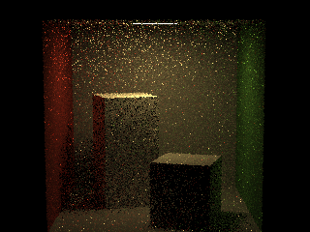
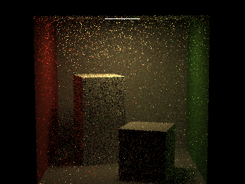

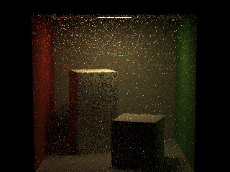
MAX_PATHS = 1; MAX_BOUNCE = 4;
LinearCongruential
MersenneTwister
SubtractWithCarry
ShuffleOrder

Slide 2
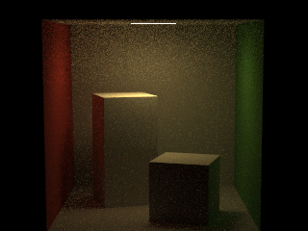
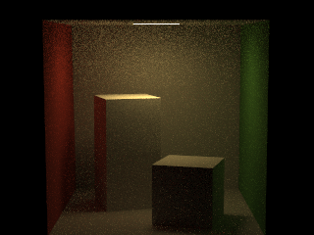
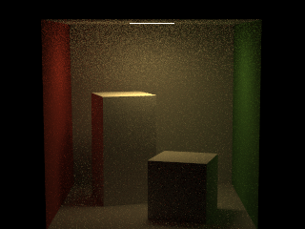

MAX_PATHS = 32; MAX_BOUNCE = 4;
LinearCongruential
MersenneTwister
SubtractWithCarry
ShuffleOrder

Slide 3
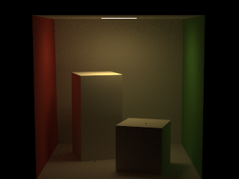



MAX_PATHS = 1000; MAX_BOUNCE = 8;
LinearCongruential
MersenneTwister
SubtractWithCarry
ShuffleOrder

