Slide 1
MSS data testing & validation

Slide 2
MS data used
Qtof data from solvent extraction sample
Parameter for softwares:
MSS:
Intensity threshold: 3000
Mass tolerance: 20 PPM
Msdial
Intensity threshold: 1000
Mass tolerance: 0.015 Da
Xcms
Prefilter intensity: 500
Mass tolerance: 5
Effect of parameter:
Intensity:
Higher → less features
Lower → more features
Tolerance:
Higher → wider mz bin, which could have less features candidates, but more peaks can pass filter
Lower → narrower mz bin, more feature candidates but less peaks can pass filter respectively

Slide 3
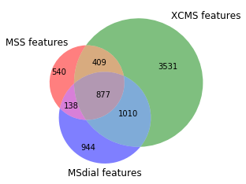
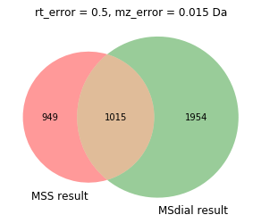
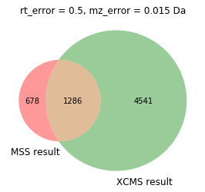
Overlap for all features
Feature numbers:
MSS: 1964
Msdial: 2969
Xcms: 5827
Due to higher threshold and wider mz bin, mss have less features out
Caveat: increase the precision will consume calculation resources intensively → memory leaking and longer processing time

Slide 4
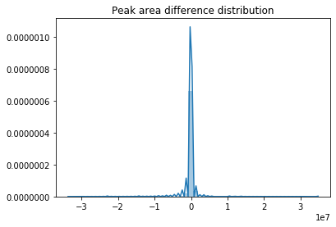
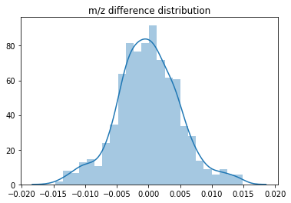
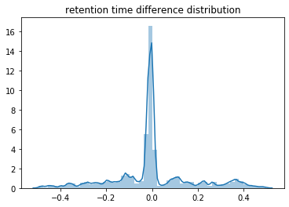
Overlap features overview
Compare the overlap features mz/rt difference from different methods
Plots above are normalized distribution plot
Result for Msdial:
Follows normal distribution and mostly within tolerable range

Slide 5
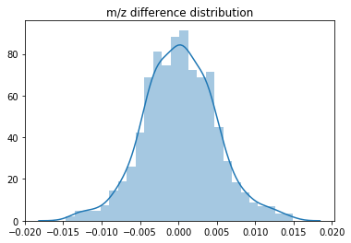
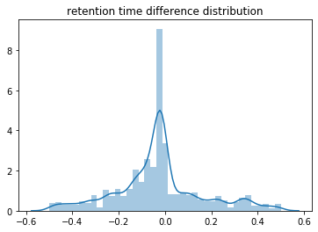
Overlap features overview
Result with XCMS

Slide 6
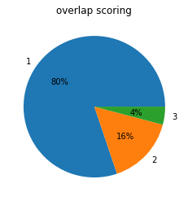
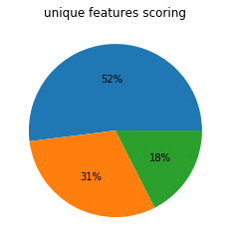
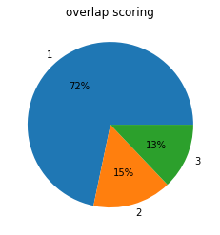
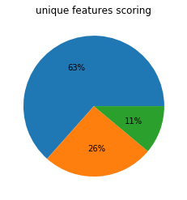
Scoring examples
Tested scoring under lower threshold(3000 intensity threshold) and higher threshold (5000 intensity thres) on MSS
Scoring works better under 5000 intensity thres (as the training data was from 5000 intensity thres setting)
Score:
1- good peak
2- uncertain peak
3- bad peak/noise
5000 intensity thres, overlap with same msdial data as mentioned at beginning, pie chart for all the scores
3000 intensity thres, overlap with same msdial data as mentioned at beginning, pie chart for all the scores

Slide 7
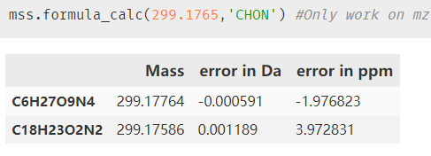
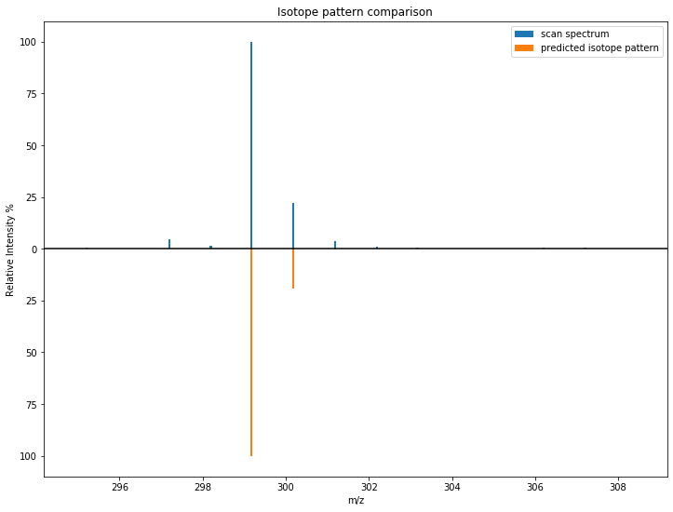
Basic function update
Formula prediction
Isotope pattern check for selected formula

Slide 8
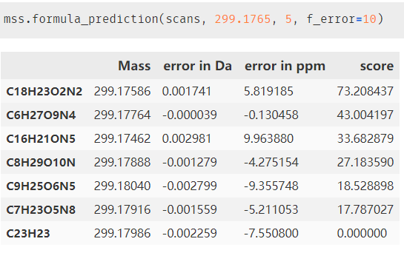
Basic function update
Formula assignment and scoring based on isotope pattern
Improve:
Formula database or prediction algorithm – currently only can predict up to 500 Da as restricted by calculation speed
Support more towards single feature prediction, could potentially move to batch but will be also calculation intensive
Scoring algorithm check: currently using algorithm from SIRUIS but seems to be more space there

Slide 9
Conclusion
MSS works functional as commercial software. Peak picking algorithm based on scipy.signal package works on peak selection
Scoring function works better on peaks with higher intensities (restriction coming from training data, the model used now should be fine → RF model built on ~10 selected parameters of peaks)
Caveat: intensive calculation time on lower thres settings and heavy memory use, which could potentially by optimize the code

