Slide 1
Recap & Next steps
20201102

Slide 2
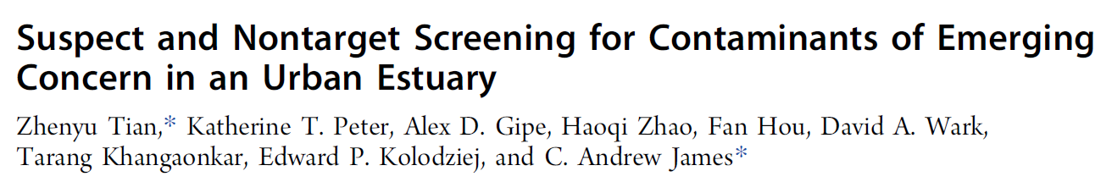
Recap
First stage current status & to include
Current features: peak picking, alignment, visualization, formula tools, other basic functions
Verification and moving on: peak picking verification, code optimization(peak algorithm refinement)
Data for verification
Ideally standard samples with known peaks, cover different RT, mz and peak areas (EPA pesticide mix?)
In house NTA samples with manual confirmation
Question to answer
Apple to Apple comparison (same parameter comparison)
How many peaks in the std found?
Else than known peaks, is there other interested hits? → i.e. proof that the algorithm find most good shape peaks (Manual check?)
Hit rate = good peaks number / total features extracted by package

Slide 3
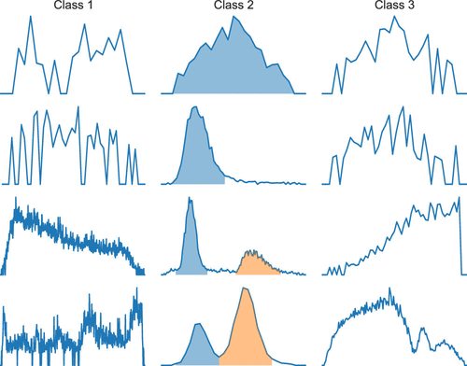
Recap to do
Noise Hit ?
Retrieve the std data to use along with reference feature list
Run the data through 3 workflow, compare the results as validation steps with same parameter setting
Compare workflow result with std reference, count for absolute hits
Manual check the peak shape hit rate
Collect the results → depending on performance, optimize the peak picking algorithm repeatedly
Reference: https://pubs.acs.org/doi/10.1021/acs.analchem.9b04811

Slide 4
Presenting the tool
Verify it is functional as other tools: solid start
Re-address the advantage of novelty, portability, flexibility and Scalability
Novelty: First fully functional package for environmental analysis based on python
Portability: unlimited external resource usage rather than workstation in lab
Flexibility: user can reprint result by different settings immediately
Scalability: Modularized set up for future development

Slide 5
Module | Function | Description
mssmain | get_scans | HRMS data import
 | peak_pick | peak picking from imported data using defined parameters
 | peak_list | generate a feature list based on user-defined settings
 | formula_prediction | predicting selected feature's formula with isotopic pattern scoring
 | realignment | align the feature lists from different samples
 | mss_processor | Integrated script process data from mzml to csv though peak picking and alignment
visreader | tic_plot | Present the TIC plot for selected data
 | ms_plot | present the selected spectrum indexing by numbers
 | ms_chromatogram | generate a chromatogram plot for selected features
 | integration_plot | generate an integrated chromatogram plot for peak area checking
 | iso_plot | present the MS1 spectrum for selected features with the theoratical MS1 spectrum from input formula for comparison
frag | frag_massbank | search online database for the input fragment list
 | frag_comp | present the MS2 spectrum for selected precursors with optional online database search and comparison
dm | data_prep | data cleaning and preliminary filters for subsequent analysis
 | ms_cluster | unsupervised clustering on HRMS data, dimension reduction is optional
 | trend_calc | calculate the trend correlation of selected features*
 | source_label | tracking the source from different samples*
 | feature_model | modeling function towards experimental backgrounds
 | cluster_pred | prediction on new data based on trained models
Current functions

Slide 6
Note
Possible data
Parameter that matters
Intensity threshold
Code review
Other functions

Slide 7
Next step – Data to use
Dilution to find fingerprints (anchors)
1) Methanol dilution
Dilution in organic solvent (MeOH):
Tire leachate extract
2) Source dilution in different matrices
Fingerprints in different background
DI water
Tire leachate extract
Surface water
…
…
…
…
…
Highway run off

Slide 8
Source Identification
Dilution series from Tire extract
How to find the end members? (fingerprints)
1. Automated workflow: DBSCANS, OPTICS
2. Manual defined criteria
Extended work: alignment
Is the fingerprint there? (source identification)
Quantification
If it is, how much likely is there? (Low dimensional image recognition or high dimensional data approaches)
If the source is present, how much? (Modeling approaches using the fingerprints)
If the fingerprint is in different shape/position, can we still find it? If we can, then how can we reshape it back?
Development roadmap
Manual fingerprint search criteria example: recursively find features:
Decrease over dilution
Fit in the linear relationship with tolerance range(+/-15%)
Within the retention time and mz range
In different backgrounds

Slide 9
Pattern recognition idea board
Imagine we have a triangle as our original data, by finding the fingerprints, we found the shape of triangle
Q1. how do we find triangle in different background?
Q2. how do we ‘quantify’ the triangle?
Q3. all of the others also triangle, how do we find them? If we can find them, how can we stretch them back?
Challenge: data loss, the triangle in real sample may be imperfect
Partially developed in current package already

Slide 10
How to find end members
Blank subtraction and noise removal
Get rid of all the features that didn’t follow the dilution behavior(e.g. didn’t decrease or even increase)
Check the features using defined criteria: how much did it follow linear relationship, how similar with each other
DBSCANS, OPTICS
‘Manual’ filter
Power of using numbers of feature rather than few:
Reduced individual effect
Overviewed the source
Identification of the source use the relative pattern rather than absolute value

Slide 11
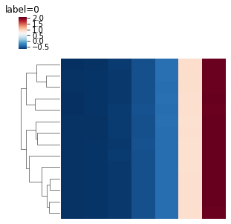
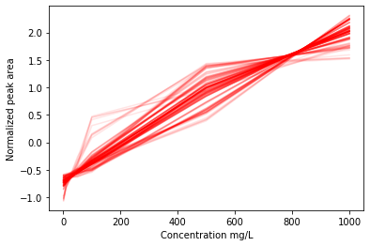
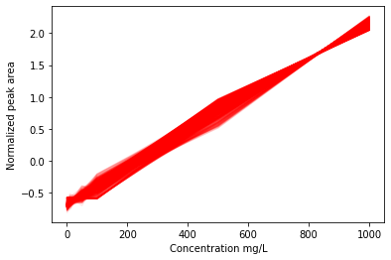
Quick trail
1) Methanol dilution
Color representing peak area
Dilution in organic solvent (MeOH):
Tire leachate extract
Different fingerprints
Blank subtraction and rough noise removal
Sample Max/Blank Avg >=5
Retention time between 2-20min, m/z < 800
2533 features passed
OPTICS
179 features prioritized
Linear regression
R2 >= 0.99
Slope >= 0.002
642 features prioritized
The lower end determined the result as they are more crowded
Comparison – which one works better?
Should be a case-to-case discussion
Dilution rate
OPTICS sample
OPTICS prioritized features
regression prioritized features

Slide 12
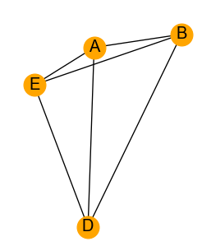
Pattern recognition idea board
Color representing peak area
Imagine we have a triangle as our original data, by finding the fingerprints, we found the shape of triangle
Different fingerprints
Strategy to use:
a) machine learning
b) Manual calculation
How it looks like
Dilution rate
The relative position of the points (network) calculate as right
Save the connection and edge as the source network information – HOW?
Edge: absolute RT & mz pair for the fingerprint features
Connection: relative positions from the fingerprint networks

Slide 13
Pattern recognition idea board
Simple answer: align the data and find the shape
However, sometimes the datapoint shifts or interfered with neighbors, lead to a failure on alignment→ introduce relative position as additional layer of identification
Option:
a) Image processing package
b) Data engineering – mining into numbers
The relative position information can also be used for data alignment(mentioned in Q3)
Q1. how do we find triangle in different background?
Which algorithm to use : image process or mathematical model?
Ref https://www.pyimagesearch.com/2018/09/24/opencv-face-recognition/

Slide 14
Pattern recognition idea board
Q2. how do we ‘quantify’ the triangle(Source)?
Multivariate modeling based on the fingerprint features
Data shape: (split into training and validation)
Challenge:
Data loss
Model agreement & average on different background
Training data is small (sample case: 7dilution points, 3x replicate, 5 different background = 7*3*5 = 105 rows data)
 | Feature1(F1) e.g: 293.151@10min | F2 | F3 | F4 | F5 | … | Fn | Dilution rate (Final concentration) | Background
Peak Area | 1e8 | 1e6 | 1e8 | 2e5 | 3e3 | … | 6e4 | 10 mg/L | Surface water
 | … | … | … | … | … | … | … | …

Slide 15
Pattern recognition idea board
Complicate: deformation
Q3. all of the others also triangle, how do we find them? If we can find them, how can we stretch them back?
Simple case: even shift→shape didn’t change, but panned
Solution:
Use relative position to back align the dataset

Slide 16
Next steps
On the established workflow:
Find data for validation
Process the data under same condition for comparison
Collect detailed and solid results with optimization on the workflow
User-demo for other functions
On the new idea:
Collect the data for the development
Verify the ‘fingerprint searching’ algorithm
Seek for algorithms answering Q1 and Q3

