Slide 1
CR points
Major
Mass list generation
Logic
Efficiency
Peak detection
Efficiency
Logic
Anything else?

Slide 2
Logic flow
Peak utils for getting the index of peak
Loop for low and high index bound
Judge index bound with scan_window
Integration & calculate peak statistics
Scoring
Save result

Slide 3
Logic flow
Generate mz list **
Loop every mz in peak_picking
Overlapping filter
Save the results

Slide 4
CR points
Minor
Mz locator
Logic
Reading external data
Build class?—private variables/funcs
Efficiency of ms_chromatogram_list?

Slide 5
Algorithms
Dummy data
Pattern storage
Recognition
Quantification → any dummy data/existing data possible?
Data collection
Same tire cluster in different matrix

Slide 6
Contents
Current contents
Anything else needed for manuscript? Data/functions/etc

Slide 7

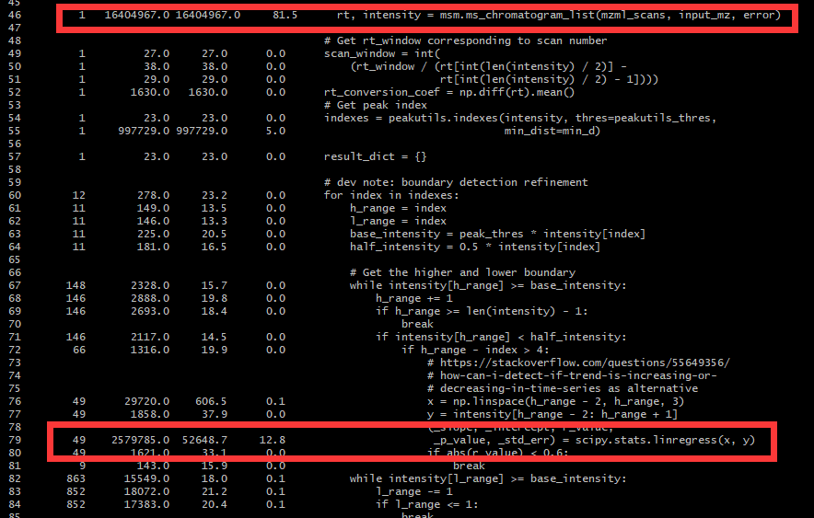
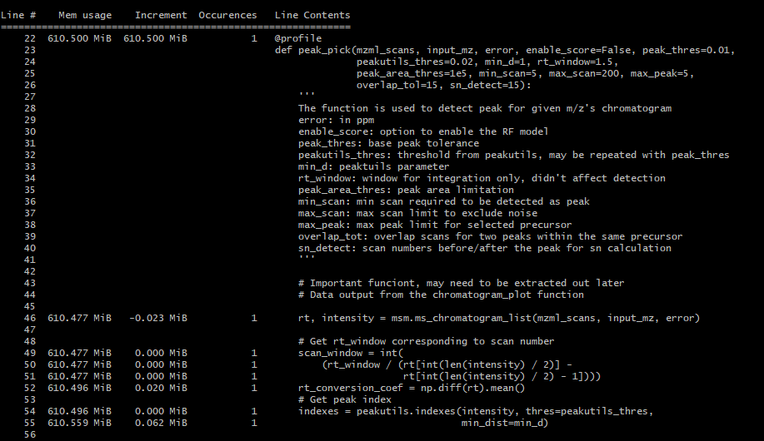
Peak pick

Slide 8
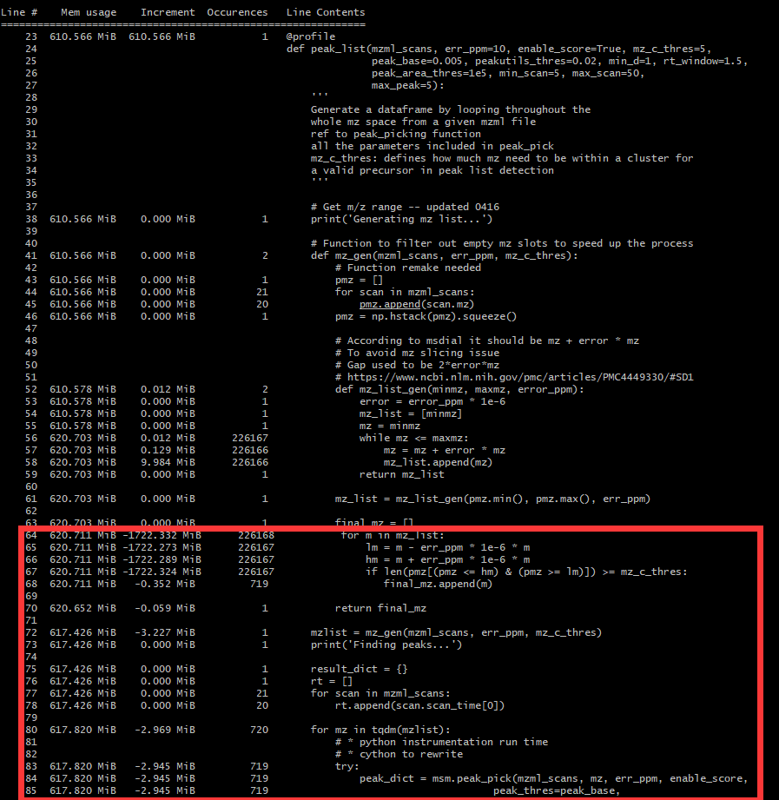
Peak list

Slide 9

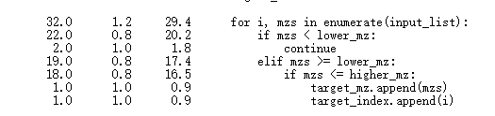
Peak_list
Peak_pick
64% time
mzgen
36% time
Ms_chromatogram_list
81.5% time
Mz_locator
71% time
List appending
26% time
100
100*(1+1e-6*100)
25%~40%

Slide 10
Real detection mzlist
[101.1,101.2]

Slide 11
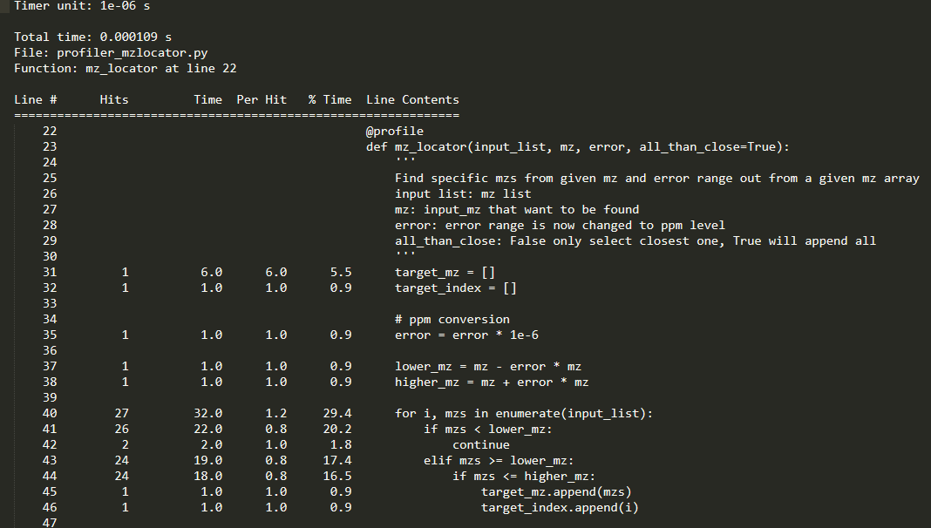
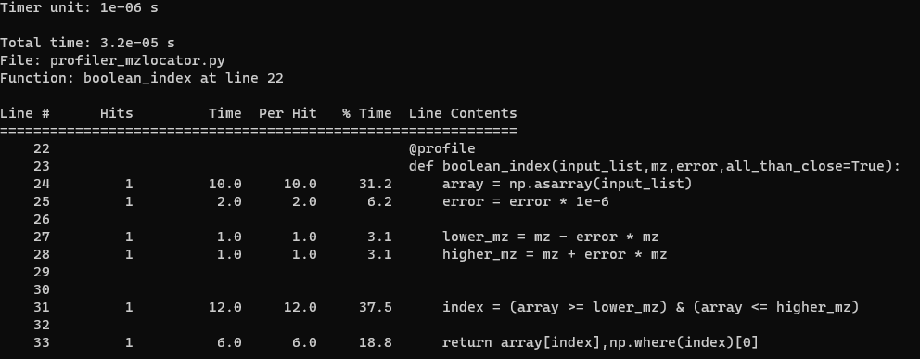

Slide 12
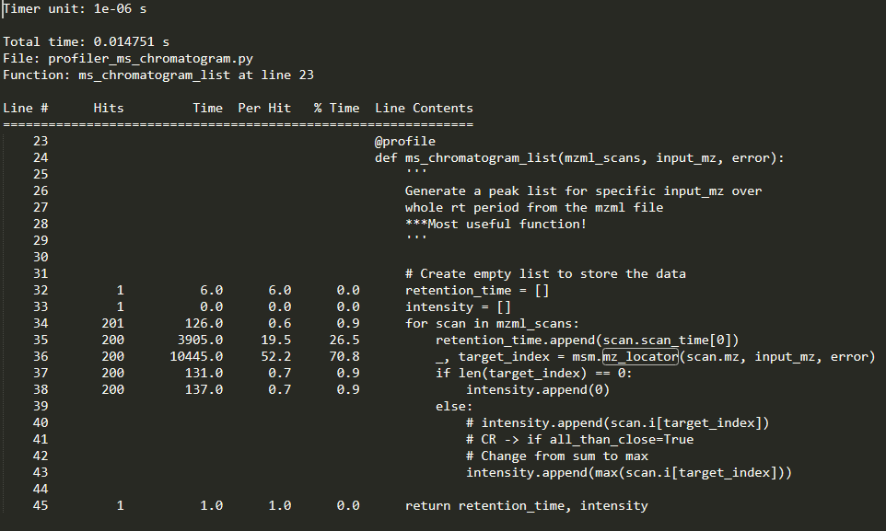
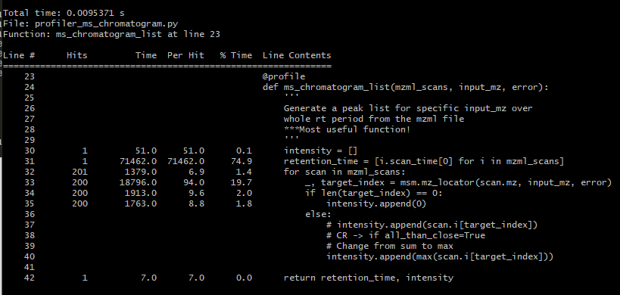

Slide 13
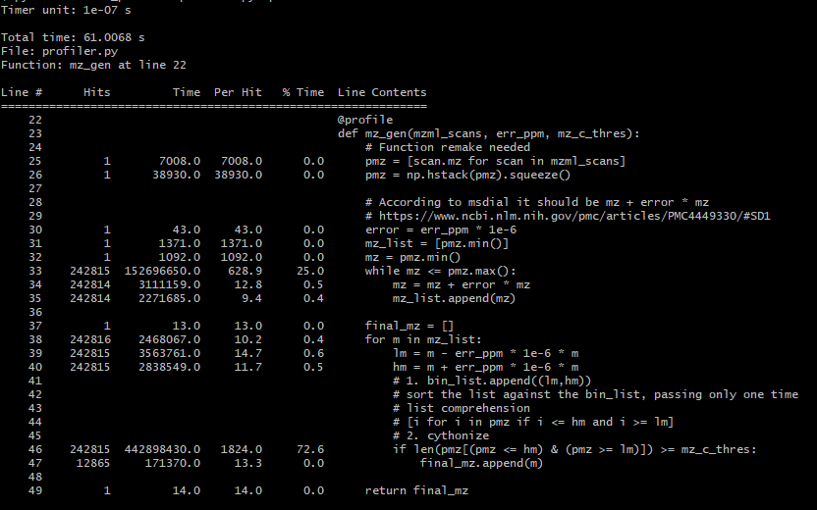
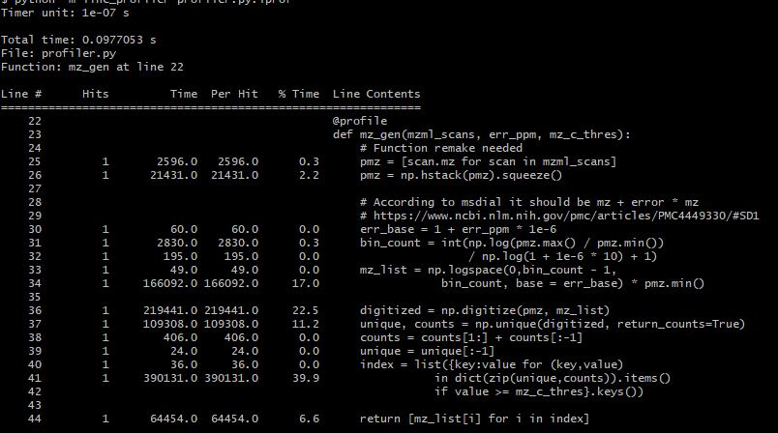
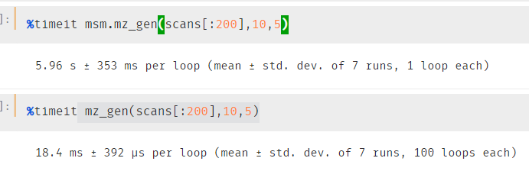
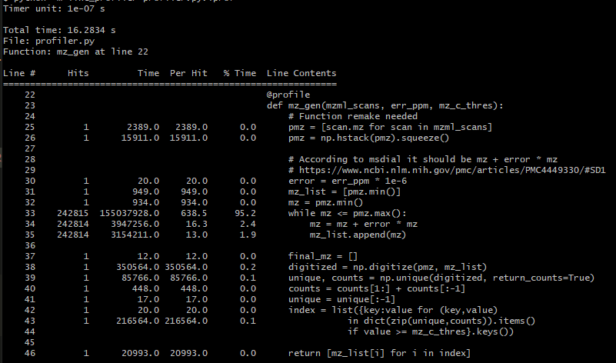

Slide 14
Peak_list
Peak_pick
99.6% time
mzgen
Ms_chromatogram_list
56% time
Mz_locator
20% time
List appending
70% time
Note: how to process RT only for one time and use in all the functions?
Class?

Slide 15
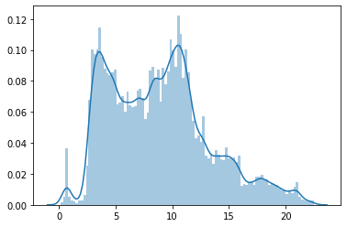
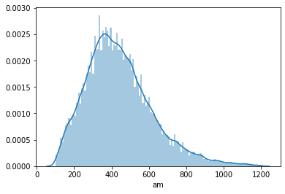
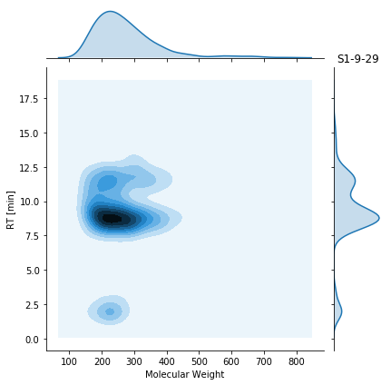
Dummy data
Follow the previous dataset distribution
Covers simple matrix (ozonation experiment dilution) and complex matrix(field samples)
Dummy source: random 200 features
Dummy background: random 10000 mz/rt pairs
So far, only up to 2D (intensity didn’t included)

Slide 16
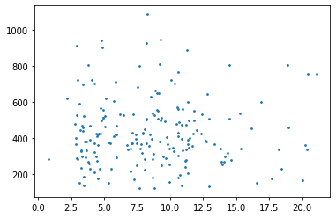
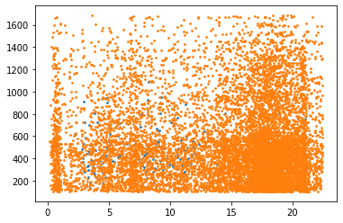
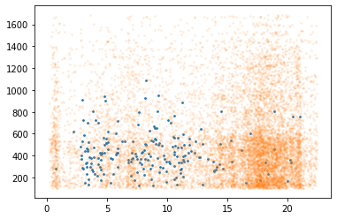
Source identification strategy
10 100
20 200
15,100
25,200
Based only on mz/rt pair
From data
Pick up fingerprint features (clustering, regression)
Alignment between fingerprint and field samples
Assess a match score (cos similarity/msdial algorithm) and coverage (dot product/Jaccard as baseline)
If score/coverage lower than threshold, check for the shift
Use relative position to reinforce the confidence
From graph
Undirected network?
Pattern match?

Slide 17
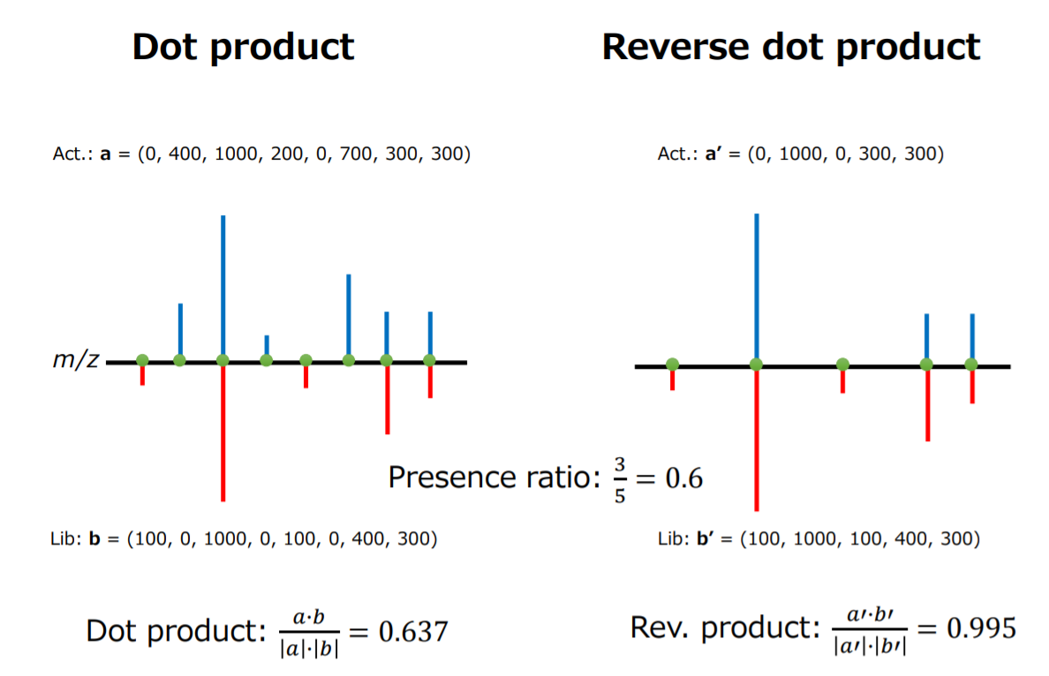
RT

Slide 18
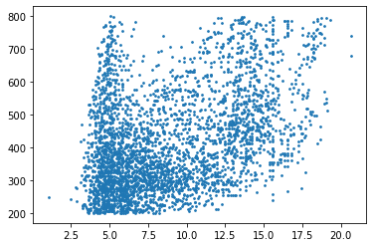
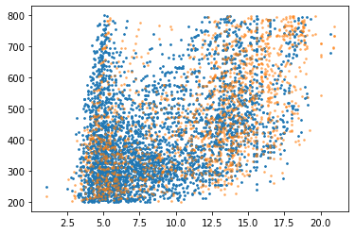
Third dimension -- intensity
1e6,5e5,1e5 1e8
How to generate dummy data? – generating random number from 2D distribution
Start with distribution comparison(source/field)
See how it goes, can this comparison have been used assist identification
Min-max (0-1)
Z-sore
Log-trans
Uncertainty from real sample turbulence
How to use intensity assess the identification (k2_samp?)
Assist identification
Quantification
Need a way to establish LOD for the source
Realdata in hand

Slide 19
Multiple sources
Treat as separate single source problem, then do a Venn diagram
Quantification strategy awaiting

