Slide 1
CR points
Major
Mass list generation
Logic
Efficiency
Peak detection
Efficiency
Logic
Anything else?

Slide 2
Logic flow
Peak utils for getting the index of peak
Loop for low and high index bound
Judge index bound with scan_window
Integration & calculate peak statistics
Scoring
Save result

Slide 3
Logic flow
Generate mz list **
Loop every mz in peak_picking
Overlapping filter
Save the results

Slide 4
CR points
Minor
Mz locator
Logic
Reading external data
Build class?—private variables/funcs
Efficiency of ms_chromatogram_list?

Slide 5
Algorithms
Dummy data
Pattern storage
Recognition
Quantification → any dummy data/existing data possible?
Data collection
Same tire cluster in different matrix

Slide 6
Contents
Current contents
Anything else needed for manuscript? Data/functions/etc

Slide 7

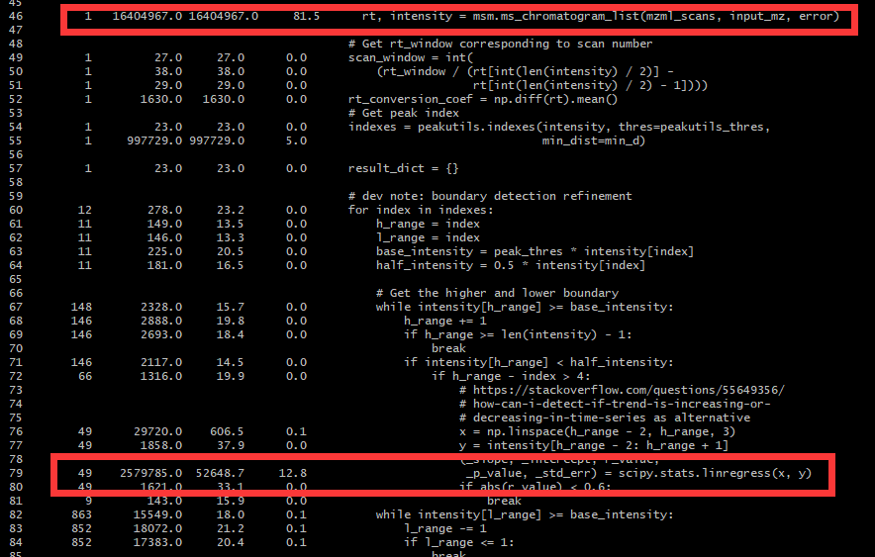
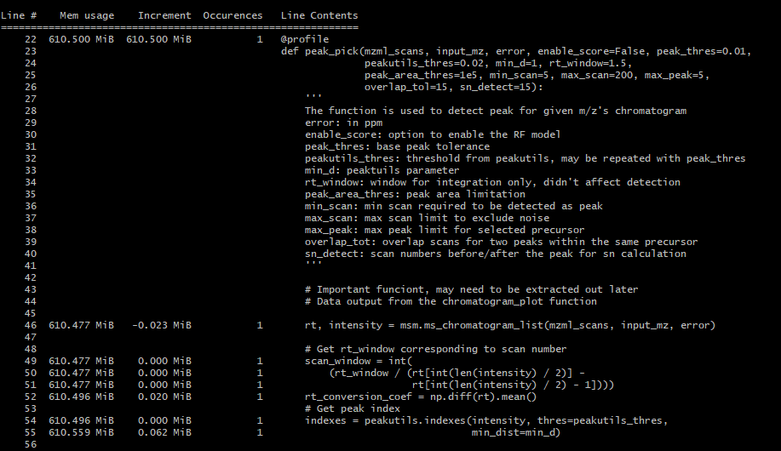
Peak pick

Slide 8
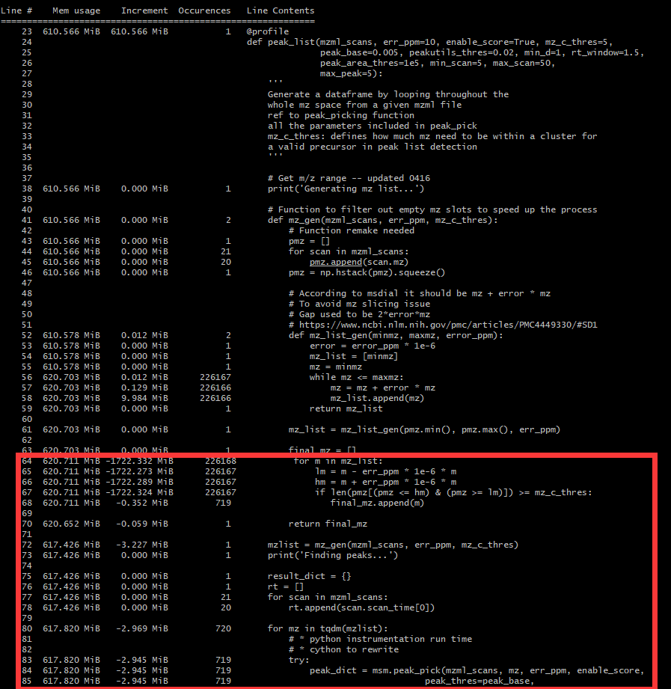
Peak list

Slide 9

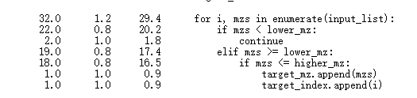
Peak_list
Peak_pick
64% time
mzgen
36% time
Ms_chromatogram_list
81.5% time
Mz_locator
71% time
List appending
26% time
100
100*(1+1e-6*100)
25%~40%

Slide 10
Real detection mzlist
[101.1,101.2]

Slide 11
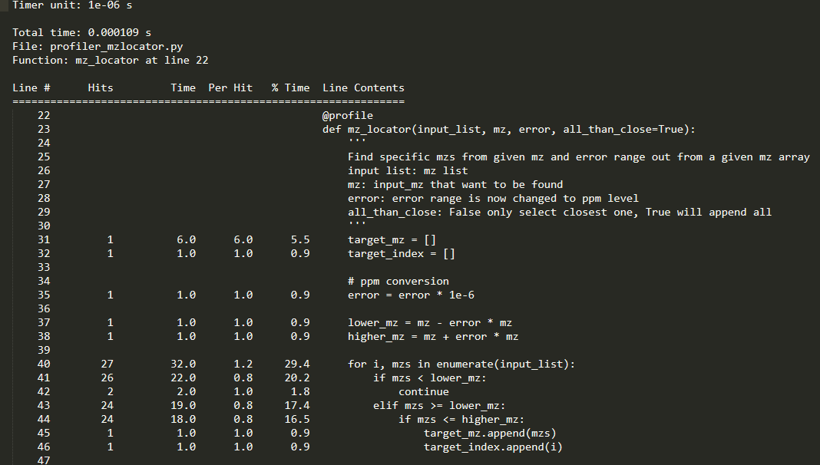
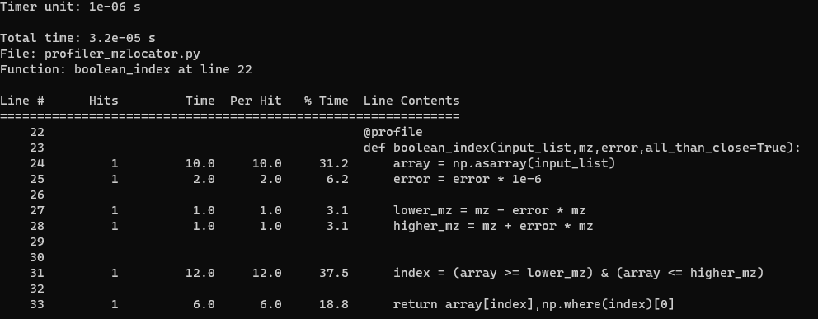

Slide 12
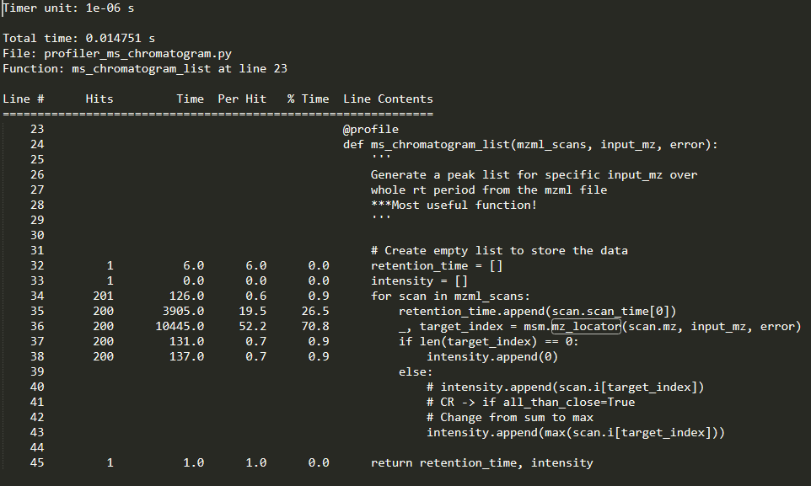
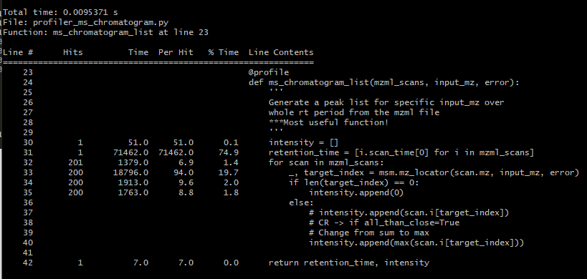

Slide 13
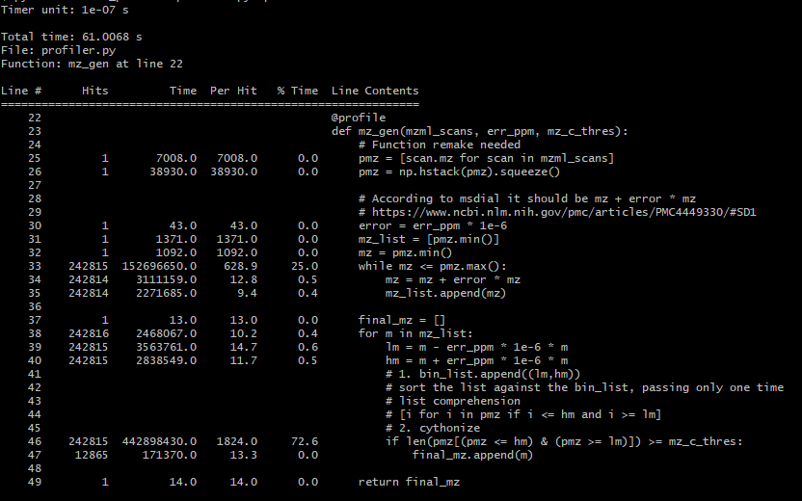
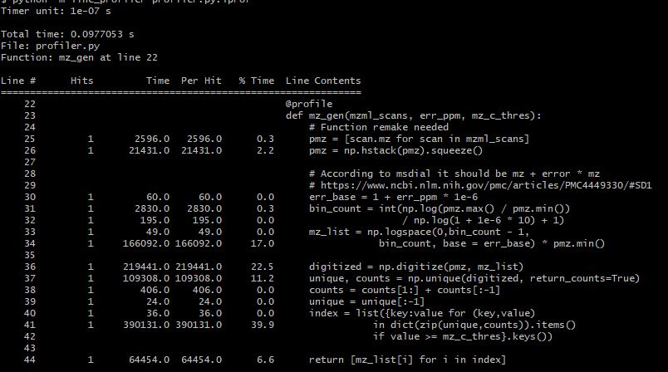
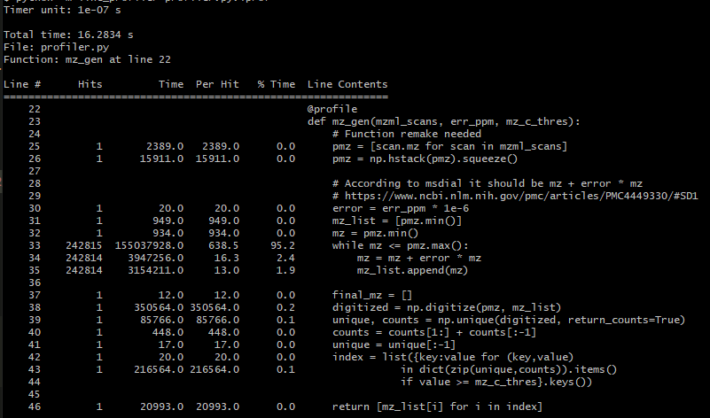
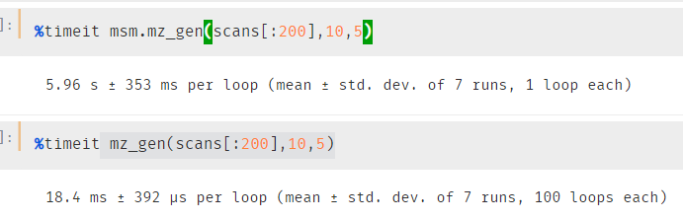

Slide 14
Peak_list
Peak_pick
99.6% time
mzgen
Ms_chromatogram_list
56% time
Mz_locator
20% time
List appending
70% time
100
100*(1+1e-6*100)
Note: how to process RT only for one time and use in all the functions?
Class?

