Slide 1
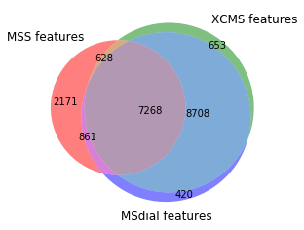
505 min_scan 7
Msdial :21759
Mss: 10928
Xcms: 17257

Slide 2
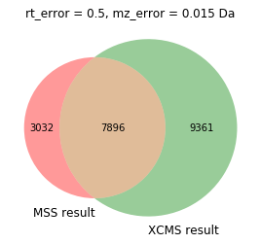
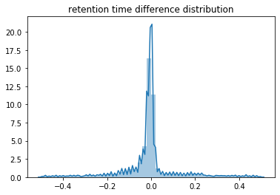
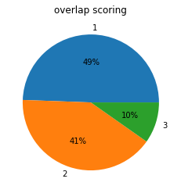
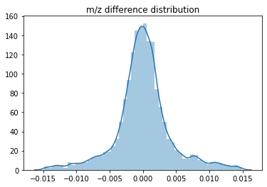
MSS vs XCMS

Slide 3
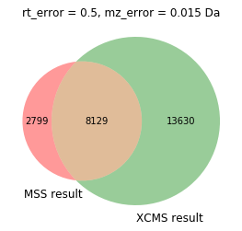
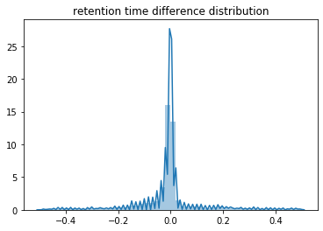
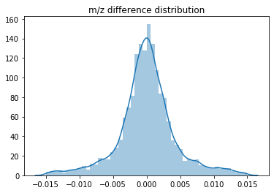
MSS vs msdial

Slide 4
505 – min_scan5
Overlap check:
Rt_tolerance:0.2 min
Mz_tolerance:0.015 Da
Msdial :21759
Mss: 26242
Xcms: 17257
Min_scan 7 is verified as subset from min_scan 5

Slide 5
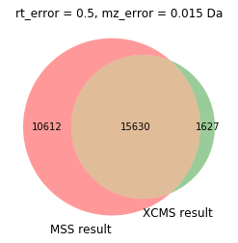
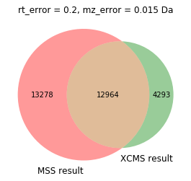
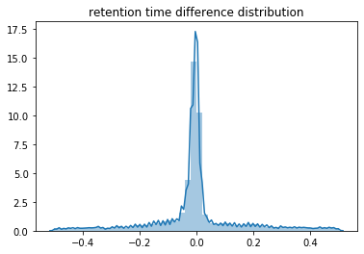
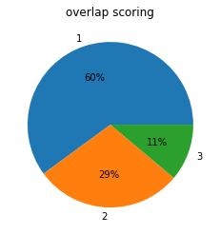
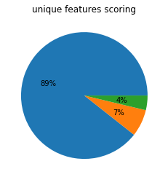
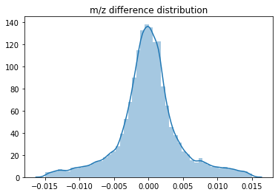
MSS vs XCMS
Reason: unique features mostly small peaks, the model built on the larger peaks

Slide 6
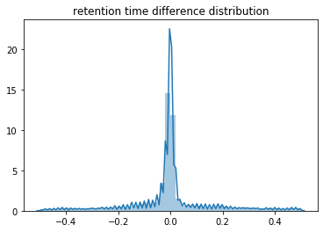
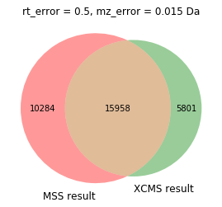
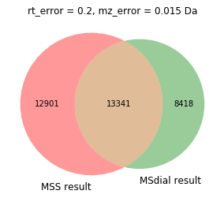
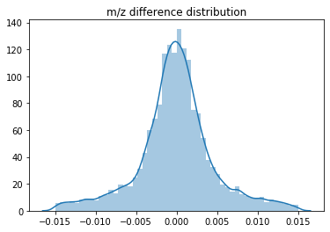
MSS vs msdial
msdial

Slide 7
Note
The tolerance allows multiple overlap happens, i.e. several features from mss aligned with either xcms or msdial features
Next, compare with ENTACT information seeking for known peaks and validation
Detailed checked into overlap peaks and non-overlap peaks? – Manual
Stats on all peaks? thinking

Slide 8
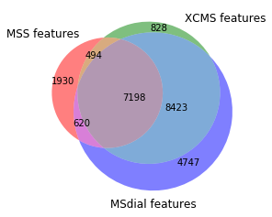
506 min_scan7
Msdial :20988
Mss: 10242
Xcms: 16943

Slide 9
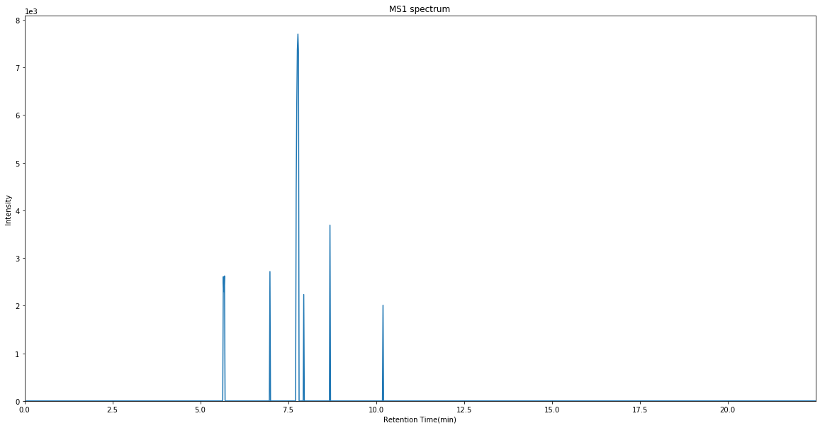
Reason
Peak in xcms but not in mss
Different limits
Minscan
Scan window
Max peak within same chromatogram

Slide 10
Manual validation using ENTACT dataset
505 dataset
136 out of 146 matched, 4 not sure, 6 didn’t match
506 dataset
144 out of 150 matched, 4 not sure, 2 didn’t match
508 dataset
110 out of 113 matched, 2 unsure, 1 didn’t match

