Slide 1
Procedure of alignment assessment
Idea:
If bring in a new sample, how much likely the source is there? How’s the quality of the new sample?
Alignment
Screening
Only check for the closest neighbor
Scoring
Euclidean
Cos score
KL divergence
Dataset:
Mz/rt pair 200 * 20 sets
Missing mz/rt pair 20~100% * 200 * 20 * 5 sets
Rt+-0.2 norm.dist
Mz+-5ppm
200,10
205,10
205,10
205,10
205,10
205,10
205,10
200,10
205,10
205,10
205,10
205,10
205,10
205,10

Slide 2
X-axis: simp match
With screening
Closest neighbor

Slide 3
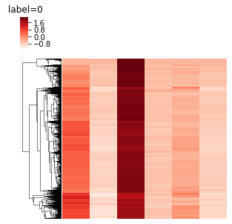
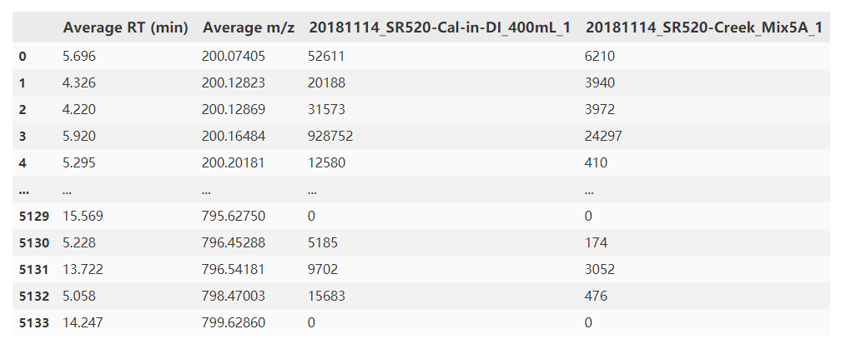
Procedure of source identification
Alignment of data
DBSCAN/regression to figure out source features
Match source features with samples
Apply score
Source
Sample
Source features
Noise features

Slide 4
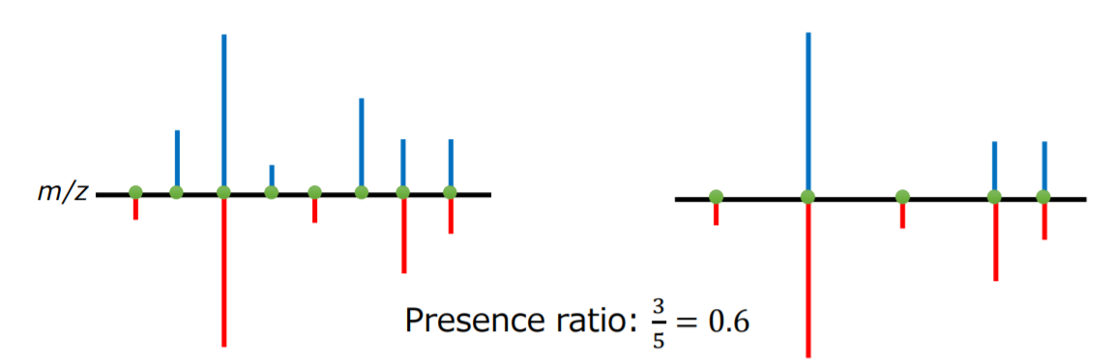
Blue: sample
Red: source
Mz/rt

Slide 5
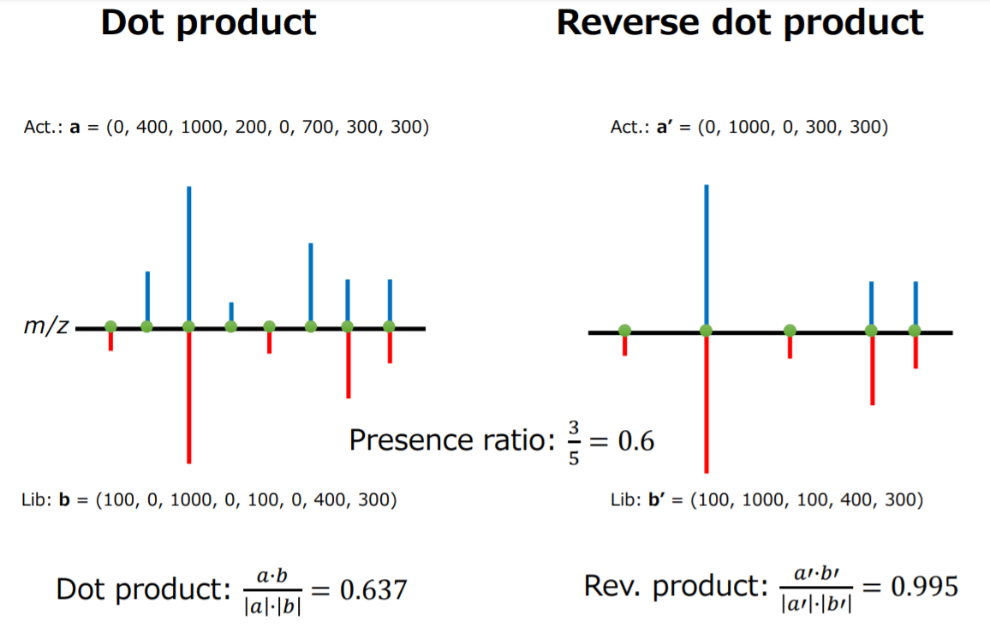

Slide 6
Scores
1
0
1
1
0
0
Source
Sample
Calculated based on
Entire population of features
Source features only
Option:
Simple score
Dot product
Jaccard
Log-transformation
Binary-transformation
Entropy – kl divergence
[0.5, 0.5]
[1e8,1e3]
Source features
Noise features

Slide 7
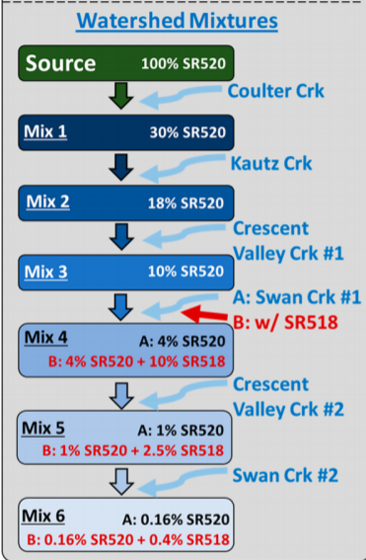
Results
Which performance is preferred? Regression like/decision like
Compare with true negatives

Slide 9
Formula annotation
Knapsack problem? DP?
300+-err range
C: 12 0~50
H: 1 0~100
N:14 0~5
3.2G 100~900 csv
128mb 100~500
Formula mass
C2H2 26
H2O 18

Slide 10
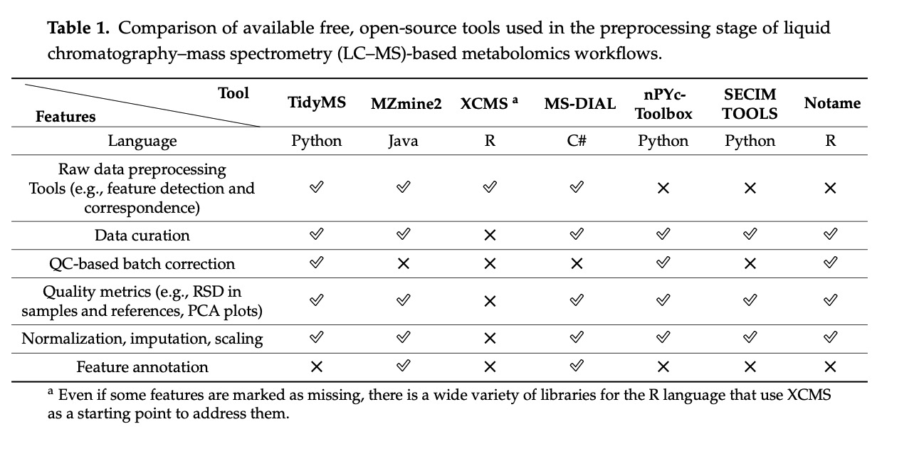
ACS presentation
Introduction
Major functions of the package
Merits
Showcase
Screenshot of processed results
Visualization module
Scoring on the source identification?
Benchmarks
Vs. other softwares – peak picking
Runtime/resource benchmark
Benchmarks on supercomputer?
Comparison?
Function comparison
Anything else?
Project directed presentation

