Slide 1
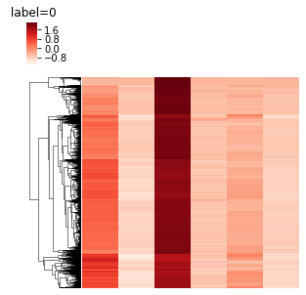
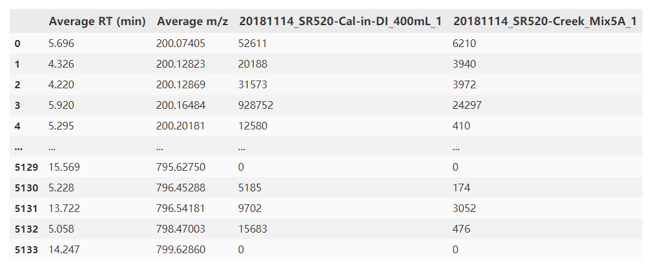
Procedure of source identification
Alignment of data
DBSCAN/regression to figure out source features – features follows dilution curve(optional)
Match source features with samples
Apply score
Source
Sample
Source features
Noise features

Slide 2
Scores
Source
Sample
Calculated based on
Entire population of features
Source features only
Option:
Presence ratio
Dot product
Jaccard
Log-transformation
Binary-transformation
Entropy – kl divergence
[0.5, 0.5]
[1e8,1e3]
Source features
Noise features

Slide 3
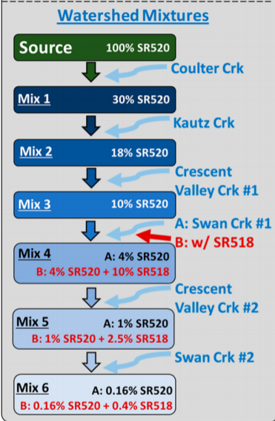
Results
Which performance is preferred? Regression like/decision like
X-axis: % of SR520 in the sample

Slide 4
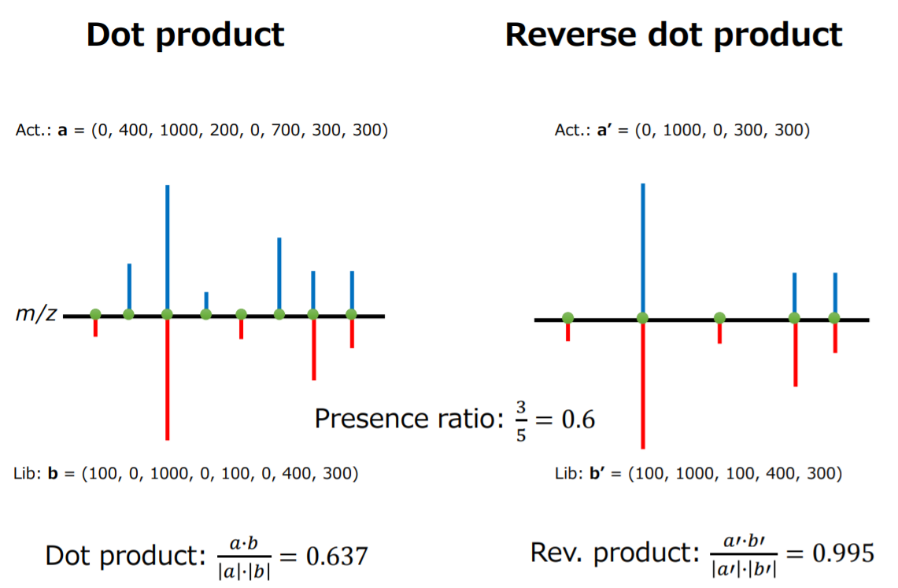

Slide 5
X-axis: % of SR520 in the sample

Slide 7
Based on 1114 triplicate raw data vs true negative

Slide 8
SR518

Slide 9
Discussion
Work or not?
More data
Alignment assessment

Slide 10
Procedure of alignment assessment
Idea:
If bring in a new sample, how much likely the source is there? How’s the quality of the new sample?
Alignment
Screening
Only check for the closest neighbor
Scoring
Euclidean
Cos score
KL divergence
Dataset:
Mz/rt pair 200 * 20 sets
Missing mz/rt pair 20~100% * 200 * 20 * 5 sets
Rt+-0.2 norm.dist
Mz+-5ppm
200,10
205,10
205,10
205,10
205,10
205,10
205,10
200,10
205,10
205,10
205,10
205,10
205,10
205,10

Slide 11
X-axis: simp match
With screening
Closest neighbor

