Slide 1
20200826 Next steps

Slide 2
Current status
C- directly comparable with current software
M – modified from current workflow or slight revise, but somehow comparable
N – New methodn validation needed
Current functions:
MS data import & fully access, basic MS data checking functions including interactive and feature extraction – C
Peak picking based on scipy and optional scoring system based on sklearn random forest model – M
Alignment among different samples or different – C
Data cleaning including triplicate detection check/RSD calculation, blank subtraction in group and other basic cleaning steps – N but minor
Clustering algorithm with optional dimension reduction for end member extraction based on sklearn unsupervised machine learning – N
Modeling on dilution rate prediction from selected members based on selected models – N
Source tracking from multiple sources based on Venn diagram approach – questionable, more counts for experimental setups?
Existing packages: Pyteomics, pyopenms, peakonly, lipyd, emzed(outdated 2013)

Slide 3
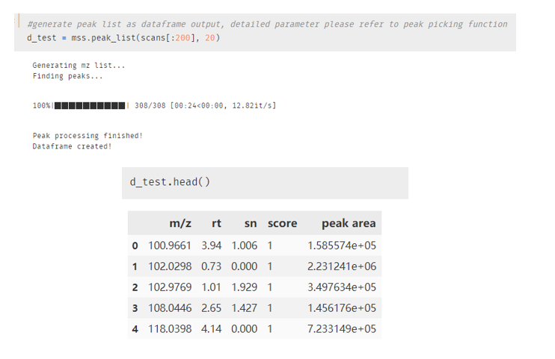
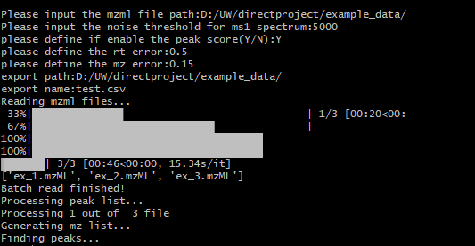
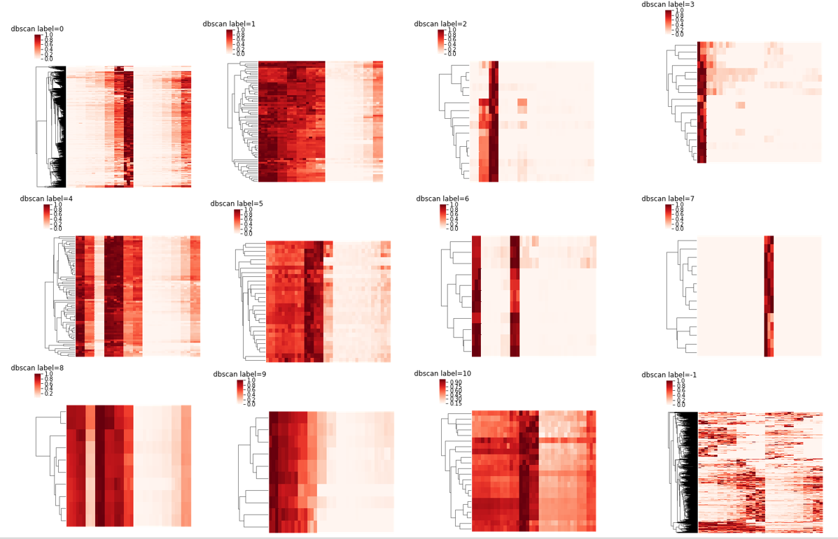
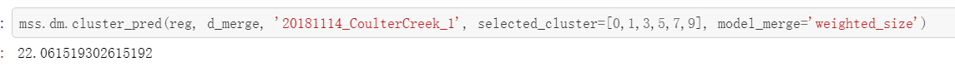

Slide 4
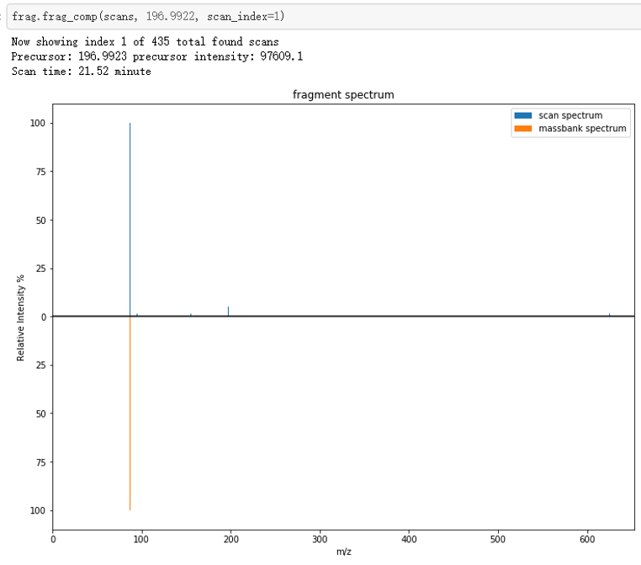
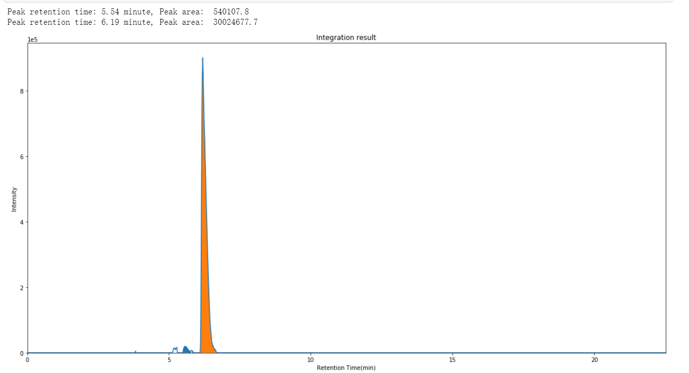

Slide 5
Current status
Package testing and compatibility:
Data wise: test data ran through data import to alignment workflow, but only tested for functionality, for advanced workflow, data were generated from msdial to make sure it robust as real data
Package wise: Testing coverage 62%, compatibility tested on windows, mac and linux, pypi install available but didn’t test as a plug-to-use package
Performance test: enabled the connection to Hyak for laborious process, as for tested, process time for 200~ samples will be around 12 hrs, regularly take 3 ~ 5 min for single sample peak picking based on setup, personal laptop is slower as taking 5~7min per sample (memory leaking), 1.5 x times applied if scoring enabled
Current drawback:
Basic functions are not fully complete yet, such as formula assignment, isotope pattern check, GUI on MS data access
Advanced data analysis workflow is built on in-house data; thus some function is very hard to be used out separately
Not yet tuned for best default settings on clustering/modeling
Memory usage and calc efficiency can be optimized

Slide 6
Short term dev to complete basic functions
Strategy: compare and refine
Which software to compare: agilent/msdial/mzmine ?
Finish basic functions based on compared software to make it more functional and can be started use in lab
Formula assignment (with isotope pattern check)
Better interactive plot
Revise to make data analysis functions more compatible from outside data

Slide 7
Long term dev
GUI/user friendly interface for the whole package
MS2 oriented functions: TP search with MS2 network(already a lot); in-silico structure prediction refinement; functional group prioritization from MS2 information
Pattern recognition: given a set of end member from a source and new dataset, can we use the pattern (either in plot or data) to identify the source out?
Multiple source tracking report: how much each source contribute towards final pollution?

Slide 8
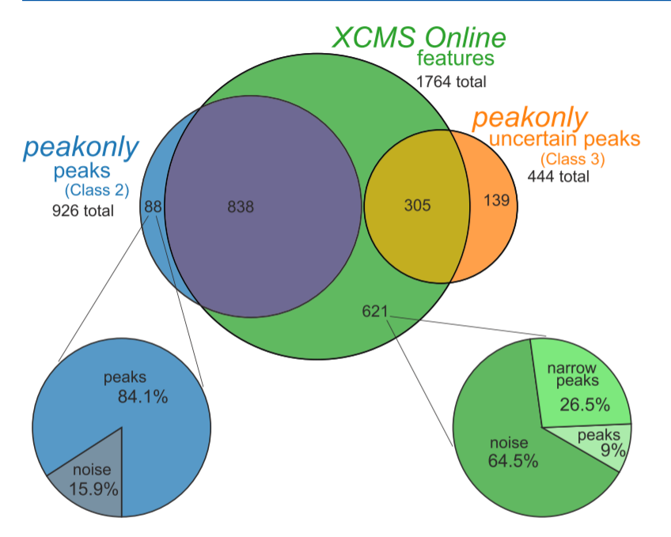
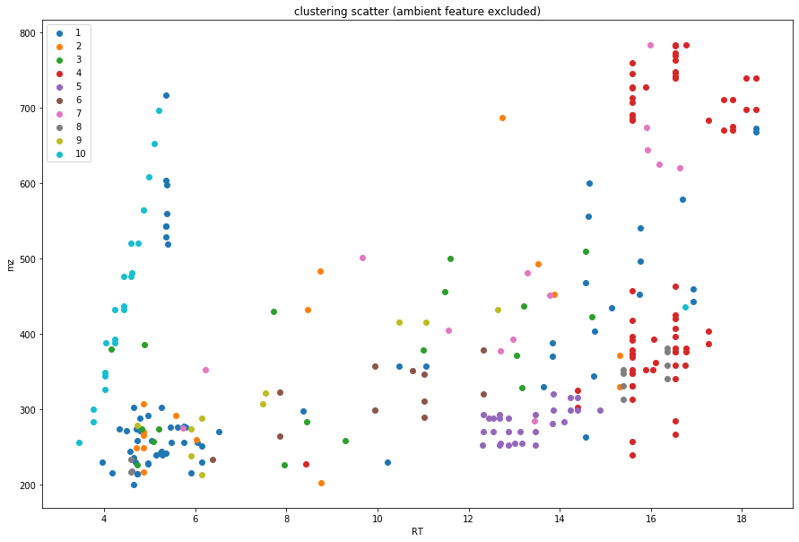
Validation & data test
Basic functions: peak picking & alignment → use same data set run through different software to compare the output
Setup a scenario for advanced data analysis – what it’s for? How can we approve?
Clustering → end member extraction for single source; co-eluent search; matrix effect grouping
Clustering + modeling → dilution rate prediction based on selected features from single source
Venn diagram + ? → Better approach for multiple source tracking
Prove by setting up experiment according to the scenario depending on the scale of the story, how much to include?
Touch to the detail of each analysis approach
Reveal the possibilities and only give out some flavors

Slide 9
Story outline
Which one do we want to emphasis? 1) functionality as a package 2) practicality as MS tool
What scale do we want to achieve
Outline of the workflow
Comparison with other software on basic functions
Advanced workflow illustration with test data
Novelty
First fully functional package for environmental analysis based on python – previously most for metabolomics and only have partial function: spectrum_utils; pyOpenMS; Pyteomics
Faster performance: comparing to existing packages under R, python is more sufficient
External port: unlimited external resource usage rather than workstation in lab
Better flexibility: user can reprint result by different settings immediately rather than reprocess the whole dataset
Novel data analysis approach based on unsupervised machine learning
Open source and easy to read: everyone can easily contribute to the package
Challenge? Being persuasive to people using R

Slide 10
Data needed for completing the story
Test data: which data to use and how
Basic workflow can be tested on any data, dataset size is the only thing to decide
Advanced analysis test data:
Dilution series data from SR520 → end member extraction, dilution rate prediction
AFFF data (if permitted) → similar to SR520 but more complicated in matrix
Not yet have data subjected to multiple source tracking

