Slide 1
Procedure of alignment assessment
Alignment
Screening/not screening
Scoring
Euclidean
Cos score
KL divergence

Slide 2
With screening
Without screening

Slide 3
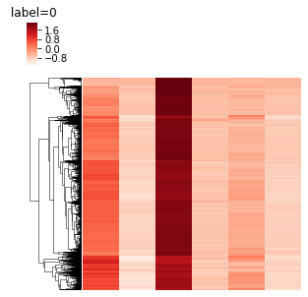
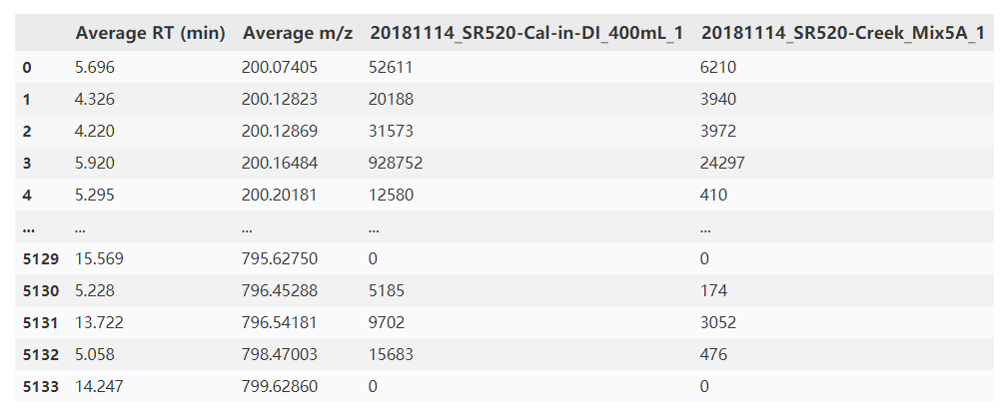
Procedure of score assessment
Alignment of data
DBSCAN/regression to figure out source features
Match source features with samples
Apply score
Source
Sample
Source features
Noise features

Slide 4
Scores
Option:
Simple score
Dot product
Jaccard
Log
Binary
Entropy

Slide 5
Results
Which performance is preferred? Regression like/decision like

Slide 6
Formula annotation
Knapsack problem? DP?

Slide 7
ACS presentation
Introduction
Showcase
Benchmarks
Comparison?

