Slide 1

PRINCIPLES OF DATA SCIENCE
Harshavardhan Reddy Kapeta-16327671
Madhu Hanimi Reddy-16326622
Janapala Sai Krishna Teja Reddy-16324593
Layoff data analysis during recession period

Slide 2
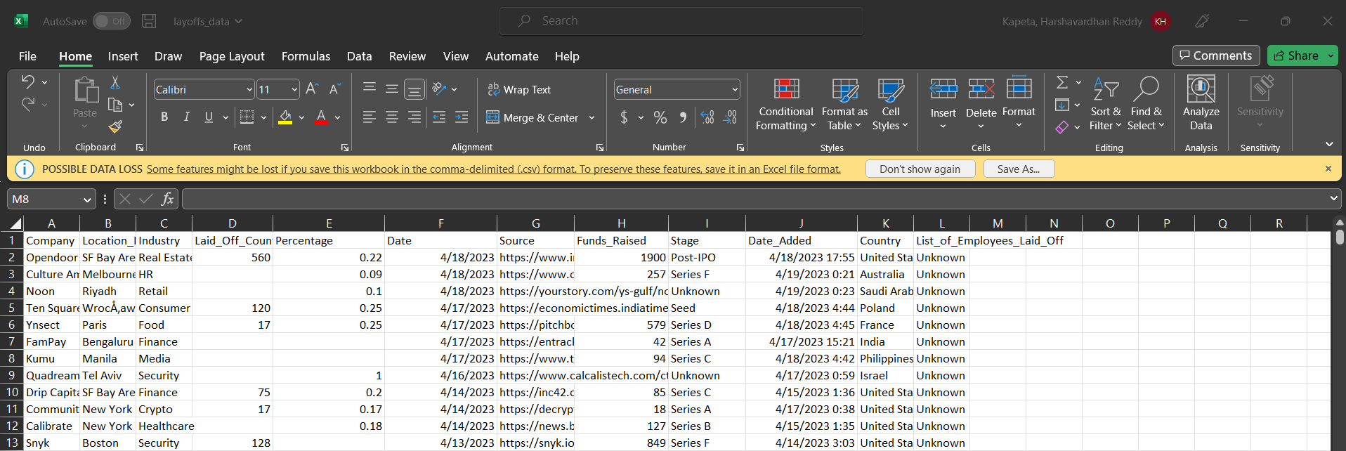
DATSET
2508x12

Slide 3
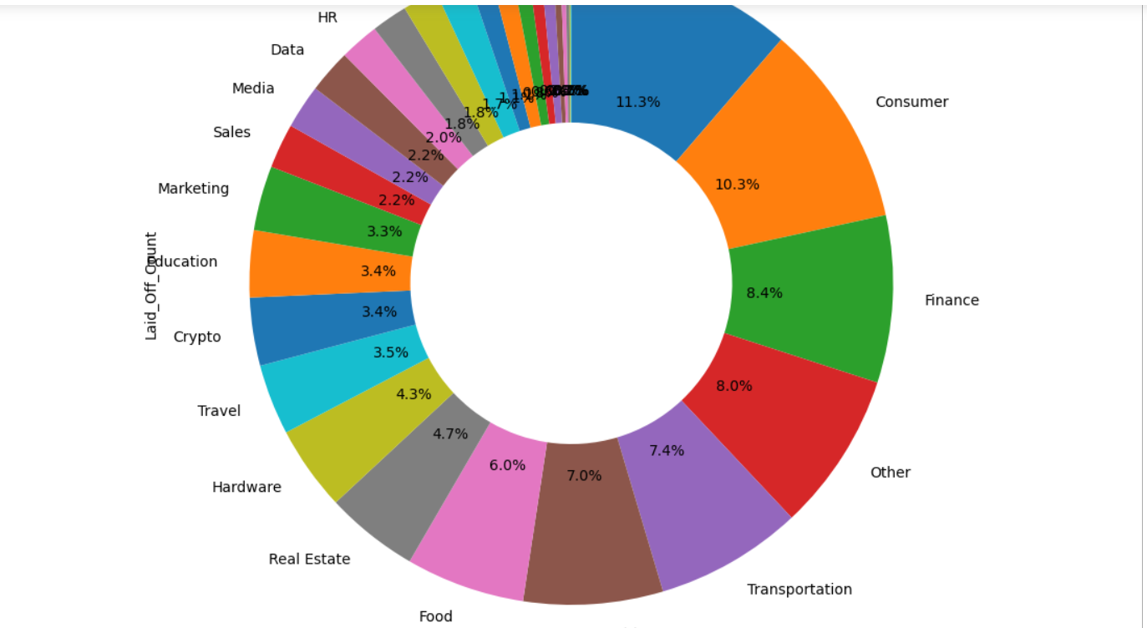
INDUSTRY Wise Layoffs

Slide 4
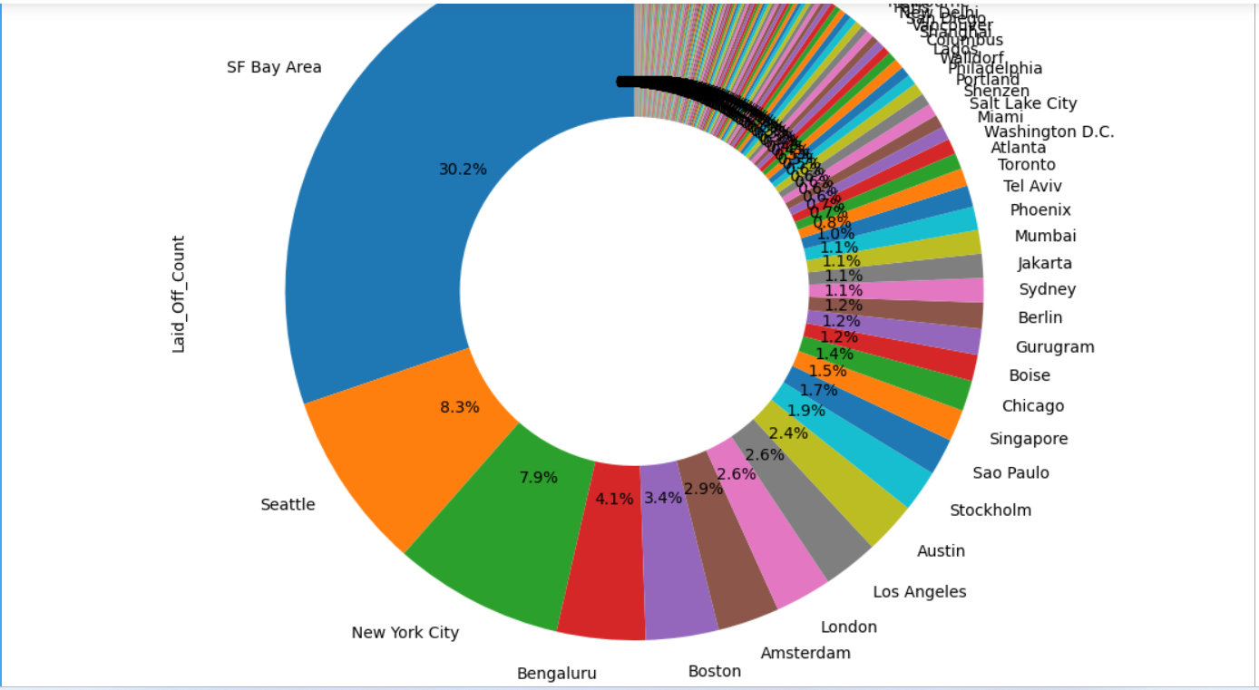
Headquarters wise Layoffs

Slide 5
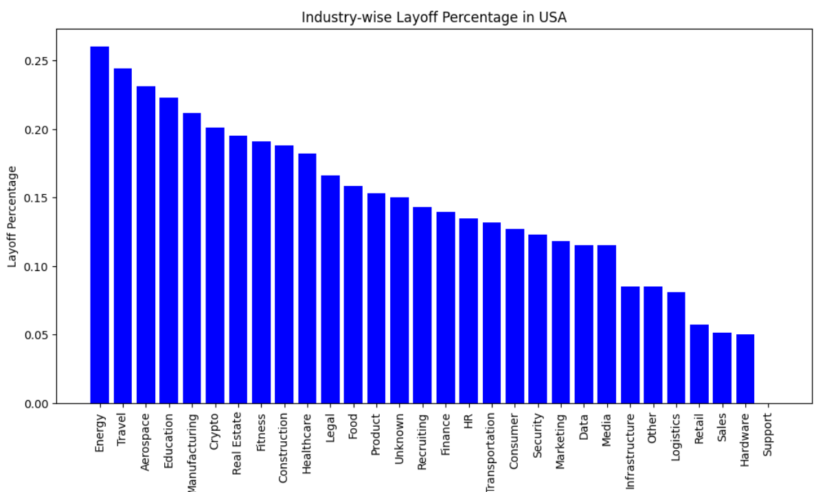
Layoffs in USA

Slide 6
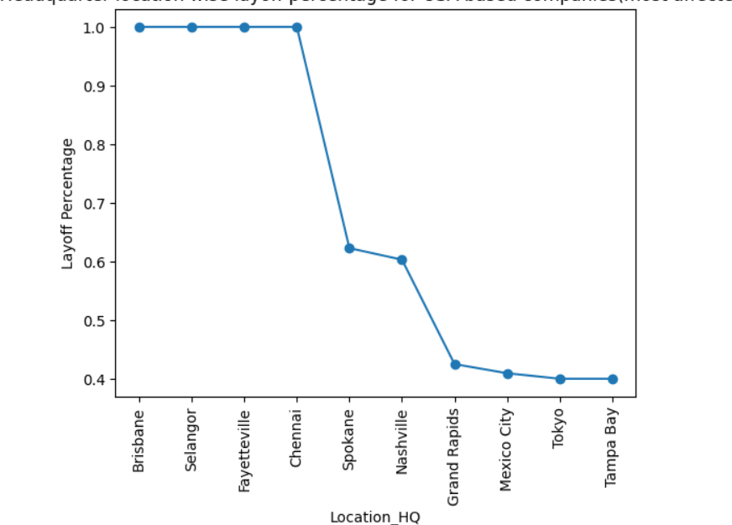
Layoffs in US based companies

Slide 7
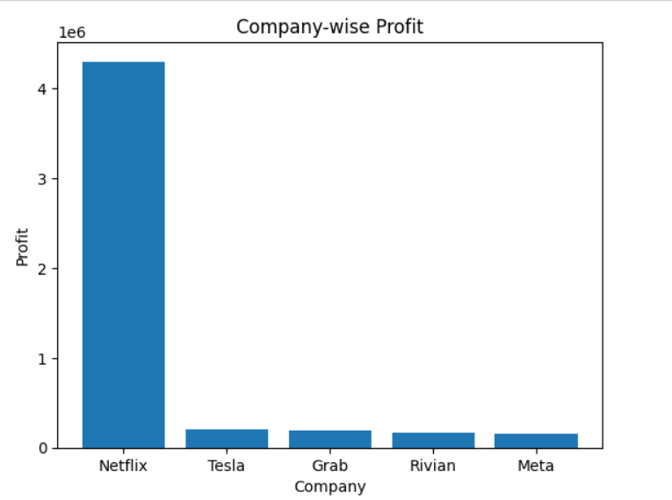
Companies benefited from layoffs

Slide 8
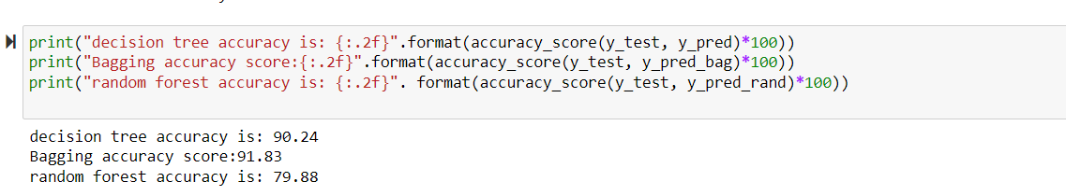
Model Accuracy

Slide 9

Thank You

