Slide 1

Shotmaniacs Group 1
Beau Jonkhout, Pavan Awadhpersad, Baris Yilmaz, Raphael Ritz, Alex Culda, Raluca Gavrila

Slide 2
Logistics
Planning
Design
Security
Testing
Demo
Table of Contents

Slide 3
Logistics

Slide 4
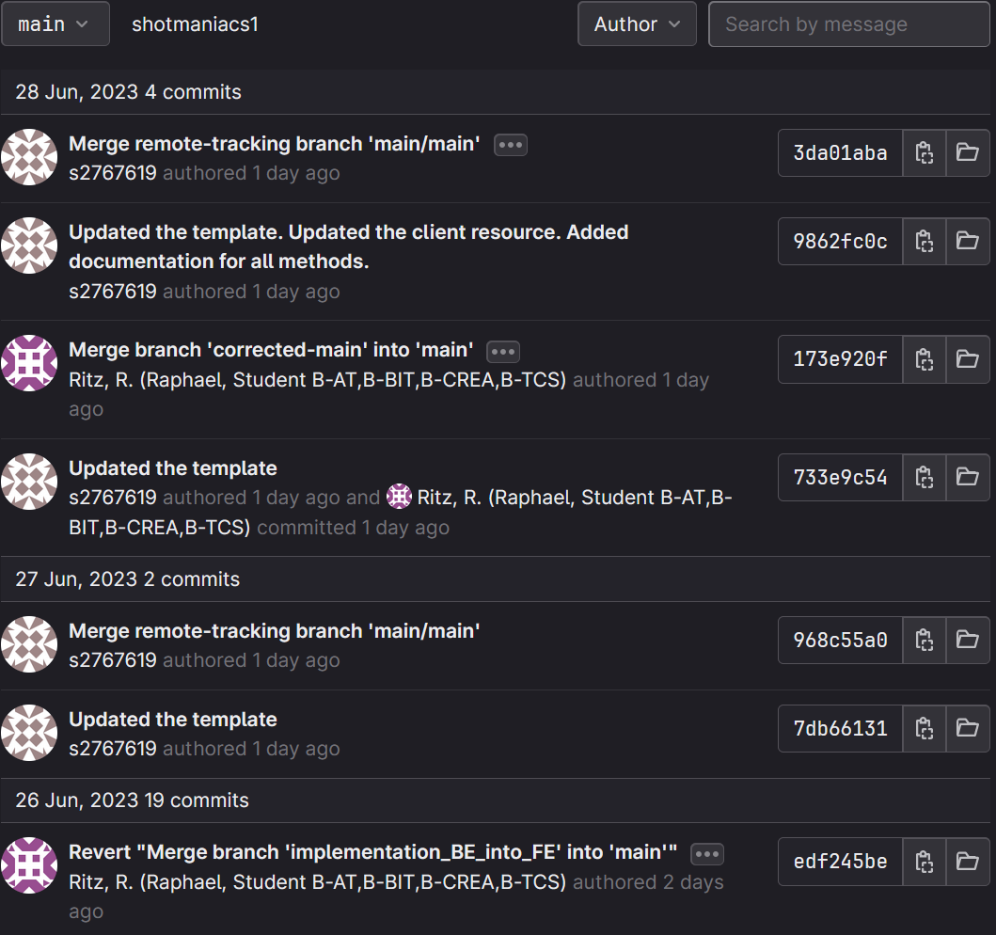
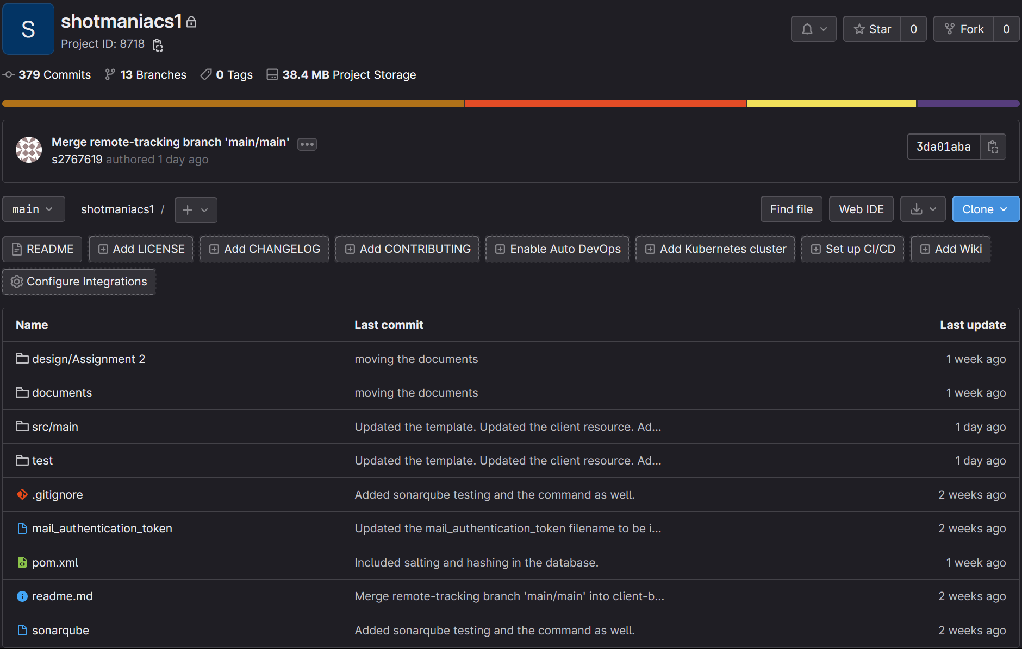

Gitlab
Protected main branch

Slide 5
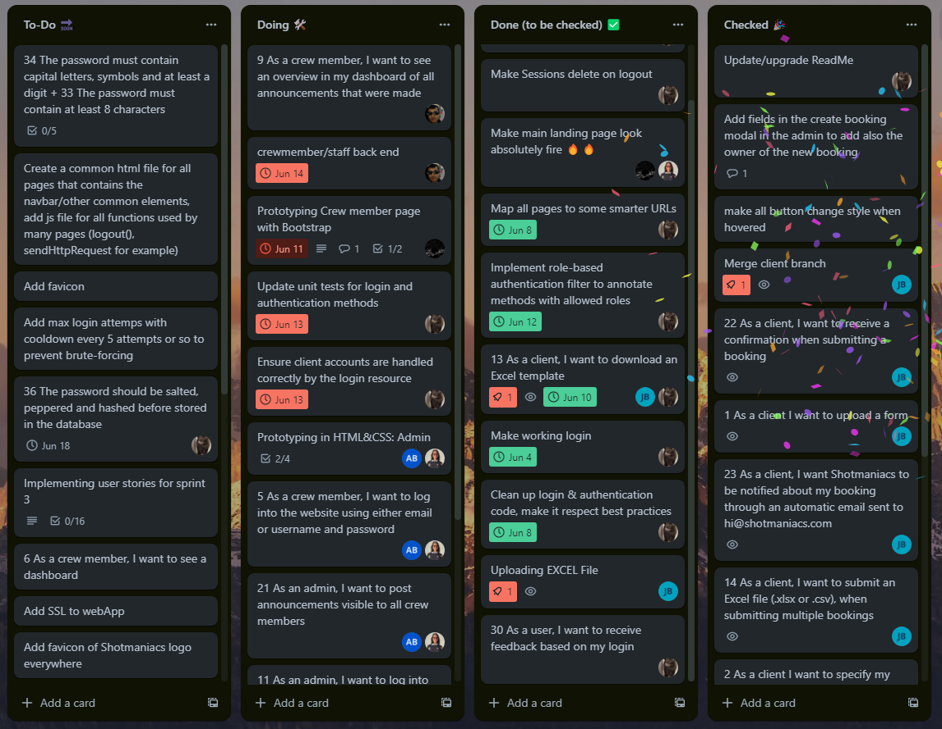
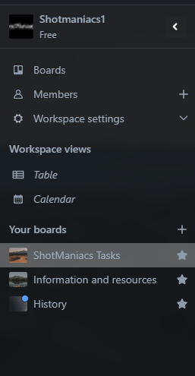
Trello

Slide 6
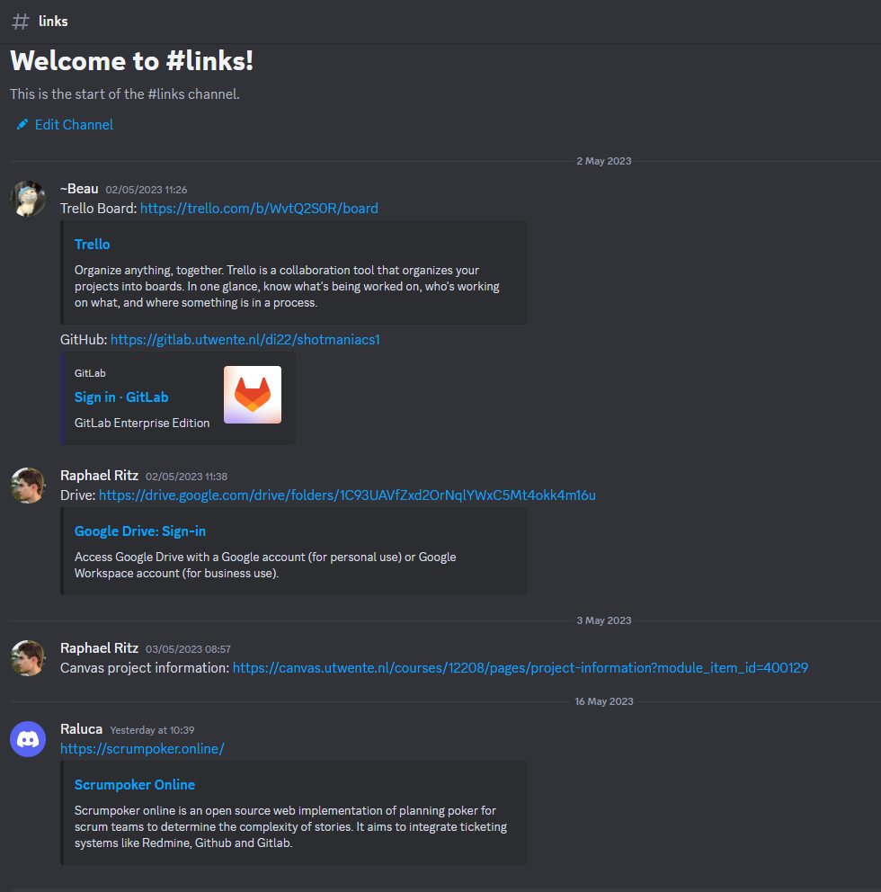
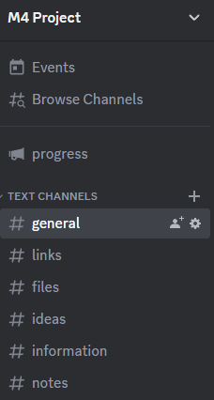
Discord

Slide 7
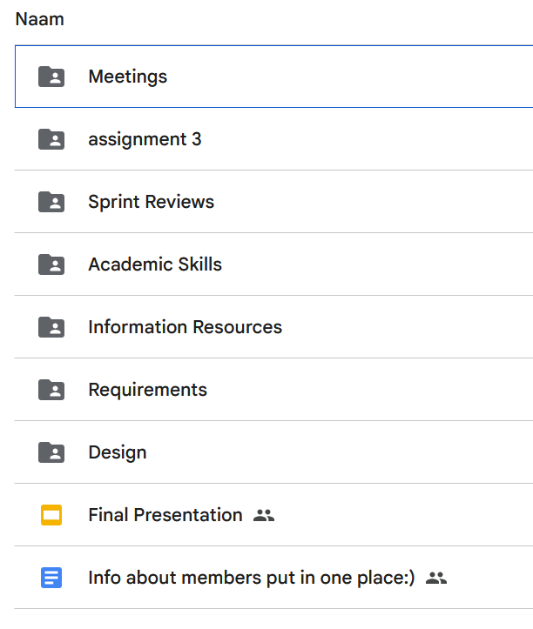
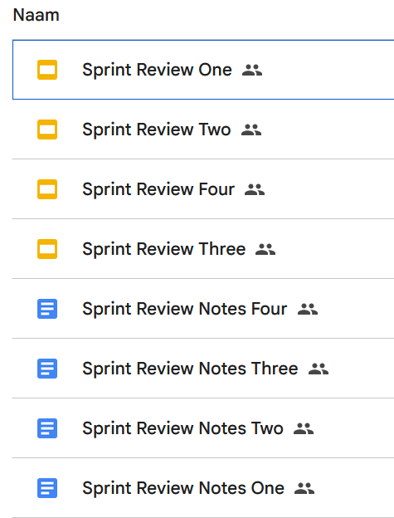
Drive

Slide 8
Planning

Slide 9
Cost estimation
Split into three groups of users
  Clients
  Crew
  Admin
Story points assigned to each group
Order of completion
Client
9
Crew
29
23
Admin

Slide 10
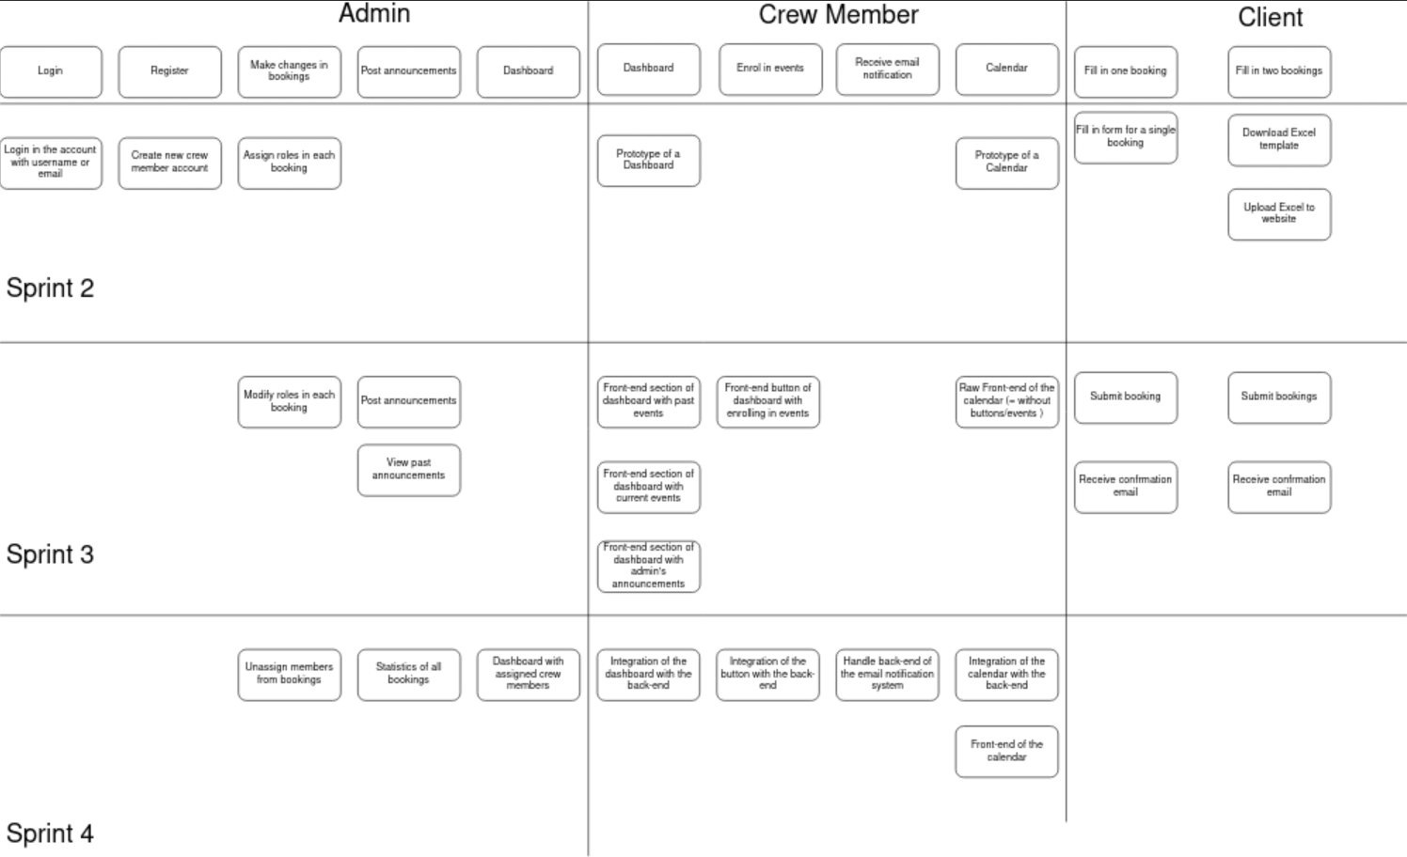
Story Map

Slide 11
Story Map

Slide 12
Story Map

Slide 13
Story Map

Slide 14
Design

Slide 15
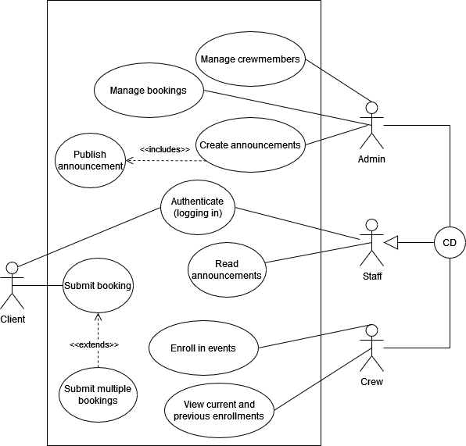
Use-case

Slide 16
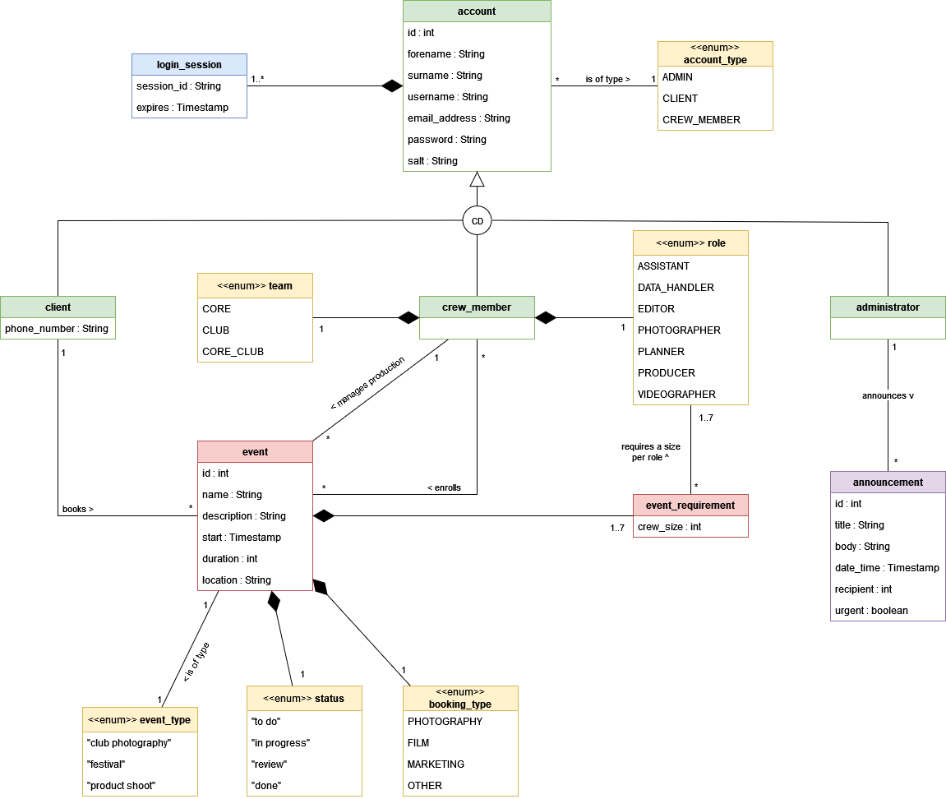
Class Diagram

Slide 17




Tools &
Frameworks

Slide 18
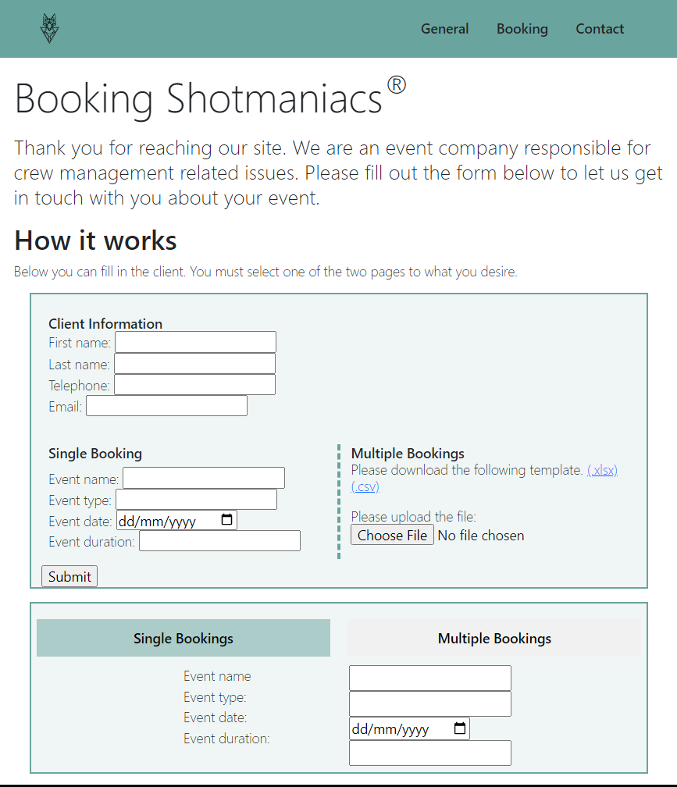
Client Page

Slide 19
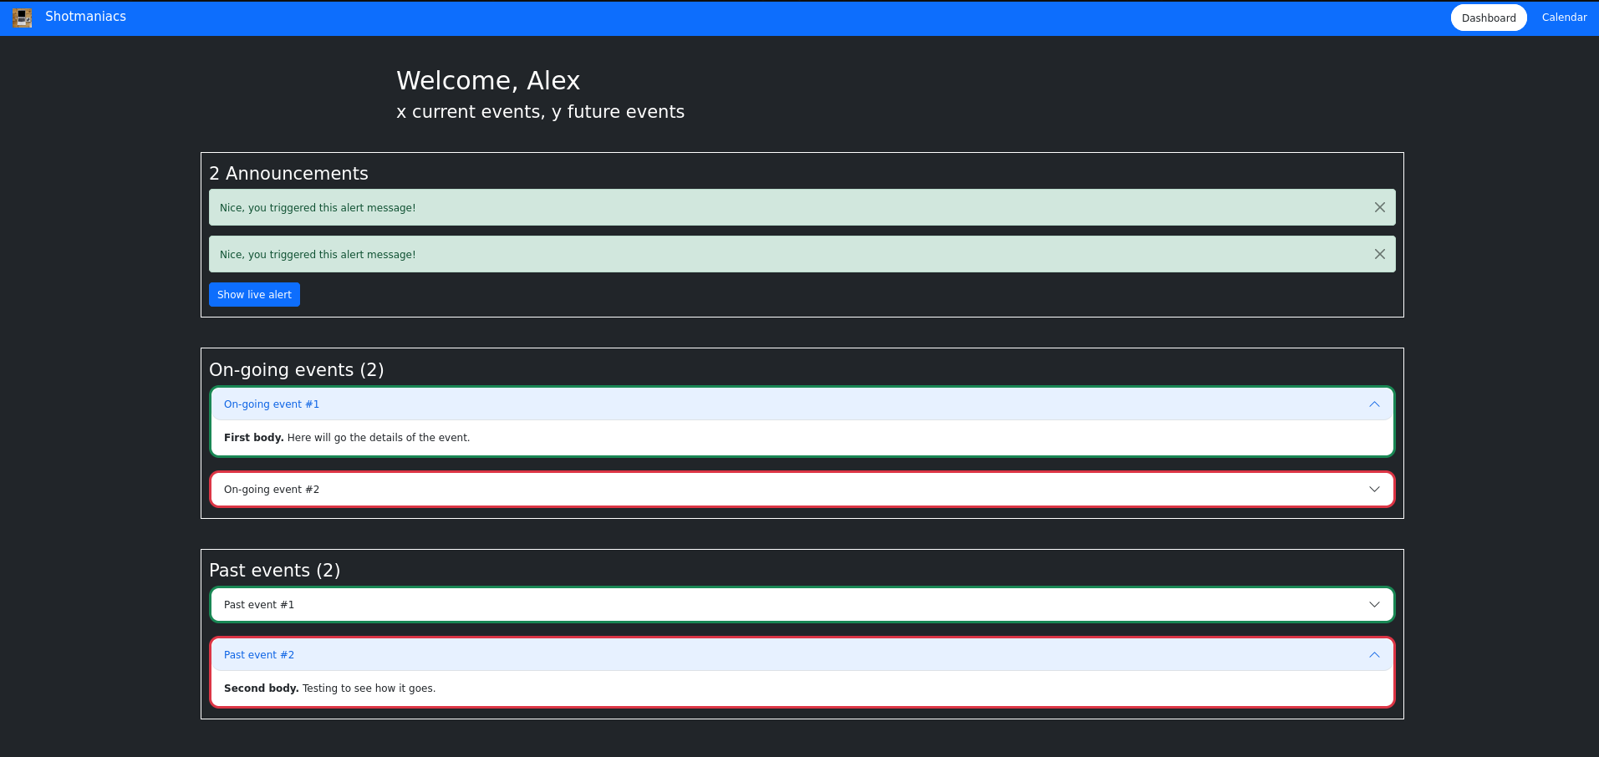
Client Page

Slide 20
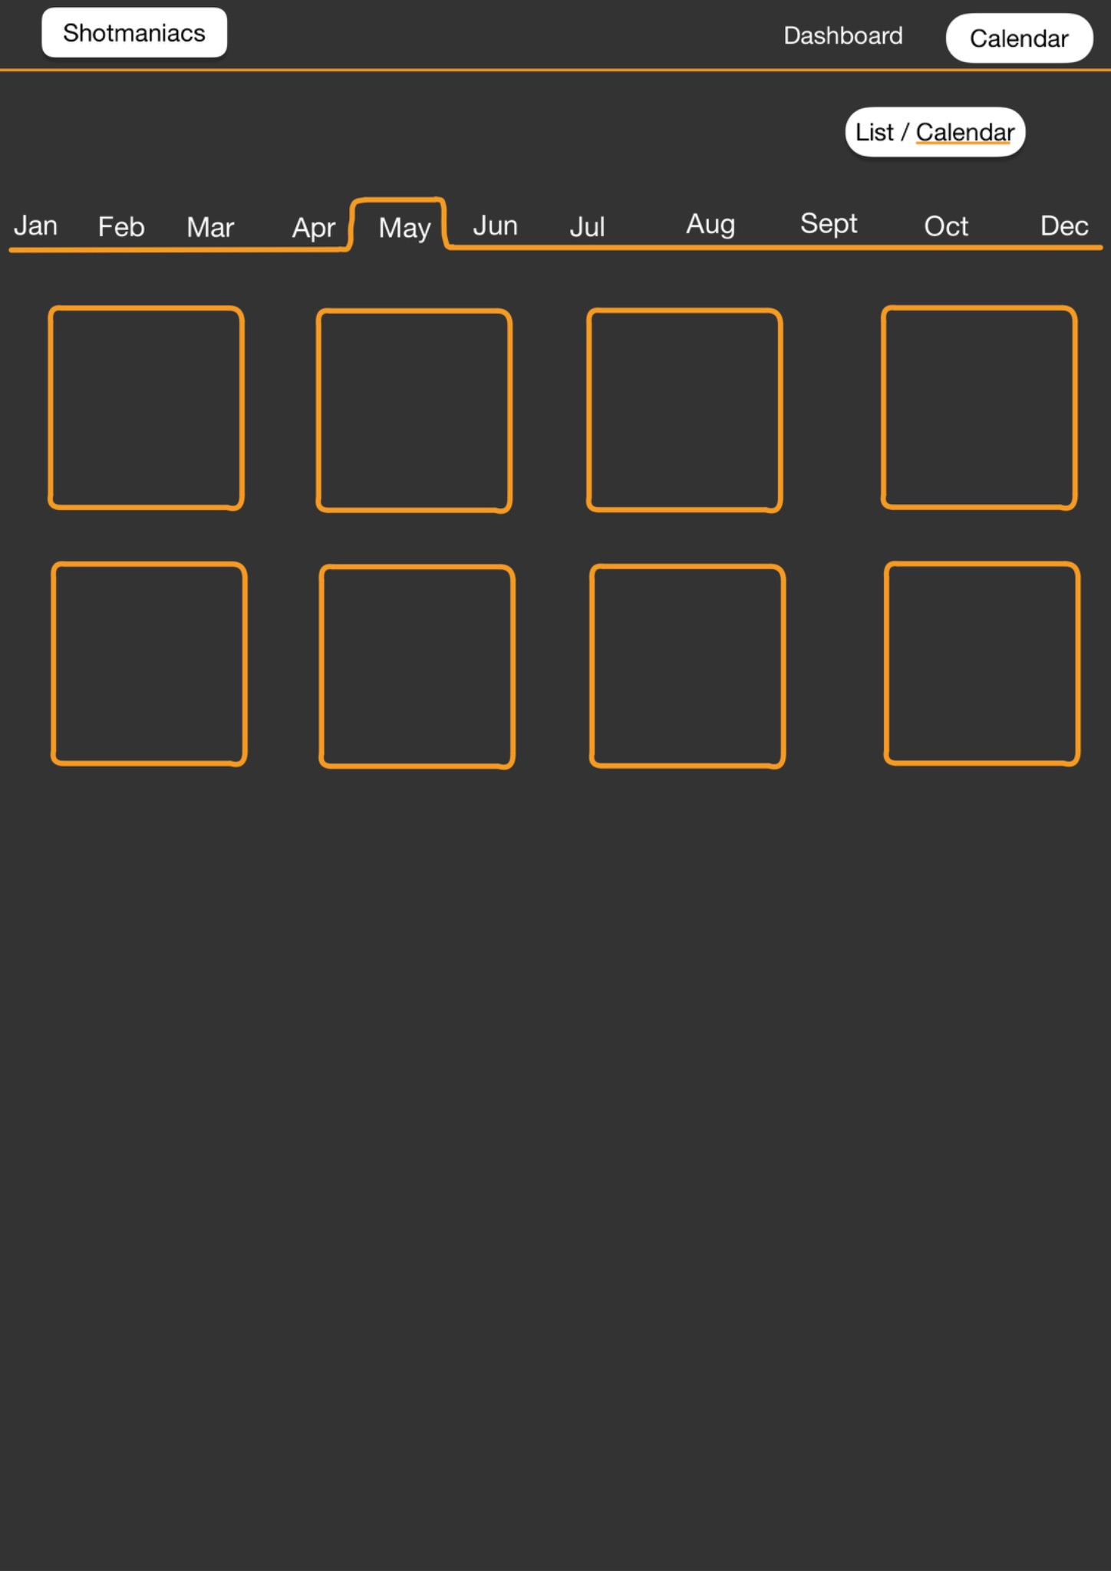
Crew Page
Calendar

Slide 21
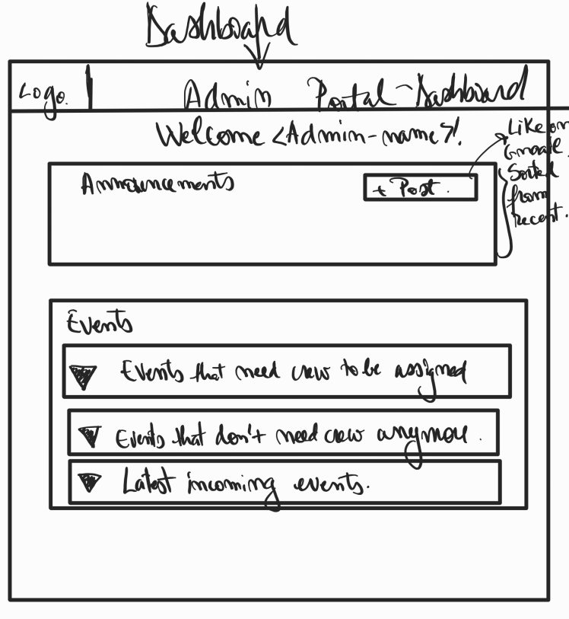
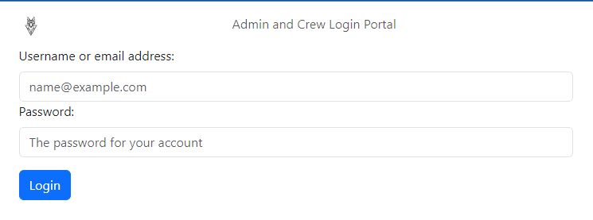
Admin Page

Slide 22
Security

Slide 23


Security
Prepared Statements
Roles, through JAX-rs filters.
  Authorisation
  Filter
Page Mapping
  L/R File Inclusion
  Path Traversal
Hashing and salting/peppering passwords
  Safe password storage
  Peppering not yet implemented
Protected against XSS-attacks

Slide 24
Testing

Slide 25

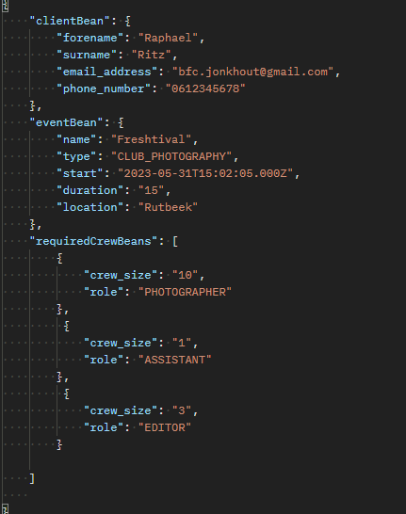

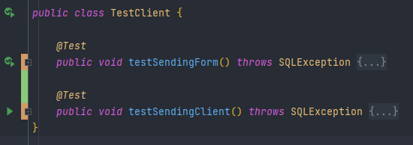
Testing
Postman
jUnit Testing
Application Testing
Test-driven development
  Write request before back-end
SonarQube

Slide 26
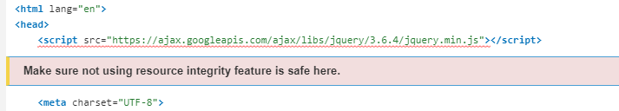
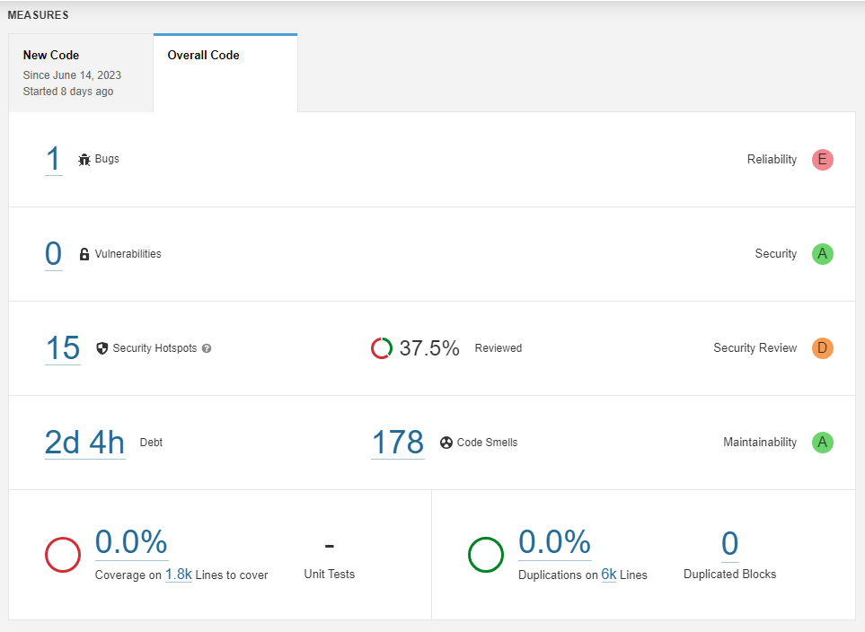
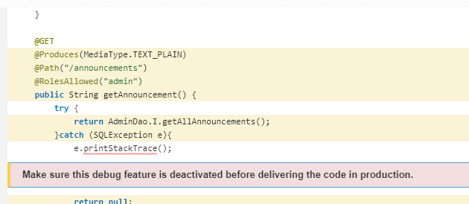
Testing
Sonarqube
Shows major and minor security issues.
Examples:
  Printstacktrace must be removed
  Not using resource integrity

Slide 27
Demo

Slide 28
Logistics
Planning
Design
Security
Testing
Demo
Summary

Slide 29
Thank you for listening.
Beau Jonkhout, Pavan Awadhpersad, Baris Yilmaz, Raphael Ritz, Alex Culda, Raluca Gavrila

