Slide 1


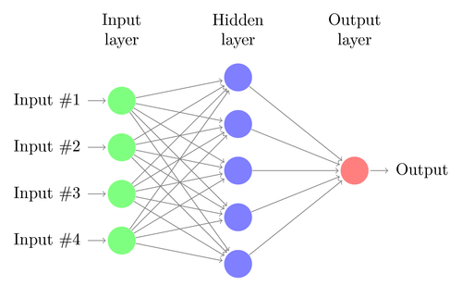
Mood Enhancer Explanation and Details

Slide 2
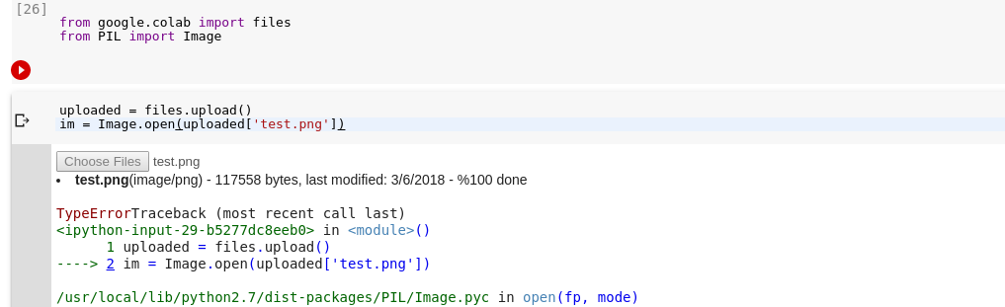
Local and Cloud Services
Local Host facilities:
Keras model training on GPU.
How??
Access files easily.
Read data from csv using pandas
Services available on Cloud:
Use GPU and TPU on google colab.
(Jupyter notebook)

Slide 3
Accesing Files
Upload on drive.
Mount drive.
Open and perform
Operations.

Slide 4

Activity
Load a csv file in colab and extract the rows and columns and print shape of it.

Slide 5
Data is most important thing in word.
More is data better are results.

Slide 6
Training Your Model
Deep learning features are extracted automatically.
Neural Networks…
How to build a neural network ?????

Slide 7
Mood Enhancer

Slide 8
Idea
Parkinson, stress, emotional imblanace.
Read unhealthy emotions and try to cheer up person.

Slide 9
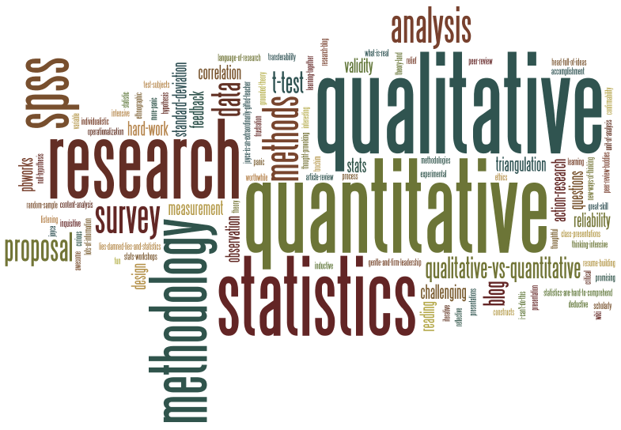
Methodology
Part 1
Capture image from camera using python script.
Part 2
Retrain the already trained model for our application and detect emotions.
Part 3
Play songs for person depending on mood.

Slide 10

Tips
Retraining better than training like imagenet, facial_recognition and many more.
Use appropriate data and pre-processing techniques.

