Slide 1
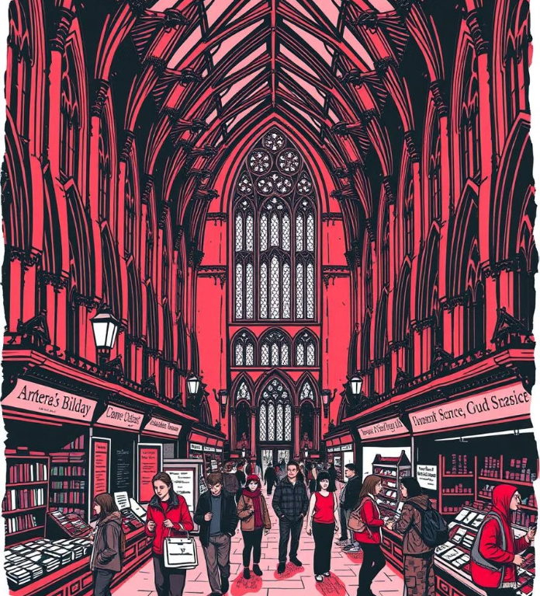

The CampusMart
SELL NEWBIES.
Under Guidance : Prof. Gayathri Ananthanarayanan
Kapil Kumar Bhardwaj : cs24mt012
Manish Bisht : cs24mt022
Mridul Chandrawanshi : cs24mt002

Slide 2
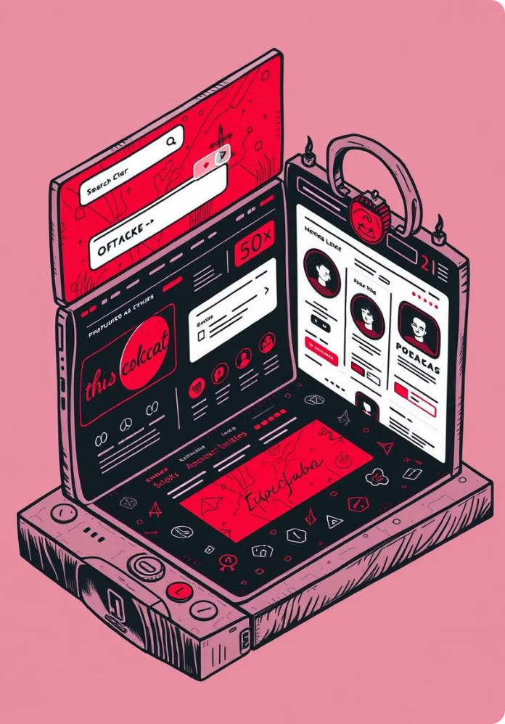
Introducing the IIT Marketplace
Student-to-Student
Affordable Solutions
Connecting IITians for a seamless buying and selling experience.
Providing a platform for students to purchase used goods at competitive prices.
Sustainable Practices
Encouraging responsible consumption and reducing waste by giving used items a second life.

Slide 3
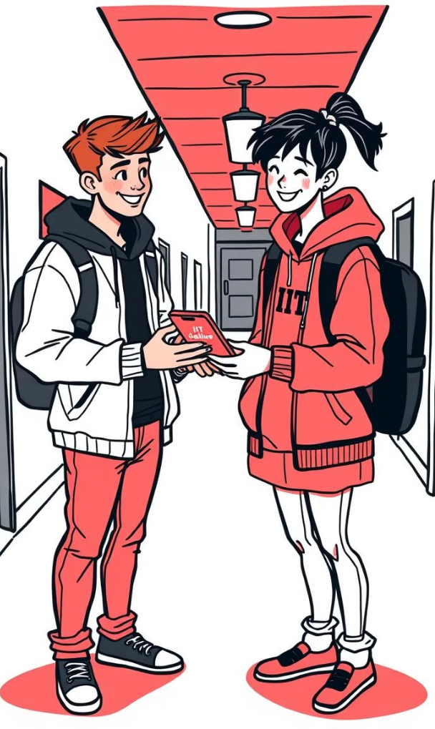



Seamless Buying and Selling
Seller Lists
Sellers post items for sale with detailed descriptions and photos.
Buyer Browses
Buyers browse listings based on categories, search terms, and filters.
Direct Interaction
Buyers and sellers can chat directly to discuss details, negotiate prices, and arrange transactions.

Slide 4
Product Details and Interactions
Detailed Information
Purchase Options
Interactive Features
Comprehensive descriptions, high-quality photos, and specifications.
Buy Now for immediate purchase or Make Offer for price negotiation.
Real-time chat for direct communication between buyer and seller.

Slide 5
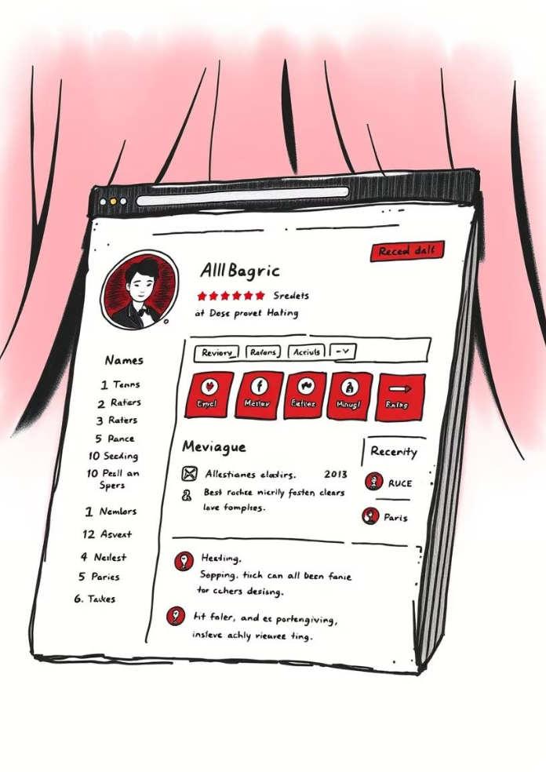
Profile Management and Reviews
Profile
Personal information, contact details, and transaction history.
Reviews
Honest feedback from buyers and sellers, enhancing trust and transparency.
Ratings
Numerical scores based on user feedback, indicating the trustworthiness of profiles.

Slide 6
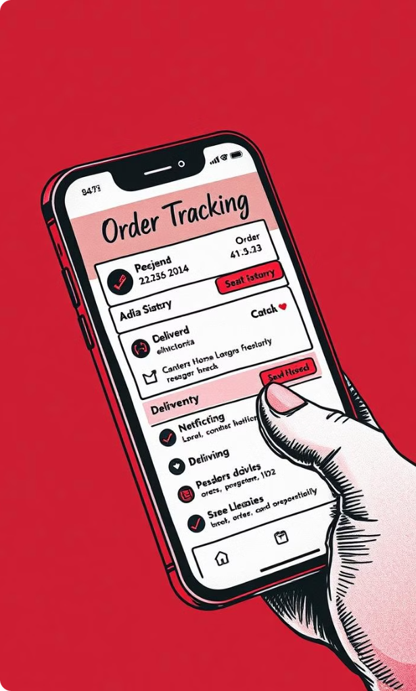
Order Tracking and Transparency
1
Order Placement
Real-time confirmation of order placement and payment processing.
2
Seller Confirmation
Notification when the seller accepts the order and begins preparation.
3
Delivery Updates
Tracking information with estimated delivery time and real-time updates.

Slide 7

DATASET
Senior Lists
Created Our own Dataset
This initially contains, 8 categories
Consist of 40 rows.
Seniors list their items for sale, with detailed descriptions and photos.
Junior Browses
Juniors browse listings based on categories, search terms, and filters.
Direct Interaction
Seniors and juniors can chat directly to discuss details, negotiate prices, and arrange meetings.

Slide 8
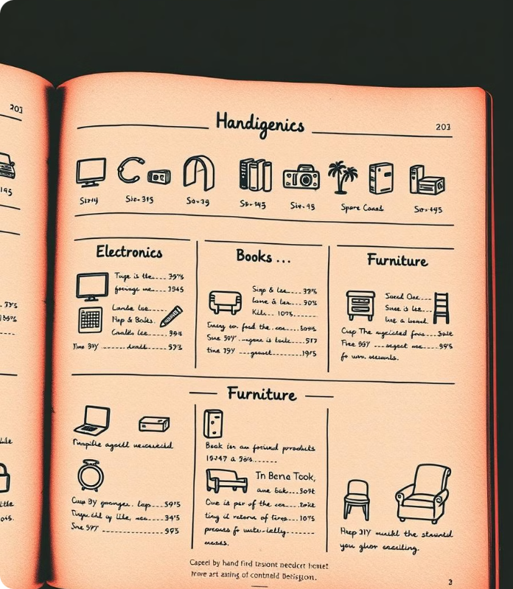
Category-based Listings
1
Electronics
2
Books
Laptops, phones, tablets, headphones, and other tech gadgets.
Textbooks, novels, reference materials, and other publications.
3
Furniture
Desks, chairs, beds, shelves, and other furniture items for dorm rooms or apartments. And 8more categories.

Slide 9





Refining the User Experience
Intuitive Navigation
Responsive Design
User Feedback
Security and Privacy
Simplified search, browsing, and product details for a seamless experience.
Optimized for various screen sizes, ensuring usability on desktops, tablets, and smartphones.
Regularly gathering user feedback to identify areas for improvement and enhance the overall experience.
Implementing robust security measures to protect user data and ensure a safe platform.

Slide 10


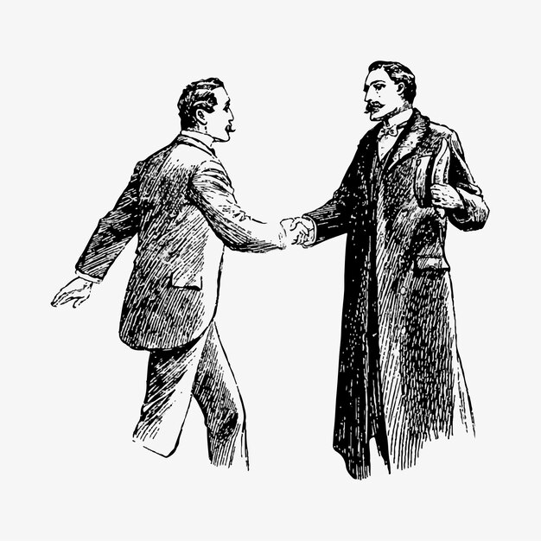
Vectorized Design Branding
A unique and memorable brand identity that aligns with the platform's focus on community and sustainability. The hand-drawn aesthetic adds a personal touch and reflects the platform's student-driven nature.

Slide 11






A Presentation By
Team Innovators

