Slide 1
PIN Encryption and Decryption Flow
In Trezor One firware 1.12.1 version

Slide 2
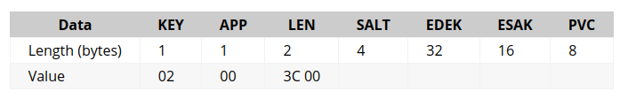

The PIN is no longer stored in the flash storage in plain text.
A new entry is added to the flash storage consisting
  256-bit encrypted data encryption key (EDEK)
  128-bit encrypted storage authentication key (ESAK)
  64-bit PIN verification code (PVC)
The PIN is used to decrypt the EDEK and ESAK and the PVC is used to verify that the correct PIN was used.
We use Chacha20Poly1305 as defined in RFC 7539 to encrypt/decrypt the protected entries.
The random salt (32 bits), EDEK (256 bits), ESAK (128 bits) and PVC (64 bits) is stored in a single entry under APP=0, KEY=2:

Slide 3
PIN verification and decryption of protected entries in flash storage
From the flash storage read the entry containing the random salt, EDEK and PVC.
Gather constant data from various system resources such as the ProcessorID (aka Unique device ID) and any hardware serial numbers that are available. The concatenation of this data with the random salt will be referred to as salt.
Now user will enter PIN and from PIN compute
  PBKDF2(PRF = HMAC-SHA256, Password = pin, Salt = salt, iterations = 10000, dkLen = 352 bits)
  First 256 bit output used as : KEK(key encryption key)
  Remaining 96 bits will be used as the key encryption initialization vector (KEIV).
Now Compute (dek, tag) = ChaCha20Poly1305Decrypt(kek, keiv, edek)
Compare the PVC (read from the flash storage) with the first 64 bits of the computed tag value. If there is a mismatch, then fail. Otherwise store the DEK in a global variable.
When a protected entry needs to be decrypted, load the IV, ENCRDATA and TAG of the entry and compute: (data, tag) = ChaCha20Poly1305Decrypt(dek, iv, (key || app), encrdata)
Now again Compare the TAG read from the flash storage with the computed tag value. If there is a mismatch, then fail.

Slide 4
Actual Flow in code Implemenation
Key function which is used to unlock the device is :
static secbool unlock(pin, pin_len, ext_salt) :
This function check wipe code, failure counter etc. which is not too relevant to our work.
Function read random_salt, which is stored in flash storage.
Inside this function there is one more function called derive_kek which is used to generate KEK and KEIV.
derive_kek(unlock_pin, unlock_pin_len, (const uint8_t *)rand_salt, ext_salt, kek, keiv)
Now using KEK and KEIV we decrypt DEK (EDEK+ESAK+PVC)
decrypt_dek(const uint8_t *kek, const uint8_t *keiv) :
  Now first this function get the EDEK, ESAK and PVC from storage
  rfc7539_init(&ctx, kek, keiv); // ctx contain contex which is generated by calling rfc7539_init function
  chacha20poly1305_decrypt(&ctx, ekeys, keys, KEYS_SIZE)//keys contain decrypted key and ekeys contain encrypted key
  rfc7539_finish(&ctx, 0, KEYS_SIZE, tag); //at the end we get tag which is generated while decrypting the keys
  Now we will compare this tag and PVC are equal or not if not then failure otherwise success.

Slide 5
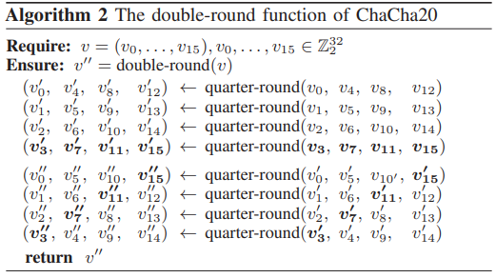
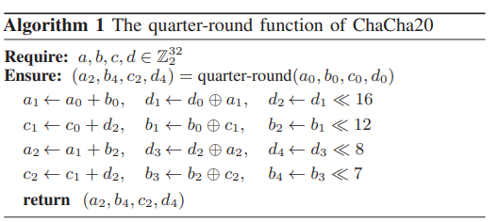
Summary of Paper
They use Pearson Correlation coefficent with Hamming Weight leakage model.
For Leakage Detection they use NICV
For Leakage Assessment they use TVLA, in that they focus on Fixed vs Random test(FVR)
ChaCha20 Algorithm :
- The quarter-round function is used to build double round function, and we can execute double round function 10 times to run ChaCha20 algorithm.
- The initial state of ChaCha20 is set as : v0 to v3 → C0 to C3, v4 to v11 → k0 to k7, v12 → count, v13 to v15 → n0 to n2

Slide 6
Summary of Paper
- Where C0...C3 are pre-defined contant
- K0...k7 are key words split into 8 words
- Count is message block counter
- n0...n2 are three words forming the 96 bit nonce.
- After the computation of th 20 rounds, the end result is added to the initial state.
Side Channle Evaluation
- As our attacker model, we use the HW model :
  HW (d1 ) = HW (d0 ⊕ a1 ) = HW (d0 ⊕ (a0 + b0 ))
  - where the input a0 is one of the constants Ci ,
  - b0 is the key word that we want to attack and d0 is a word of the nonce or the message block counter
  For the attack, we could choose to compute hypotheses for all 32 bits of the key word, but this becomes computationally costly to mount. Another approach is divide and conquer, i.e. we extract only a subset of bits of the key at a time and combine the individual results. In the current work, we extract each key word byte by byte
  Next part of paper show the actual result of this attack and their counter measure.

Slide 7
Future Work
- Right now I am trying to understand how can we apply this paper ‘s SCA attack method in our cryto wallet.
- This cryto wallet have emulator so first I install emulator and do attack based on emulator if they get succeed we go with acutal power traces.

